Slide 1


CULTURAL OPENNESS AND PERCEPTION
Adapted from:
Stringer, D. M., & Cassiday, P. A. (2003). A value to D-I-E for. In 52 Activities for exploring values differences (pp. 17-19). Intercultural Press.

Slide 2

TODAY’S PLAN
Whole class activities and discussion to
Learn some new concepts
Become more open
Recognize the impact of culture on perception
A Pair/Share activity to
Practice applying new skills

Slide 3
D.I.E. ACTIVITY
Take a look at the following picture.
In a few seconds I am going to ask you to describe it.

Slide 4
D.I.E. ACTIVITY
Now I need some volunteers to tell me what you saw.
We’ll take notes on your descriptions here on the projector.

Slide 5
D.I.E. ACTIVITY
How are these different?
D – Description
I – Interpretation
E – Evaluation

Slide 6
D.I.E. ACTIVITY
When I asked you to describe the picture, what did you actually do?
D – Description?
I – Interpretation?
E – Evaluation?
Why are they so hard to separate?

Slide 7
D.I.E. ACTIVITY
Let’s try again!
Take another look at the picture.
This time, try ONLY to describe it.

Slide 8
D.I.E. ACTIVITY
More thoughts to ponder
What does this have to do with CULTURE?
“Neural signals are related less to a stimulus per se than to its congruence with internal goals and predictions, calculated on the basis of previous input to the system.” Karsten Rauss, Cognitive Scientist
How do people from different cultures interpret and evaluate this picture?

Slide 9
D.I.E. ACTIVITY
Common interpretations in various cultures… What do you think?
Concentration camp
Political prisoners working
People praying
A foot race about to begin
Something else entirely – be prepare to explain

Slide 10
FRAME-SHIFTING
Learning to Frame-Shift
Look closely at each of the following pictures.
Each can be seen two different ways.

Slide 11
FRAME-SHIFTING
What do you see?
Young woman
Old woman
Both
Something else

Slide 12
FRAME-SHIFTING
What do you see?
An image
A word
Both
Something else

Slide 13
FRAME-SHIFTING
What do you see?
One face
Two faces
Three faces
Something else

Slide 14
FRAME-SHIFTING
What have we learned through optical illusions?
Everyone does not naturally experience events in the same way: We frame in different ways
Our frame is influence by what we notice, and what we know/recognize
We can “catch” ourselves framing and learn to shift our frame of reference
Other people can help us experience other ways of framing

Slide 15
FRAME-SHIFTING
Ask yourself:
What assumption am I making,
That I’m not aware I’m making,
That gives me what I see?
And when you answer that, ask yourself:
What might I now invent,
That I haven’t yet invented,
That would give me other choices?
*Zander, R. S. & Zander, B. (2000). The art of possibility. Penguin

Slide 16
PLUS/MINUS/NULL ACTIVITY
What’s your gut reaction interpretation of what is happening?
Does that interpretation lead to positive, negative, or neutral evaluation?
What are two plausible alternate interpretations with different evaluations (so if your first ideas was negative, think of neutral and positive explanations of that is happening)?

Slide 17
PLUS/MINUS/NULL ACTIVITY
What are your Plus/Minus/Null D.I.E.’s?

Slide 18
PLUS/MINUS/NULL ACTIVITY
Use your iClickers:
Is your first reaction (evaluation)
  Positive
  Negative
  Neutral
What do you see (interpretation)
  A woman being kidnapped
  People catching a woman falling
  A woman dancing
  Something else entirely
What are other possible interpretations?
Does context matter? What if we play music while you look at the picture?

Slide 19
Pair/Share D.I.E. Activity
Now it’s time to see what you have learned.
Working with a partner, look at the next picture and then answer the following questions.

Slide 20
Pair/Share D.I.E. Activity

Slide 21
Pair/Share D.I.E. Activity
Take notes with your partner:
Describe what you saw. Be sure to separate description from interpretation and evaluation
Now move on to interpretations and evaluation. Is your first reaction a positive, negative, or neutral evaluation?
Follow through with Plus/Minus/Neutral – What are other possible interpretations?

Slide 22
Pair/Share D.I.E. Activity

Slide 23
Pair/Share D.I.E. Activity
Time to share:
Describe what you saw.
Is your first reaction a positive, negative, or neutral evaluation?
What are other possible interpretations?
Do you want to know the truth
What “insider cultural knowledge” would you need to interpret this picture accurately?
Is it possible to come to different evaluations for one interpretation?

Slide 24
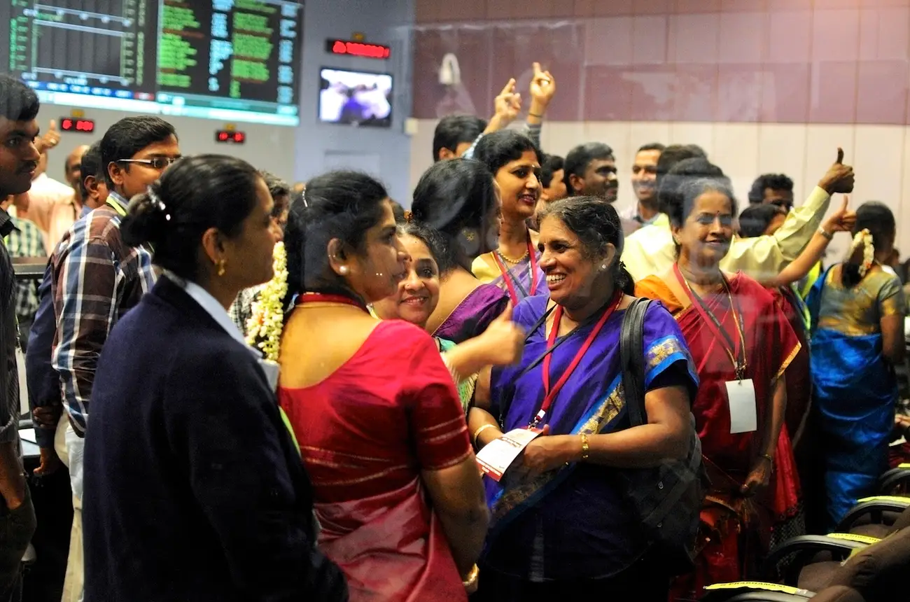
Pair/Share D.I.E. Activity

Slide 25
Pair/Share D.I.E. Activity
Photo from REUTERS/A. N. Chinnappa.
Utilized in the following article:
Brueck, H. (2017, December 1). India is preparing to land on the moon for the first time in the country's history. Business insider. https://www.businessinsider.com/india-moon-landing-chandrayaan2-2017-12

Slide 26
Pair/Share D.I.E. Activity
Time to share:
Describe what you saw.
Is your first reaction a positive, negative, or neutral evaluation?
What are other possible interpretations?
Do you want to know the truth
What “insider cultural knowledge” would you need to interpret this picture accurately?
Is it possible to come to different evaluations for one interpretation?

