Slide 1

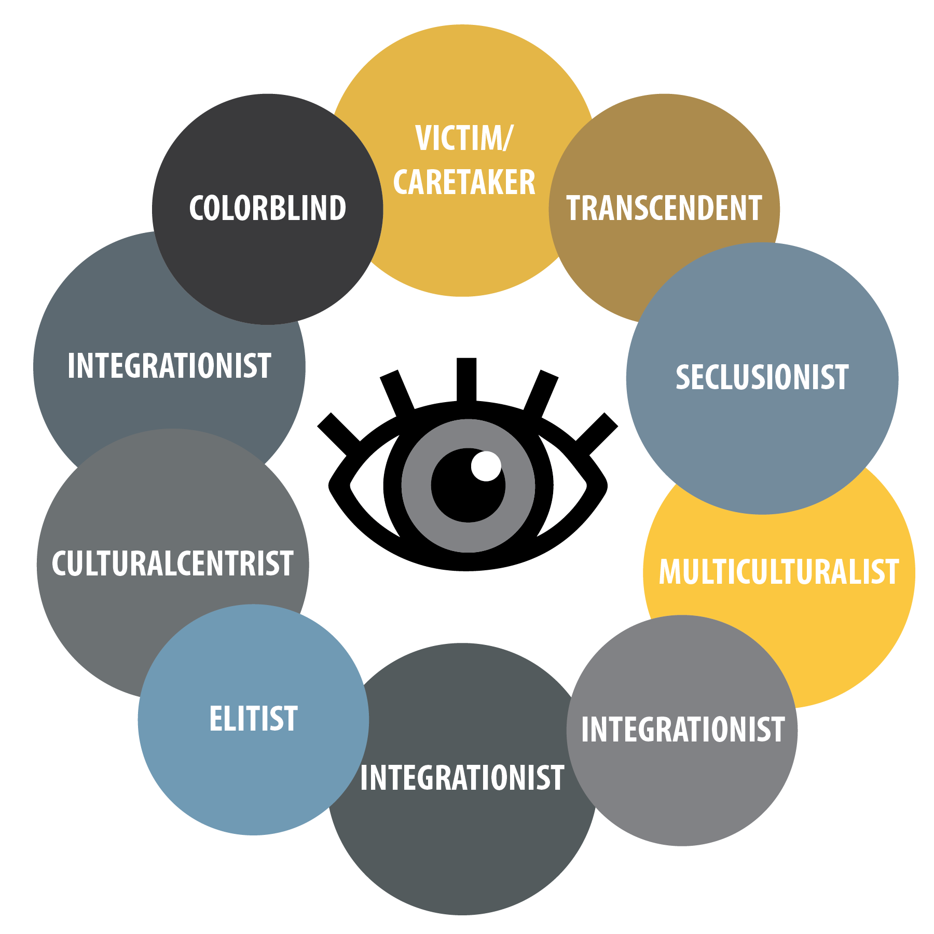
v

Slide 2
THE TEN LENSES:
DECODING CULTURAL BELIEFS
Presented by:
Annette Benson
Communication Strategist
Center for Intercultural Learning,
Mentorship, Assessment and Research
Purdue University
Adapted from Mark A. Williams’ The 10
Lenses: Your guide to living & working in a multicultural world.
Wilfrido Cruz
Assistant Director for Diversity, Inclusion, and Outreach
University Residences-Residential Life
Purdue University

Slide 3


Slide 4
EXAMPLES OF INVITATIONS TO
PRESENT THE 10 LENSES, 2006-2018:
Housing and Food Services administrative and professional staff, Purdue University
Housing and Food Services clerical and service staff, Purdue University
Resident Advisors (RAs), Residential Life, Purdue University
Counseling & Psychological Services, Purdue University
Accomplished Clerical Excellence (ACE) program, Purdue University
Supervisor Springboard, 100 new supervisors/year for the last 3 years
College staff retreats
Intercultural Pedagogy Grant workshops (preps faculty for study abroad)
Students in multicultural and global classes
West Lafayette Police Department
Tippecanoe Sheriff Department
Tippecanoe Diversity (Matters) Summit
Tippecanoe Realtors Association
Tippecanoe Human Resources Association
TRANSITION SLIDE
(NEW ACTIVITY, DIRECTION, ETC.)
CHOOSE COLOR FOR SOLID BACKGROUND

Slide 5



AAC&U* VALUE**
RUBRIC FOR INTERCULTURAL KNOWLEDGE & COMPETENCE
Adapted by Purdue University.
*American Association of Colleges & Universities **Valid Assessment of Learning in Undergraduate Education

Slide 6
 | Developing | Emerging | Proficient
Knowledge Cultural self- awareness | Identifies own cultural rules and biases (e.g. with a strong preference for those rules shared with own cultural group and seeks the same in others.) | Recognizes new perspectives about own cultural rules and biases (e.g. not looking for sameness; comfortable with the complexities that new perspectives offer.) | Articulates insights into own cultural rules and biases (e.g. seeking complexity; aware of how her/his experiences have shaped these rules, and how to recognize and respond to cultural biases, resulting in a shift in self-description.)
Knowledge Knowledge of cultural worldview frameworks | Demonstrates partial understanding of the complexity of elements important to members of another culture in relation to its history, values, politics, communication styles, economy, or beliefs and practices. | Demonstrates adequate understanding of the complexity of elements important to members of another culture in relation to its history, values, politics, communication styles, economy, or beliefs and practices. | Demonstrates sophisticated understanding of the complexity of elements important to members of another culture in relation to its history, values, politics, communication styles, economy, or beliefs and practices.
Skill Empathy | Identifies components of other cultural perspectives but responds in all situations with own worldview. | Recognizes intellectual and emotional dimensions of more than one worldview and sometimes uses more than one worldview in interactions. | Interprets intercultural experience from the perspectives of own and more than one worldview and demonstrates ability to act in a supportive manner that recognizes the feelings of another cultural group.
Skill Verbal & Nonverbal Communication | Identifies some cultural differences in verbal and nonverbal communication and is aware that misunderstandings can occur based on those differences but is still unable to negotiate a shared understanding. | Recognizes and participates in cultural differences in verbal and nonverbal communication and begins to negotiate a shared understanding based on those differences. | Articulates a complex understanding of cultural differences in verbal and nonverbal communication (e.g., demonstrates understanding of the degree to which people use physical contact while communicating in different cultures or use direct/indirect and explicit/implicit meanings) and is able to skillfully negotiate a shared understanding based on those differences.
Attitude Curiosity | Asks simple or surface questions about other cultures. | Asks deeper questions about other cultures and seeks out answers to these questions. | Asks complex questions about other cultures, seeks out and articulates answers to these questions that reflect multiple cultural perspectives.
Attitude Openness | Expresses openness to most, if not all, interactions with culturally different others. Has difficulty suspending any judgment in her/his interactions with culturally different others, and is aware of own judgment and expresses a willingness to change. | Begins to initiate and develop interactions with culturally different others. Begins to suspend judgment in valuing her/his interactions with culturally different others. | Initiates and develops interactions with culturally different others. Suspends judgment in valuing her/his interactions with culturally different others.

Slide 7

AAC&U VALUE RUBRIC FOR INTERCULTURAL KNOWLEDGE & COMPETENCE
ATTITUDE OF OPENNESS
 | Developing | Emerging | Proficient
Attitude of Openness | Expresses openness to most, if not all, interactions with culturally different others. Has difficulty suspending any judgment in her/his interactions with culturally different others, and is aware of own judgment and expresses a willingness to change. | Begins to initiate and develop interactions with culturally different others. Begins to suspend judgment in valuing her/his interactions with culturally different others. | Initiates and develops interactions with culturally different others. Suspends judgment in valuing her/his interactions with culturally different others.

Slide 8
AAC&U VALUE RUBRIC FOR INTERCULTURAL KNOWLEDGE & COMPETENCE
KNOWLEDGE OF SELF-AWARENESS
 | Developing | Emerging | Proficient
Knowledge of Cultural Self-Awareness | Identifies own cultural rules and biases (e.g. with a strong preference for those rules shared with own cultural group and seeks the same in others.) | Recognizes new perspectives about own cultural rules and biases (e.g. not looking for sameness; comfortable with the complexities that new perspectives offer.) | Articulates insights into own cultural rules and biases (e.g. seeking complexity; aware of how her/his experiences have shaped these rules, and how to recognize and respond to cultural biases, resulting in a shift in self-description.)

Slide 9
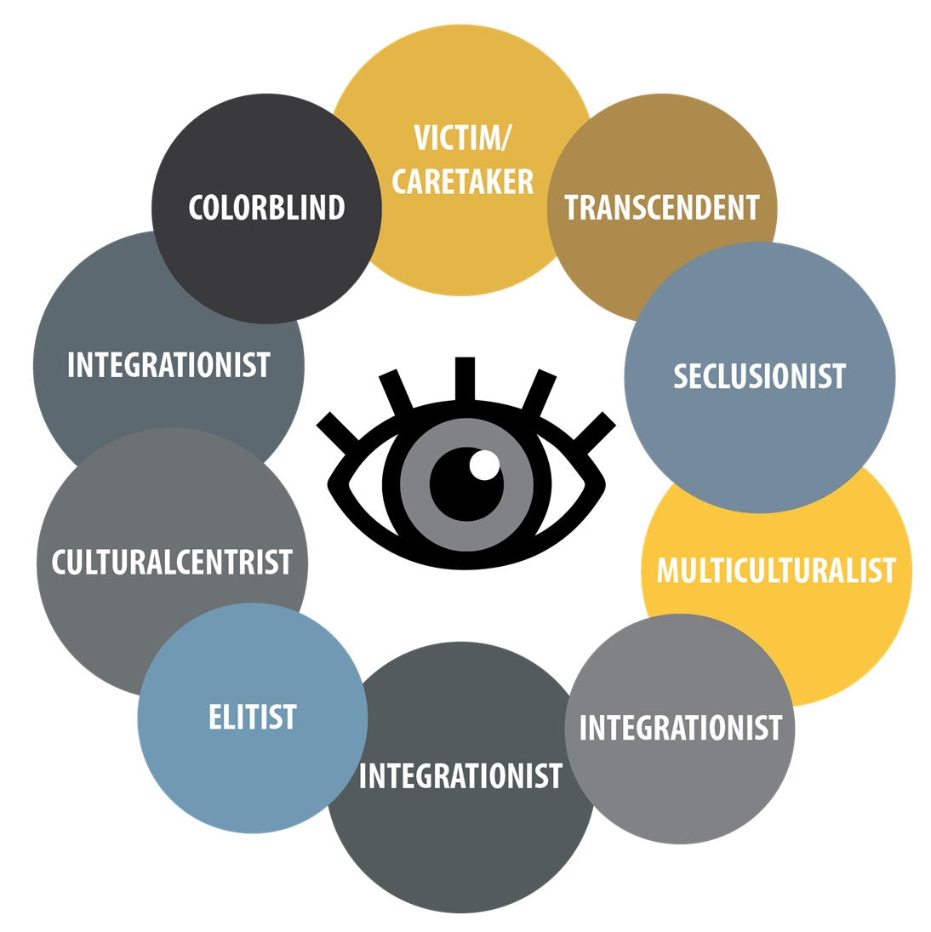
WHY ARE WE HERE TODAY?
People have the tendency to think that their perspective is the right and the only one operating.

Slide 10
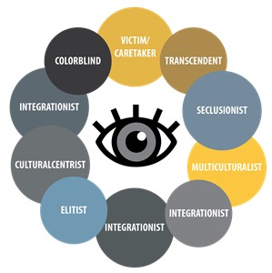
Old frameworks classified people only according to demographics, and using visible differences such as:
  Race
  Ethnicity
  Gender
  Age

Slide 11
WHAT IS A LENS?
A Lens is our way of making sense of the world.
L
+
L
=
Lens
Adapted from Mark A. Williams’ The 10 Lenses: Your guide to living & working in a multicultural world.

Slide 12
WHAT IS A LENS?
A Lens is our way of making sense of the world.
L
L
=
Lens
+
Historic Events
Discoveries of Land
Slavery
The Mayflower
Immigration
Ellis Island
Laws
Life Experiences
Race
Gender
Ethnicity
Ability
Sexual Orientation
Nationality
Adapted from Mark A. Williams’ The 10 Lenses: Your guide to living & working in a multicultural world.

Slide 13
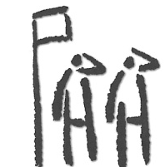
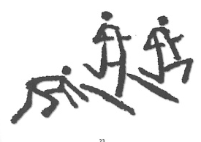
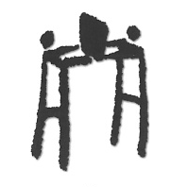
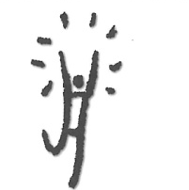
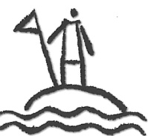
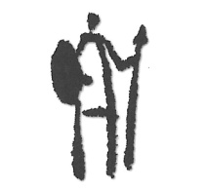
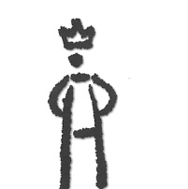
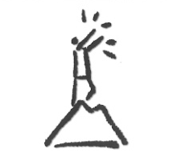
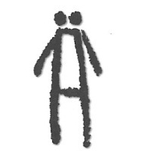
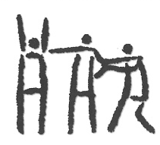
THE TEN LENSES
Assimilationist
When in Rome,
do as the Romans.
Meritocratist
Cream rises to
the top.
Colorblind
When I see you, I see
a person not your color.
Multiculturalist
The more cultural
diversity the better.
Culturalcentrist
My culture is central to my
personal & public identity.
Seclusionist
Birds of a feather
flock together.
Elitist
Membership has its
privileges.
Transcendent
There’s really only
race: the human race.
Integrationist
Ebony and ivory live together on my piano keys, shouldn’t we?
Victim / Caretaker
We shall overcome.

Slide 14
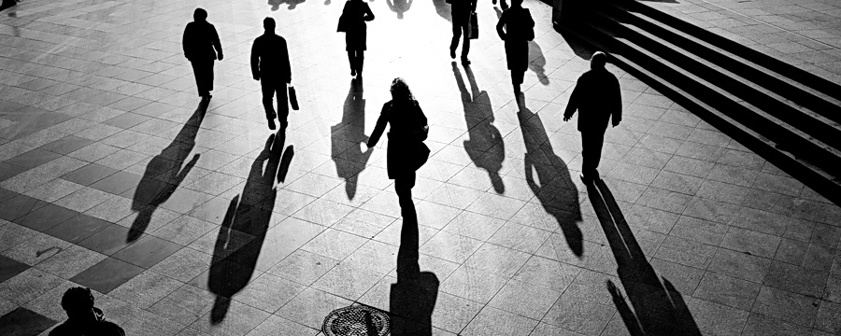
STRENGTHS & SHADOWS

Slide 15
SURVEY SAYS…
Lens Estimate in U.S. Population
Multiculturalist | 21.0
Colorblind | 20.4
Transcendent | 18.4
Meritocratist | 17.9
Assimilationist | 16.4
Integrationist | 16.0
Victim/Caretaker | 13.2
Culturalcentrist | 10.9
Elitist | 10.8
Seclusionist | 9.3

Slide 16
Diversity feels valued and involved
INTERCULTURAL
MINDSET
INTERCULTURAL DEVELOPMENT CONTINUUM:
PRIMARY ORIENTATIONS
Diversity feels understood
Diversity feels unheard
Diversity feels uncomfortable
Diversity
feels
ignored
ACCEPTANCE
Deeply
Comprehends
difference
ADAPTATION
Bridges across difference
MINIMIZATION
Deemphasizes
difference
POLARIZATION
Judges difference
MONOCULTURAL
MINDSET
DENIAL
Misses difference
Modified from the Developmental Model of Intercultural Sensitivity (DMIS), M. Bennett, 1986.

Slide 17
Lenses and the Workplace
Individuals Should Change
Organization Should Change
Neutral
Notes:
Willie: 8:55-9:05 So when you think about the lenses, how do they function at work?

Slide 18
Individuals Should Change
Organization Should Change
Neutral
Assimilationist
Meritocratist
Seclusionist
Elitist
Culturalcentrist
Multiculturalist
Integrationist
Victim
Colorblind
Transcendent
Notes:
Discuss how/why some lenses work well and others don’t.

Slide 19
What do you do at your institution to increase self-awareness and openness for staff?
For students?
To prepare for study abroad?

Slide 20
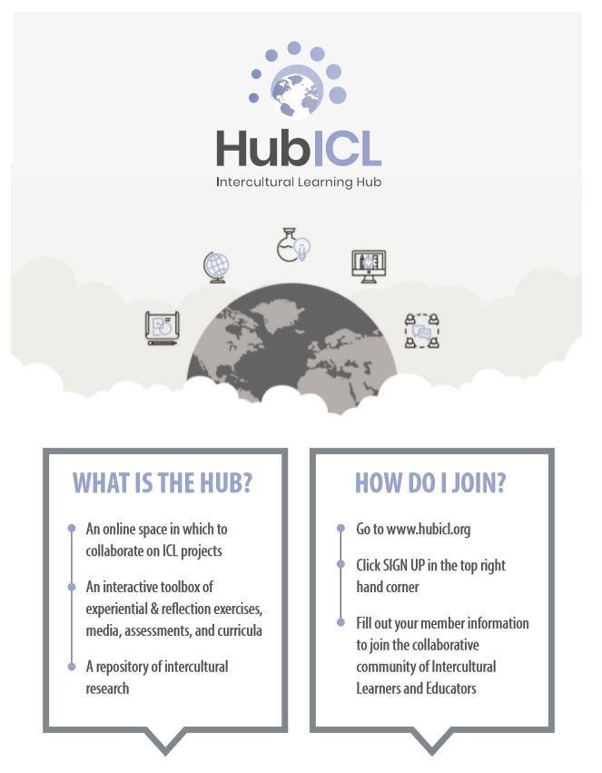
www.hubicl.org

Slide 21

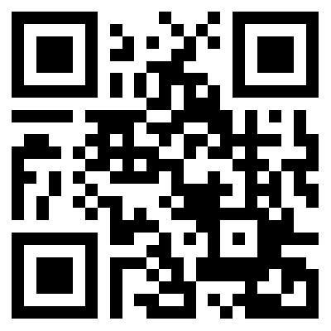
Register today at
http://www.cvent.com/d/nbqn27

Slide 22
WE’D LOVE TO HEAR FROM YOU!
Email us at cilmar@purdue.edu
Like and follow us at https://www.facebook.com/PurdueCILMAR/
For more information, please go to www.purdue.edu/ippu/cilmar
Engage with the Intercultural Learning Hub at www.hubicl.org

Slide 24
MASTER KEY
COLORS TO USE:
R: 227
G: 192
B: 102
R: 128
G: 128
B:128
R: 75
G: 84
B: 89
R: 197
G: 204
B: 214
R: 171
G: 139
B: 77
*Another easy way to choose a color is use the eyedropper tool (shape fill > eye dropper > select color desired from another shape on the screen)
FONTS TO USE:
Headers and Titles: Myriad Pro Bold
Body Text: Myriad Pro Regular
*All text should be the dark grey color provided
Stick to all the colors provided to create unity, try to keep the fonts relatively the same size (body text same size, headers same size, sub headers same size), and don’t cram the slides too much with text, make sure that the white negative space around the text in the slide is balanced with the positive space.

Slide 25
TRANSITION SLIDE
(NEW ACTIVITY, DIRECTION, ETC.)
CHOOSE COLOR FOR SOLID BACKGROUND

