Slide 1
SLC Intercultural Learning Study Group Fall 2019 Session 2 Aletha Stahl, PhD Senior Intercultural Learning Specialist

Slide 2
Permissions
What “permissions” or “invitations” would help you feel like you belong in this workshop and want to be here?
Permission to take care of your bio needs -- bathroom, sleepiness, comfort
Invitation to speak to each other, not just me

Slide 3
Focus today
Activity: Pick-a-Postcard
Other metaphors for culture
Activity: 6 Differences
Application of AACU Intercultural Rubric
Discussion of frameworks for intercultural development (readings)

Slide 4
Pick-a-Postcard
Choose an object that you can use as a metaphor for “culture.”
We’ll also use our object to share names.

Slide 5
Four Analogies
Drawn from an activity by Kate Berardo
Berado, K. (2012). Four analogies. In In K. Berardo & D. K. Deardorff (Eds.), Building cultural competence: Innovative activities and models (pp. 61-68). Sterling, VA: Stylus Publishing.
How is culture like a/an…

Slide 6
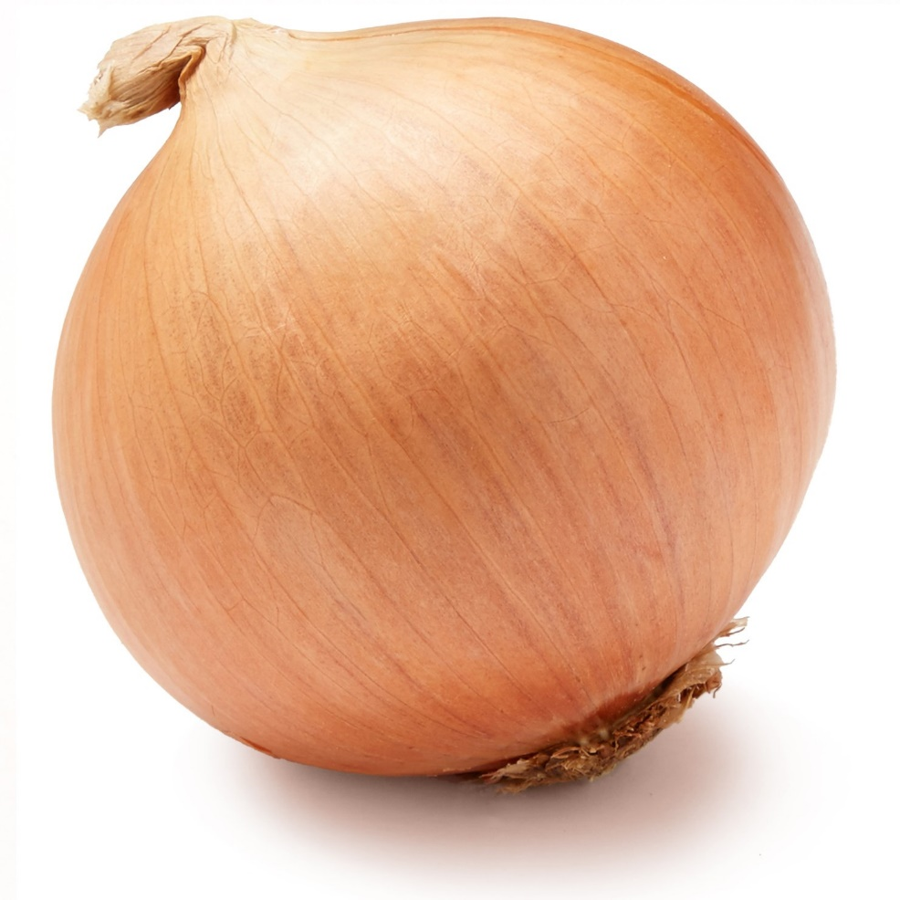
Benefits
Emphasizes the complexity of human identity
Illustrates that some layers/aspects of identity are closer to the surface or more visible than others
Drawbacks
Depicts layers are separate from each other rather than intersecting
Implies that revealing cultural identity is destructive to the self (peeling back layers)
…Onion?
Notes:
According to Berardo (2012): “Like an onion, people are shaped by many layers of culture: national culture, regional culture, organizational culture, and many other types of culture (gender, religion, family, etc.)” (p. 62).
When we focus on only one layer, we can fall back on ideas of “us” vs. “them.” This also reduces a person to a single layer and not a complex being (p. 62).
Benefits of thinking of culture like an onion include emphasizing the complexity of human identity (many cultural layers) and understanding that some layers/aspects of identity are closer to the surface or more visible than others.
Drawbacks to this analogy include the implication that layers are separate from each other (not intersecting, as they are in reality) and the idea that peeling back layers is destructive to the self

Slide 7
Benefits
Demonstrates that much of culture is hidden below the surface
Illustrates that the unknown aspects of deep culture is what presents danger/risk in terms of miscommunication or misunderstanding by outsiders
Drawbacks
Depicts culture as a monolithic whole (homogeneous, or the same for all members), which is a dangerous assumption
Implies that culture is solid – static and unchanging over time, which is not true
…Iceberg?
Notes:
Culture is also like an iceberg: there are elements that are visible above the water and hidden elements below the water. These hidden elements represent the deeper, often invisible, elements of culture. By focusing only on the visible, we miss important pieces and can easily stereotype a culture. However, it is more difficult to adapt to these deeper elements (Berardo, 2012, p. 62).
Benefits of thinking about culture like an iceberg include the understanding that most of culture is hidden, and that the hidden part is what presents a danger to miscommunication (like hidden ice to ships).
Drawbacks include thinking about culture as monolithic (all the same for everyone in the culture) and solid (static, unchanging).

Slide 8
Benefits
Emphasizes how culture can constrain our perceptions and experiences
Shows how we can’t see these constraints until we jump outside the fishbowl to another environment or perspective
Drawbacks
Shows an individual in an inanimate environment, neither of which is accurate
Depicts culture as having rigid, non-porous boundaries (except the escape hatch)
…Fishbowl?
Notes:
According to Berardo (2012): “Like water to a fish, the influence of our own culture is often invisible to us: It is simply what we know and what we depend on for survival” (p. 62).
When we become like a “fish out of water,” then we can start to recognize our culture and our dependency on it (Berardo, 2012, p. 62).
Benefits of thinking about culture as like a fishbowl include the way it can constrain our thinking, and that we can’t even see those constraints until we jump out of our fishbowl into another environment.
Drawbacks include the framing of an individual fish solo in an environment that is inanimate and static, and the idea of cultural boundaries being rigid and non-porous.

Slide 9
Benefits
Emphasizes how culture can shape our perceptions and experiences
Illustrates that we can consciously choose to change our perceptions (by removing or changing glasses)
Drawbacks
Implies that we can be “objective” if we just remove the glasses that are distorting our vision
Suggests that escaping cultural biases is as easy as taking off one’s glasses
…Lenses?
Notes:
According to Berardo (2012), since all “culture is a system for making meaning of things, and as a result, we all wear cultural lens or filters when we interpret a situation” (p. 62).
Like the fish out of water, we have to work to recognize our own lenses (Berardo, 2012, p. 62).
Benefits of thinking about culture as a pair of lenses include the idea that it shapes our perceptions and experiences, and the concept that we are not trapped by these perceptions (we can take off the glasses).
Drawbacks include thinking that we are objective without the lenses, and that it is easy to escape our cultural biases by removing the lenses.

Slide 10
Other Metaphors for “Culture”
Drawn from materials by Jennifer E. Beer
Beer, J. E. (1997-2003). A picture is worth a thousand words… Metaphors for “culture.” Culture at Work. Retrieved from http://www.culture-at-work.com/concept2.html
Why do people think of culture in these ways?
How does each enable and constrain our understanding of culture?
Notes:
Place learners into groups to discuss these additional metaphors with the prompts above.

Slide 11
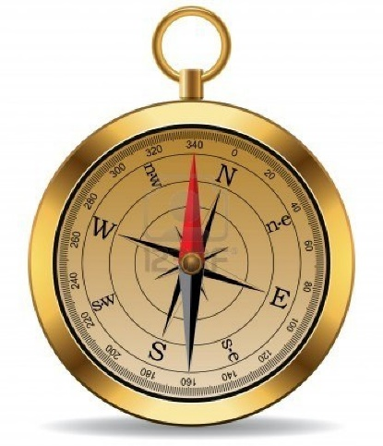
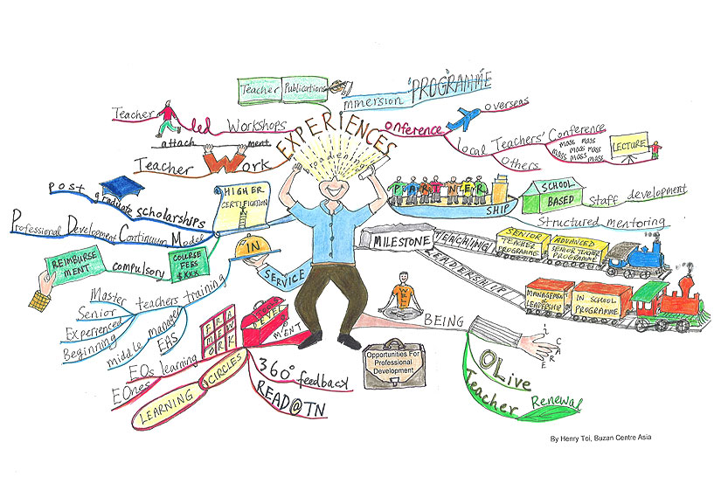
Force Field
Compass
Mind Map
Organism
Chaos
Software
Notes:
According to Jennifer E. Beer (1997-2003), force fields are invisible but “unifying and powerful.” This suggests that culture is dynamic and “beyond individual control” (n.p.)

Slide 12
6 Differences
Find a partner. . .

Slide 13
With your partner
Look at the AAC&U Intercultural VALUE Rubric
Discuss which elements of the Rubric the activities “Miniature Metaphors” and “6 Differences” addressed.
Discuss whether you would/wouldn’t use these activities in class and why not.

Slide 14
Group Discussion
Would you use either or both activities in your classroom? Explain.
Why wouldn’t you want to use either or both of these in the classroom?
What activities do you do now that address the intercultural attitude of curiosity?
How do you present the concept of “culture” to students?

Slide 15
Reading discussion
What insights, questions, connections did you get from the readings?
What do you want to explore further?

Slide 16
Notes:
The first model for thinking about how individuals develop intercultural effectiveness is the Intercultural Development Continuum.
Suggests people move from a monocultural to an intercultural or ethnocentric to ethnorelative mindset.
IDI logo – Intercultural Development Inventory, widely used assessment tool at Purdue. High validity, 70+ dissertations have used it, Polytechnic pre/post.
Criticisms of IDI -- self-reporting, numerical data for a highly subjective experience.
Criticisms of IDC model: suggests teleology; individual experience may be more like a pendulum.
Useful as a diagnostic tool to think about where your students are and where they might go and even for designing learning activities that help them get there.

Slide 17
Wrap-up
Overall takeaways?
Intro to HubICL
Next time:
Openness, Worldview Frameworks
Intercultural competence & language learning

