Slide 1
What can we do to help our students learn to cross cultural boundaries?
A train-the-trainer workshop
Michael Vande Berg, Ph.D.
Purdue University
23-24 April, 2015

Slide 2
Cultural Curiosity
In your small groups, get acquainted if you don’t know each other, and discuss the two questions below. One person will report the small group’s responses to the larger group.
1. Why is it important for you to learn about and teach “culture” for your professional effectiveness?
2. What are two questions your group has about helping students or colleagues learn to cross cultural boundaries?

Slide 3
First Story
“. . . a real external world whose properties are definite and independent of the observer who perceives them” (S. Hawking & L. Mladinow, The grand design)

Slide 4
Cross-cultural teaching and learning: Three dominant narratives
1. Humans learn cross-culturally through talking about and being exposed to the right sort of culture: experience is learning.
2. Humans learn cross-culturally through talking about and being immersed in any new and different culture.
3. Humans learn and develop interculturally to the extent that we can shift our frames of reference, attune our emotions, and adapt our behavior to unfamiliar or challenging cultural contexts.
Vande Berg, M., Paige, R. M., & Lou, K. H. (Eds.) (2012). Student learning abroad: what our students are learning, what they’re not, and what we can do about it. Sterling, VA: Stylus.

Slide 5
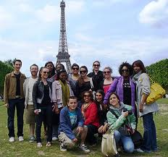
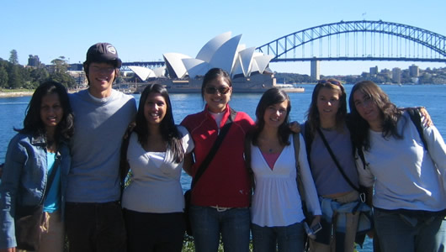
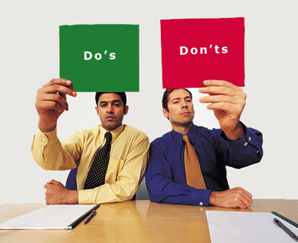
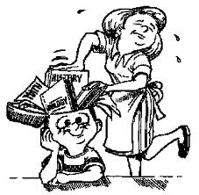
Story 1, 2015: Students learn as we expose them to an unfamiliar and privileged culture “out there”
Students learn through exposure to the new and different in privileged places.
Students learn when educators describe,
talk about, culture-specific differences.
Michael Vande Berg, PhD, © 2015

Slide 6
Second story, 1960s forward: Cultural relativism is undermining the assumption of cultural hierarchy
Our common humanity binds us together, and no culture is superior to any other
Michael Vande Berg, PhD, © 2015

Slide 7
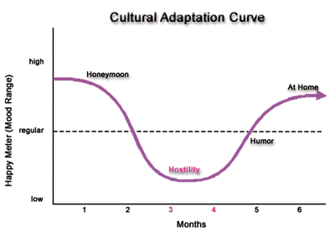
Second story: We need to teach learners about different sorts of cultural differences, and about how to prepare themselves for the shock of encountering them.
Some types of cultural
differences educators
teach learners:
Non-verbal
communication
Communication
styles
Learning styles
Cognitive styles
Value contrasts
Michael Vande Berg, Ph.D., © 2015

Slide 8
Second Story: educators “immerse” students in cultural difference

Slide 9
Georgetown Study findings*: To what extent do traditional “immersion” practices foster intercultural learning?
Take steps to improve language proficiency: Little impact
Maximize contact with host nationals: No impact
Enrollment in host school classes: No impact
Carry out internships, service learning: No impact
Be housed in home stays: No impact
Send away for longer periods: Yes—some impact
Pre departure cultural orientation: Yes—some impact
Home stays: Yes—when students engaged with host family
Cultural mentoring at sites abroad: Yes—by far the highest impact practice in the study
*Vande Berg, M.; Connor-Linton, J.; & Paige, R. M. The Georgetown Consortium Study: Intervening in student learning abroad. Frontiers: the Interdisciplinary Journal of Study Abroad. Vol. XVIII, pp. 1-75.
Michael Vande Berg, Ph.D., © 2015

Slide 10
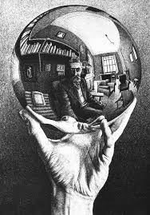
Third story
M.C. Escher

Slide 11
“Wanderer, there is no road; the road is made by walking”(A. Machado)
“We create history by our observation, rather than history creating us” (Hawking & Mladinow)
Michael Vande Berg, Ph.D., © 2015
Notes:
We construct and co-construct the meaning we experience in the world.

Slide 12
Four core intercultural competencies: Interacting more effectively and appropriately with culturally different others”—bridging cultural gaps”—means:
Increasing cultural and personal self awareness through reflecting on our own experiences, past and present;
Increasing awareness of others within their own cultural and personal contexts;
Learning to manage emotions and thoughts in the face of ambiguity, change, and challenging circumstances & people
Learning to shift frames, attune emotions and adapt behavior to other cultural contexts.
Michael Vande Berg, PhD, © 2015

Slide 13
Assessing Intercultural Development: Comparative Program Data (IDI=90-point scale*)
SA without facilitation at program site: IDI Gains
Georgetown U. Consortium Study (60 progs.) +1.32
SA with facilitation across program: IDI Gains
U of Pacific training program +17.46
AUCP training program (Aix, Marseille) +13.00
Bellarmine U/Willamette U ICC course: +8.19
CIEE training course (20 programs abroad) +11.34
Intercultural Development Inventory (IDI): www.idiinventory.com; Hammer, M. (2012).
Hammer, M. (2012). The Intercultural Development Inventory: A new frontier in assessment and development of intercultural competence. In Vande Berg, M., Paige, R. M. & Lou, K. H. (Eds.). What our students are learning, what they’re not, and what we can do about it. Sterling, VA: Stylus.

Slide 14
Intercultural teaching and learning: 5 frames to guide our work—including this workshop
Crossing cultural boundaries: Three stories
4 core intercultural competencies
Balancing challenge and support
The experiential learning cycle (Kolb Learning Style Inventory: KLSI)
The Intercultural Development Continuum (IDI)

Slide 15
Intercultural teaching and learning: A widening cultural gap
Which story are we telling?
Which story are our students telling?
Which story are our institutions telling?
Our challenge: How do we bridge these widening cultural gaps?

Slide 16
Four core intercultural competencies: Interacting more effectively and appropriately with culturally different others”—bridging cultural gaps”—means:
Increasing cultural and personal self awareness through reflecting on our own experiences, past and present;
Increasing awareness of others within their own cultural and personal contexts;
Learning to manage emotions and thoughts in the face of ambiguity, change, and challenging circumstances & people
Learning to shift frames, attune emotions and adapt behavior to other cultural contexts.
Michael Vande Berg, PhD, © 2015

Slide 17
Framing the experience their way: Students choose to learn away “to make a difference”
Goals
“Making a difference”: for self, self & other, society
Study what I can’t at home in my major
Explore new academic perspectives
Improve Second Language proficiency
Make a difference in others’ lives: service
Make a difference in other’s lives: research
Enhance c.v. and employability
Travel to new and different places
Find romance, maybe the love of my life
Make friends in new & different places
“Start over” in making friends
Escape academic rigor of home campus
“Bragging rights”
1
1
1, 2
3
3
1
1
2
2
2
1
1

Slide 18
Framing the story for students who wonder about the workplace value of intercultural learning
“There is real business value in employing staff who have the ability to work effectively with individuals and organizations from cultural backgrounds different from their own.
Employees who lack these skills may leave their organizations susceptible to risks including:
Loss of clients
Damage to reputation
Conflict with Teams” *
Employers report that educational institutions should do more to help students develop intercultural competence.
*“Culture at Work: The Value of Intercultural Skills in the Workplace.”(2013). British Council, IPSOS, & Booz/Allen/Hamilton. http://www.britishcouncil.org/press/research-reveals-value-intercultural-skills-workplace

Slide 19
What’s the first thing you see?
*M.C. Escher drawing Michael Vande Berg, Ph.D., © 2015

Slide 20
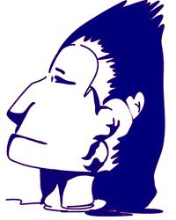
Describe the figure you see in this picture.
Michael Vande Berg, Ph.D., © 2015

Slide 21
How many triangles do you see?
To find one solution--but not the only one!—see the video clip at http://blog.mamashealth.com/anything-goes/how-many-triangles-do-you-see/

Slide 22
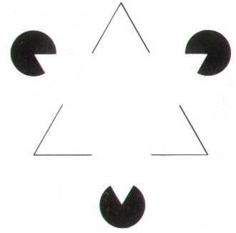
How many triangles do you see?
Michael Vande Berg, Ph.D., © 2015

Slide 23
Draw these two forms on a blank piece of paper 4-5 inches (10-13 centimeters) apart
“We do not see that we do not see.”*
*Maturana, H. & Varela, F. (1998). The tree of knowledge: The biological roots of human understanding (pp. 18-21g. Boston: Shambhala.
Michael Vande Berg, Ph.D., © 2015

Slide 24
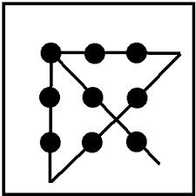
A basic simulation game: Introducing the connection between framing & assumptions Draw four straight lines connecting all nine dots, without retracing any line or lifting your pen from the page

Slide 25
Practicing framing & frame shifting
“Ask yourself:
What assumption am I making,
That I’m not aware I’m making,
That gives me what I see?
And when you answer that, ask yourself:
What might I now invent,
That I haven’t yet invented,
That would give me other choices?”
* Zander, R. S. & Zander, B. (2000). The art of possibility. New York: Penguin

Slide 26
Becoming aware of the out-of-awareness assumptions behind our frames. More practice! Draw three straight lines connecting all nine dots, without retracing any line, or lifting your pen from the page

Slide 27
Describe the man’s face here
Now describe what the man and woman are doing

Slide 28
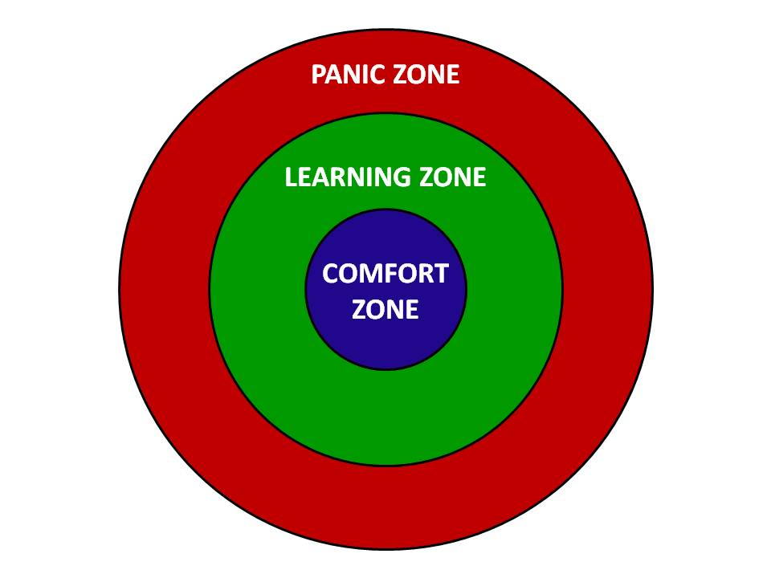
Another model offering insights into “the structure of the knower”: Challenge & support*
*Challenge/Support Hypothesis: Sanford, N. (1966). Self and society: Social change and individual development. New York: Atherton Press.

Slide 29
Introducing challenge and support: Warm up questions*
What kind of environment do I need in this course/workshop/orientation so I’m able to get out of my comfort zone, yet not go into the panic zone?
How can the teacher/trainer/facilitator contribute to getting me into the learning zone?
How can the other participants contribute to getting me into the learning zone?
What can I do to get myself into the learning zone?
What can I do, based on what I’ve just heard my peers say, to help others get in and stay in their learning zone in this workshop, much of the time?
* Activity designed by Tara Harvey, Ph.D. 2015

Slide 30
An important third-narrative theoretical description of “the structure of the knower”

Slide 31
Choosing a Cultural Partner (CP)
Choose a CP—someone you don’t know at all, or don’t know well—who differs from you in at least 6 of these ways:
Nationality of origin
Urban-suburban-rural
Social class in which you grew up
Race or ethnicity
Preferred learning style (look for the colored stickers!)
Religious beliefs/background
Gender
Sexual orientation
Age—at least ten years older or younger
First language
Emotionally restrained/emotionally expressive
Has children/doesn’t have children

Slide 32
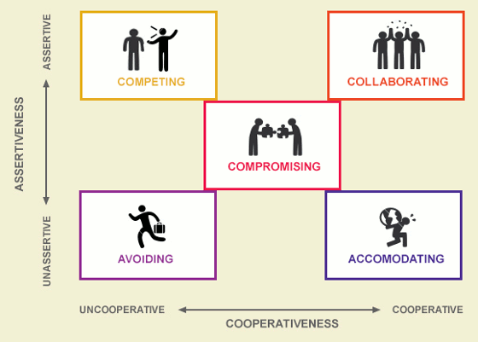
Becoming more effective and appropriate
Thomas-Kilman Conflict Modes

Slide 33
Developing IC: Interacting more effectively and appropriately with culturally different others

Slide 34
An important model describing “the structure of the knower”: The Intercultural Development Continuum (IDC)
Denial
Polarization
Minimization
Acceptance
Adaptation
Bridges across Difference
Deeply Comprehends Difference
Intercultural
Mindset
De-emphasizes Difference
Judges Difference
Misses Difference
Monocultural
Mindset
Modified from the Developmental Model of Intercultural Sensitivity (DMIS), M. Bennett, 1986
Notes:
Cultural Disengagement:
A feeling of being an “outsider” in your own group
May feel comfortable with a “contrarian” stance
May have difficulty participating in important symbols, events and activities shared in your community
May be related to experiences of being rejected in your own group
May be related to experiences where one feels “between two or more” cultural communities

Slide 35
Intercultural Development Inventory (IDI)
Group Report
Purdue University
April 23-24, 2015

Slide 39
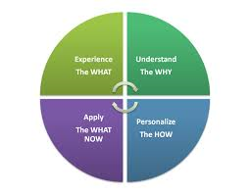
4 key components of transition planning*
* Berardo, K. 2012: Building cultural competence.

Slide 40
Thank You! mvandeberg@mvbassociates.com

