Slide 1
iLEAD WORKSHOP SERIES FOR VISITING SCHOLARS #3 Provided by: Purdue Polytechnic Institute The Office of International Students and Scholars The Center for Intercultural Learning, Mentorship, Assessment and Research Presenter: Dr. Daniel Jones

Slide 2
Workshop #3: Culture Shock & Developing a Support Network
Agenda:
Share writing prompt reflections
What is “culture?”
Intercultural Openness
Value and Diversity Dimensions
Critical Incidences
Writing Prompt
Notes:
To create a new slide: right click and select “Duplicate Slide.”

Slide 3
Writing Prompt Homework
Who is your support network at home?
Who is your support network at Purdue/in the Greater Lafayette area?
How will you expand your local support network?
Notes:
Participants can address as many or as few of these as they wish.

Slide 4
What is “culture?”

Slide 5
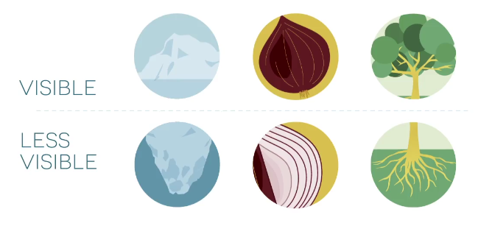
Metaphors of Culture
Notes:
90% of a personal identity is not obvious yet we often treat people based on the 10% that is.
Furthermore, according to neurologists, it takes the human brain a fraction of a millisecond to perceive “difference”…especially racial/ethnic difference.
Ask group for input on how to get to know one beyond just the 10%.
Ask group at what point it becomes appropriate to inquire about a person’s religion, or class, or sexual orientation. (If group feels it is never appropriate to ask those questions, ask how they can avoid labeling or stereotyping individuals).

Slide 6
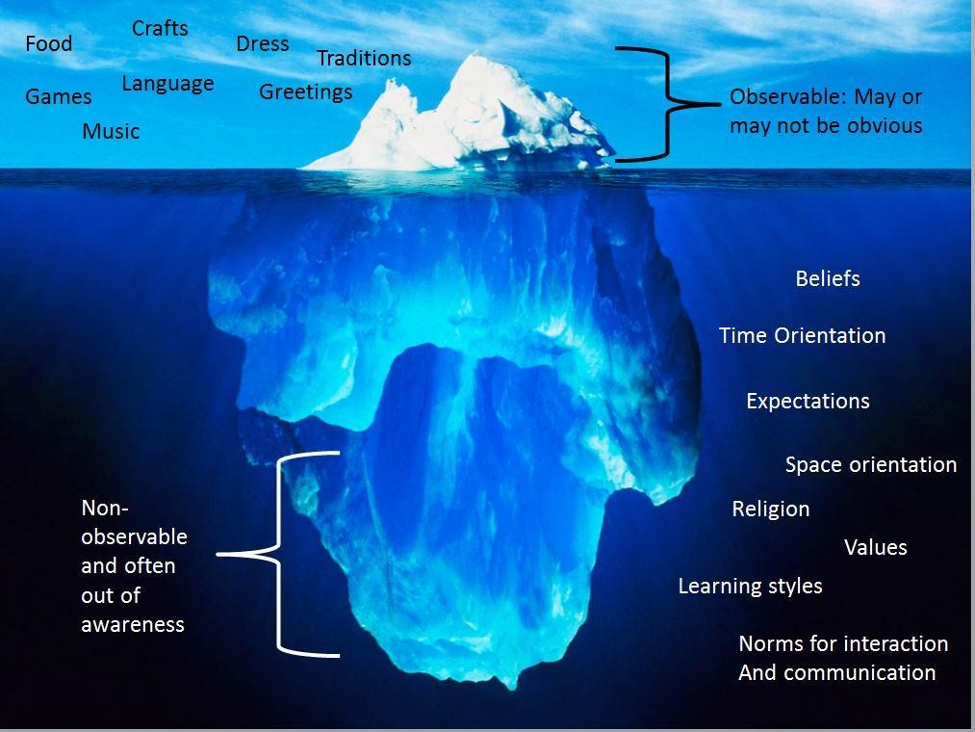
The Tip of the Iceberg
Notes:
90% of a personal identity is not obvious yet we often treat people based on the 10% that is.
Furthermore, according to neurologists, it takes the human brain a fraction of a millisecond to perceive “difference”…especially racial/ethnic difference.
Ask group for input on how to get to know one beyond just the 10%.
Ask group at what point it becomes appropriate to inquire about a person’s religion, or class, or sexual orientation. (If group feels it is never appropriate to ask those questions, ask how they can avoid labeling or stereotyping individuals).

Slide 7
AAC&U VALUE Rubric:
Intercultural Knowledge and Competence
 | Developing | Emerging | Proficient
Attitudes Openness | Has difficulty suspending judgment in interactions with culturally different others, and is aware of own judgment and expresses a willingness to change. | Begins to suspend judgment in valuing interactions with culturally different others. Begins to initiate and develop interactions with culturally different others | Initiates and develops interactions with culturally different others. Suspends judgment in valuing her/his interactions with culturally different others.

Slide 8
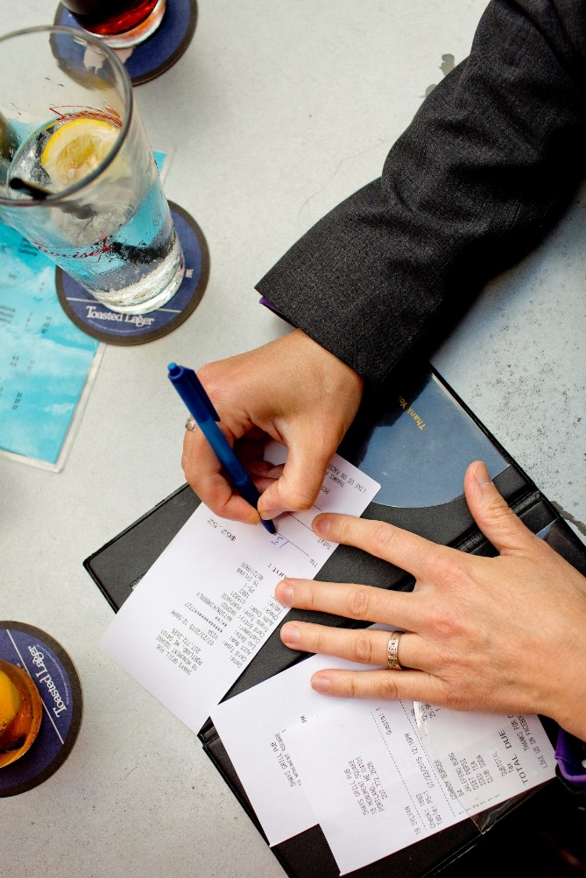
Tipping
Restaurants and Food Delivery
Expected in the U.S.
Tip (gratuity) sometimes added to a bill.
Tip between 15-20%.
Not tipping is extremely rude.
Also expected for deliveries.
Not expected where you order food at a counter.

Slide 9
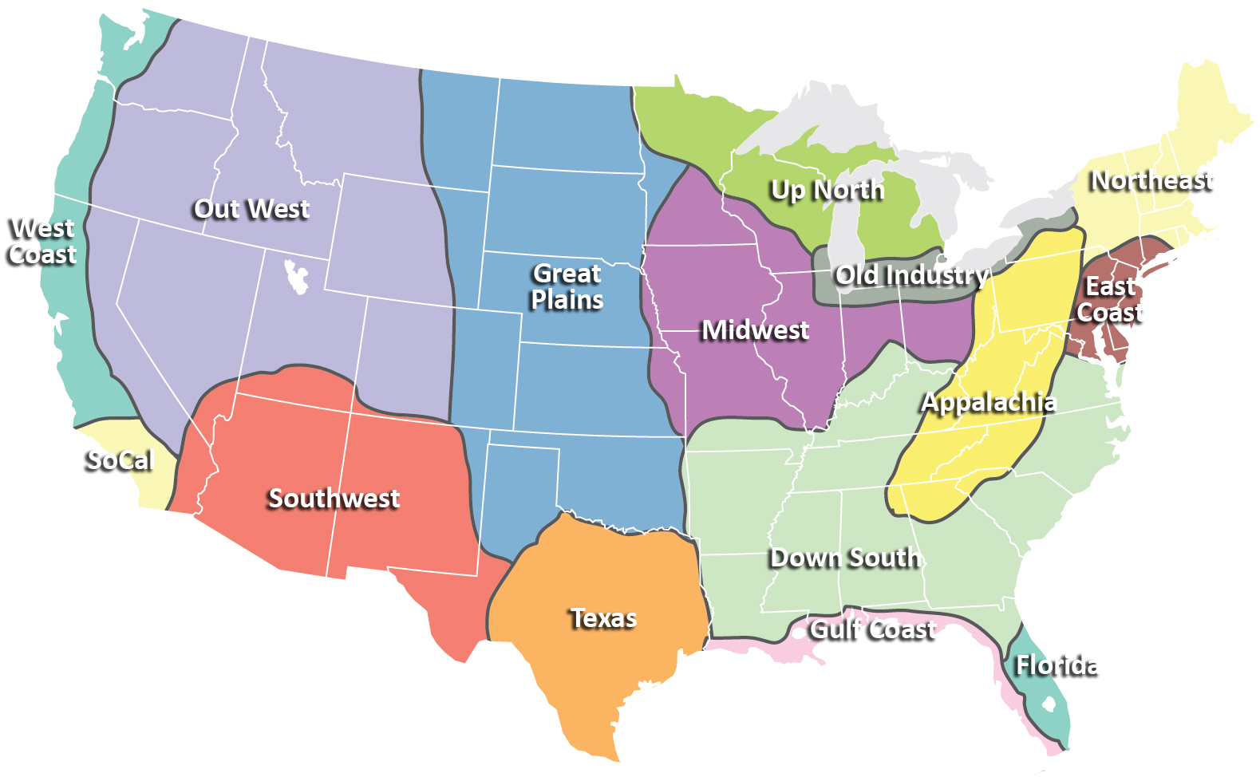
Midwest Culture
“Midwest Nice”
Notes:
apologizing involuntarily when scooting past someone, both to warn of your presence and to express regret for any inconvenience your mere existence may have caused. It is greeting people as they step into a lift and wishing them well as they leave. It is a strong preference for avoiding confrontation.

Slide 10
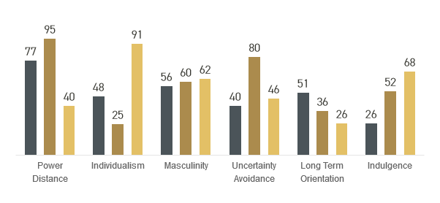
American Cultural Values
Independence – Hofstede Cultural Dimensions
Equality
Informality
Directness
Punctuality
India
United States
Saudi Arabia
Notes:
Ask the Audience:
What are some generalizations you would make about American culture?
When we generalize about American culture with these 5 aspects, what does it mean to be independent or informal or direct”?

Slide 11
Cultural Difference
How is the United States different?
Which of these difference might be challenging for you?
Discuss in groups of 3-4 for 5-7 minutes
Share your list of problems
Let’s discuss.

Slide 12
Critical Incidences
Alcohol
Where to eat?
Clothing
Language Competence
Communication style
Gender roles
Why did that happen?
Suspend judgement and create awareness
Notes:
Language Competence – understanding/being understood

Slide 13
KEY INSIGHTS AND LEARNING
Appropriate behavior in one culture may be considered rude in another culture. It all depends on the cultural context.
It is important to ask for more information about what we experience or observe, especially if we are offended by the behavior or don't understand it.
Suspending judgement is an important component of remaining open, objective, and in the Learning Zone.
Identifying potential stress points and strategies for managing emotions can reduce the effects of culture shock.

Slide 14
Homework

Slide 15
Writing Prompt
Because of who you are or where you’re from . . .
Have you been stereotyped?
Have you been discriminated against?
Have you been excluded?

Slide 16
Thank You
Contact info:
dcjones@purdue.edu
shouston@purdue.edu
sparks36@purdue.edu
mclugh@purdue.edu
barajase@purdue.ed

