Slide 1
iLEAD WORKSHOP SERIES FOR VISITING SCHOLARS #7 Provided by: Purdue Polytechnic Institute The Office of International Students and Scholars The Center for Intercultural Learning, Mentorship, Assessment and Research Presenter: Dr. Daniel Jones

Slide 2
Workshop #7: Emotional Resilience, Part 2
Agenda:
Share writing prompt reflections
Review of Emotional Resilience
Mindfulness Activity
Writing Prompt
Notes:
To create a new slide: right click and select “Duplicate Slide.”

Slide 3
Writing Prompt Homework
Revisiting Emotional Resilience
What triggers/stressors have you identified since ER, Part I
What coping strategies have you used?
Which have worked/not worked?
Have you found new coping strategies?
Notes:
Participants can address as many or as few of these as they wish.

Slide 4
Review

Slide 5
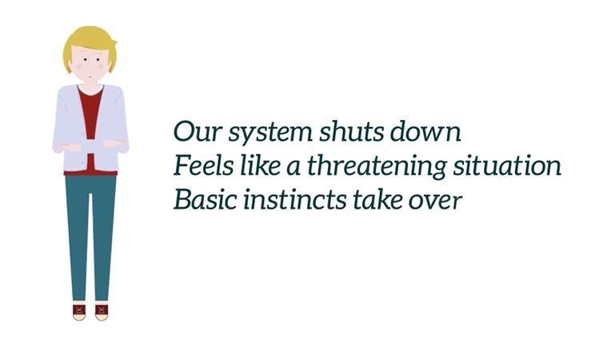
Emotional Resilience, Part 2
Let’s Review!
What do the zones look like?
Comfort zone
Learning zone
Panic zone
Share a critical incidence that sent you into the panic zone.

Slide 6
Activities

Slide 7
Mindfulness & Managing Emotions
Noticing & Slowing Down Our Automatic Reactions
Increasing Self-Awareness
Increasing Awareness of Others
Engaging Ambiguity
Increasing Creativity
Enhancing Resiliency
Cultivating Compassion & Empathy
Stone, J. (2011). Minding the Bedside- Nursing from the Heart of the Awakened Mind. Minneapolis, MN: Langdon Street Press.
Notes:
“Culture” is essentially the habits of our mind – how we have been programmed. Increasing intercultural competency requires becoming more aware of our own cultural programming—understanding how the ways we make meaning of the world are socially & culturally constructed. This includes the need to get in touch with our emotions and physical sensations, and consider what they offer us in any given moment. Mindfulness helps increase our awareness of our emotions, experience, and habits of our mind. Practicing mindfulness helps us get in touch with who we are on a deeper level. (T. Harvey, 2017)

Slide 8
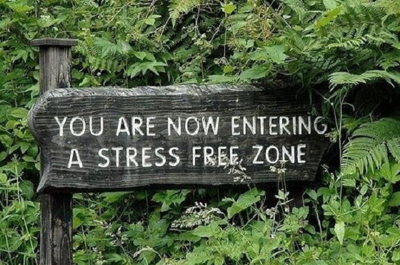
ACTIVITY EXEMPLAR: PRACTICING MINDFULNESS
Presented by: Michael Bittinger

Slide 9
DEBRIEFING
The Thiagi Debrief
How do you feel?
What happened?
What did you learn?
How does this relate to the real world?
What if?
What next?

Slide 10
Homework

Slide 11
Writing Prompt
Capstone: Research Presentation to PPI students
What questions do you have about presenting?
What aspects of this workshop might be useful for or during your presentation?
What would you like students to know about your cultural background/international experiences that are relevant to your presentation?

Slide 12
Thank You
Contact info:
dcjones@purdue.edu
shouston@purdue.edu
sparks36@purdue.edu
mclugh@purdue.edu
barajase@purdue.ed

