Slide 1
INTERCULTURAL PEDAGOGY GRANT WORKSHOP #2 Fall 2019 Presenter: Dr. Daniel Jones Intercultural Learning Specialist

Slide 2
IPG WORKSHOP #2
Today’s agenda
Debriefing of HW 1: Who am I?
Learning outcomes:
Worldview Frameworks and Curiosity
Reflection and debriefing tools
Sample activity: Values Continuum
Assessment Tools
Sample activity: Dialogue starters
Homework

Slide 3
WORKSHOP #1 HOMEWORK

Slide 4
HW DEBRIEFING: Who am I?
Intended Student Learning Outcomes:
Build student self-awareness
Find/Discuss commonalities
Build group cohesiveness
Discuss stereotyping & being stereotyped

Slide 5
HW Debriefing: Who am I?
Relationships | Skills | Scholarship | Regional Groups | Hobbies | Religion | Nationality | Educator Roles | Personality Types | School Affiliations | Socio-Political | Social Responsibility
Brother | Artist | Scholar/ Academic | Iowan | Gamer | Agnostic | American | Advisor | Leader | Aggie | Liberal | Civil Rights and Civil Liberties Advocate
Brother-in-law | Musician | Intellectual | Mediterranean | Knitter | Athiest | Chinese | Educator | Supporter | Hoosier | Progressive | Feminist
Father | Mechanic | Linguist | Middle Eastern | Animal-lover | Catholic | Colombian | Mentor | Adventurer | Kentucky Wildcat | Realist-Pragmatist | Activist
Husband | Writer | Literature Scholar | Midwesterner | Cheese-lover | Christian | Jamaican | Professor | Innovator | Boilermaker/Alumn
Mother | Grill Master | Disability Studies Scholar | North African | Crazy Cat Lady | Jew | Immigrant | Teacher
Parent | Navigator | Modernist Scholar | Southern Indian | Foodie | Muslim | International
Divorce' | Traveller | Researcher | Southerner | Environmental Enthusiast | Protestant
Single (unmarried) | Exercise Physiologist | Scientist | Wisconsonite |  |  | Race | Gender | Athletics | Professional | Ethnic Groups | Misc
Son | Health and Nutrition Advocate | Cinephile |  |  |  | Caucasian | Female | Athlete | Purdue Employee | (Jamaican) Patwah or Creole | Hard of hearing/deaf
Wife |  |  |  |  |  | African | Male | Dancer | Worker | Arab-American | Homosexual
Friend |  |  |  |  |  | White | Woman | Runner |  |  | Vegetarian

Slide 6
HW Debriefing: Who am I?
Discussion Questions:
Which ONE identity, of the items you listed, are you proudest of and why?
Are there any identities that you did not claim on the worksheet that people you meet try to assign to you anyway? [Example: Your last name is Cortes; you must be a native Spanish-speaker.] Does it bother you when people assume that you have this identity?

Slide 7
WHY INTERCULTURAL INTERVENTION?

Slide 8
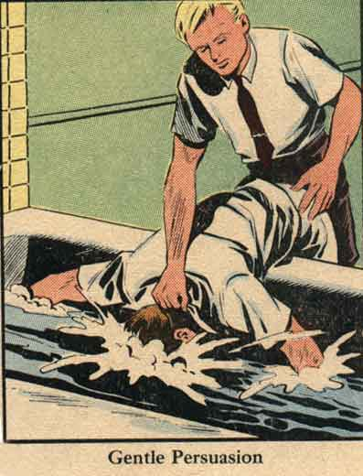
IMMERSION
Who needs scuba gear?
Immersion will help you learn to breathe underwater.
Notes:
Immersion was long believed to provide “transformative” experiences. Exposure was equated with learning. Even Krashen’s Input hypothesis (language learning) is understood in terms of its association with Instructional scaffolding.

Slide 9
3 DOMINANT NARRATIVES (MVB)
1. Humans learn through exposure to cultural difference
2. Humans learn by being immersed in another culture
3. Humans learn and develop:
a) by being immersed in cultural difference,
b) by reflecting on how they & others frame experience,
c) and by re-framing their experience
Vande Berg, M., Paige, R. M., & Lou, K. H. (Eds.) (2012). Student learning abroad: what our students are learning, what they’re not, and what we can do about it. Sterling, VA: Stylus.

Slide 10
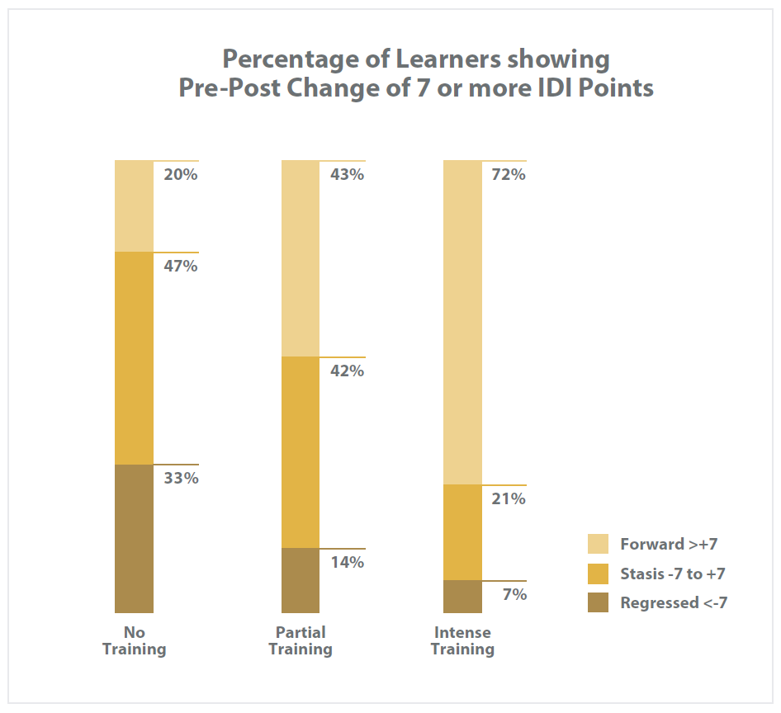
Yngve, K. (2018) Intercultural Learning in Purdue Faculty-Led Study Abroad, 2018

Slide 11
EDUCATORS NEED TO INTERVENE:
Help students learn to interact more effectively and appropriately in unfamiliar cultural contexts by:
Immersing students in difference part of the time, and with support
Encouraging students to reflect and thus to become aware of the ways that they and others characteristically frame experiences
Teaching students to re-frame—that is, to shift perspective and adapt behavior to other cultural contexts

Slide 12
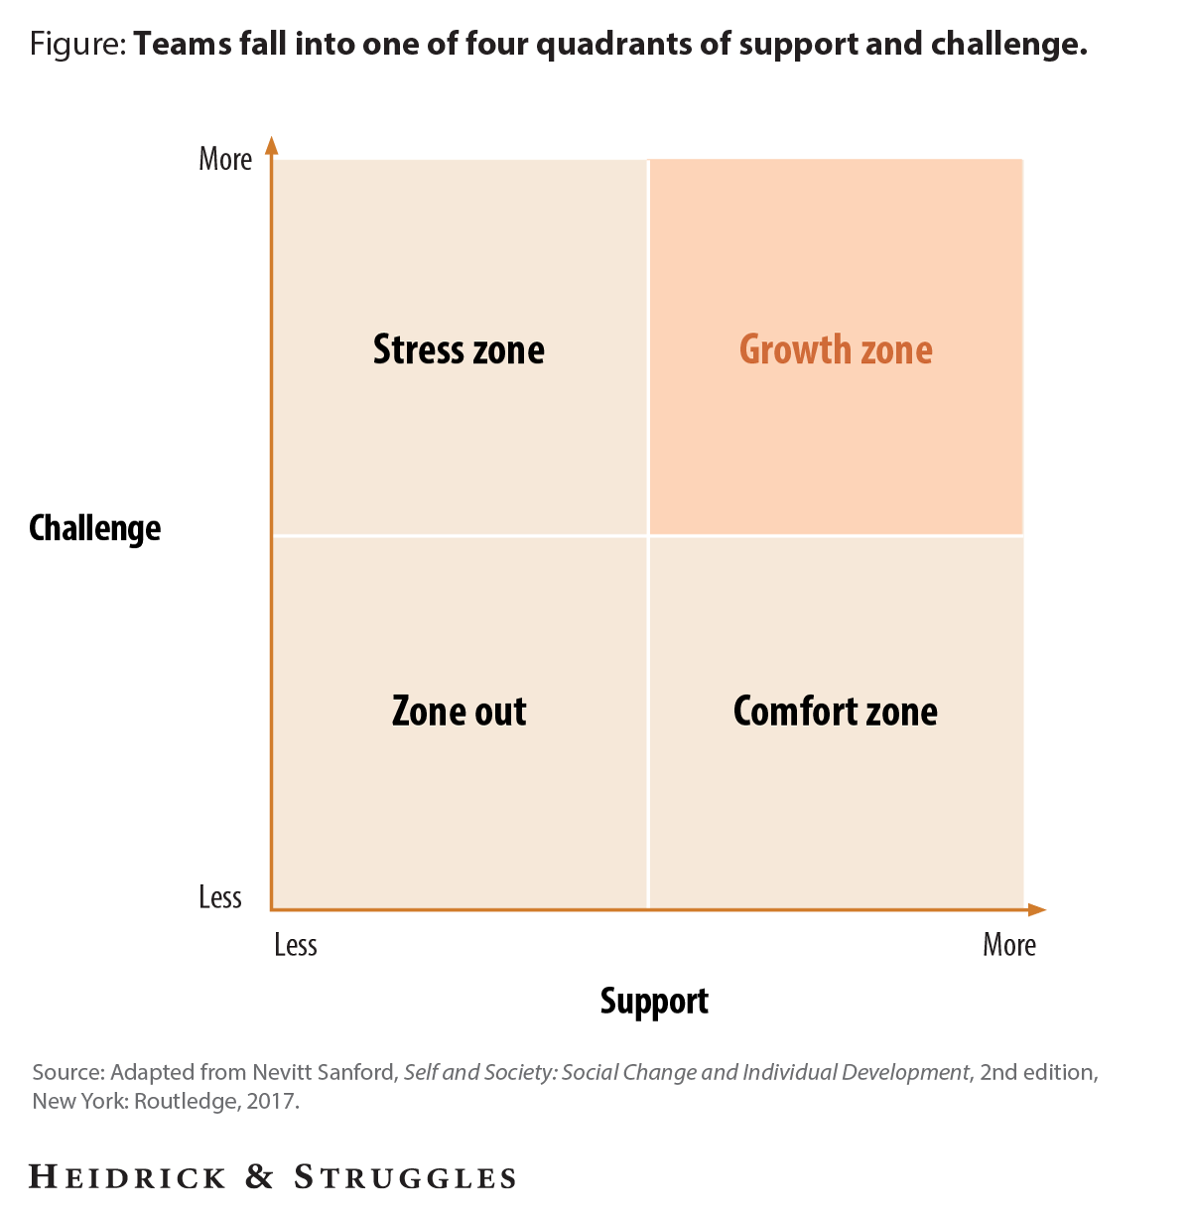
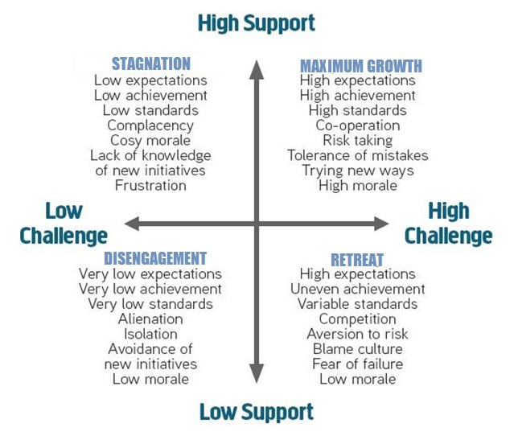
CHALLENGE AND SUPPORT
Sanford, N. (1968). Where colleges fail: A study of student as person. San Francisco: Jossey-Bass.
Notes:
Katherine

Slide 13
INTERCULTURAL MENTORING
Mentoring means providing:
Ongoing support of learning
Cultural concepts and ideas to anchor learning (such as value patterns, communication styles, etc.)
Strategies for cross-cultural learning (such as developing self-awareness, observations skills, etc.)
Opportunities to put learning into practice
Opportunities to reflect on experiences (including blogging or vlogging or taking a skills quiz)
Opportunities to connect what was learned to the future (employment, graduate education, life choices, etc.)
Notes:
Support, concepts & strategies, practice, reflection, and connection

Slide 14
SHARE YOUR EXPERTISE
What successful pre-departure activities have you used to stimulate curiosity and/or teach cultural worldview frameworks?
How do you help your students reflect on and process their study abroad experiences?
How do you encourage your students to recognize and address their own and others’ stereotypes?

Slide 15
STUDENT LEARNING OUTCOMES

Slide 16
AAC&U Intercultural Knowledge & Competence VALUE Rubric
 | Capstone | Milestones |  | Benchmark
 | 4 | 3 | 2 | 1
Knowledge Cultural self- awareness | Articulates insights into own cultural rules and biases… | Recognizes new perspectives about own cultural rules and biases… | Identifies own cultural rules and biases… | Shows minimal awareness of own cultural rules and biases…
Cultural worldview frameworks | Demonstrates sophisticated understanding of the complexity of elements… | Demonstrates adequate understanding of the complexity of elements… | Demonstrates partial understanding of the complexity of elements… | Demonstrates surface understanding of the complexity of elements…
Skills Empathy | Interprets intercultural experience from the perspectives of own and more than one worldview… | Recognizes intercultural and emotional dimensions of more than one worldview and sometimes uses more than… | Identifies components of other cultural perspectives but responds in all situation with own worldview | Views the experience of others but does so through own cultural worldview
Verbal and nonverbal communication | Articulates a complex understanding of cultural differences in verbal and nonverbal communication… | Recognizes and participates in cultural differences in verbal and nonverbal communication and begins to negotiate… | Identifies some cultural differences in verbal and nonverbal communication and is aware that… | Has a minimal level of understanding of cultural differences in verbal and nonverbal communication…
Attitudes Curiosity | Asks complex questions about other culture, seeks out and articulates answers to these… | Asks deeper questions about other cultures and seeks out answers to these questions | Asks simple or surface questions about other cultures | States minimal interest in learning more about other cultures
Openness | Initiates and develops interactions with culturally different others… | Begins to initiate and develop interactions with culturally different other… | Expresses openness to most, if not all, interactions with culturally different others… | Receptive to interacting with culturally different others. Has difficulty suspending…
Cartwright, C., et al. (2009). Intercultural Knowledge & Competence. Association of American Colleges & Universities. Retrieved from https://www.aacu.org/value
Notes:
Kris

Slide 17
LEARNING OUTCOMES:
WORLDVIEW FRAMEWORKS AND CURIOSITY
 | Capstone | Milestones |  | Benchmark
 | 4 | 3 | 2 | 1
KNOWLEDGE Cultural worldview frameworks | Demonstrates sophisticated understanding of the complexity of elements… | Demonstrates adequate understanding of the complexity of elements… | Demonstrates partial understanding of the complexity of elements… | Demonstrates surface understanding of the complexity of elements…
ATTITUDE Curiosity | Asks complex questions about other culture, seeks out and articulates answers to these… | Asks deeper questions about other cultures and seeks out answers to these questions | Asks simple or surface questions about other cultures | States minimal interest in learning more about other cultures
Cartwright, C., et al. (2009). Intercultural Knowledge & Competence. Association of American Colleges & Universities. Retrieved from https://www.aacu.org/value
Notes:
Kris

Slide 18
PROVOKING CURIOSITY

Slide 19
ACTIVITY 2

Slide 20
ASSESSMENT TOOLS
Co-facilitator: Dr. Heidi Parker
Who feels like they know nothing about assessment?
Who has used an assessment tool before?
What assessment tools have you used?
What do you know about assessments already?
What were some of the advantages and disadvantages?

Slide 21
ASSESSMENT TOOLS:
It’s not When you Assess, but Why
TYPES
Assessment OF Learning (summative)
Assessment FOR Learning (formative)
Assessment AS Learning (pedagogical)
Approaches
Holistic vs. Component Approaches
Direct vs. Indirect Measures
Quantitative vs. Qualitative methods
High vs. Low Face Validity
Notes:
Holistic vs. Component Approaches = Large picture measuring multiple items (BEVI, maybe IDI) vs. One Competence from AAC&U
Direct vs. Indirect Measures = Using AAC&U to qualitatively assess student essay responses on “Competence” vs. ASKS2+ where students are asked to self-assess their “Competence.”
Quantitative vs. Qualitative methods
High vs. Low Face Validity = how obvious a tool is about what it is assessing, can affect the extent to which participants can “game” the system, provide the desired answers.

Slide 22
ASSESSMENT TOOLS WORKSHEET
On the Assessment Tool Worksheet keep notes about each tool presented:
Rank it as something you would or wouldn’t use.
Do you have a budget for it?
What do you consider a positive? Negatives?
What questions do you have about the tool?
After all tools are presented, share and discuss with a partner.

Slide 23
ASSESSMENT TOOLS
Co-facilitator: Dr. Heidi Parker
 | VALUE rubrics | BEVI | CQ | IDI | IES | ASKS2+
Medium | Downloadable from the | Web-based mixed | Web-based | Web-based mixed | Web-based quantitative | Downloadable from the
 | web, adaptable, meant | methods survey (multiple | quantitative | methods survey |  | web, printable for paper-
 | to be applied to | choice and open-ended |  | (multiple choice and |  | based self-assessment.
 | qualitative data such as | questions) |  | open-ended questions) |  | Purdue faculty and staff
 | reflective writing |  |  |  |  | may request an optional
 | assignments, online |  |  |  |  | web-based version.
 | dialogue, transcribed
 | interviews, and open-
 | ended survey questions
Length | 16 rubrics, 1 page each | 185 likert-scale items plus demographics and short answer questions | 20 likert-scale items | 50 likert-scale items plus demographics and short answer questions | 60 likert-scale items | Versions for pre and post testing and reflection, 1 page each
Face validity | High | Low | High | Medium | High | High (retro pretest model recommended)
Cost | Free | Annual institutional | $11 per student (T1) | $12 per student and $18 | $14 per person in | Free
 |  | license, with cost | $20 per student (T2) | per non-student | academic contexts plus
 |  | structured by size of | $50 group reports |  | bulk pricing and
 |  | university |  |  | research discounts
 |  |  |  |  | available
Requires Debrief | No | Individual – No Group – Yes | Individual – No Group – Yes | Yes | Individual – No Group – Yes | Group recommended
Need Training | No | Yes | Yes | Yes | Optional | No
Measures | Constructs relevant to | 17 scales, including | Cultural intelligence | Intercultural sensitivity | Competencies critical to | 6 components of
 | undergraduate learning, | sociocultural openness, | (capacity to adapt to | (orientation towards | interacting with | intercultural
 | including intercultural | global resonance, | various cultural | cultural difference) | culturally different | competence (attitudes,
 | knowledge and | emotional attunement, | contexts) |  | others: continuous | skills, and knowledge)
 | competence as well as | gender traditionalism, |  |  | learning, interpersonal | from the AAC&U rubric
 | global learning, | ecological resonance, and |  |  | engagement, and
 | teamwork and more | more |  |  | hardiness
More info | https://www.aacu.org/value-rubrics | http://thebevi.com/ | https://culturalq.com/p%20roducts-services/assessments/cq-assessments/ | https://idiinventory.com/products/idi-products-services-pricing/ | https://www.kozaigroup.com/intercultural-effectiveness-scale-ies/ | https://www.purdue.edu/cie/globallearning/InterculturalAttitudes_Skills_Knowledge_Short_Scale_Plus.pdf

Slide 24
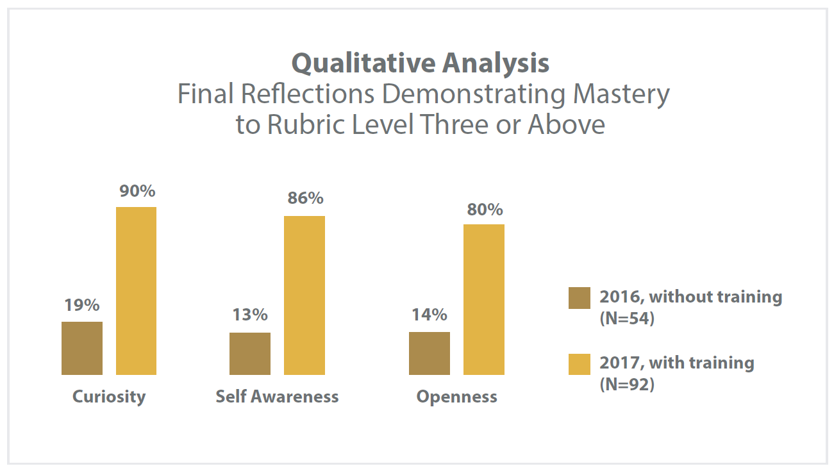
AAC&U Intercultural Knowledge & Competence VALUE Rubric
Yngve, K. (2017) Intercultural Learning in Purdue Faculty-Led Study Abroad, 2016-2017

Slide 25
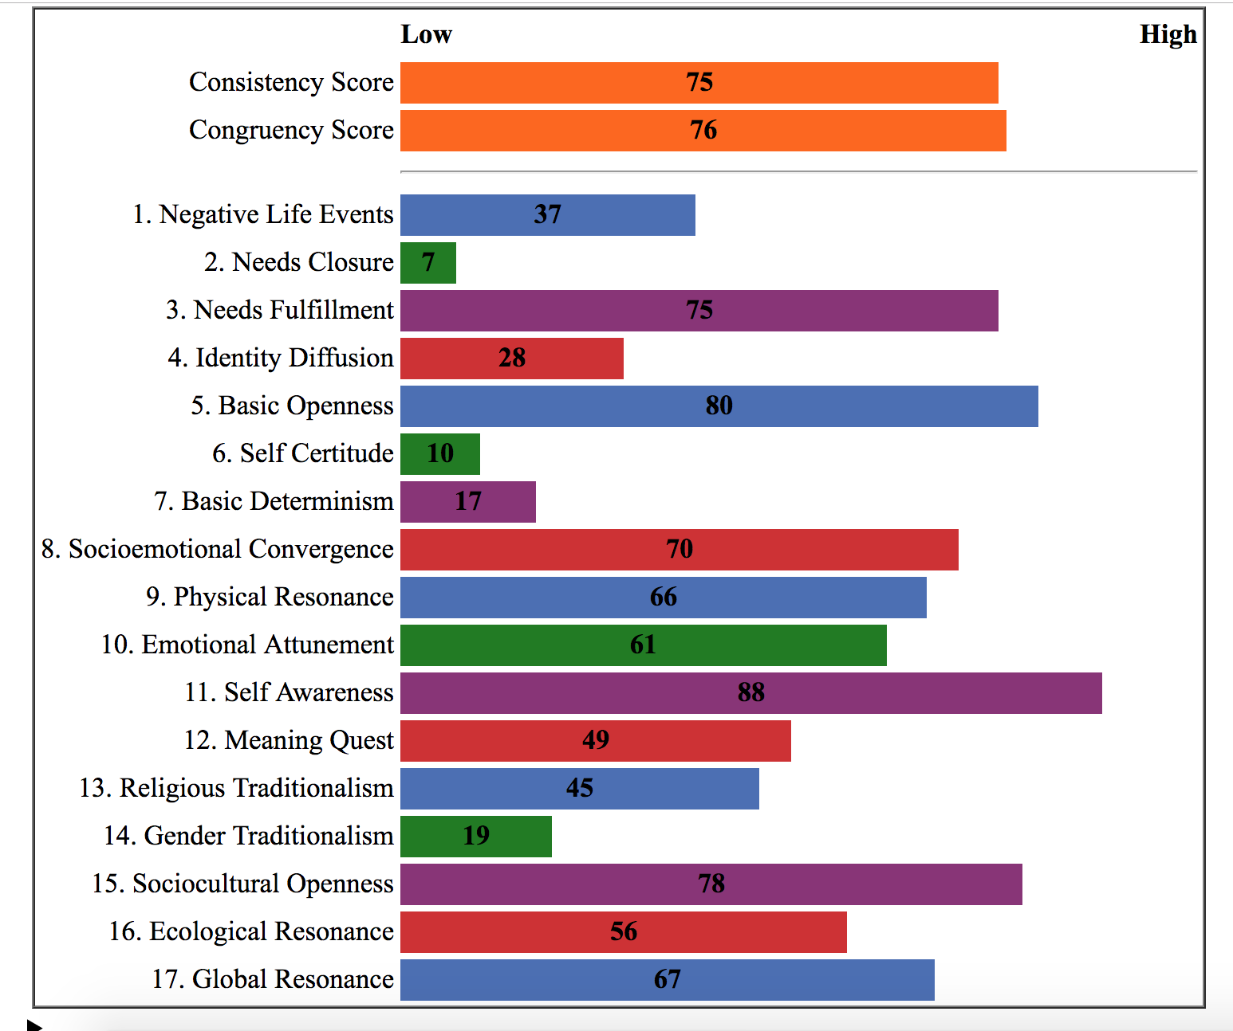
Beliefs, Events, and Values Inventory Sample BEVI Aggregate Profile
Formative Variables
Fulfillment of Core Needs
Tolerance of Disequilibrium
Critical Thinking
Self Access
Other Access
Global Access
Notes:
Potentially add screen shots from PDF of group report

Slide 26
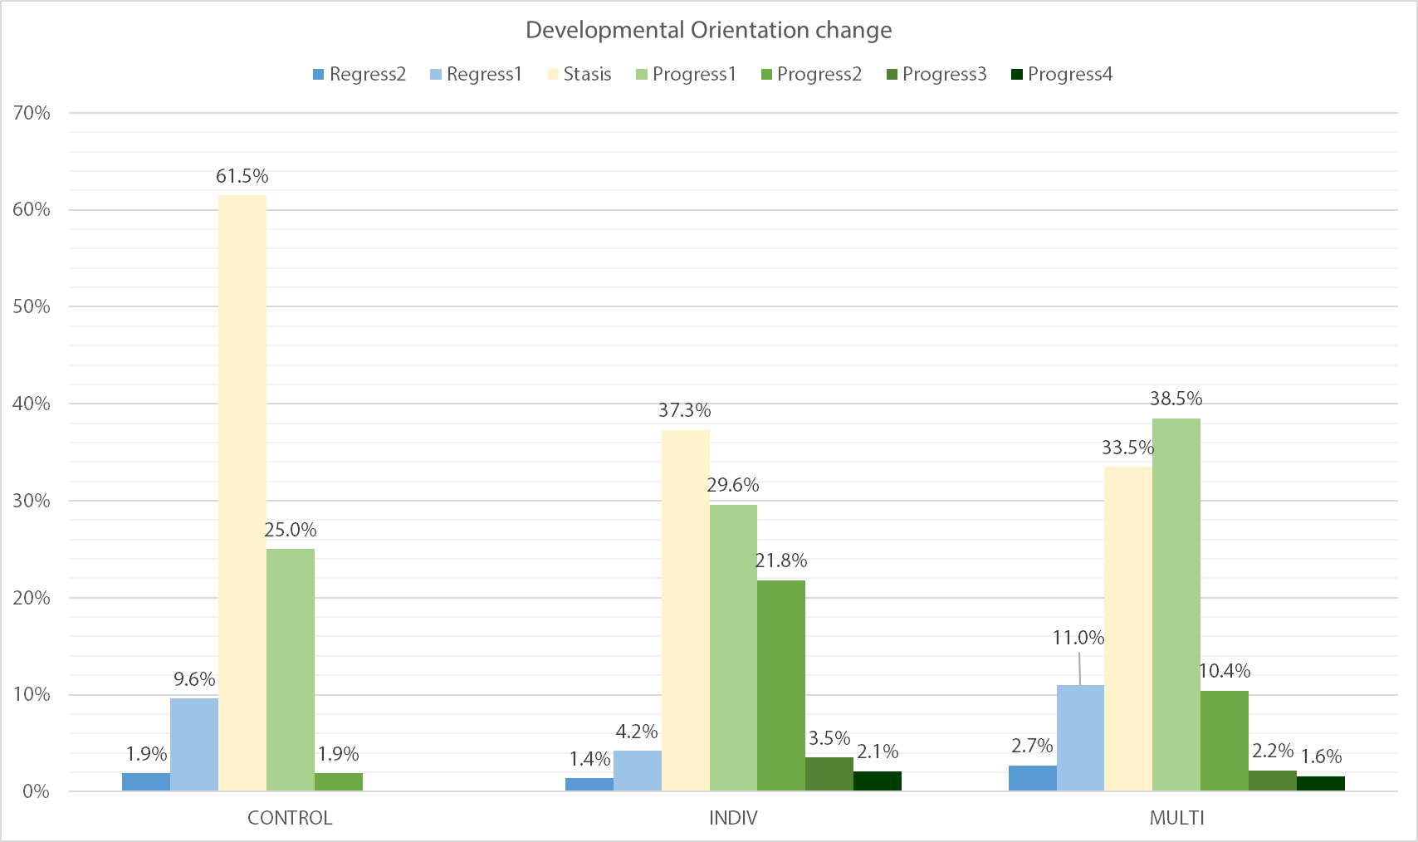
PRE- & POST-IDI RESULTS
Chart displays regression, stasis, and growth percentages. Numbered levels indicate the number of orientations changed, e.g. “Regress2” indicates that participants regressed two orientation stages.
N=376
Participants: semester and year-long study abroad students
T1: Individually mentored intervention (n=142)
T2: Group mentored intervention (n=182)
Control Group: (n=52)
Data collected over 4 semesters
Notes:
For those who prefer larger, longitudinal studies, this is a study of two intervention types on semester and year-long study abroad.

Slide 27
Assessments Debrief
Share and discuss
What questions do you have?

Slide 28
ACTIVITY 1

Slide 29
WORLDVIEW FRAMEWORKS EXEMPLAR
What is an example of a value difference you’ve encountered?
About family?
About work?
About time?
About social responsibility?
Other?

Slide 30
WORLDVIEW FRAMEWORKS ACTIVITY: HUMAN VALUES CONTINUUM
Each side of the room represents one extreme of the spectrum.
Listen closely to each value statement as it is designated to a specific side of the room.
Based on how you feel about the statement, move to an appropriate spot on the continuum between each side of the room.

Slide 31
WORLDVIEW FRAMEWORKS ACTIVITY: HUMAN VALUES CONTINUUM
Life is what happens to me./Life is what I make it.
Competition brings out the best./ Cooperation is the way to get things done.
Change is good./Tradition is important.
People should tell it like it is even if it hurts./Maintaining harmony is important even if it means not telling the complete truth.
Group membership is essential for my success./I don’t need to belong to a group to be successful.
Notes:
Can you explain your choice? Can you give an example of what that looks like?
What judgments do you make of people in other places on the continuum
Can you think of any contexts in which you would change your response?
Is there consensus among your cultural groups? How much do members of your cultural groups differ?
What might the underlying value be? Why is it important to understand underlying cultural values?

Slide 32
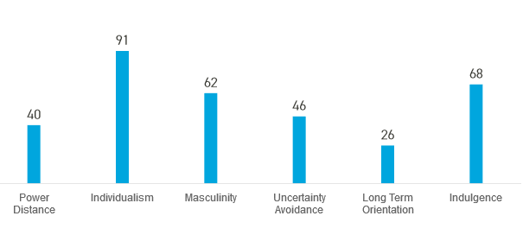
HOFSTEDE DIVERSITY DIMENSIONS:
Individualism: the degree of interdependence a society maintains among its members.
China: 20
act in the interests of the group
In-group considerations affect hiring and promotions
closer in-groups (such as family) receive preferential treatment
Employee commitment to the organization (but not necessarily to the people in the organization) is low.
cold or even hostile to out-groups
Personal relationships prevail over task and company.
India: 48 (both collectivistic and Individualist traits)
C: a high preference for belonging to a larger social framework
C: act on behalf of the greater good
C:Rejection by peers causes a sense of intense emptiness
C: Employment decisions are often based on relationships
I: a result of its dominant religion/philosophy – Hinduism.
I: People are individually responsible for the way they lead their lives
U.S.: 91
hierarchy is established for convenience
hiring, promotion and decisions are based on merit or evidence of what one has done or can do
people look after themselves and their immediate families
should not rely (too much) on authorities for support
not shy about approaching their prospective counterparts in order to obtain or seek information

Slide 33
DEBRIEFING PRACTICE
Pair up. One of you play the role of instructor and debrief the other. You’ll get a chance to switch roles later today.
What did you/we learn?
What if?
What are some other ways this activity could be debriefed? What other intercultural competence could be focused on?
What complications could arise from such an activity? How could these be mitigated?
How does this relate to the real world (your teaching)?
What next? What might you do differently?

Slide 34
ACTIVITY 2

Slide 35
TOOLS FOR STIMULATING DIALOGUE
Minature Metaphors
Pick-a-Postcard
Chiji Processing Dice
Let’s try it!

Slide 36
MINIATURE METAPHORS
Element of Worldview Frameworks:
History
Values
Politics
Communication styles
Economy
Beliefs
Practices
Select a “metaphor” that elicits a connection to one of the above elements
Be prepared to share
After each person shares, ask questions about the association or element chosen.
Notes:
After each person shares, ask questions about the association or element chosen.

Slide 37
DEBRIEFING PRACTICE
Pair up in your original partnerships. Switch roles so that the second person has a chance to play the debriefer.
How do you feel?
What happened?
What did you/we learn?
How does this relate to the real world (your teaching)?
What if?
What next?
Notes:
37

Slide 38
HOMEWORK

Slide 39
WORKSHOP #2 HOMEWORK
Reflection on Mediated Dialogue Prompts (clips from Crossing Borders Education films)
Intercultural assessment plan for your study abroad program
Upload both assignments to Blackboard in the appropriate Assignment Submission box.

Slide 40
QUESTIONS & COMMENTS
The AAC&U Intercultural Knowledge and Competence VALUE Rubric?
Curiosity activities
Worldview activities

Slide 41
THANK YOU
Contact info: dcjones@purdue.edu

