Slide 1

The Good, the Bad and the Ugly of Empathy
An interactive intercultural learning workshop facilitated by
Annette Benson
Senior Public Relations Consultant & HubICL Manager

Slide 2

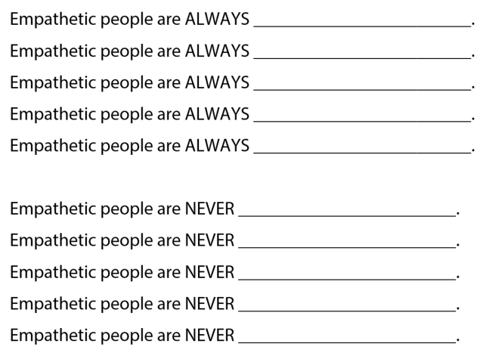
ALWAYS & NEVER
Thiagarajan, S. & van den Bergh, S. (2017). Always and Never. Interactive templates for intercultural training. Bloomington, IN: Workshops by Thiagi, Inc., pp. 82-86. Retrieved from https://hubicl.org/toolbox/tools/128/objectives

Slide 3

“According to a 2009 study, American college students believe themselves to be less empathetic than previous generations. Taken over a period of time spanning three decades (1979-2009), the study surveyed a total of 13,737 college students about their perceived tendencies toward empathy and social concern.
“Dr. Sara Konrath, Assistant Professor at the Lilly Family School of Philanthropy at Indiana University and one of the authors of the 2009 study, spoke with BTR to discuss its findings.
“’What’s interesting is that [our study] didn’t look at the attitudes of previous generations toward college students, but actually surveyed the beliefs of college students themselves,’ Konrath explains. ‘When asked about some core empathy traits, we tended to see responses such as, “I don’t think about others when they’re in need, when someone is suffering it doesn’t move me,” and so on.’
Gentzel, T. (2015, October 27). Lifestyle: Do Millennials Lack Empathy? BTRtoday. Retrieved from http://www.btrtoday.com/read/lifeandtimes/misc-lifeandtimes/tuesday-life-times-70/

Slide 4
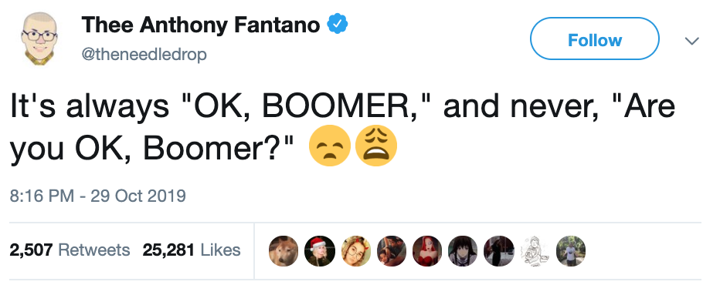

Slide 5

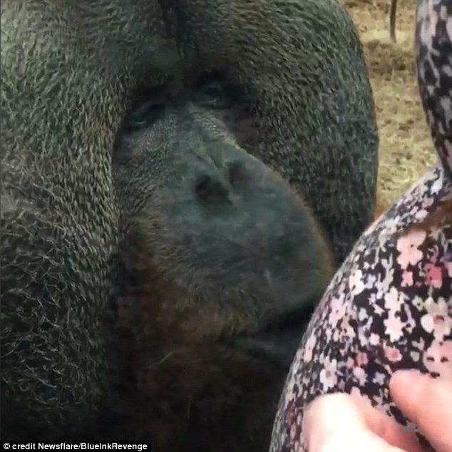
Definition of empathy
How do you define empathy?
https://www.dailymail.co.uk/news/article-3891088/The-orangutan-loves-pregnant-women-Rajang-filmed-kissing-baby-bump-glass-Colchester-Zoo-just-month-melting-hearts-similar-kiss.html

Slide 6
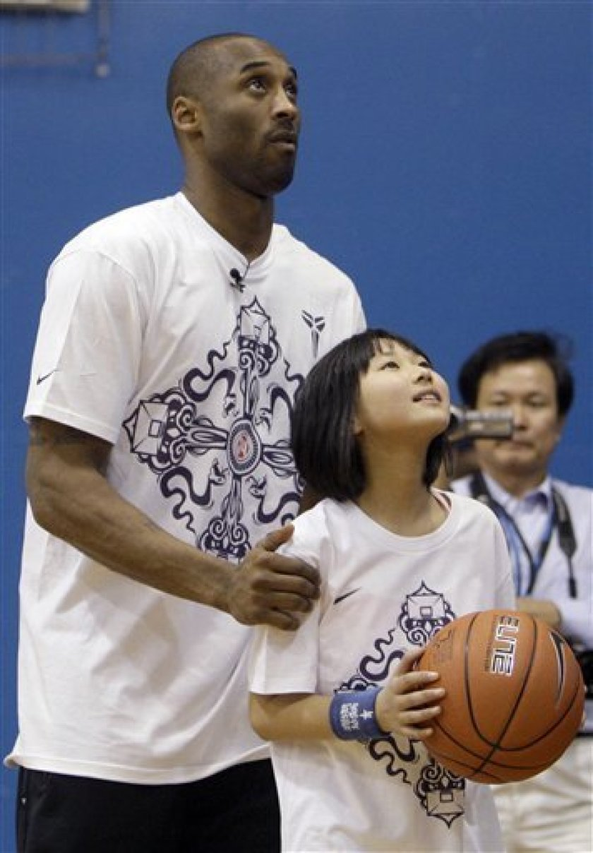
Definition of empathy
How do you define intercultural empathy?
https://www.sandiegouniontribune.com/sdut-bryant-promotes-chinese-in-calif-self-in-china-2011feb01-story.html

Slide 7

VALUE Rubric Definition of Intercultural Empathy
Benchmark (1): Views the experience of others but does so through own cultural worldview.
Milestone (2): Identifies components of other cultural perspectives but responds in all situations with own worldview.
Milestone (3): Recognizes intellectual and emotional dimensions of more than one worldview and sometimes uses more than one worldview in interactions.
Capstone (4): Interprets intercultural experience from the perspectives of own and more than one worldview and demonstrates ability to act in a supportive manner that recognizes the feelings of another cultural group.
https://www.aacu.org/value/rubrics/intercultural-knowledge

Slide 8
Intercultural Knowledge and Competence VALUE Rubric for more information, please contact value@aacu.org
The VALUE rubrics were developed by teams of faculty experts representing colleges and universities across the United States through a process that examined many existing campus rubrics and related documents for each learning outcome and incorporated additional feedback from faculty. The rubrics articulate fundamental criteria for each learning outcome, with performance descriptors demonstrating progressively more sophisticated levels of attainment. The rubrics are intended for institutional-level use in evaluating and discussing student learning, not for grading. The core expectations articulated in all 15 of the VALUE rubrics can and should be translated into the language of individual campuses, disciplines, and even courses. The utility of the VALUE rubrics is to position learning at all undergraduate levels within a basic framework of expectations such that evidence of learning can by shared nationally through a common dialog and understanding of student success.
Definition
Intercultural Knowledge and Competence is "a set of cognitive, affective, and behavioral skills and characteristics that support effective and appropriate interaction in a variety of cultural contexts.” (Bennett, J. M. 2008. Transformative training: Designing programs for culture learning. In Contemporary leadership and intercultural competence: Understanding and utilizing cultural diversity to build successful organizations, ed. M. A. Moodian, 95-110. Thousand Oaks, CA: Sage.)
Framing Language
The call to integrate intercultural knowledge and competence into the heart of education is an imperative born of seeing ourselves as members of a world community, knowing that we share the future with others. Beyond mere exposure to culturally different others, the campus community requires the capacity to: meaningfully engage those others, place social justice in historical and political context, and put culture at the core of transformative learning. The intercultural knowledge and competence rubric suggests a systematic way to measure our capacity to identify our own cultural patterns, compare and contrast them with others, and adapt empathically and flexibly to unfamiliar ways of being.
The levels of this rubric are informed in part by M. Bennett's Developmental Model of Intercultural Sensitivity (Bennett, M.J. 1993. Towards ethnorelativism: A developmental model of intercultural sensitity. In Education for the intercultural experience, ed. R. M. Paige, 22-71. Yarmouth, ME: Intercultural Press). In addition, the criteria in this rubric are informed in part by D.K. Deardorff's intercultural framework which is the first research-based consensus model of intercultural competence (Deardorff, D.K. 2006. The identification and assessment of intercultural competence as a student outcome of internationalization. Journal of Studies in International Education 10(3): 241-266). It is also important to understand that intercultural knowledge and competence is more complex than what is reflected in this rubric. This rubric identifies six of the key components of intercultural knowledge and competence, but there are other components as identified in the Deardorff model and in other research.
Glossary
The definitions that follow were developed to clarify terms and concepts used in this rubric only.
Culture: All knowledge and values shared by a group.
Cultural rules and biases: Boundaries within which an individual operates in order to feel a sense of belonging to a society or group, based on the values shared by that society or group.
Empathy: "Empathy is the imaginary participation in another person’s experience, including emotional and intellectual dimensions, by imagining his or her perspective (not by assuming the person’s position)". Bennett, J. 1998. Transition shock: Putting culture shock in perspective. In Basic concepts of intercultural communication, ed. M. Bennett, 215-224. Yarmouth, ME: Intercultural Press.
Intercultural experience: The experience of an interaction with an individual or groups of people whose culture is different from your own.
Intercultural/cultural differences: The differences in rules, behaviors, communication and biases, based on cultural values that are different from one's own culture.
Suspends judgment in valuing their interactions with culturally different others: Postpones assessment or evaluation (positive or negative) of interactions with people culturally different from one self. Disconnecting from the process of automatic judgment and taking time to reflect on possibly multiple meanings.
Worldview: Worldview is the cognitive and affective lens through which people construe their experiences and make sense of the world around them.

Slide 9
3 Definitions of empathy from research
  Emotional empathy: the ability to feel what another person feels (what most people think of when they think of empathy)
  Cognitive empathy: the ability to understand how a person may feel in a particular situation
  Empathic concern: Perspective-taking which elicits some sort of caring or compassionate response
Tullmann, K. (2019). Empathy, power, and social difference. The Journal of Value Inquiry, 1-23. https://doi.org/10.1007/s10790-019-09691-8
Watt, D.F. (2005). Social bonds and the nature of empathy. Journal of Consciousness Studies, 12, 185-209.
Watt, D.F. (2014). Toward a neuroscience of empathy: Integrating affective and cognitive perspectives. Neuropsychoanalysis, 9(2), 119-140. DOI: 10.1080/15294145.2007.10773550
Alda, A. (Host) (2019, December 17). Jamil Zaki on empathy and how to hack it [Audio podcast episode]. In Clear+vivid. Alda Communication Training. https://www.aldacommunicationtraining.com/podcast/jamil-zaki-empathy-hack/

Slide 10
Today, class, we are going to work on the skill of intercultural empathy…
What is it exactly that we are going to work on?
  3 Research Definitions
  Emotional empathy: the ability to feel what another person feels (what most people think of when they think of empathy)
  Cognitive empathy: the ability to understand how a person may feel in a particular situation
  Empathic concern: Perspective-taking which elicits some sort of caring or compassionate response
AAC&U VALUE Rubric
Benchmark (1): Views the experience of others but does so through own cultural worldview.
Milestone (2): Identifies components of other cultural perspectives but responds in all situations with own worldview.
Milestone (3): Recognizes intellectual and emotional dimensions of more than one worldview and sometimes uses more than one worldview in interactions.
Capstone (4): Interprets intercultural experience from the perspectives of own and more than one worldview and demonstrates ability to act in a supportive manner that recognizes the feelings of another cultural group.
Janet Bennett’s definition:
"Empathy is the imaginary participation in another person’s experience, including emotional and intellectual dimensions, by imagining his or her perspective (not by assuming the person’s position)."

Slide 11
The Good, the Bad, and the Ugly of Empathy
The Bright, the Dark and the Darker Side of Empathy
Against Empathy: The Case for Rational Compassion by Paul Bloom (2016)
The darker side of empathy
Examples of empathy that is bad
Examples of empathy that can cause ugliness
Examples of empathy that is good
The dark side of empathy
The bright side of empathy

Slide 12
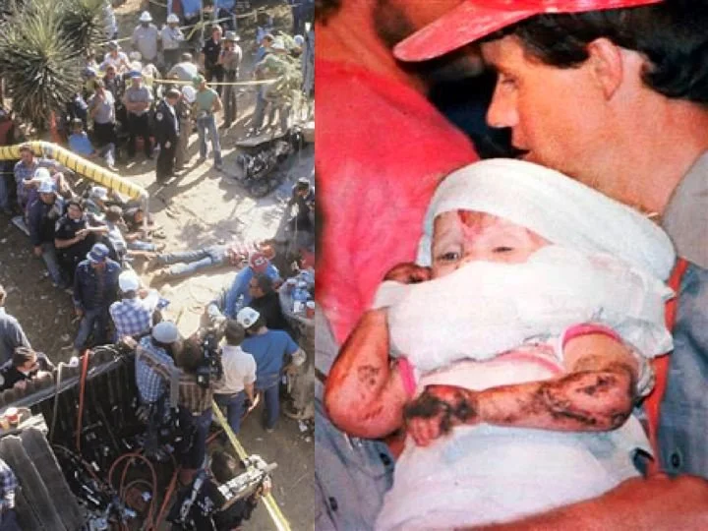
1987 Aegean crisis
1987 Tunisian coup d'état
Anfal genocide
Aouzou, Chad
Battle of Arghandab (1987)
Battle of Aouzou
Battle of Maaten al-Sarra
Battles of Farsia and Oum Dreyga (1987)
Brașov rebellion
Bridgeton incident
1987 Burkinabé coup d'état
1987 Burundian coup d'état
Cambodian–Vietnamese War
Communist insurgency in Malaysia (1968–1989)
Communist insurgency in Sarawak
Battle of Cuito Cuanavale
Operation Earnest Will
Battle of B'ir Kora
Battle of Fada
1987 Fijian coups d'état
Operation Firewood
Gukurahundi
Indian intervention in the Sri Lankan Civil War
Jaffna University Helidrop
Battle of Jaji
Operation Moduler
Night of the Gliders
Operation Nimble Archer
Operation Pawan
Operation Prime Chance
Operation Rajiv
1987 Republic of the Congo coup d'état attempt
1987 Sino-Indian skirmish
Somali Rebellion
Surinamese Interior War
Thai–Laotian Border War
USS Stark incident
War of the Camps
Yama–Ichi War
In 1987, Jessica McClure Morales, aged 18 months, fell down an 18 inch well in her backyard in Midland, Texas, getting stuck 22 feet down. It took 58 hours for rescue workers to successfully get her out.

Slide 13






Slide 14
The Bright, the Dark and the Darker Side of Empathy
Assault
Assailant of a certain people group
Revenge
Empathy
Our own ego
Projection of our own feelings onto someone else
+ Power
“I choose to empathize.”
Empathy
Oppressor
Oppressed

Slide 15
3 Definitions of empathy from research
  Emotional empathy: the ability to feel what another person feels (what most people think of when they think of empathy)
  Cognitive empathy: the ability to understand how a person may feel in a particular situation
  Empathic concern: Perspective-taking which elicits some sort of caring or compassionate response
Tullmann, K. (2019). Empathy, power, and social difference. The Journal of Value Inquiry, 1-23. https://doi.org/10.1007/s10790-019-09691-8
Watt, D.F. (2005). Social bonds and the nature of empathy. Journal of Consciousness Studies, 12, 185-209.
Watt, D.F. (2014). Toward a neuroscience of empathy: Integrating affective and cognitive perspectives. Neuropsychoanalysis, 9(2), 119-140. DOI: 10.1080/15294145.2007.10773550
Alda, A. (Host) (2019, December 17). Jamil Zaki on empathy and how to hack it [Audio podcast episode]. In Clear+vivid. Alda Communication Training. https://www.aldacommunicationtraining.com/podcast/jamil-zaki-empathy-hack/

Slide 16
Recommendations from the Research
Emotional empathy
Cognitive empathy
Empathic Concern/
Perspective Taking
Tucker, H. (2016). Empathy and tourism: Limits and possibilities. Annals of Tourism Research, 57, 31-43. http://dx.doi.org/10.1016/j.annals.2015.12.0010160-7383
  Promotes an "unsettled empathy"
  The empathizer recognizes the experience of others, but does not try to conflate it with their own.
  This allows the empathizer to be more reflective about their privilege in the situation and allow them to feel what the author calls "a productive sense of shame."

Slide 17
Recommendations from the Research
Emotional empathy
Cognitive empathy
Empathic Concern/
Perspective Taking
Tullmann, K. (2019). Empathy, power, and social difference. The Journal of Value Inquiry, 1-23. https://doi.org/10.1007/s10790-019-09691-8
  Cites Iris Marion Young’s concepts of asymmetrical relationships and moral communication: The empathizer recognizes the experience of others, but does not try to conflate it with their own.
  “…the goal is not to reverse perspective with the target, but rather to recognize and embrace the different perspectives that every subject brings to bear in moral communication” (20)
  “The idea is that subjects who seek to understand others should, ideally, be aware of their own social perspective and relationship to the target they attempt to understand” (21).

Slide 18
Recommendations from the Research
Emotional empathy
Cognitive empathy
Empathic Concern/
Perspective Taking
Lanzoni, S. (2019, February 22). Why empathy is the key to dismantling white racism. The Washington Post. https://www.washingtonpost.com/outlook/2019/02/22/why-empathy-is-key-dismantling-white-racism/
  Empathy in the visceral [from instinct rather than intellect] sense may be parochial [limited in scope]
  With “self-examination” empathy can foster “empathic reason,” which is the ability of people to “transcend the barriers of their own minds,” understand others, and thereby come to the rational conclusion that every person deserves equal rights.

Slide 19
Recommendations from the Research
Emotional empathy
Cognitive empathy
Empathic Concern/
Perspective Taking
Bruneau, E.G., & Saxe, R. (2012). The power of being heard: The benefits of ‘perspective-giving’ in the context of intergroup conflict. Journal of Experimental Social Psychology, 48, 855-866. DOI:10.1016/j.jesp.2012.02.017
  In terms of inter-group dialogue,
  Members of the dominant group benefitted from perspective-taking (actively listening to the non-dominant group and showing that that they understood them)
  Members of the non-dominant group benefitted from perspective-giving (being able to talk about and share their issues and feeling as though they have been heard and understood). The only thing that the non-dominant group members needed to hear in order to know that they were understood was what they said repeated back to them.

Slide 20
Recommendations from the Research
Emotional empathy
Cognitive empathy
Empathic Concern/
Perspective Taking
Gleichgerrcht, E. & Decety, J. (2013). Empathy in clinical practice: How individual dispositions, gender, and experience moderate empathic concern, burnout, and emotional distress. PLos ONE, 8(4), e61526. doi:10.1371/journal.pone.0061526
  Perspective-taking can help to mitigate burnout/emotional exhaustion associated with empathy because it is “the ability to infer others’ thoughts and feelings while understanding that they may differ from an individual’s own.”
  You will feel less distressed if you are able to understand another’s feelings/experiences while acknowledging that your own feelings/experiences are different.

Slide 21
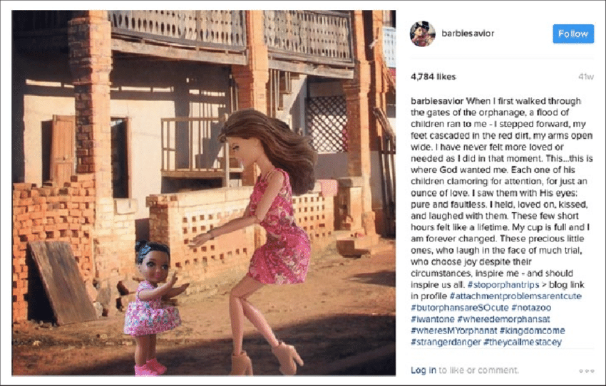
When I first walked through the gates of the orphanage, a flood of children ran to me—I stepped forward, my feet cascaded in the red dirt, my arms open wide. I have never felt more loved or needed as I did in that moment. This…this is where God wanted me. Each one of his children clamoring for attention, for just an ounce of love. I saw them with His eyes: pure and faultless. I held, loved on, kissed, and laughed with them. These few short hours felt like a lifetime. My cup is full and I am forever changed. These precious little ones, who laugh in the face of much trial, who choose joy despite their circumstances, inspire me—and should inspire us all.
#stoporphantrips #attachmentproblemsarentcute #butorphansareSOcute #notazoo #iwantone #wheredemorphansat #wheresMYorphanat #kingdomcome #strangerdanger #theycallmestacey

Slide 22

Resources for Facilitating Empathy Conversations
Disagree Better: Empathy Gym Lindsey Macdonald
Empathy and Fiction Lindsey Macdonald and Annette Benson
Empathy for Those We Hate Annette Benson and Dr. Brittany Biesiada
Flower's Point of View, A Dr. Aletha Stahl
Identity-based Rejection Sensitivity Dr. Kris Acheson-Clair
Limits of Empathy, The Lindsey Macdonald and Annette Benson
Music and Memories Katherine Yngve
Scenery, Machinery, People Dr. Kris Acheson-Clair
Self-Care 101 Dr. Michelle Campbell
Tribalism and Empathy Lindsey Macdonald and Annette Benson

Slide 23
Round Robin
Find the people in the room who have the same color of paper that you do and meet as a group.
Make sure that everyone understands the basics of how to lead a particular conversation well enough to explain it to someone else.
When Annette rings the bell, find someone who has a different color than you do. Introduce yourself to your new partner.
When the bell rings a second time, discuss what is on your paper with your partner.
When the bell rings a third time, discuss what is on your partner’s paper.
Repeat steps 3-6.
Questions for Discussion
Is there a particular group that you think your tool would work particularly well with?
Is there a group that you would not use your tool with?
How much challenge does your tool present/support does your tool require?
Is their something in your own repertoire of tools that you would use before or after this tool?
How would you debrief your tool?

Slide 24
We’d love to have your reviews!
Disagree Better: Empathy Gym https://hubicl.org/toolbox/tools/489/reviews
Empathy and Fiction https://hubicl.org/toolbox/tools/504/reviews
Empathy for Those We Hate https://hubicl.org/toolbox/tools/358/reviews
Flower's Point of View, A https://hubicl.org/toolbox/tools/270/reviews
Identity-based Rejection Sensitivity https://hubicl.org/toolbox/tools/471/reviews
Limits of Empathy, The https://hubicl.org/toolbox/tools/506/reviews
Music and Memories https://hubicl.org/toolbox/tools/149/reviews
Scenery, Machinery, People https://hubicl.org/toolbox/tools/109/reviews
Self-Care 101 https://hubicl.org/toolbox/tools/244/reviews
Tribalism and Empathy https://hubicl.org/toolbox/tools/362/reviews

Slide 25
We would love to have your original or adapted intercultural learning tools in the Intercultural Learning Hub (HubICL)!
https://hubicl.org/toolbox/tools/new

Slide 26
To learn more…
Empathy: The good, the bad and the ugly
https://hubicl.org/members/1005/collections/empathy-the-good-the-bad-and-the-ugly
Empathy: It’s Complicated
https://hubicl.org/members/1413/collections/empathy-its-complicated
The Shadow Side of Empathy
https://hubicl.org/members/1099/collections/the-shadow-side-of-empathy
Tools for Teaching Empathy
https://hubicl.org/members/1005/collections/tools-for-teaching-empathy
Building the Skill of Empathy for the Excluded
https://hubicl.org/members/1005/collections/building-the-skill-of-empathy-for-the-excluded
Building the Skill of Empathy for Language Learners
https://hubicl.org/members/1005/collections/building-the-skill-of-empathy-for-language-learners
Empathy on the path toward justice, depolarization, grace
https://hubicl.org/members/1099/collections/empathy-on-the-path-toward-justice-depolarization-grace

Slide 27

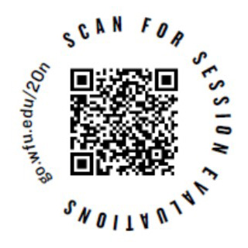
The Good, the Bad and the Ugly of Empathy
An interactive intercultural learning workshop facilitated by
Annette Benson
Senior Public Relations Consultant & HubICL Manager
Center for Intercultural Learning, Mentorship, Assessment and Research
abenson@purdue.edu
cilmar@purdue.edu
www.purdue.edu/ippu/cilmar/
hubicl.org
facebook.com/PurdueCILMAR
Please evaluate this session at

