Slide 1

Best Practices in Creating Your Own Intercultural Learning Tools
WISE Pre-Conference Workshop
February 12, 2020
Annette Benson
Senior Public Relations Consultant
Manager of the Intercultural Learning Hub
Kris Acheson-Clair, PhD
Director, Center for Intercultural Learning, Mentorship, Assessment and Research
Notes:
Annette and Kris

Slide 2

Best practices in creating
your own intercultural learning tools
Artifacts of Learning
Learning Outcomes
Backward Design
Debriefing
Stage-Based Pedagogy
Adapting Tools to Context
Creating Original Tools
Notes:
Annette

Slide 3
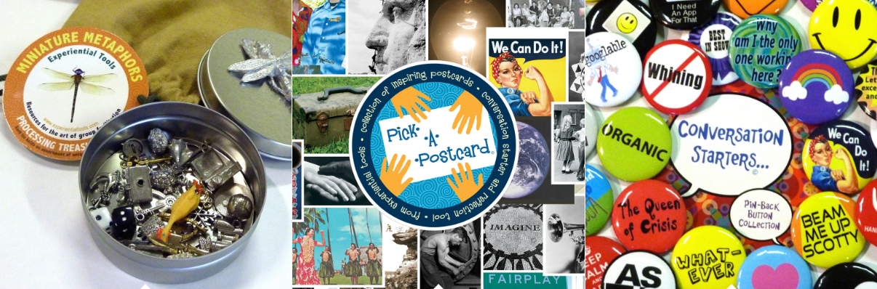
Let’s get started!
Miniature Metaphors
https://hubicl.org/toolbox/tools/141/
Pick-A-Postcard
https://hubicl.org/toolbox/tools/142/
Conversation Starters (Buttons)
https://hubicl.org/toolbox/tools/143/
https://experientialtools.com/collections/teaching-facilitation-tools
Notes:
Annette

Slide 4
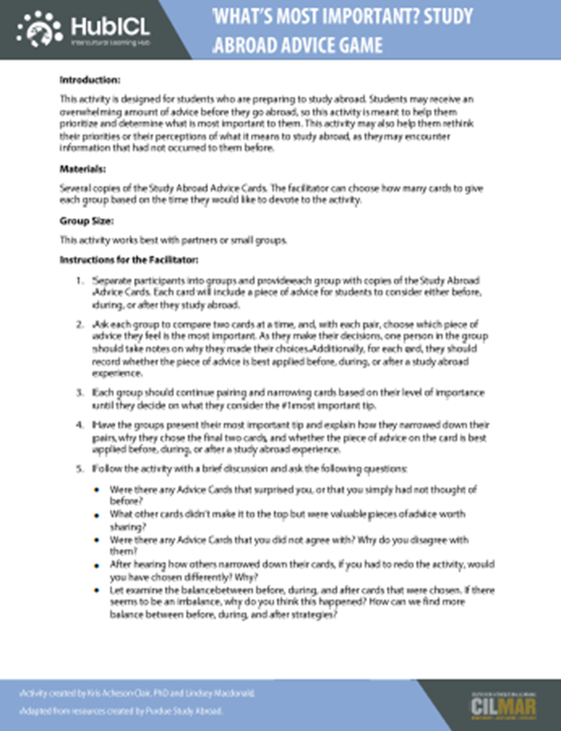
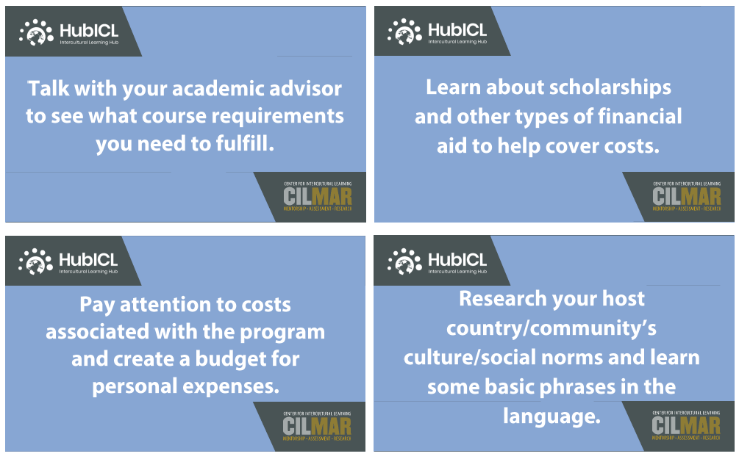
Study Abroad Advice Card Game
hubicl.org/toolbox/tools/482/
Notes:
Kris

Slide 5

Best Practice 1
Artifacts of Learning
Notes:
Annette

Slide 6
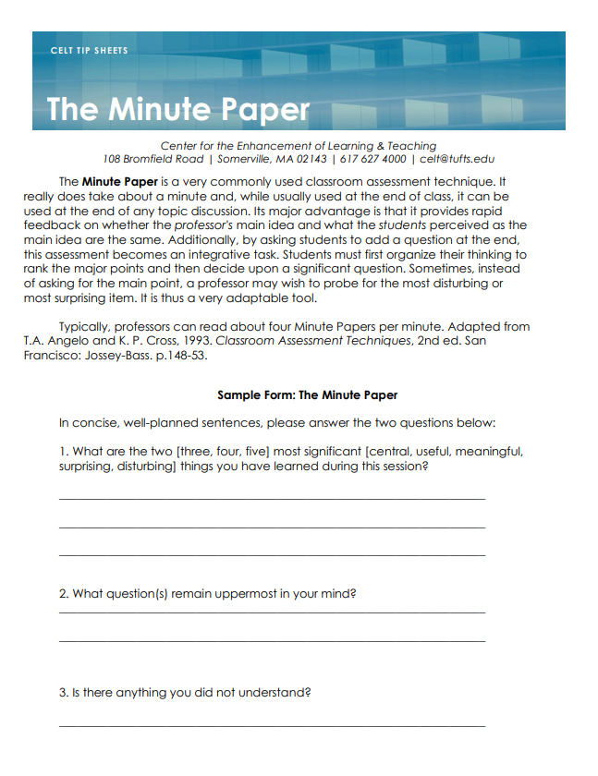
The Minute Paper
https://provost.tufts.edu/celt/files/MinutePaper.pdf
hubicl.org/toolbox/tools/53/
Notes:
Annette

Slide 7
Best Practice 2
Learning Outcomes
Notes:
Kris

Slide 8
Bloom’s Taxonomy
Evaluation
Synthesis
Analysis
Cognitive
Application
Psychomotor
Comprehension
Evaluation
Knowledge
Evaluation
Affective
Synthesis
Synthesis
Analysis
Analysis
Application
Application
Comprehension
Comprehension
Knowledge
Knowledge
Notes:
Kris

Slide 9
Bloom’s Taxonomy of Action Verbs—What do you want the student to be able to do?
Definitions | Knowledge | Comprehension | Application | Analysis | Synthesis | Evaluation
Bloom’s Definition | Remember previously learned information | Demonstrate an understanding of the facts | Apply knowledge to actual situations | Break down objects or ideas into simpler parts and find evidence to support generalizations | Compile component ideas into a new whole or propose alternative solutions | Make and defend judgments based on internal evidence or external criteria
Verbs | Arrange | Classify | Apply | Analyze | Arrange | Appraise
 | Define | Convert | Change | Appraise | Assemble | Argue
 | Describe | Defend | Choose | Breakdown | Categorize | Assess
 | Duplicate | Describe | Compute | Calculate | Collect | Attach
 | Identify | Discuss | Demonstrate | Categorize | Combine | Choose
 | Label | Distinguish | Discover | Compare | Comply | Compare
 | List | Estimate | Dramatize | Contrast | Compose | Conclude
 | Match | Explain | Employ | Criticize | Construct | Contrast
 | Memorize | Express | Illustrate | Diagram | Create | Defend
 | Name | Extend | Interpret | Differentiate | Design | Describe
https://www.utica.edu/academic/Assessment/new/Blooms%20Taxonomy%20-%20Best.pdf
Notes:
Kris

Slide 10
Best Practice 3
Backward Design
Notes:
Kris

Slide 11
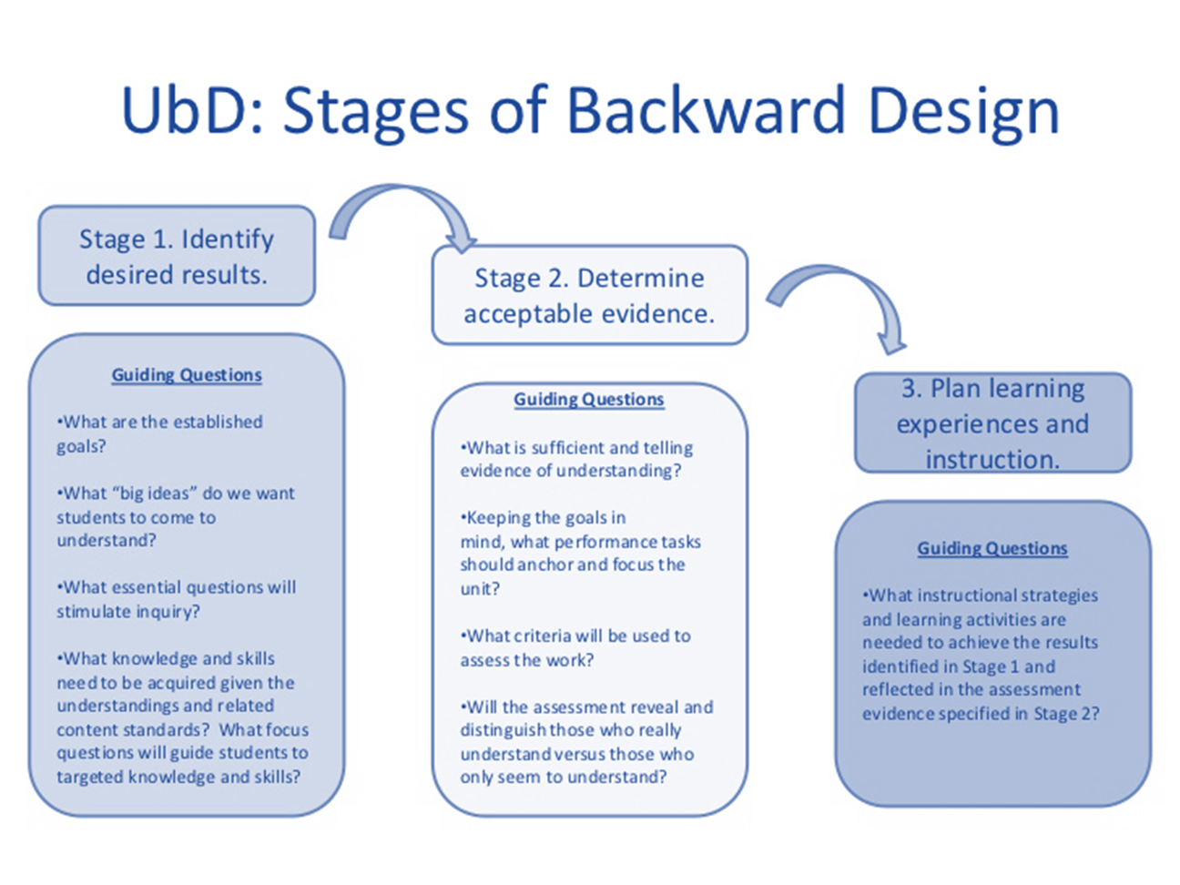

Slide 12
AAC&U VALUE Rubric for Intercultural Knowledge and Competence
 | Developing | Emerging | Proficient
Knowledge Cultural self- awareness | Identifies own cultural rules and biases (e.g. with a strong preference for those rules shared with own cultural group and seeks the same in others.) | Recognizes new perspectives about own cultural rules and biases (e.g. not looking for sameness; comfortable with the complexities that new perspectives offer.) | Articulates insights into own cultural rules and biases (e.g. seeking complexity; aware of how her/his experiences have shaped these rules, and how to recognize and respond to cultural biases, resulting in a shift in self-description.)
Knowledge Cultural worldview frameworks | Demonstrates partial understanding of the complexity of elements important to members of another culture in relation to its history, values, politics, communication styles, economy, or beliefs and practices. | Demonstrates adequate understanding of the complexity of elements important to members of another culture in relation to its history, values, politics, communication styles, economy, or beliefs and practices. | Demonstrates sophisticated understanding of the complexity of elements important to members of another culture in relation to its history, values, politics, communication styles, economy, or beliefs and practices.
Skill Empathy | Identifies components of other cultural perspectives but responds in all situations with own worldview. | Recognizes intellectual and emotional dimensions of more than one worldview and sometimes uses more than one worldview in interactions. | Interprets intercultural experience from the perspectives of own and more than one worldview and demonstrates ability to act in a supportive manner that recognizes the feelings of another cultural group.
Skill Verbal & Nonverbal Communication | Identifies some cultural differences in verbal and nonverbal communication and is aware that misunderstandings can occur based on those differences but is still unable to negotiate a shared understanding. | Recognizes and participates in cultural differences in verbal and nonverbal communication and begins to negotiate a shared understanding based on those differences. | Articulates a complex understanding of cultural differences in verbal and nonverbal communication (e.g., demonstrates understanding of the degree to which people use physical contact while communicating in different cultures or use direct/indirect and explicit/implicit meanings) and is able to skillfully negotiate a shared understanding based on those differences.
Attitude Curiosity | Asks simple or surface questions about other cultures. | Asks deeper questions about other cultures and seeks out answers to these questions. | Asks complex questions about other cultures, seeks out and articulates answers to these questions that reflect multiple cultural perspectives.
Attitude Openness | Expresses openness to most, if not all, interactions with culturally different others. Has difficulty suspending any judgment in her/his interactions with culturally different others, and is aware of own judgment and expresses a willingness to change. | Begins to initiate and develop interactions with culturally different others. Begins to suspend judgment in valuing her/his interactions with culturally different others. | Initiates and develops interactions with culturally different others. Suspends judgment in valuing her/his interactions with culturally different others.
Notes:
Kris

Slide 13


Jones, J. (2017, February 1). Scenery, machinery, people—Rethinking our view of humans. The Culture Blend.
http://www.thecultureblend.com/scenery-machinery-people-rethinking-our-view-of-humans/
Notes:
Annette

Slide 14
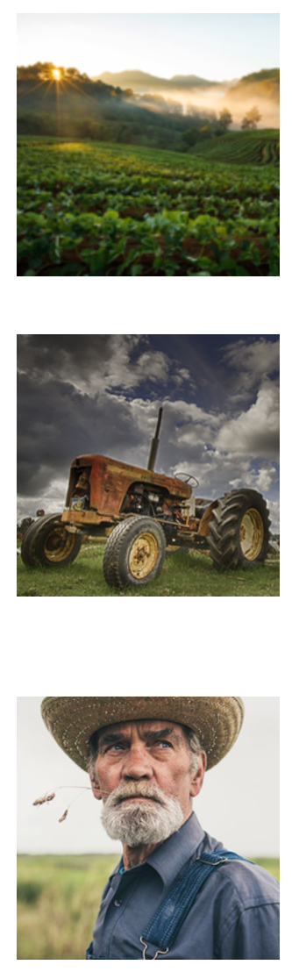
SCENERY encompassed everything off in the distance worth looking at and talking about. Mountains. Clouds. Trees. Fascinating things. Confusing things. Strange things. It might be fun to explore and makes for great conversation but doesn’t take priority in the day to day.
MACHINERY then, was everything that helped the farmer accomplish his goals and get his work done. Tractors. Horses. Pitchforks. Manure spreaders. It existed for the sole purpose of accommodating the farmer. Machine maintenance is hard work but worth it because the farmer’s life is better when the machines work well. When machinery is no longer helpful it get chucked onto the scrap pile.
PEOPLE were people. Family. Friends. Neighbors. Other farmers. Complex relationships that involve a give and take. Emotions are invested in all directions and the benefits along with the challenges are mutual (although not necessarily balanced). People are also high maintenance but less likely to be chucked onto the scrap pile because they hold intrinsic Value beyond what they offer to the farmer…and they keep off of the scrap pile.
Notes:
Annette

Slide 15
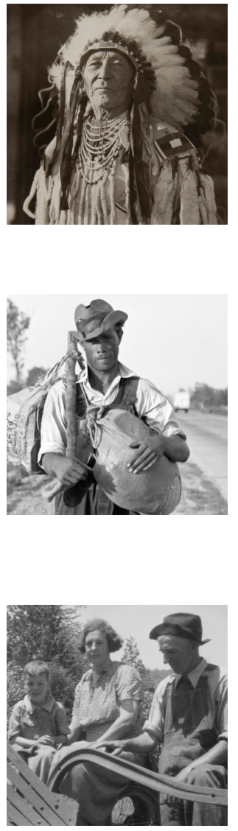
The Native Americans off in the distance with their strange clothes and confusing rituals were definitely worth talking about and absolutely fascinating to watch…but not so significant day to day.
They were scenery.
The hired help—the farm hands—the transient laborers were good to have around, especially if you got a strong one at a low wage. They were incredibly helpful…until they weren’t.
They were machinery.
The prime spot was reserved exclusively for those worth a relationship. Family, friends, neighbors and other farmers. Despite the fact that they were not the only humans in the picture they had a category all their own.
They were the only people.
Notes:
Annette

Slide 16
FOR WHOM ARE YOU…
?
FOR YOU, WHO ARE…
?
Acheson, K. (2017). Scenery, machinery, people. The HubICL. https://hubicl.org/toolbox/tools/109/objectives

Slide 17
Best Practice 4
Debriefing
Notes:
Debrief of Scenery, Machinery, People--Annette

Slide 18

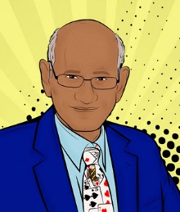
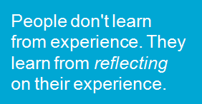
Thiagi Debrief
Question | Purpose
How Do You Feel? | Lets off Steam
What Happened? | Collect Data from Participants
What Did you Learn? | Generate Hypotheses or Principles
How Does This Relate to the Real World? | Encourage Application of Above to Meaningful Contexts
What If? | Create Alternative Scenarios
What Next? | Use Insights to Formulate Goals
Notes:
Thiagi debrief--Kris

Slide 19
Best Practice 5
Stage-Based Pedagogy
Notes:
Annette

Slide 21
Best Practice 6
Re-writing to meet audience needs
Notes:
Kris

Slide 22
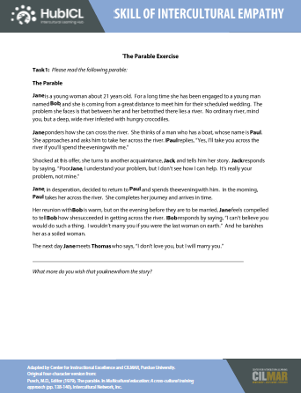
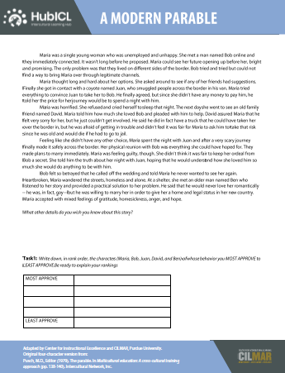
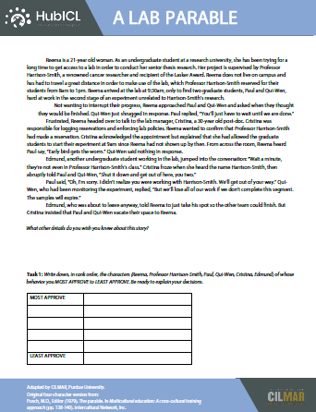
https://hubicl.org/toolbox/tools/71/downloads
Notes:
Kris

Slide 23
Now let’s try putting it all together!
https://hubicl.org/toolbox/tools/new
Notes:
Kris & Annette

