Slide 1
TECH 330
Week 1 – Class #2
January 16, 2018

Slide 2
TODAY - Please sit …….By Birth Month
Mar -Apr
Jan - Feb
May - Jun
Sep - Oct
HALL WAY AND ENTRY DOORS
Jul -Aug
Nov - Dec
TEACH PODIUM

Slide 3
January 16th Plans for Today
Where we left off….
  Levels Introduction
History of the World in less than 5 minutes
Complete Group Exercises
  Individual Culture / Hot Buttons
  5 minute AAAHHH HAAAHHHH briefing
Cox Factoid #2
Technology??
Our Global Foot Print
Next Week

Slide 4
Four core intercultural phases:
  Increasing Self-Awareness
  Increasing Awareness of Others
  Learning to Manage Emotions
  Learning to shift frames and adapt behavior
  Michael Vande Berg, PhD, © 2015

Slide 5
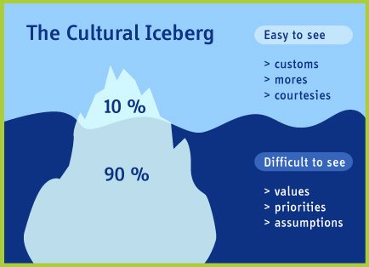
Culture is the shared assumptions, values, and beliefs of a group of people which result in characteristic behaviors. (Storti, 1999)

Slide 6
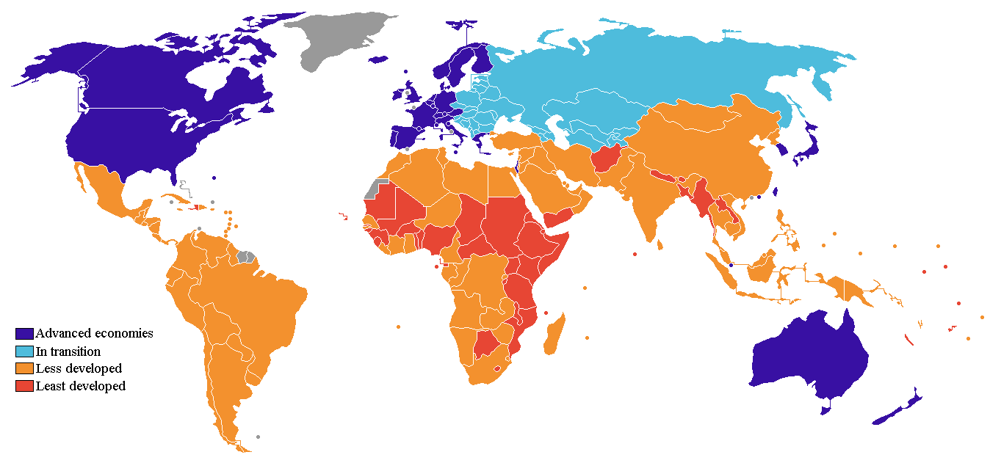
Economies
www.worldbank.org 2012

Slide 7
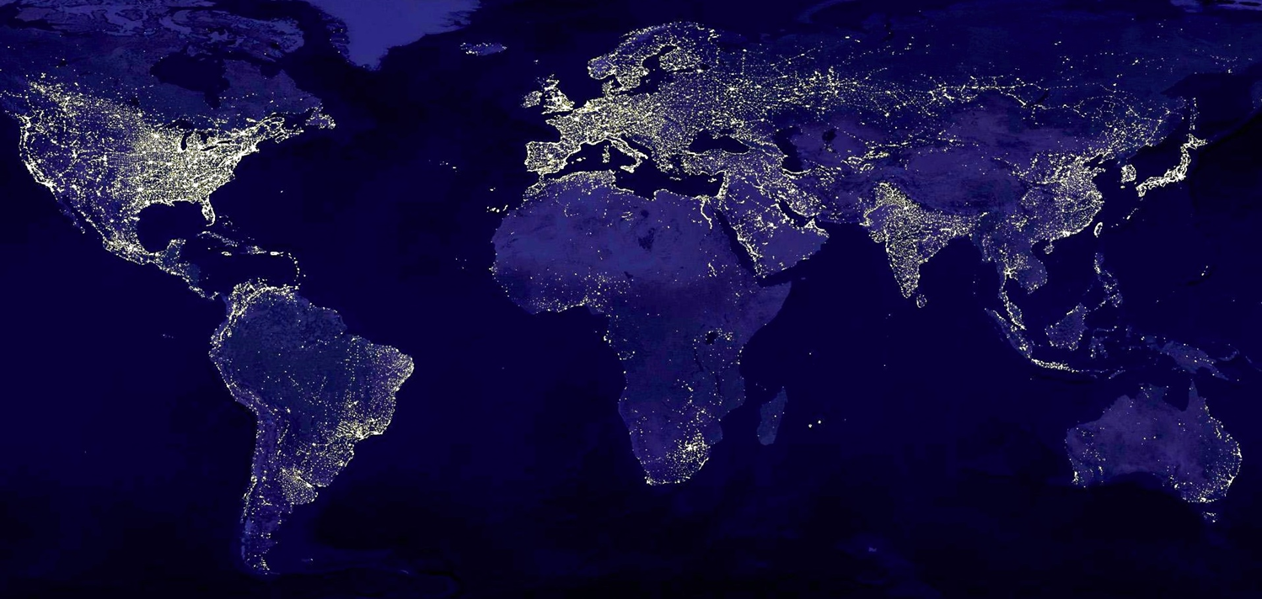
How does this picture reflect culture?

Slide 8
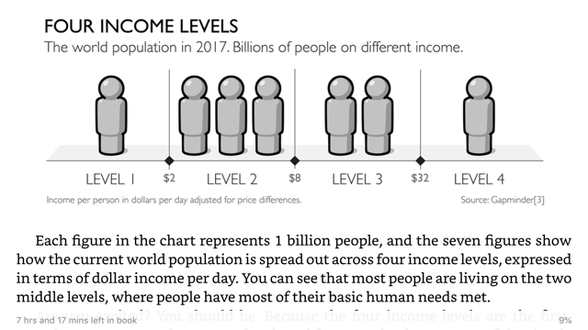

Slide 9
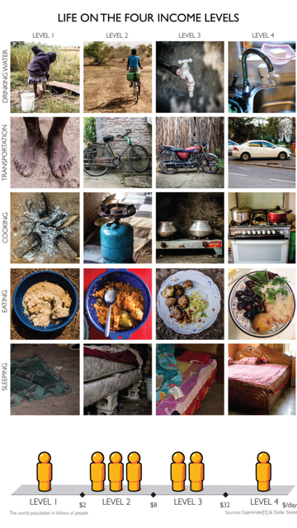
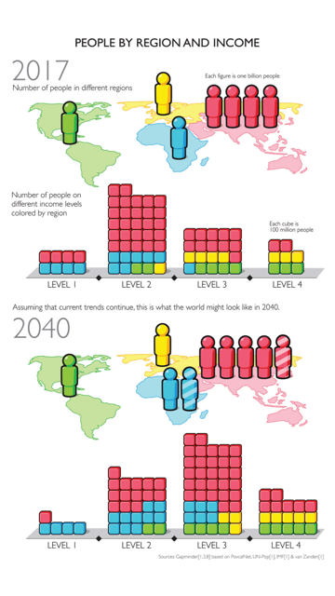

Slide 10
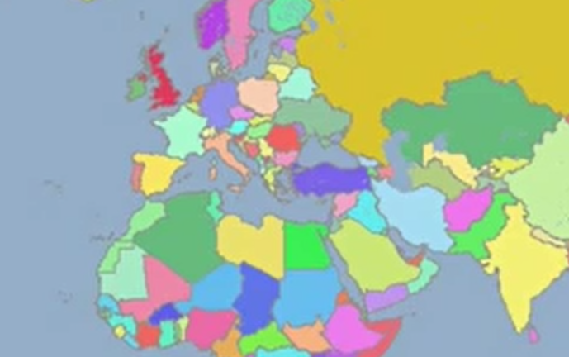
History
https://www.youtube.com/watch?v=ewd4l2rD2_U

Slide 11
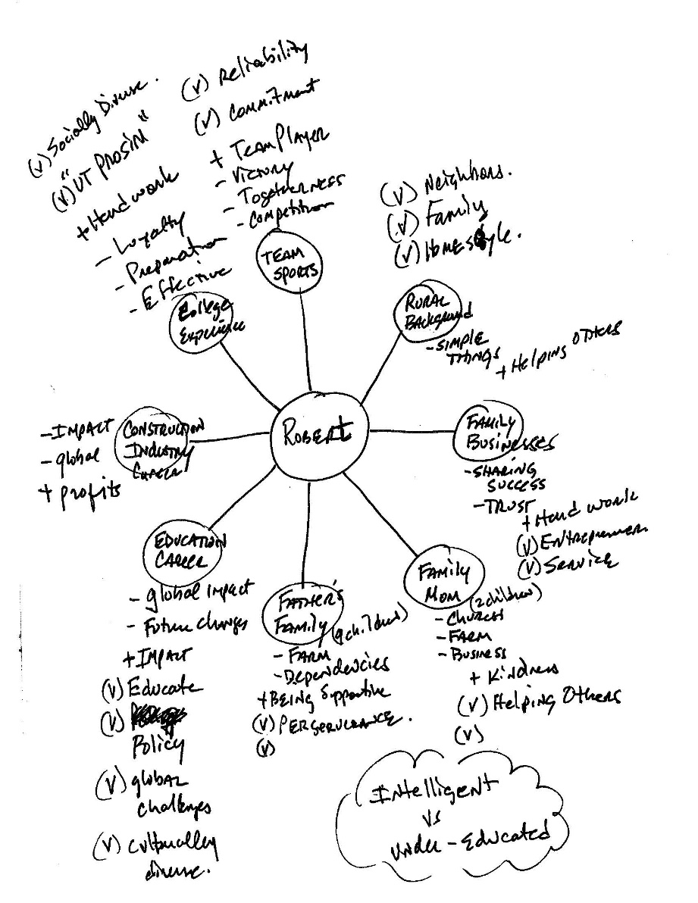
“Individual Culture
Exercise”

Slide 12
In your groups…
1) Introduce yourselves
2) Discuss individual culture and Hot Buttons exercise:
  Were there any surprises? Realizations?
3) Cultural “mind triggers” (Please note these on your paper)
  What Music reminds you of your home?
  What are your comfort foods? Do they remind you of home?

Slide 14
x
x
x
x

Slide 16
x
x
x
x

Slide 18
“Are these the sources of my Hot Buttons?”

Slide 19
Qualtrics Survey
Better understand our group’s Individual culture attributes….

Slide 20
Cultural Impacts on Operations
History – prohibited multinational team members
Gender Roles – women in the workforce
Etiquette – proper and accepted behaviors
Doing business – contracts and business practices
Language and communications – multiple languages
Ethnic Issues – accepted wardrobes and dress
Spirituality and Religion – work hours, prayer times, and team members
Economic Concerns – use of local currency requirements
Traditions – holidays, meals and work breaks
Education – capacity level of your workforce

Slide 21
Cultural “mind triggers”
Music
Food / smells
Architecture / arts
Clothing

Slide 22
Take 5 minutes and write down your AHHH HAHHH’s from Individual Cultures /Hot Buttons exercises
Please answer the following questions as quickly as you can and make sure to turn them in at the end of class.
What was your biggest surprise from the individual culture activity?
Did you find a lot of similarities among your group members?
Could you identify where your hot buttons might have originated? Why or why not?
Were there many common hot buttons among your group? What were they?
What was the BIGGEST AHHHH HHHHAAAAHHHH for you in completing this group activity?

Slide 23
Cox Factoid #2
Dr. Cox has three children…can you guess their gender and ages?

Slide 24
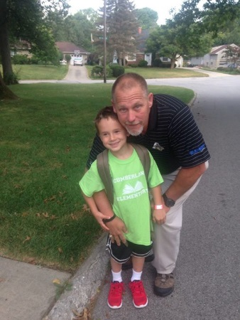
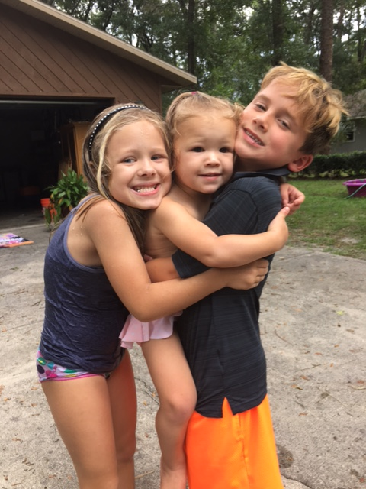
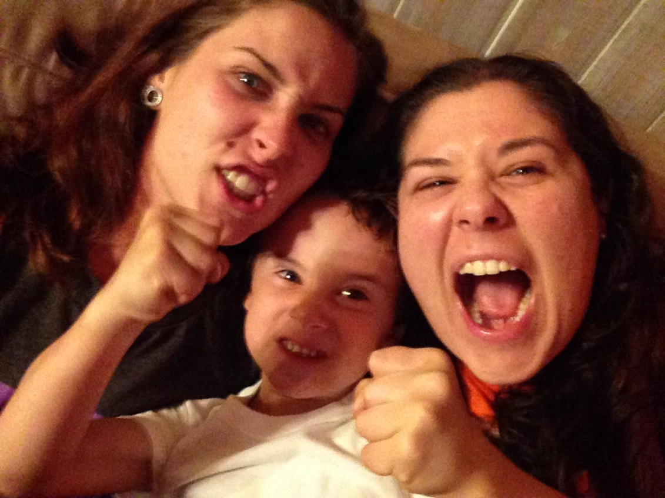
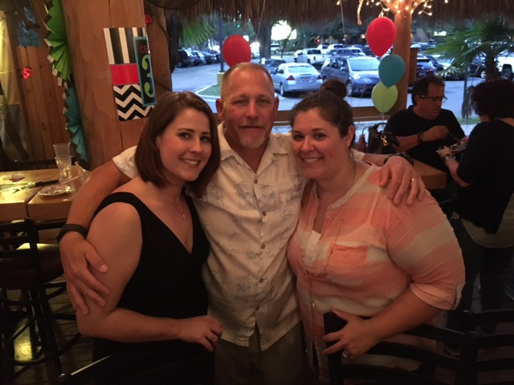
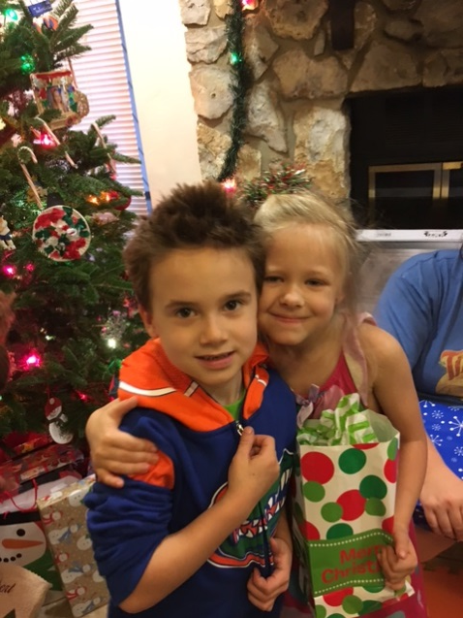
Dr. Cox has three children…
& 2 granddaughters (Evelyn 10 and Lydia 6)
Amber (34)
Sami (32)
Nash (10)

Slide 25
Four Core Intercultural Competencies:
  Increasing Self-Awareness
  Increasing Awareness of Others
  Learning to Manage Emotions
  Learning to shift frames and adapt behavior
  Michael Vande Berg, PhD, © 2015

Slide 26

Technology
http://youtu.be/e8SC6bny1SA
Cynthia L. Estlund, professor of law at the New York University School of Law, cited in a journal article McKinsey Global Institute researchers, who claim “73 percent of the time for which humans are now paid ... is spent in activities that could be automated with existing technology.”
DEEP DIVE8 global trends impacting higher ed By Shalina Chatlani, Published Jan. 24, 2018 https://www.educationdive.com/news/8-global-trends-impacting-higher-ed/515272/

Slide 27
Survey of 36 countries (n=20,000 over 18 yrs old)

Slide 29
INTERNET PRIVACY

Slide 30
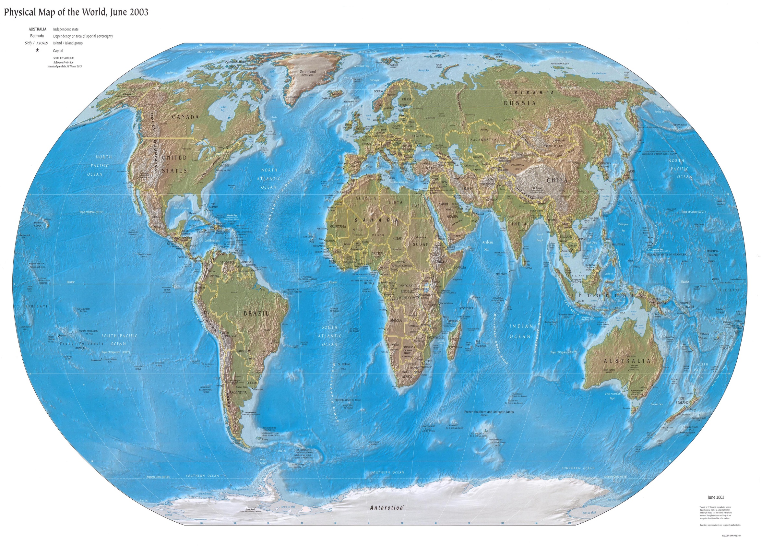


TECH 330 Global Footprint
http://www.lib.utexas.edu/maps/world.html

Slide 31
Dr. Cox’s Global Footprint
http://www.lib.utexas.edu/maps/world.html

Slide 32
QUIZ #1 launches TODAY at NOON
KEEP YOUR INDIVIDUAL CULTURES SHEET
Turn in the AHHH HAHHH from Individual Cultures and Hot Buttons exercises
Next Tuesday: Levels Activity and Worldwide Education
Complete HW#1 – In Week #2 folder
HAVE A GREAT WEEKEND! PLEASE BE SAFE!

Slide 33
Music and Culture
https://youtu.be/PGu6Xz3GofU

