Slide 1
Sept 3… start here!!

Slide 2
TODAY - Please sit …no more than 6 per table
MET
OLS
IET &
OLS
OLS
HALL WAY AND ENTRY DOORS
CGT &
OLS
ETTE &
OLS
OLS & BME
MET
TEACH PODIUM

Slide 3
September 3rd
- Today’s Activities:
Education Group Exercise
A young girls perspective on education
Shifting Frames ???
Cox Factoid…
LEVELING ACTIVITY
Start discussion of Business Cultures
Business Cultures Group Exercise

Slide 4
Group Exercise
Based on our class discussions, and your past experiences, please prepare a response to the following questions:
Discuss existing technology / systems that could increase worldwide educational opportunities and impact?
What are the major obstacles to these proposed technologies?

Slide 5
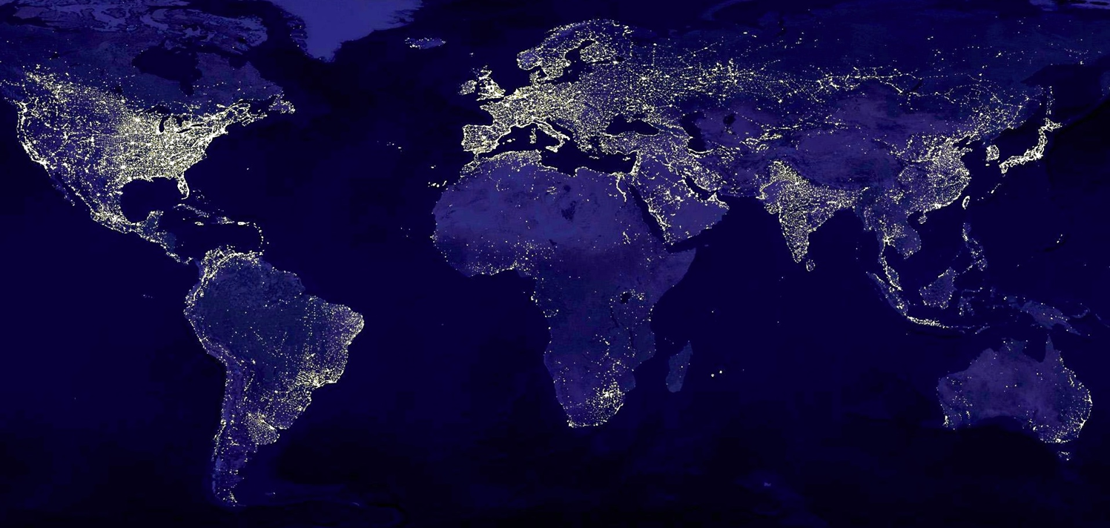
How does this picture reflect culture?

Slide 6

Learning World looks at how IT is boosting education worldwide - learning world (4 mins)

Slide 7
Learning World looks at how IT is boosting education worldwide - learning world (4 mins)
https://youtu.be/GRt71WHHbqc

Slide 8
Aksheta Kanuganti - Education for all (7 mins)

Slide 9
Published on Mar 18, 2015
Aksheta Kanuganti captivates the audience with her passion and urges everyone to never take education for granted. (7 mins)
https://youtu.be/Ujjppb7UiXI

Slide 11
Is the Internet a Right or a Privilege? (3.75 mins)

Slide 12
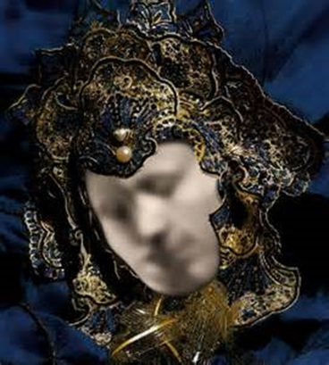

Slide 13
Four core intercultural phases:
  Increasing Self-Awareness
  Increasing Awareness of Others
  Learning to Manage Emotions
  Learning to shift frames and adapt behavior
  Michael Vande Berg, PhD, © 2015

Slide 14
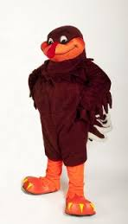
Cox Factoid #2
True or False ?
Dr. Cox was the Hokie Bird
mascot at Virginia Tech in 1983?

Slide 15
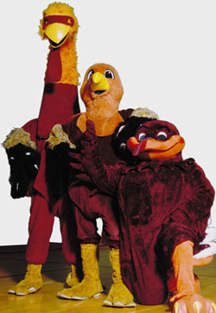
Cox Factoid
Look at the progression of the HOKIE bird!

Slide 16


Slide 17
LEVELS GROUP ACTIVITY

Slide 18
Levels Group Activity – Level One
Sit Quietly with your eyes closed and listen carefully while the professor reads the Level passage.
After the passage has been read aloud, take one minute to reflect on what was just read.

Slide 19
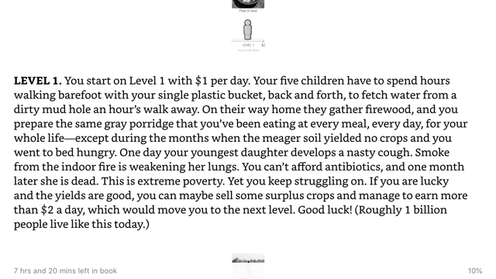

Slide 20
Levels Group Activity – Level One Reflection
As a group, answer the following questions and be prepared to share your answers with the class:
    How did this make you feel?
    What emotions could you identify?
    If you were living at Level 1, what would be your priorities?.... motivations?
    How would you try to double your income and move to Level 2?
    What technology would you desire to obtain?

Slide 21
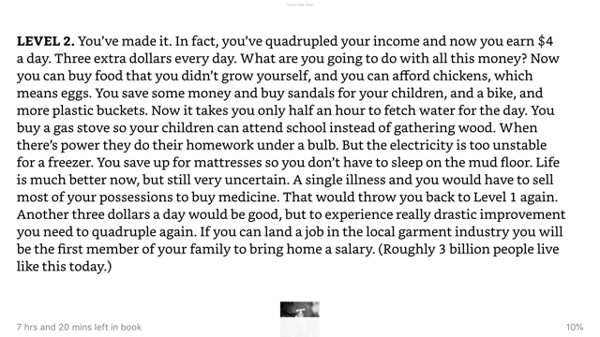

Slide 22
Levels Group Activity – Level Two Reflection
As a group, answer the following questions and be prepared to share your answers with the class:
    How did this make you feel?
    What emotions could you identify?
    If you were living at Level 2, what would be your priorities?.... motivations?
    How would you try to double your income and move to Level 3?
    What technology would you desire to obtain?

Slide 23
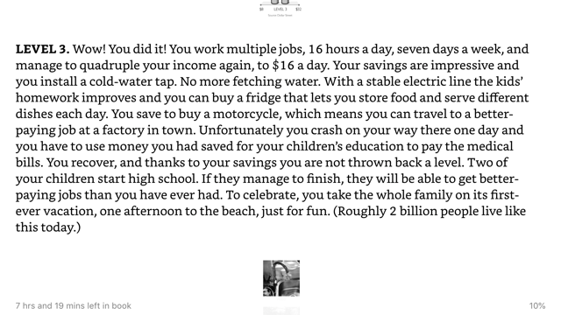

Slide 24
Levels Group Activity – Level Three Reflection
As a group, answer the following questions and be prepared to share your answers with the class:
    How did this make you feel?
    What emotions could you identify?
    YOU MIGHT BE living at Level 3, what would be your priorities?.... motivations?
    How would you try to double your income and move to Level 4?
    What technology would you desire to obtain?

Slide 25
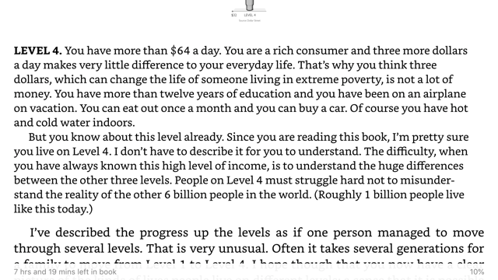

Slide 26
Levels Group Activity – Level FOUR Reflection
As a group, answer the following questions and be prepared to share your answers with the class:
    How did this make you feel?
    What emotions could you identify?
    YOU ARE living at Level 4, what are your priorities?.... motivations?
    How can you help those at Levels 1 & 2?

Slide 27
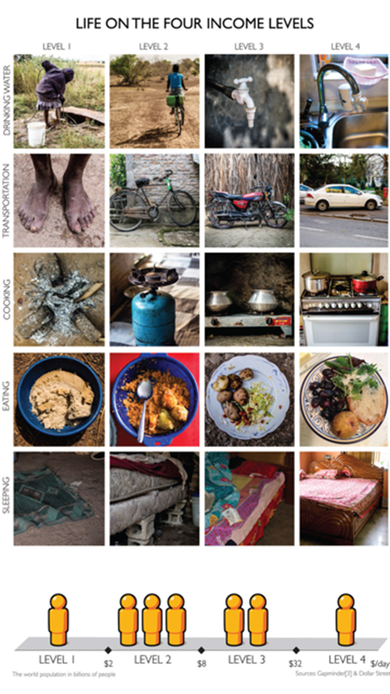

Slide 28
Four core intercultural phases:
  Increasing Self-Awareness
  Increasing Awareness of Others
  Learning to Manage Emotions
  Learning to shift frames and adapt behavior
  Michael Vande Berg, PhD, © 2015

Slide 29
SEPTEMBER 3rd we STOPPED Here

Slide 30
TODAY - Please sit …no more than 6 per table
MET
OLS
IET &
OLS
OLS
HALL WAY AND ENTRY DOORS
CGT &
OLS
ETTE &
OLS
OLS & BME
MET
TEACH PODIUM

