Slide 1
Please sit at same location as Tuesday
MET
OLS
IET &
OLS
OLS
HALL WAY AND ENTRY DOORS
CGT &
OLS
ETTE &
OLS
OLS & BME
MET
TEACH PODIUM

Slide 2
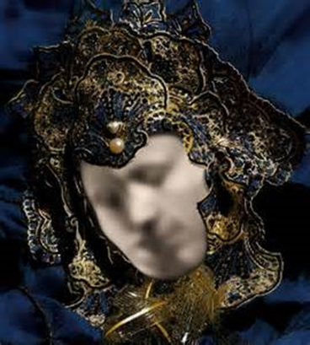

Slide 3
Levels Group Activity – Level FOUR Reflection
As a group, answer the following questions and be prepared to share your answers with the class:
    How did this make you feel?
    What emotions could you identify?
    YOU ARE living at Level 4, what are your priorities?.... motivations?
    How can you help those at Levels 1 & 2?

Slide 4
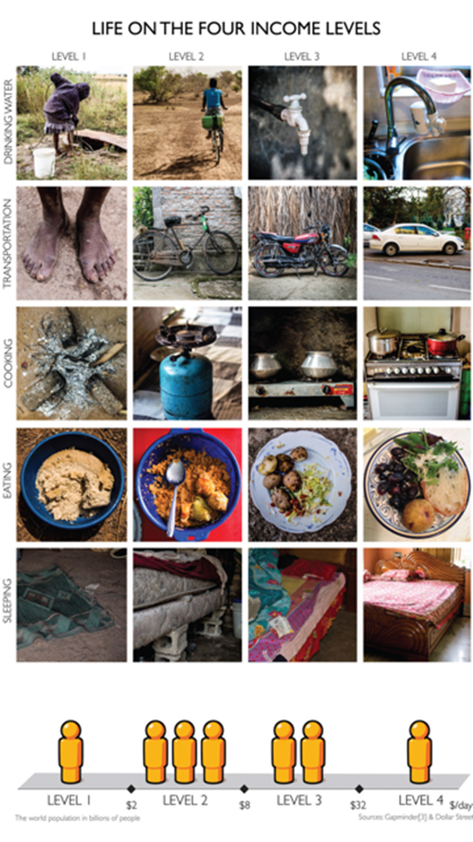

Slide 5
Week #3 – Class 2
TECH 330
September 5th , 2019

Slide 6
IDI Assessment Reminder…
IDI Assessment email notification coming soon from idiassessment.com and must be completed by September 10th

Slide 8
Communications
Work to understand the underlying cultural values that drive behavior.
You must first understand your own cultural background and before you can better understand other people’s culture.

Slide 9
Multi-Lingual
Do you speak a second language?
What language would you like to learn?

Slide 10
Speaking their Language
Removes the barrier / filter of an interpreter
Shows a level of respect towards them
Indicates a desire to communicate

Slide 11
Differences in accepted Behaviors
What is considered an appropriate behavior in one culture is frequently inappropriate in another one.
Misunderstandings arise when I use my meanings to make sense of your reality.

Slide 12

SMILE!

Slide 13
For Example:

Slide 14
Understanding Ourselves
Misinterpretations occur primarily when we lack awareness of our own behavioral rules and project them on others. (Hot Buttons)
Becoming aware of our own cultural dynamics is a difficult task because culture is not conscious to us. (Individual Cultures Exercise)

Slide 15
Simple Things
Greetings
Hand Shakes
Exchange of Business Cards
Eye Contact
Loud Voices
How we dress
How we treat others outside our “group”

Slide 16
Business Cultures

Slide 17
Pre Class Exercises Part 1
Please visit http://www.worldbusinessculture.com/
Select two (2) of the feature countries (please do not choose your country of origin or the USA)
Review, summarize, and compare /contrast each of the following for your selected countries:
Business Structures
Management Style
Meetings
Team Working
Communication Styles
Women in Business
Business Dress Code
Top Tips 1-10
Successful Entertaining

Slide 18
HW #2: Pre-Class Exercise on World Business Cultures
Part 2: Please visit the HOFSTEDE CENTRE website at: http://geert-hofstede.com/countries.html
Select and compare two (2) of the featured countries.
Please note the differences found in the various categories:
Power Distance
Individualism
Indulgence
Masculinity
Pragmatism
Uncertainty Avoidance

Slide 19
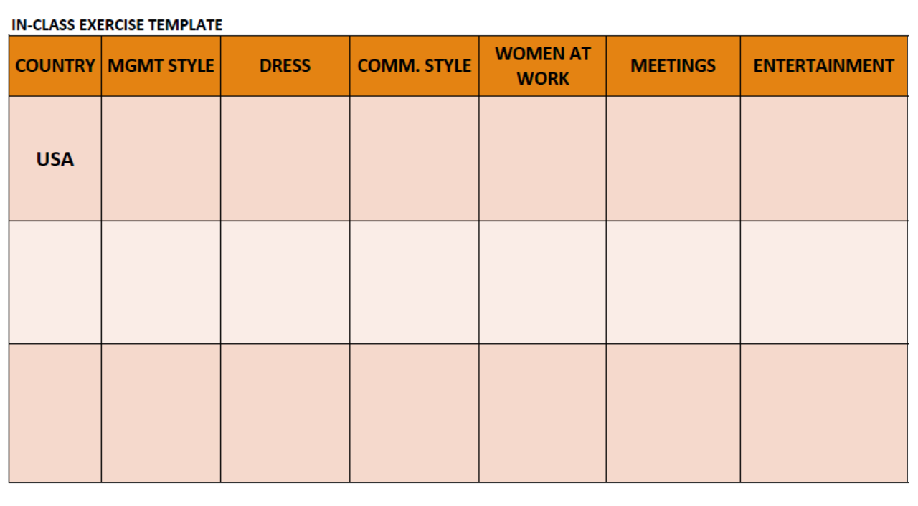
In- Class Exercise (25 points)
Working in YOUR GROUPS, please prepare a single response for submission at the end of class today. RECORD THE NAMES OF YOUR GROUP ON THE BACK OF THE TEMPLATE.
Based on the details found in HW#2 on business and cultures, use the template provided to record your group’s completion of this activity.
SELECT TWO OTHER COUNTRIES FOR COMPARISON TO THE USA
TRY TO UTILIZE ONLY 2-5 WORDS TO DESCRIBE THE BUSINESS ATTRIBUTES LISTED ACROSS THE TOP
BE PREPARED TO DISCUSS THE RESULTS OF YOUR GROUPS OBSERVATIONS
TURN-IN THE TEMPLATE AT THE END OF CLASS

Slide 21
Follow on In-Class Exercise
What was the biggest surprise about what you learned today about cultures?
Which country’s culture seems to be most like the US?
Which country’s cultures appears to be the most different from the US?

Slide 22
Four core intercultural competencies:
Interacting more effectively and appropriately with culturally different others”—bridging cultural gaps”—means:
  Increasing cultural and personal self awareness through reflecting on our own experiences, past and present;
  Increasing awareness of others within their own cultural and personal contexts;
  Learning to manage emotions and thoughts in the face of ambiguity, change, and challenging circumstances & people
  Learning to shift frames, attune emotions and adapt behavior to other cultural contexts.
  Michael Vande Berg, PhD, © 2015

Slide 23
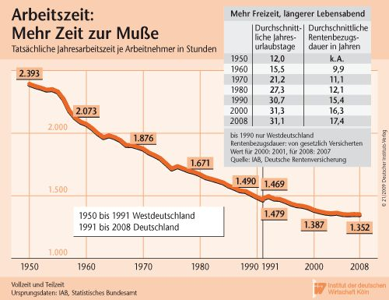
Working hours per year
Holidays per Year
Ø-duration of pension payments (years)
West-Germany
Germany

Slide 24
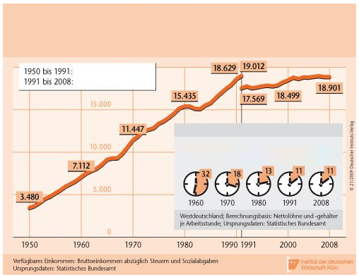
Net-Income per year and person
(private households)
West-Germany
Germany
Working hours to earn 1 $

Slide 25
The German Approach

Slide 26

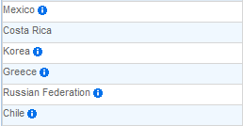
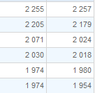
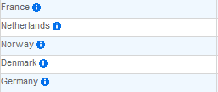
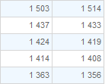
Average working Hours per year
http://stats.oecd.org/index.aspx?DataSetCode=ANHRS
Notes:
Fix USA

Slide 27
Gert Hofstede´s Highlights

Slide 28
Three levels of unique mental programming
Specific to an individual
Inherited and learned
Personality
Specific to a group
Learned
Culture
Universal
Human Nature
Inherited
Hofstede, 2010

Slide 29
Cultural Dimensions
Geert Hofstede, early 1970s
High Power Distance Index ---------------------------- Low Power Distance Index
Individualism ------------------------------------------------------------------ Collectivism
Skeptical attitude toward uncertainty --- Positive attitude toward uncertainty
Masculinity ----------------------------------------------------------------------- Femininity
Long-term orientation ---------------------------------------- Short-term orientation
Indulgence ------------------------------------------------------------------------- Restraint
Notes:
Joe – Introduction to Cultural Dimensions/Power distance
-Hofstede is known as a Social Psychologist or a Business Anthropologist from the Netherlands. He had former training in Engineering and worked for IBM. He worked as a management trainer and manager of personnel research. He gathered survey information from IBM employees in 70 countries and developed a Cultural Dimensions theory, which presents us with 6 dichotomous cultural patterns. He developed an index for each cultural pattern which he has used to ranked various cultural groups.
-Power Distance – We will spend the majority of our time focusing on this cultural dimension
-Individualism vs. Collectivism- This is probably one of the most discussed cultural dimensions. Hofstede’s index for this explores the degree to which people in society are integrated in groups. In collectivist cultures the good of the group is considered ahead of the good of the individual.
-The uncertainty and avoidance index measures the degree to which society is tolerant with ambiguity. Societies who are not as tolerant with ambiguity opt for stiff codes of behavior, guidelines, laws, on rely on absolute truths.
-Masculine cultures are defined as those that have a preference for achievement, heroism, assertiveness, and material rewards for success. Its counterpart represents a preference for cooperation, modesty, caring for the weak and quality of life
-Long-term orientated societies have emphasis on persistence while short-term societies have an emphasis on quick results. Long-term societies tend to save and be thrifty while shorter term emphasis spending
-Indulgent society believe themselves to in control of their own life and emotions while restrained societies believe other factors dictate their life and emotions

Slide 31
Power Distance Index (PDI)
High Power Distance:
Less powerful members of a society accept and expect that power is distributed unequally.
People in societies exhibiting a large degree of power distance accept a hierarchical order
Everybody has a place and needs no further justification.
Low Power Distance:
People strive to equalize the distribution of power and demand justification for inequalities of power.

Slide 32
Examples of High Power Distance
People are less likely to question the boss; students don’t question teachers
Expressing your ideas openly could get you into trouble
Workers prefer precise instructions from supervisors
Bosses are independent; subordinates are dependent
Elitism is more common and more easily tolerated; those in power have special privileges
The chain of command is sacrosanct
Authoritarian and paternalistic management style is more common
Interaction between boss and subordinate is formal

Slide 33
Examples of Low Power Distance
Expressing your ideas openly is encouraged
Subordinates and bosses are interdependent
Consultative and democratic management style is more common
Interaction between boss and subordinate is more informal

Slide 34
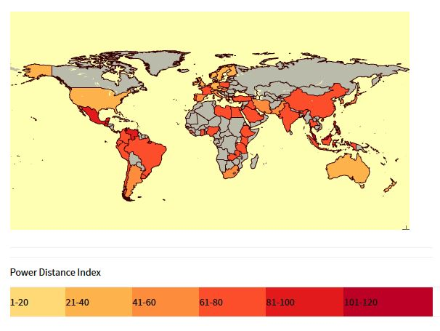
Power Distance Index
  Country PDI
  High PDI (61-120)
  Malaysia 104
  Guatemala 95
  Mexico 81
  China 80
  Egypt 80
  Saudi Arabia 80
  Ghana 77
  India 77
  Brazil 69
  France 68
  Colombia 67
  Low (1-60)
  Spain 57
  Japan 54
  Italy 50
  United States 40
  Canada 39
  Germany 35
  United Kingdom 35
  Ireland 28
  Israel 13
  Austria 11
Data and map from www.clearlycultural.com
Notes:
Our largest population of International students comes from China. At 80 it has a high PDI score. In general it is a society that believes inequalities amongst people are acceptable. The subordinate-superior relationship tends to be polarized and there is no defense against power abuse by superiors. Individuals are influenced by formal authority and sanctions and are in general optimistic about people’s capacity for leadership and initiative. People should not have aspirations beyond their rank.
Our second largest population comes from India. It also has a high PDI score. They tend to be dependent on the boss or the power holder for directions. They have acceptance of un-equal rights between the power-privileged and those who are lesser down in the pecking order. Immediate superiors seem to be accessible but one layer above is less so. Management directs, gives reasons to ones work and rewards in exchange for loyalty. Employees expect to be directed clearly as to their functions and what is expected of them. Attitudes toward managers are formal. Communication is top down and directive in its style and often feedback which is negative is never offered up the ladder.
Germany- direct and participative communication and meeting style is common, control is disliked and leadership is challenged to show expertise and best accepted when its based upon expertise

Slide 35
Individualism vs Collectivism (IDV)
High Individualism Scores: “I – me”
individuals are expected to take care of only themselves and their immediate families.
Lower Scores (collectivism): “Us – we”
Represents a society in which individuals can expect their relatives or members of a particular in-group to look after them in exchange for unquestioning loyalty.

Slide 36
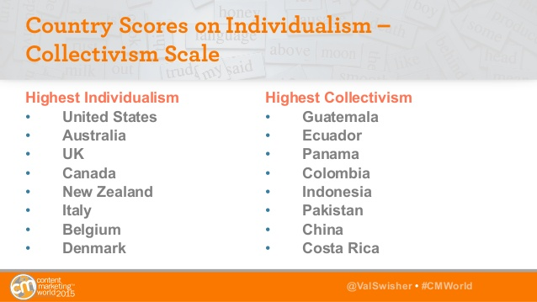
Source: Do Personas Work in a Global Marketplace? Val Swisher CEO, Content Rules, Inc. @ValSwisher @ContentRulesInc @ValSwisher • #CMWorld

Slide 37
Individualism (Storti, 1999, pg. 25)
The smallest unit of survival is the individual.
People identify primarily with self.
The needs of the individual are satisfied before those of the group.
Independence and self-reliance are stressed and greatly valued, and personal freedom is highly desired.
In general, there is more psychological and emotional distance from others.

Slide 38
Collectivism (Storti, 1999, pg. 25-26)
The primary group, usually the immediate family, is the smallest unit of survival.
One’s identity is in large part a function of one’s membership and role in a group (e.g. the family, the work team).
The survival and success of the group ensures the well-being of the individual, so that by considering the needs and feelings of others, one protects one-self.
Harmony and the interdependence of group members are stressed and valued.
There is relatively little psychological or emotional distance between group and non-group members.

Slide 39
Masculinity vs Femininity (MAS)
High Masculinity:
Preference in society for achievement, heroism, assertiveness and material rewards for success.
Society at large is more competitive.
High Femininity:
Preference for cooperation, modesty, caring for the weak and quality of life.
Society at large is more consensus-oriented.

Slide 40
Uncertainty Avoidance Index (UAI)
Expresses the degree to which the members of a society feel uncomfortable with uncertainty and ambiguity.
How a society deals with the fact that the future can never be known: should we try to control the future or just let it happen?
Countries exhibiting strong UAI maintain rigid codes of belief and behavior and are intolerant of unorthodox behavior and ideas.

Slide 41
Pragmatism (long term vs short term orientation)
Every society has to maintain some links with its own past while dealing with the challenges of the present and the future.
Societies who score low on this dimension, for example,
  Prefer to maintain time-honored traditions and norms while viewing societal change with suspicion.
  Encourage thrift and efforts in modern education as a way to prepare for the future.

Slide 42
Indulgence vs Restraint (IND)
High Indulgence:
A society that allows relatively free gratification of basic and natural human drives related to enjoying life and having fun.
High Restraint:
A society that suppresses gratification of needs and regulates it by means of strict social norms.

Slide 43
Nonverbal communication & power distance
Eye contact: Some high power distance (PD) cultures in Asia avert eye contact as sign of respect or humility; eye contact may be seen as a threat or challenge.
Low PDI cultures may use eye contact as an indicator of equality.
Proximity: Indian caste systems (high PD) have prescribed how close interlocutors from different castes should stand.
Emotions: In high PD cultures, emotional displays may reveal status differences. A subordinate may show only positive emotions to a superior and vice versa. A smile may be used to show politeness. Low PDI cultures may permit subordinates to reveal disappointment to superiors through facial expressions.

Slide 44
Descriptive Terms for Germany
Power Distance: Strong support by a middle class; direct and participative meeting styles; leadership is challenged to show expertise;
Individualism: small family focused; direct communications – “honest, even if it hurts” – give a fair chance to learn form mistakes; strong understanding for duty and responsibility
Masculinity: performance is highly valued; school system separates children into different types of schools at age ten
Uncertainty Avoidance: compensate for uncertainty by relying on expertise
Pragmatism: Adapt easily to changed conditions; save and invest;
Indulgence: Germans show restraint… common expectations

Slide 45
Descriptive Terms for Colombia
Power Distance: Inequalities are a fact of life; concentrated power
Individualism: among most collectivist cultures in the world; strong ties to groups and group’s beliefs; group loyalty is paramount; outsiders can easily be excluded
Masculinity: highly success oriented and driven; seek status and rewards linked to performance in groups
Uncertainty Avoidance: seek mechanisms to avoid ambiguity; rules for everything; power holders can make their own rules
Pragmatism: great respect fro traditions; focus on quick results
Indulgence: higher degree of importance on leisure time

Slide 47
Descriptive Terms for Japan
Power Distance: borderline hierarchical society; decisions confirmed by the top; meritocratic society
Individualism: harmony of the group over oneself; private and more reserved than Chinese and Koreans
Masculinity: one of the most masculine societies; severe competition between groups (corporations); not assertive as individuals; Workaholics
Uncertainty Avoidance: among highest avoidance societies; constantly threatened throughout history by natural disasters; prescribe for maximum predictability (think about their automobile industry).
Pragmatism: Life is seen as very short; do your best in your life time; practical good examples;
Indulgence: restrained by acceptable social norms

Slide 49
Descriptive Terms for India
Power Distance: Appreciation for hierarchy; management directs; rewards for loyalty; centralized power; clear directions/expectations.
Individualism: both preference for belonging and individualism; hiring and promotion often based on relationships
Masculinity: visual display of success and power; designer brand labels as sign of success
Uncertainty Avoidance: acceptance of imperfection; things do not always have to go as planned; comfortable in settling into roles
Pragmatism: long term pragmatic culture; concept of “karma”
Indulgence: a culture of restraint

Slide 50
Descriptive Terms for US
Power Distance: Unique implies inequality; power exerted by people to influence other people’s idea and behaviors (think about politics)
Individualism: Focus on equal rights; hierarchy established for convenience and function; reliance on expertise; look after themselves and immediate family
Masculinity: competitive; winner takes all mentality; showing we are successful by…???; live to work
Uncertainty Avoidance: fair level of acceptance of new ideas and innovations; tolerant of opinions;
Pragmatism: measure performance on short term basis; strong ideas about what is good and evil; can-do mentality
Indulgence: Work hard and Play hard!

