Slide 1
TECH 330 – Week #4
Class #2

Slide 2
Activities Day
Global Footprint
IDI Group Profile
Empathy Parable Exercise
Home-Work-Play
Current Events Stage 1

Slide 3
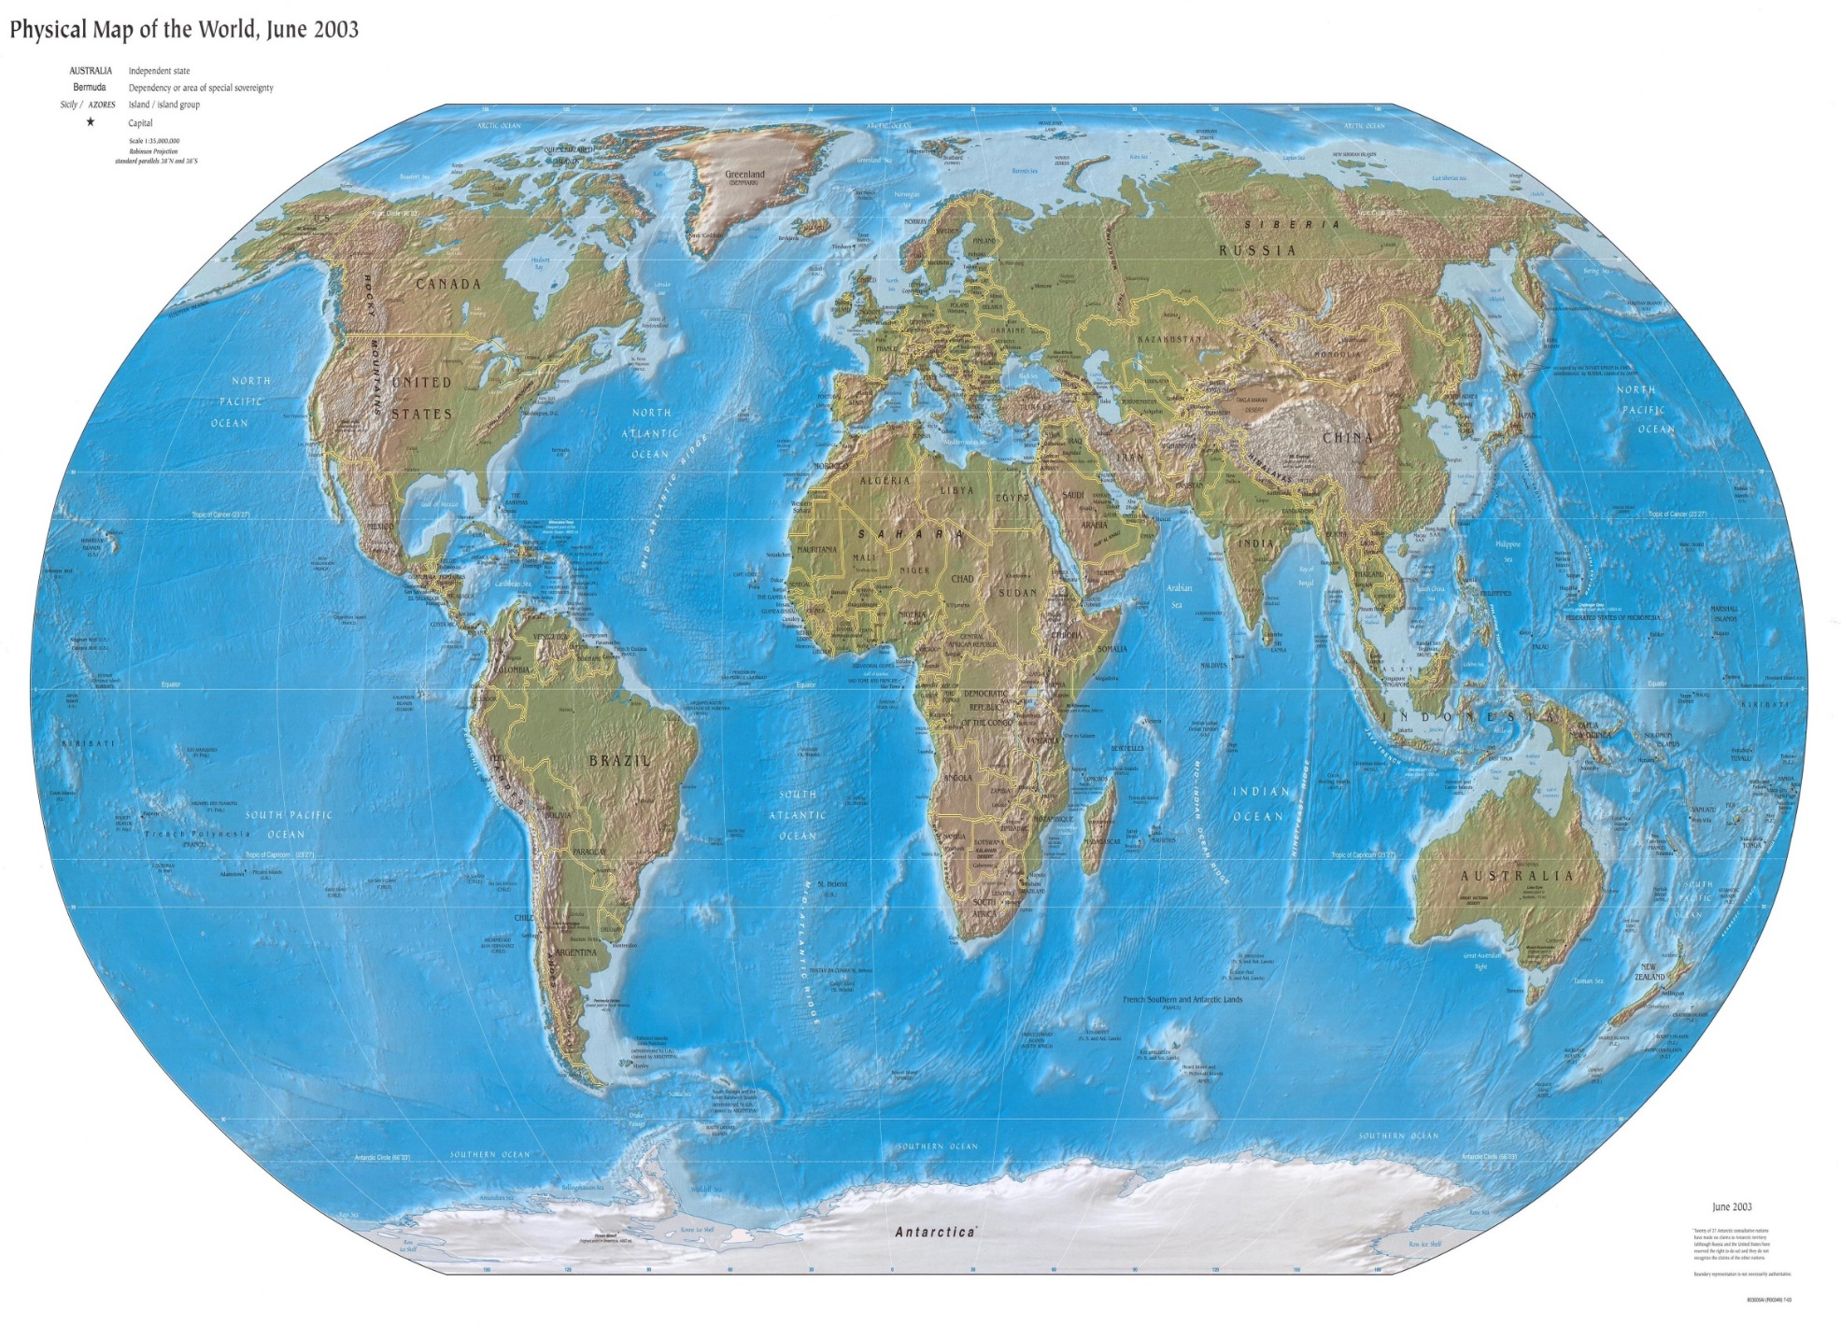



TECH 330 Global Footprint
http://www.lib.utexas.edu/maps/world.html

Slide 4

Dr. Cox’s Global Footprint
http://www.lib.utexas.edu/maps/world.html

Slide 5
TECH 330
IDI DEBRIEFING PROCEDURES

Slide 6
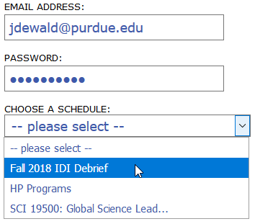
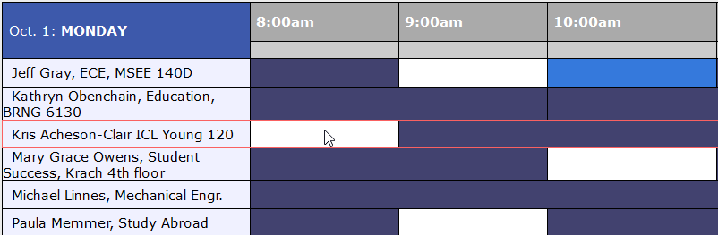
Debrief Scheduling Process
1. Go to the CILMAR website and register for a new student account:
  https://ippu.mywconline.com/register.php
  2. Go back to the website, log in and chose the Spring 2020 IDI Debrief schedule
  https://ippu.mywconline.com/
3. Click on open times (in white)

Slide 7
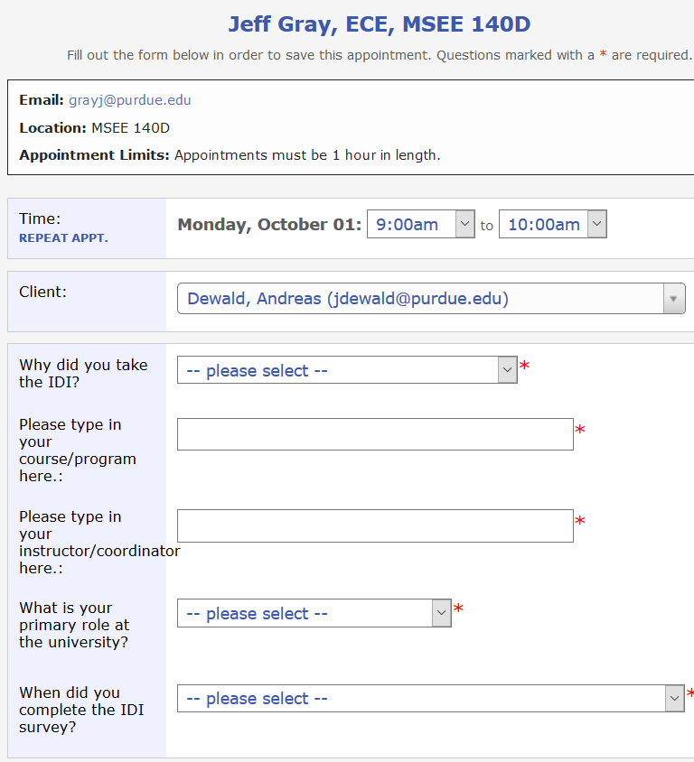
Debrief Scheduling Process
4. Fill in info and answer questions
5. You receive a confirmation email
6. Get in touch with person
before meeting
7. Read Hammer Chapter 16
8. Go to debrief, be on time!
RELAX!

Slide 8
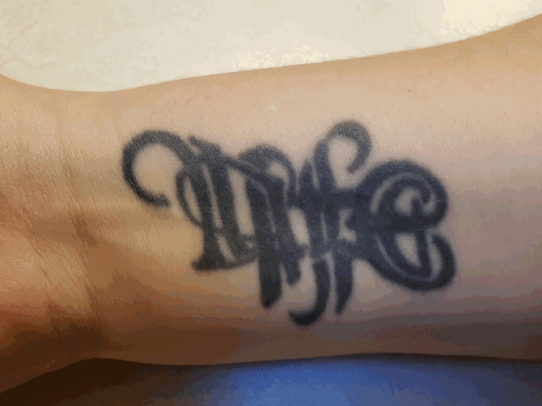

Slide 10
Upcoming Topics

Slide 11
IDI Assessment Profile
TECH 330 CLASS – Spring 2020

Slide 12

Intercultural Development Inventory

Slide 13
Group Profile – Perceived vs Developmental Orientation

Slide 15
Orientation Gap

Slide 16
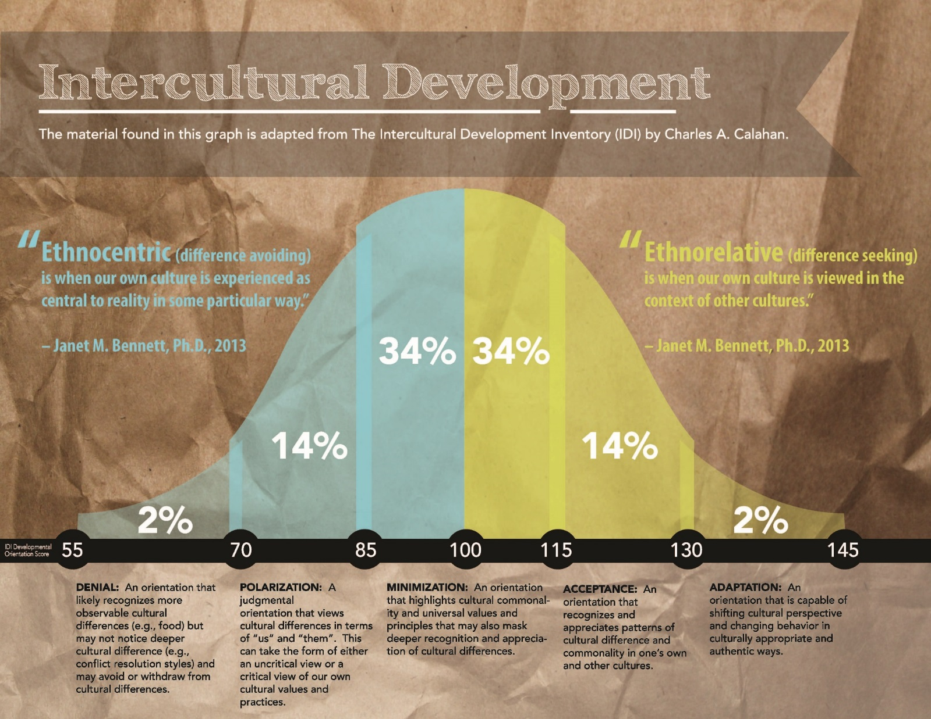

Slide 17

Intercultural Development Continuum: Primary Orientations
Denial
Polarization
Minimization
Acceptance
Adaptation
Deeply Comprehends Difference
Bridges across Difference
Intercultural
Mindset
PO
De-emphasizes Difference
DO
Judges Difference
Misses Difference
Monocultural
Mindset
Modified from the Developmental Model of Intercultural Sensitivity (DMIS), M. Bennett, 1986
Notes:
Review each primary orientation.

Slide 19

Intercultural Development Continuum: Trailing Orientations
Denial
Polarization
Minimization
Acceptance
Adaptation
Disinterest
Avoidance
Defense
Reversal
Similarity
Universalism
Cognitive frame-shifting
Behavioral code-shifting
Intercultural
Mindset
Monocultural
Mindset
Modified from the Developmental Model of Intercultural Sensitivity (DMIS), M. Bennett, 1986
Occasions Revert to “Us and Them”
Notes:
Cultural Disengagement involves:
A feeling of being an “outsider” in your own group
May feel comfortable with a “contrarian” stance
May have difficulty participating in important symbols, events and activities shared in your community
May be related to experiences of being rejected in your own group
May be related to experiences where one feels “between two or more” cultural communities
Critical to note that Cultural Disengagement is NOT a measure of intercultural competence; it is a stand-alone measure.

Slide 20
Intercultural Development Inventory

Slide 21
Leading Orientation

Slide 26
Denial
Disinterest in other cultures and a more active avoidance of cultural difference
often do not see differences in perceptions or behavior as “cultural.”
characteristic of individuals who have limited experience with other cultural groups
distanced from other cultural groups and have little interest in learning about them
associated more with members of a dominant culture
Primary Issue to Be resolved: Beginning to notice and confront cultural differences – this means beginning to establish sets of categories for one’s better understanding

Slide 29
Polarization
views cultural differences from an “us versus them” perspective.
Can take the form of:
  Defense (“My cultural practices are superior to other cultural practices”)
  Reversal (“Other cultures are better than mine”).
  When defensive, seen as threatening to one’s own “way of doing things.”
Reversal is a mindset that values and may idealize other cultural practices while denigrating one’s own culture group.
Primary Issue to be Resolved – Recognition of stereotypical nature of one’s own experiences and perceptions. Actively identify commonalities between one’s own cultural group and others’ views.

Slide 31
Minimization
Minimization is a transitional mindset between Denial and Polarization and the more Intercultural/Global worldviews of Acceptance and Adaptation.
Minimization can take one of two forms:
  (a) the highlighting of commonalities due to limited cultural self-understanding, which is more commonly experienced by dominant group members within a cultural community; or
  (b) the highlighting of commonalities as a strategy for navigating the values and practices largely determined by the dominant culture group. This often takes the form of “go along to get along.”
Primary Issue to be Resolved: Developing a deeper understanding of one’s own culture – cultural self awareness and increased understanding of cultural frameworks for making sense of the differences.

Slide 32
Acceptance
individuals recognize and appreciate patterns of cultural difference and commonality in their own and other cultures.
curious to learn how a cultural pattern of behavior makes sense within different cultural communities.
not yet fully able to appropriately adapt to cultural difference.
Someone with an Acceptance orientation may be challenged as well to make ethical or moral decisions across cultural groups.
embraces a deeper understanding of cultural differences,
Primary Issue to be Resolved: Deepening one’s perceptions of other cultures and reconciling cultural differences without giving up one’s own cultural values and principles.

Slide 33
Adaptation
Consists of both Cognitive Frame-Shifting (shifting one’s cultural perspective) and Behavioral Code-Shifting (changing behavior in authentic and culturally appropriate ways).
Enables deep cultural bridging across diverse communities using an increased repertoire of cultural frameworks and practices in navigating cultural commonalities and differences.
focused on learning adaptive strategies,
Primary issue to be Resolved: maintaining authentically competent intercultural experiences

Slide 34
IDI Case

Slide 35
The Importance of Intercultural Competency: Becoming Culturally Agile in Today's Global Workplace

Slide 36
IDI Case

Slide 37
Reminder
Quiz #3 available from 12:00 pm today until Friday 11:59pm
Schedule your individual IDI debrief
TUESDAY: STUDENT PANELS FROM PAST STUDY ABROAD PROGRAMS

Slide 38
Modern Parable Activity

Slide 44
Cultural Continuum
“Home-Work-Play Exercise”

Slide 46
FACE

Slide 47
FACE

Slide 48
CONTEXT

Slide 49
CONTEXT

Slide 50
Individualism - Collectivism

Slide 51
Individualism - Collectivism

Slide 52
Communications

Slide 53
Communications

Slide 54
Emotion

Slide 55
Emotion

Slide 56
TIME

Slide 57
TIME

Slide 58
Uncertainty

Slide 59
Uncertainty

Slide 60
Power Distance

Slide 61
Power Distance

Slide 62
Universalism - Particularism

Slide 63
Universalism - Particularism

Slide 64
In Your Groups
Discuss and compare your individual Continuum…

Slide 65
Current Event Topics….Round 1
Part 1 is Due on March 31st…
- will finalize topics by February 27th

Slide 67
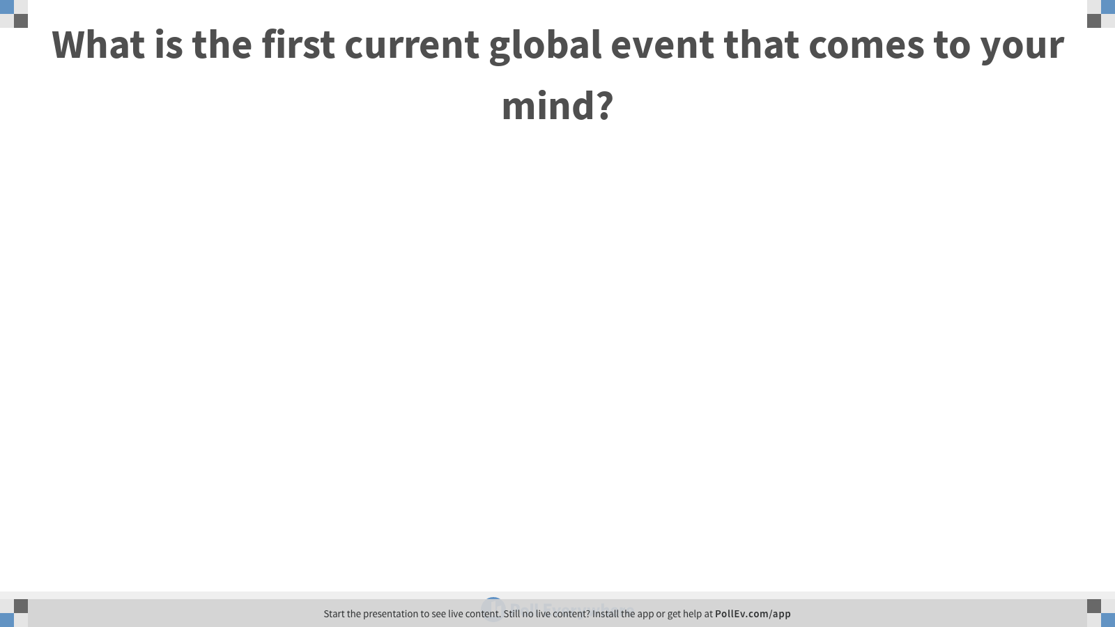
Notes:
Poll Title: What is the first current global event that comes to your mind?
https://www.polleverywhere.com/free_text_polls/wOf5GRk0m0s9scPhI9p8N

Slide 69
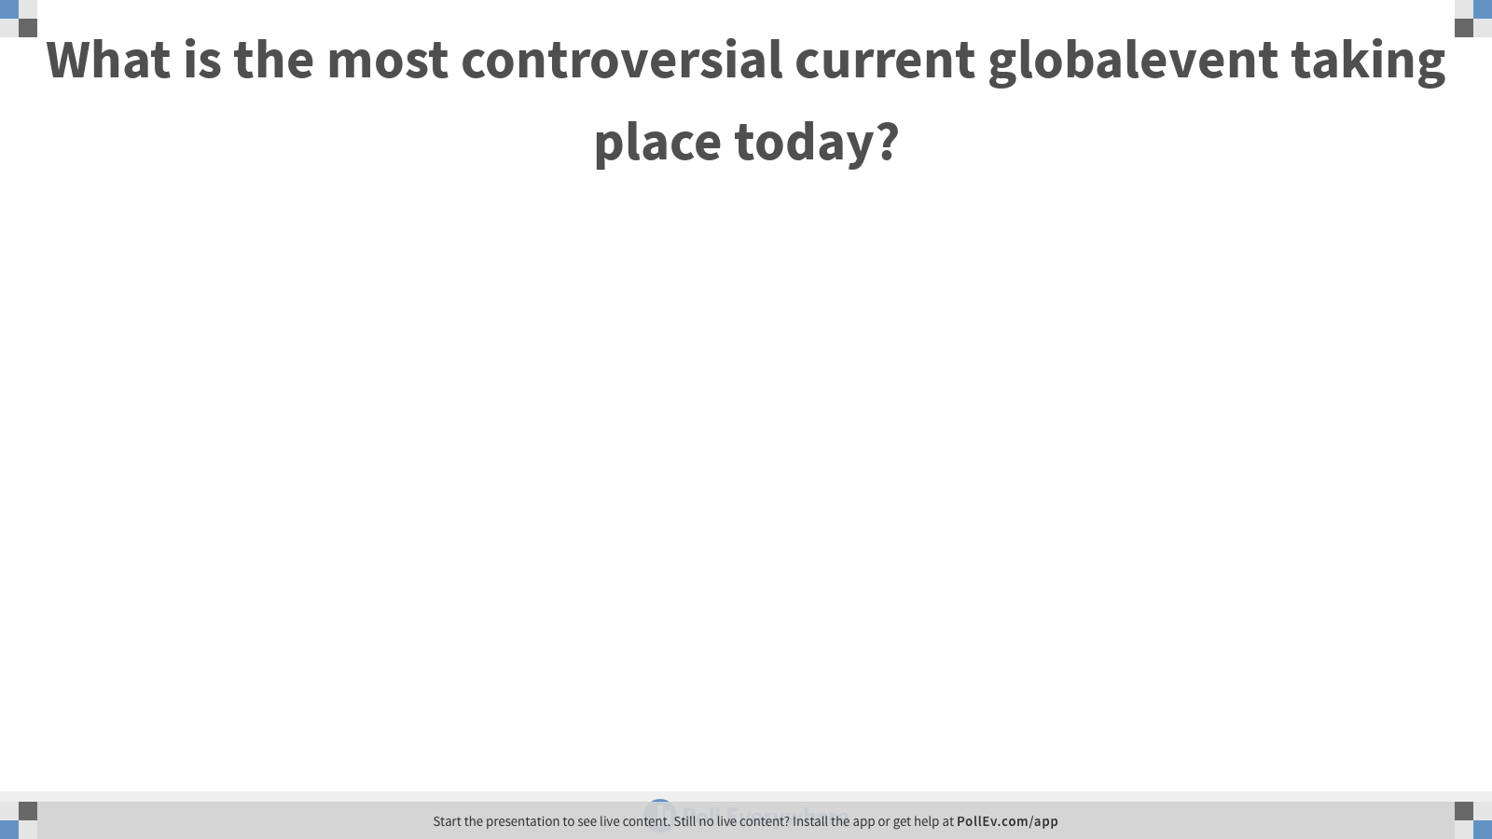
Notes:
Poll Title: What is the most controversial current globalevent taking place today?
https://www.polleverywhere.com/free_text_polls/BDpOFOhFMtE6uFYolmnab

Slide 71
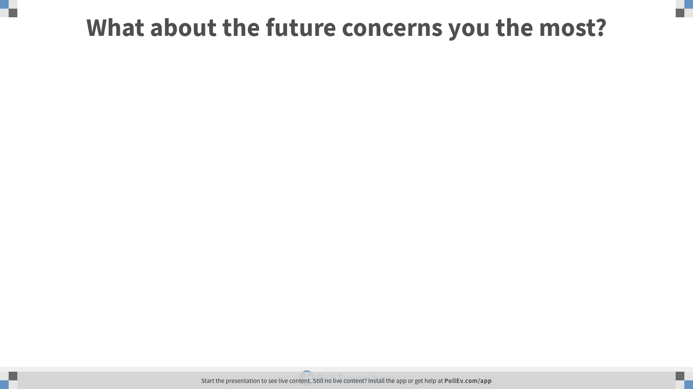
Notes:
Poll Title: What about the future concerns you the most?
https://www.polleverywhere.com/free_text_polls/MNjO41pPQQKoWA9ibAv8h

Slide 73
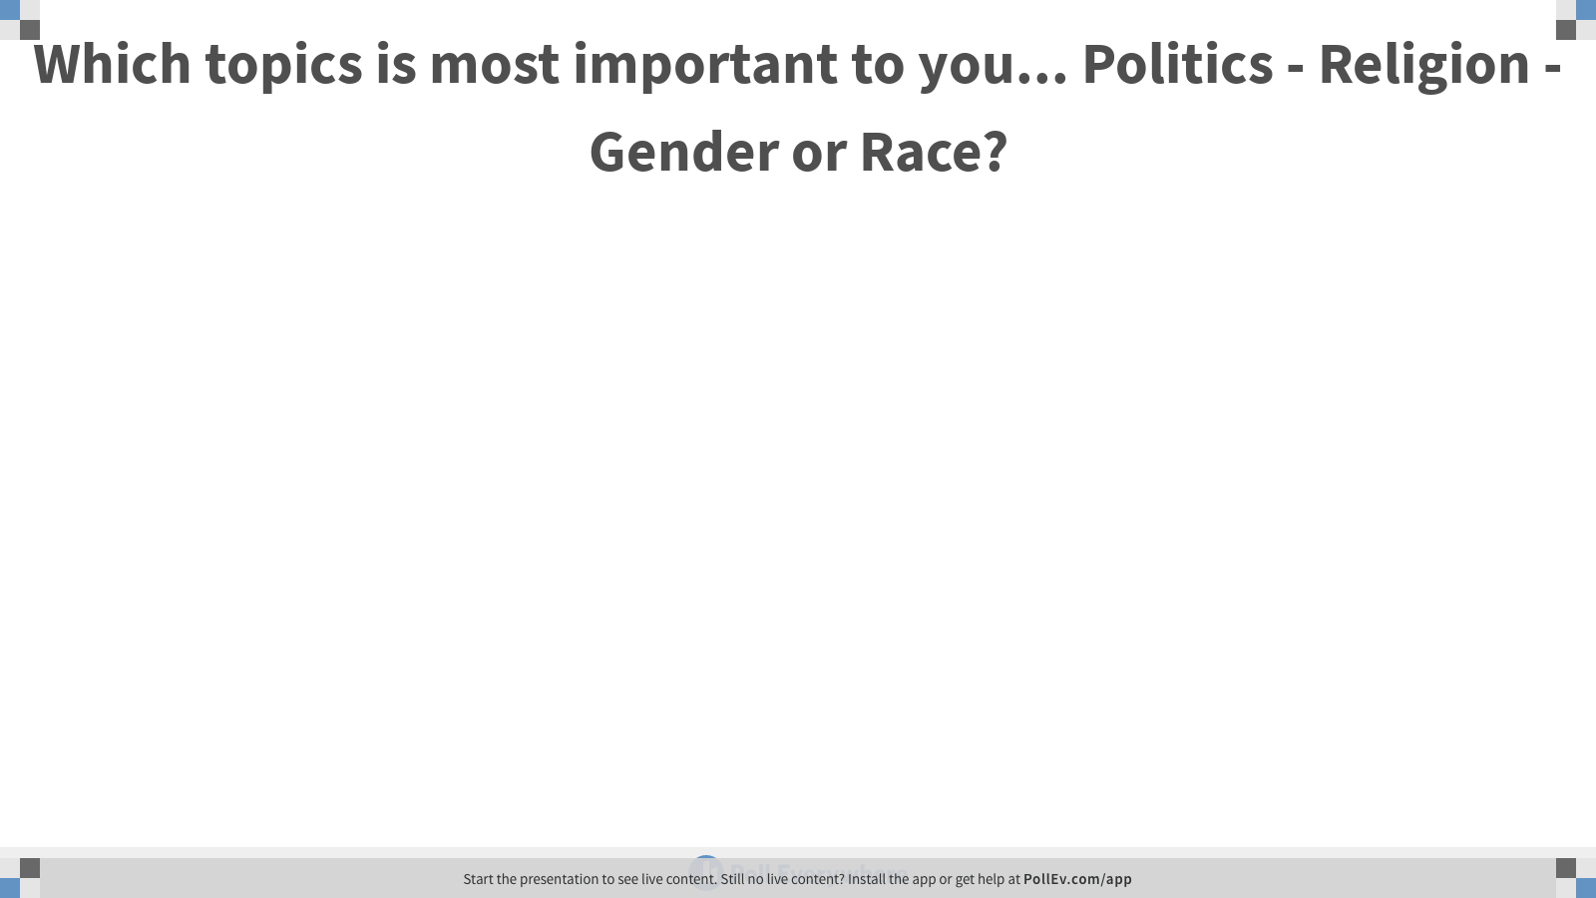
Notes:
Poll Title: Which topics is most important to you... Politics - Religion - Gender or Race?
https://www.polleverywhere.com/free_text_polls/o1vyU5yaNOUF4N9i9IfUZ

Slide 75
Reminders
Quiz #3 Launches at 12:00 today….

