Slide 1
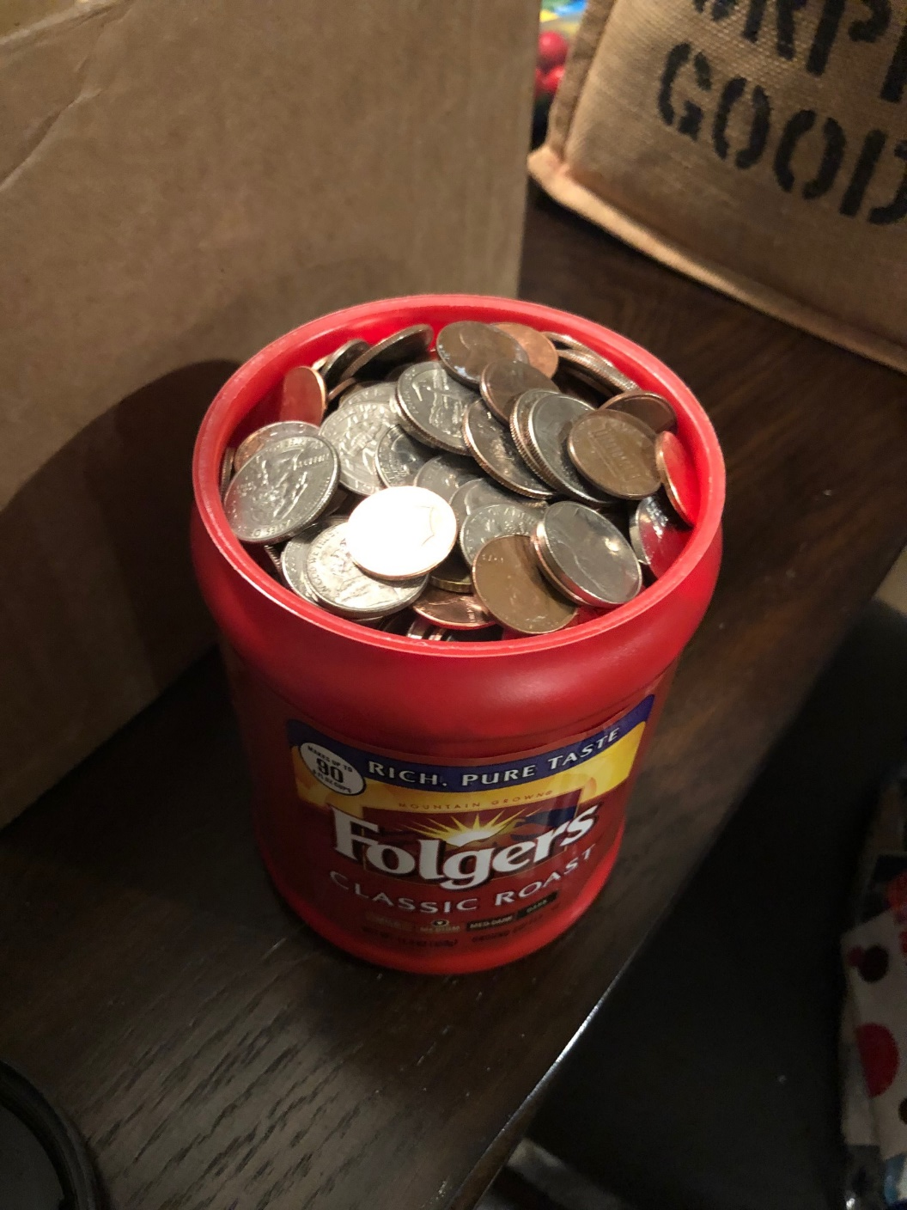
TECH 330 – Week #5
Class #1
February 11, 2020

Slide 2
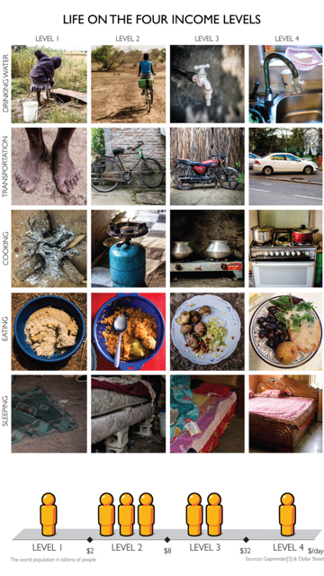
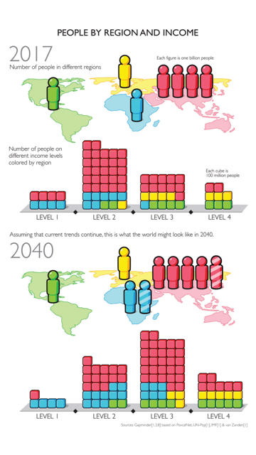

Slide 3
Activities Day
Review Global Footprint
IDI Follow-up
Group Discussion Questions
Home-Work-Play
Current Events Stage 1

Slide 4
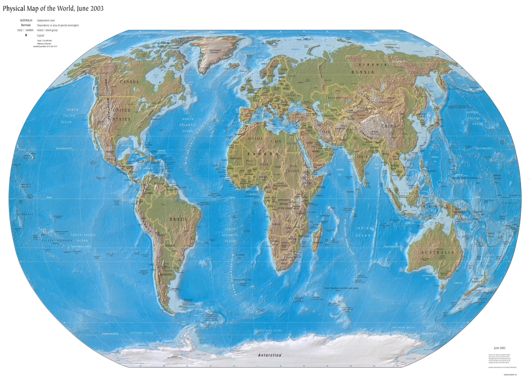



TECH 330 Global Footprint
http://www.lib.utexas.edu/maps/world.html

Slide 5
IDI Assessment Profile
TECH 330 CLASS – Spring 2020

Slide 6

Intercultural Development Inventory

Slide 7
Intercultural Development Inventory

Slide 8
IDI Case

Slide 12
Cultural Continuum
“Home-Work-Play Exercise”

Slide 14
FACE

Slide 15
FACE

Slide 16
CONTEXT

Slide 17
CONTEXT

Slide 18
Individualism - Collectivism

Slide 19
Individualism - Collectivism

Slide 20
Communications

Slide 21
Communications

Slide 22
TIME

Slide 23
TIME

Slide 24
Universalism - Particularism

Slide 25
Universalism - Particularism

Slide 26
Emotion

Slide 27
Emotion

Slide 28
Uncertainty

Slide 29
Uncertainty

Slide 30
Power Distance

Slide 31
Power Distance

Slide 32
In Your Groups
Discuss and compare your individual Continuum…

Slide 33
Current Event Topics….Round 1
Part 1 is Due on March 31st…
- will finalize topics by February 27th

Slide 35
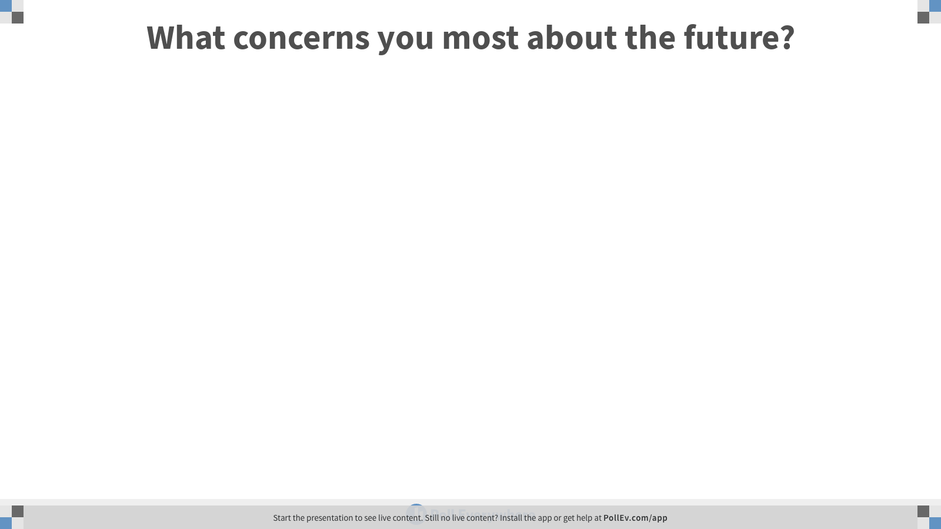
Notes:
Poll Title: What concerns you most about the future?
https://www.polleverywhere.com/free_text_polls/wk9jMGo8rnt2R0m7tbOmn

Slide 36
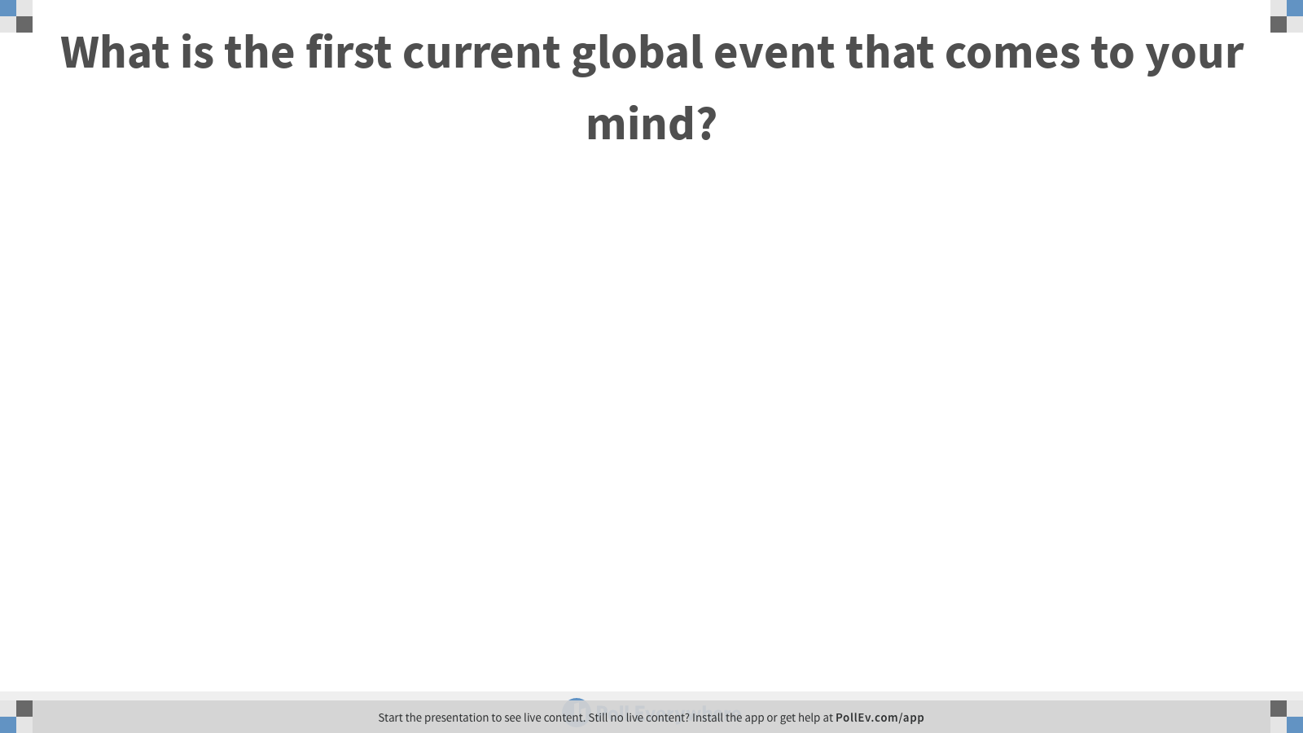
Notes:
Poll Title: What is the first current global event that comes to your mind?
https://www.polleverywhere.com/free_text_polls/HIoF4yjsPphVPAYIXxI5b

Slide 39
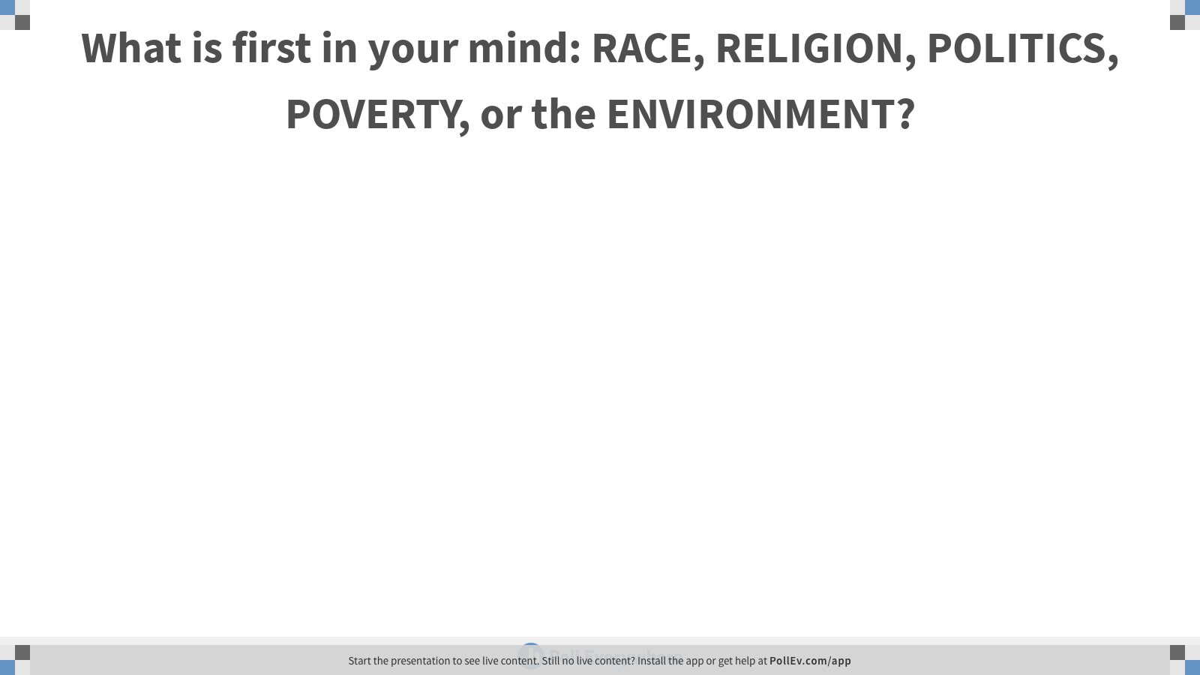
Notes:
Poll Title: What is first in your mind: RACE, RELIGION, POLITICS, POVERTY, or the ENVIRONMENT?
https://www.polleverywhere.com/free_text_polls/cvtTeGBcNoq2PWGI0iQBu

Slide 41
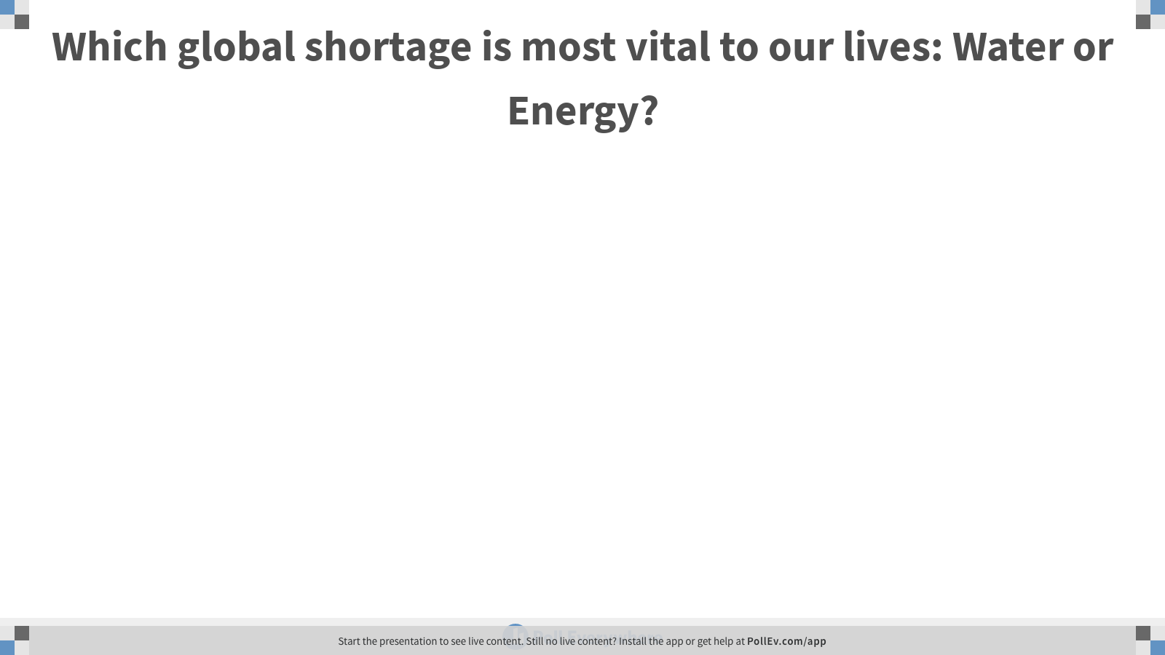
Notes:
Poll Title: Which global shortage is most vital to our lives: Water or Energy?
https://www.polleverywhere.com/free_text_polls/vBOJ439KYETnYCdlbqypl

Slide 42
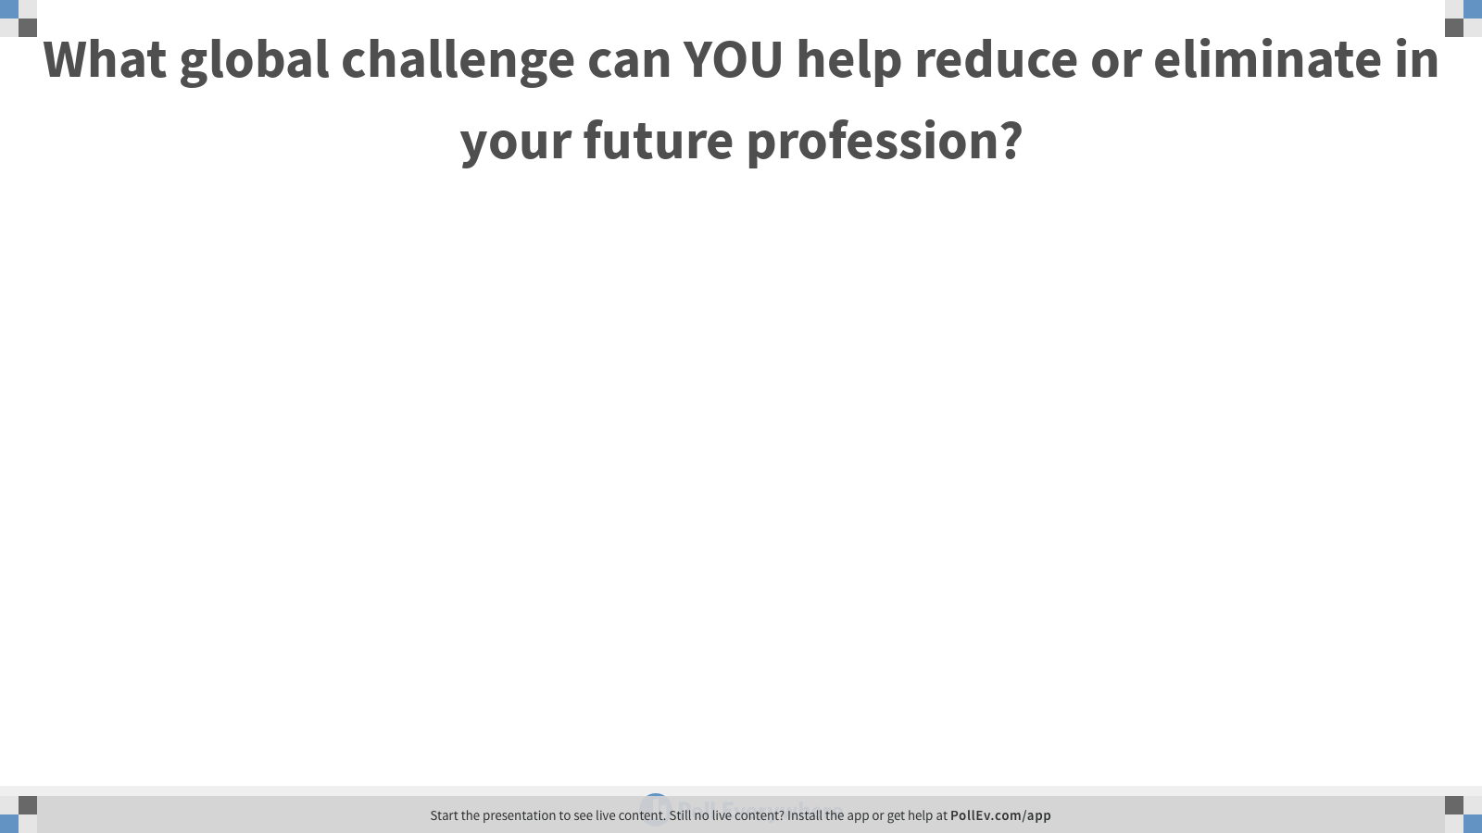
Notes:
Poll Title: What global challenge can YOU help reduce or eliminate in your future profession?
https://www.polleverywhere.com/free_text_polls/GzcoN3hF3OdoeFl7tDd1T

Slide 43
Reminders
Take Home Quiz #4- Refugees Activity was sent to you on Monday…. Due in class on Thursday.
Thursday – Refugees and Immigration

Slide 44
The Importance of Intercultural Competency: Becoming Culturally Agile in Today's Global Workplace

Slide 45
IDI Case

