Slide 1
TECH 330 – February 13, 2020
Finish Up Home-Work –Play Activity
Current Events
Immigration versus Migration of Refugees
Take home “QUIZ” Group Activity
Next Week

Slide 3
Current Event Topics

Slide 4
Current Event Topics….Round 1
Part 1 is Due on March 31st…
- We will finalize topics in class by February 27th

Slide 5
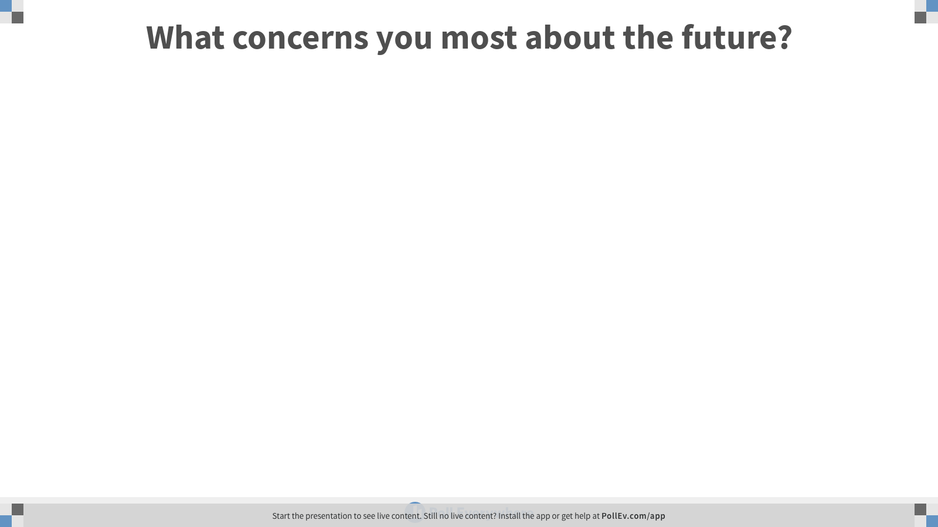
Notes:
Poll Title: What concerns you most about the future?
https://www.polleverywhere.com/free_text_polls/wk9jMGo8rnt2R0m7tbOmn

Slide 6
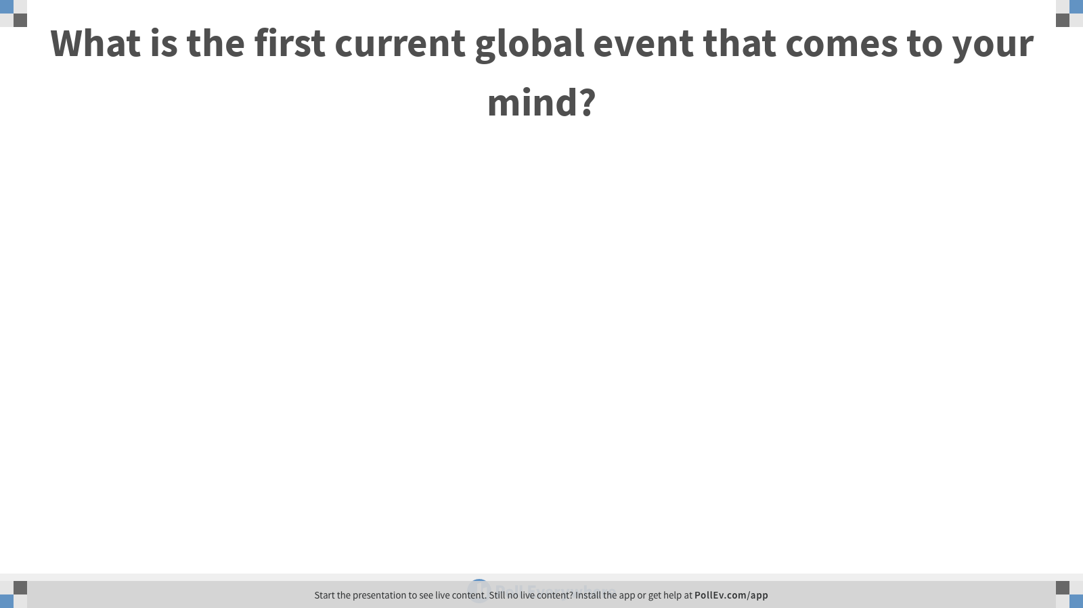
Notes:
Poll Title: What is the first current global event that comes to your mind?
https://www.polleverywhere.com/free_text_polls/HIoF4yjsPphVPAYIXxI5b

Slide 7
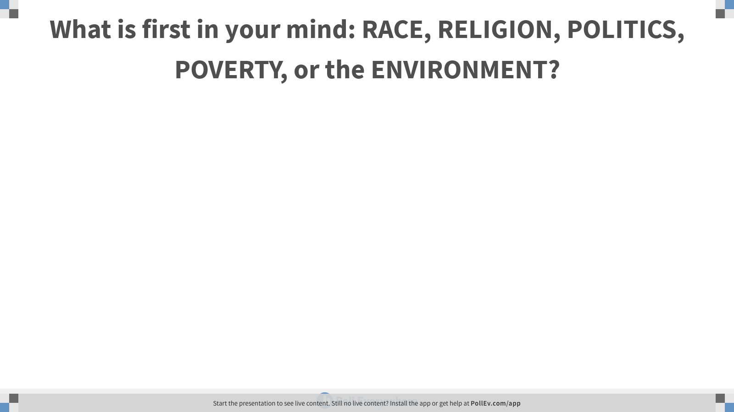
Notes:
Poll Title: What is first in your mind: RACE, RELIGION, POLITICS, POVERTY, or the ENVIRONMENT?
https://www.polleverywhere.com/free_text_polls/cvtTeGBcNoq2PWGI0iQBu

Slide 8
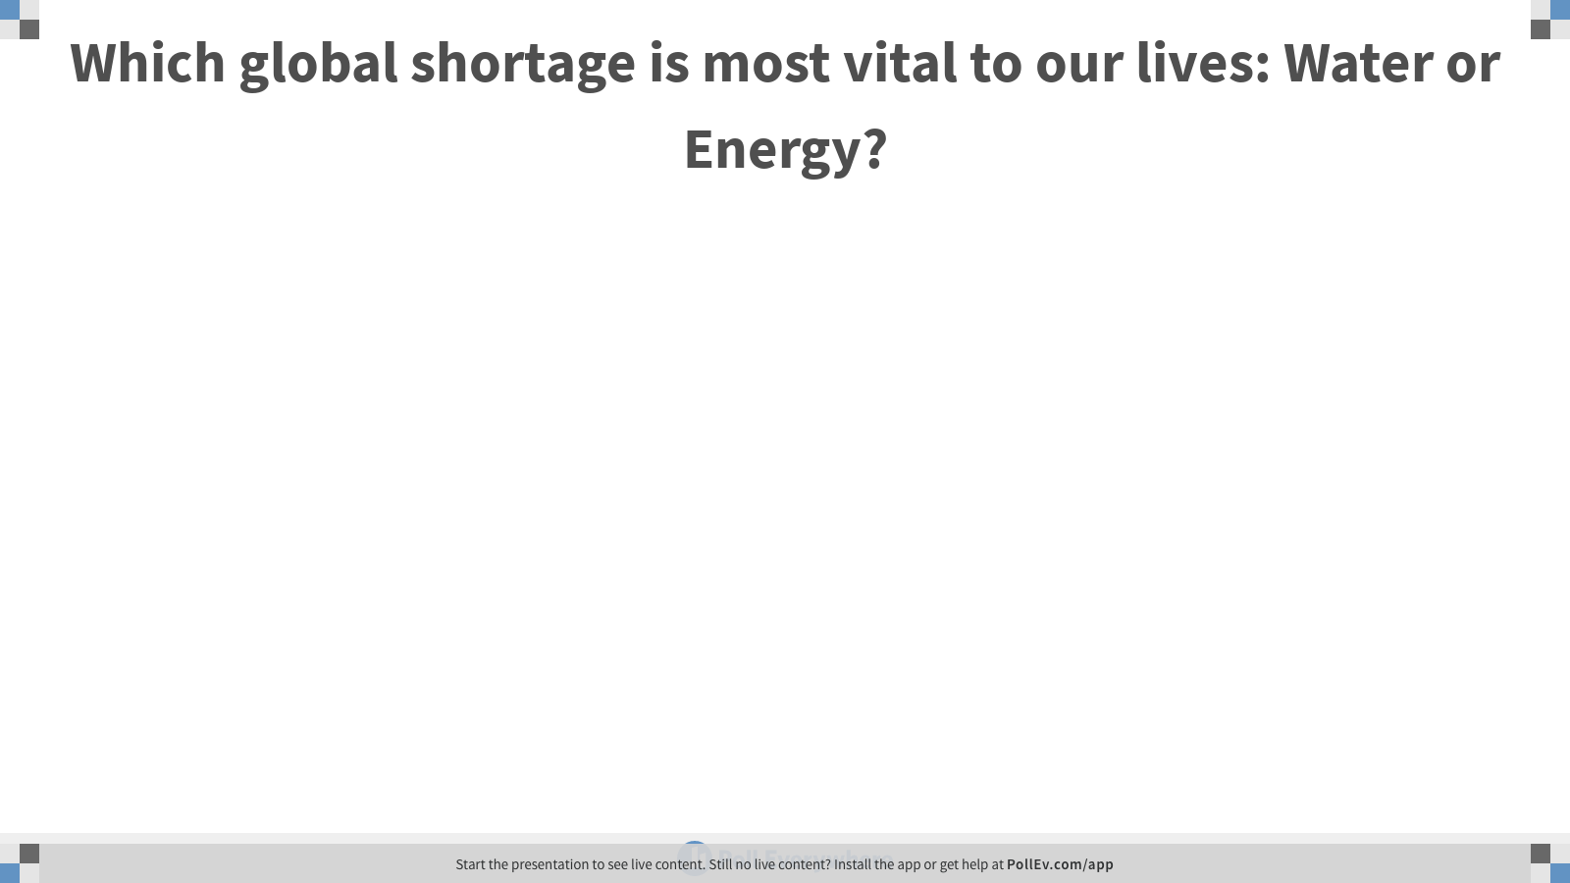
Notes:
Poll Title: Which global shortage is most vital to our lives: Water or Energy?
https://www.polleverywhere.com/free_text_polls/vBOJ439KYETnYCdlbqypl

Slide 9
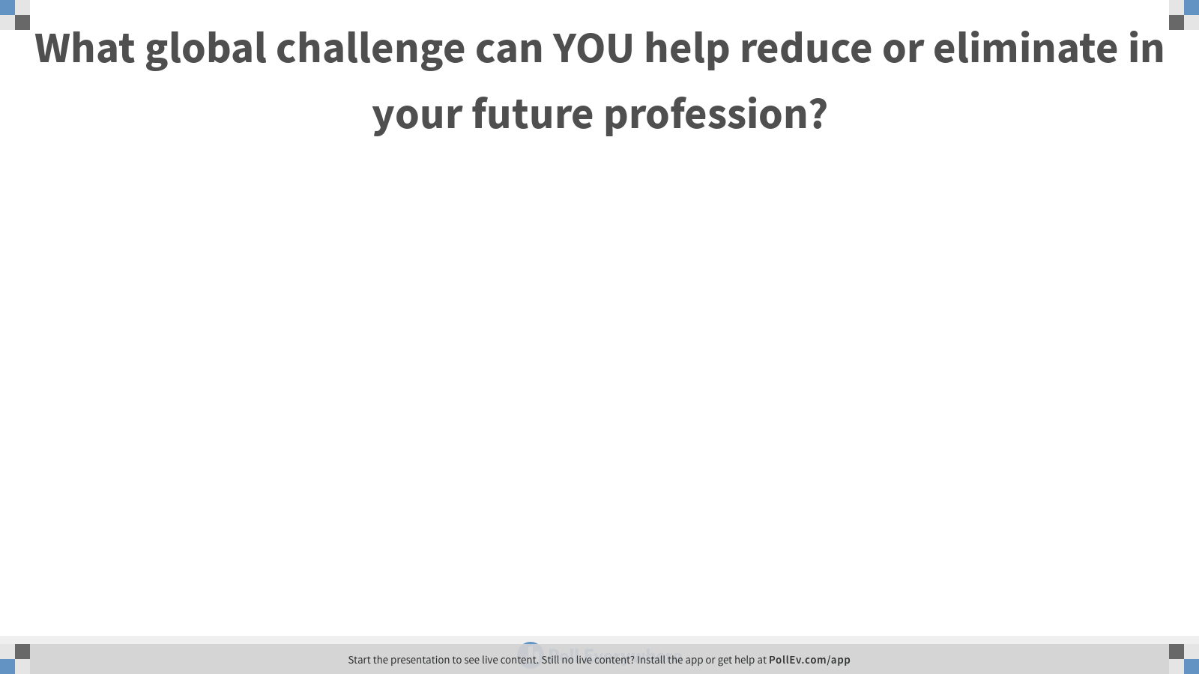
Notes:
Poll Title: What global challenge can YOU help reduce or eliminate in your future profession?
https://www.polleverywhere.com/free_text_polls/GzcoN3hF3OdoeFl7tDd1T

Slide 10
Week #5 – Class 2
Immigration or Migration of Refugees?
TECH 330 – technology and the global society
February 13, 2020

Slide 11
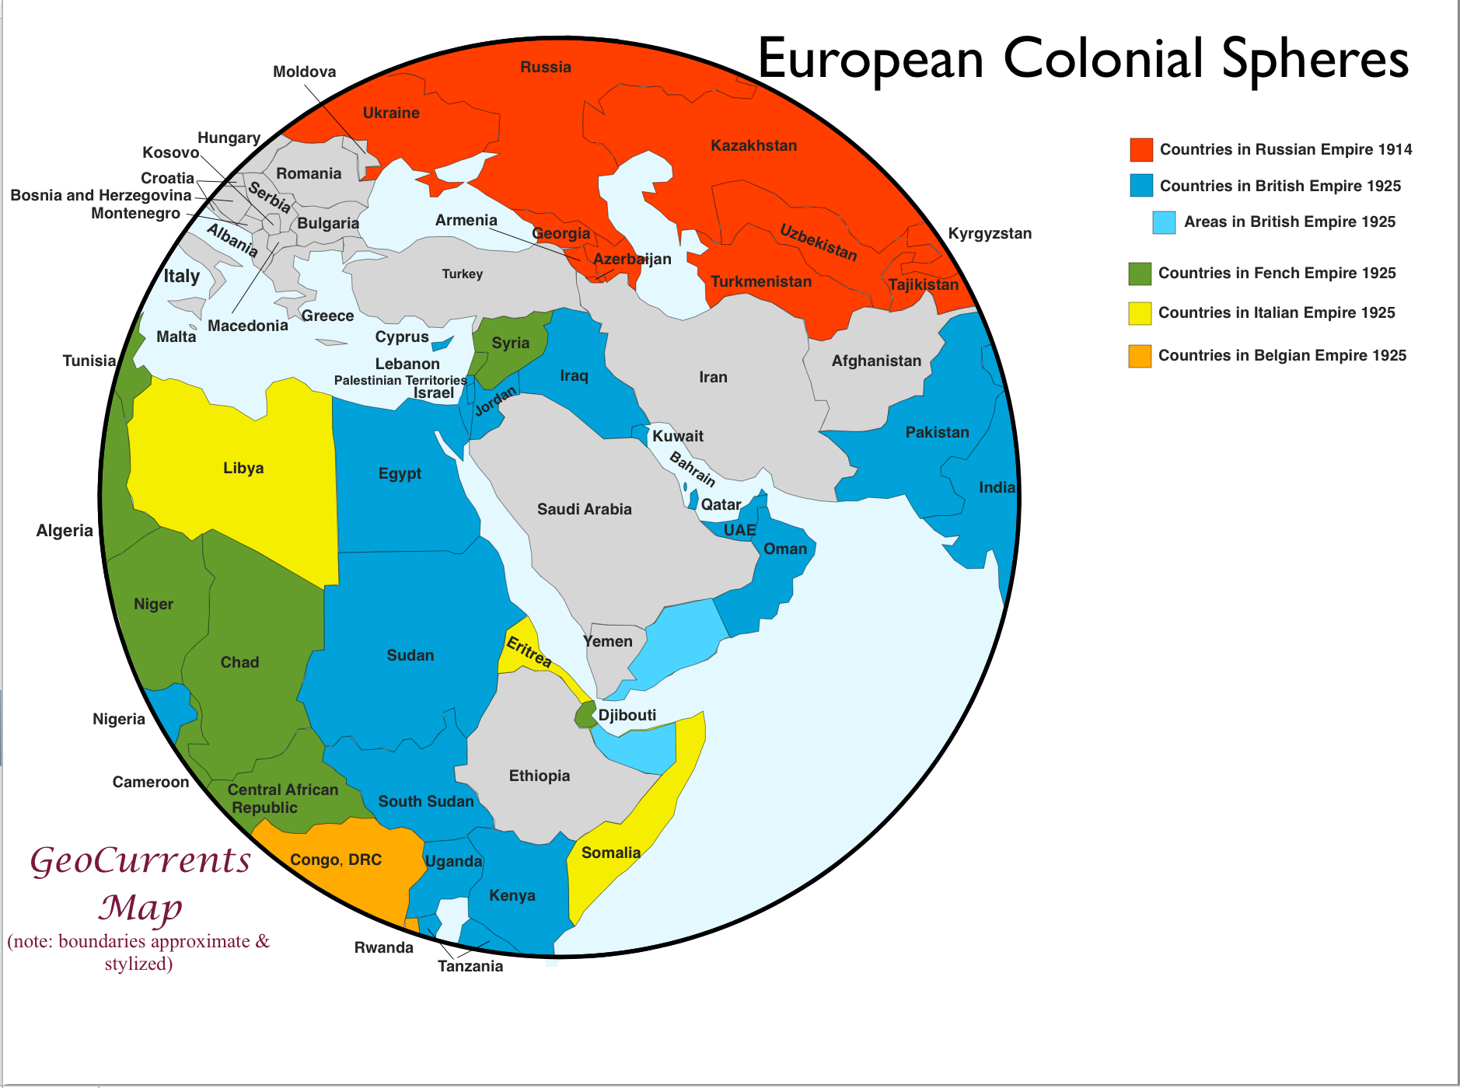

Slide 12
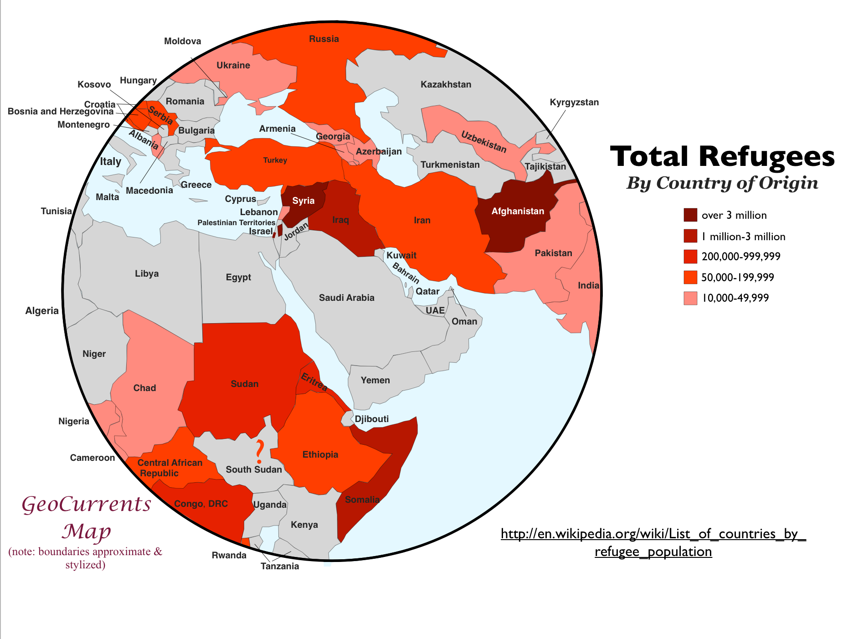

Slide 13
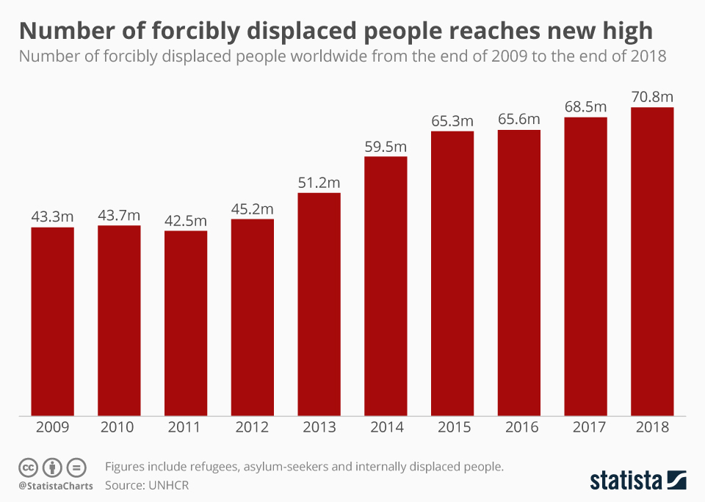
https://www.statista.com/chart/18423/forcibly-displaced-worldwide-timeline/

Slide 14
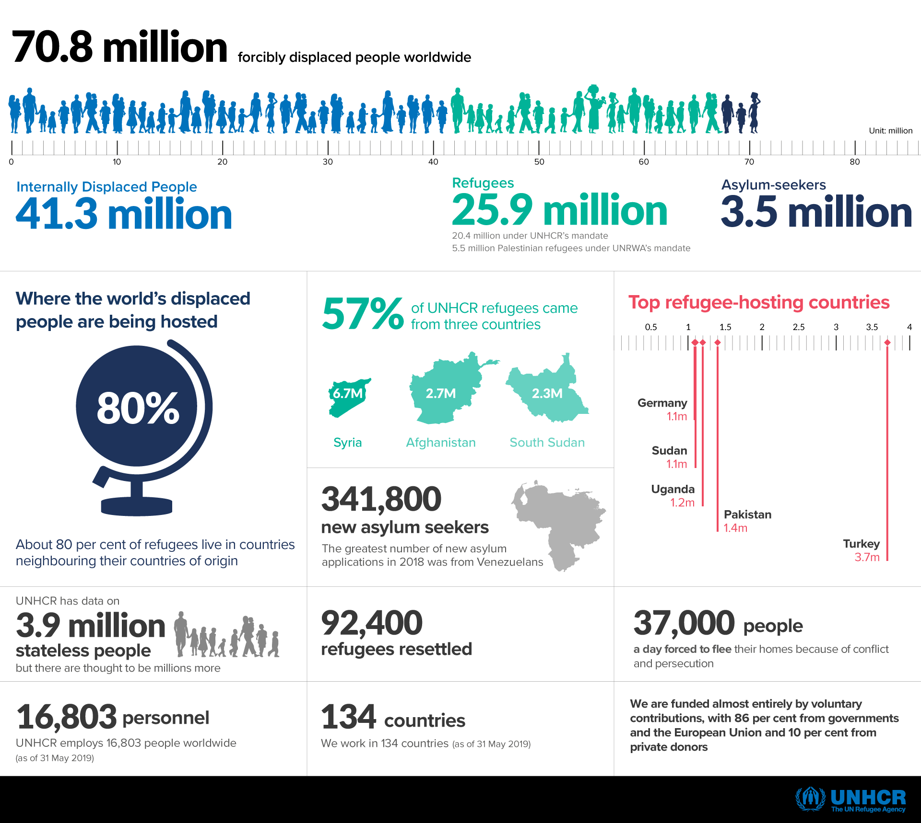
https://www.unhcr.org/en-us/figures-at-a-glance.html

Slide 15
https://www.unhcr.org/en-us/figures-at-a-glance.html
At the end of last year, 57 % of the world's refugees came from just three countries - Syria, Afghanistan and South Sudan.

Slide 16
https://www.unhcr.org/en-us/figures-at-a-glance.html
Top Host Countries:
Turkey
Pakistan
Uganda
Sudan
Germany

Slide 17
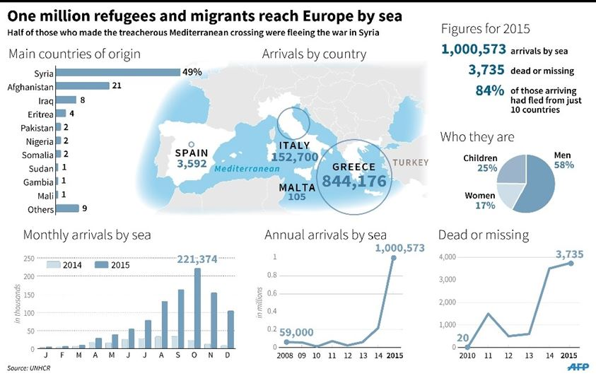
Refugee Crisis in 2015
Numbers
Notes:
1.3 million refugees seeking asylum in the EU in 2015
where do these people come from and what is the caus?

Slide 18
https://www.worldvision.org/refugees-news-stories/forced-to-flee-top-countries-refugees-coming-from
Top 7 countries of origin that account for the most refugees in the world today. About 67% of today’s refugees come from the top five of these countries.
1. Syria — 6.7 million refugees
Most of the 6.7 million Syrians who are currently refugees remain in the Middle East.
Turkey hosts 3.6 million, the largest number of refugees hosted by any country.
Syrian refugees are also in Lebanon, Jordan, and Iraq.
During 2018, 1.4 million refugees returned home to Syria.
Returnees face a daunting situation, including lack of infrastructure and services and danger from explosive devices.
About 6.2 million Syrians are still displaced inside the country.

Slide 19
2. Afghanistan — 2.7 million refugees
Representing the second-largest refugee population in the world.
Pakistan hosts nearly 1.4 million, including some second- or third-generation Afghan refugees who have never lived in their home country.
Some have been forced to return home from neighboring countries, but increased violence in Afghanistan since 2015 has led to a new surge of asylum seekers.
As many as 2.6 million Afghans are displaced within the country due to conflict, drought, and other natural disasters.

Slide 20
3. South Sudan — 2.3 million refugees
The protracted conflict in South Sudan is in its sixth year.
About 1.8 million people have been displaced within the country, in addition to 2.3 million who fled to neighboring countries.
An estimated 80% of the refugees are women and children. And about 50,000 of the children are orphaned or unaccompanied.

Slide 21
4. Myanmar – 1.1 million refugees
About 1.1 million people who identify as members of the Rohingya ethnic group have fled their homes in western Myanmar’s Rakhine state.
As many as 700,000 relocated to Bangladesh since August 2017.
Aid agencies are struggling to adequately serve people who are dependent on aid, including those in local communities.

Slide 22
5. Somalia — 900,000 refugees
Most Somali refugees have settled in Kenya, Ethiopia, or Yemen.
Some have lived in massive refugee camps for years.
About 100,000 have returned to the country since June 2016, largely due to the Kenyan government’s intent to eventually close Dadaab, which at one time was the world’s largest refugee camp.
But the widespread humanitarian need continues as a result of conflict and recurring and severe drought inside Somalia.
Within Somalia, an estimated 2.6 million people are displaced because of insecurity.

Slide 23
6. Sudan — 725,000 refugees
An economic crisis in Sudan that began in 2018 has been exacerbated by escalating violence and insecurity that continues following the overthrow of the Sudanese government in April 2019.
Deteriorating conditions have led to displacement of about 1.9 million people within Sudan, along with about 725,000 people fleeing as refugees.
At the end of 2018, Sudan was hosting more than 1 million refugees from other conflict-torn countries including South Sudan and Eritrea.

Slide 24
7. Democratic Republic of the Congo — 720,300 refugees
Conflict and food insecurity are driving people to flee the Democratic Republic of the Congo.
More than 2 million people were newly displaced in 2017 and 2018, and more than 700,000 people from the DRC live in neighboring countries as refugees.
Violence has also prevented containment of an Ebola outbreak that started in May 2018.

Slide 25
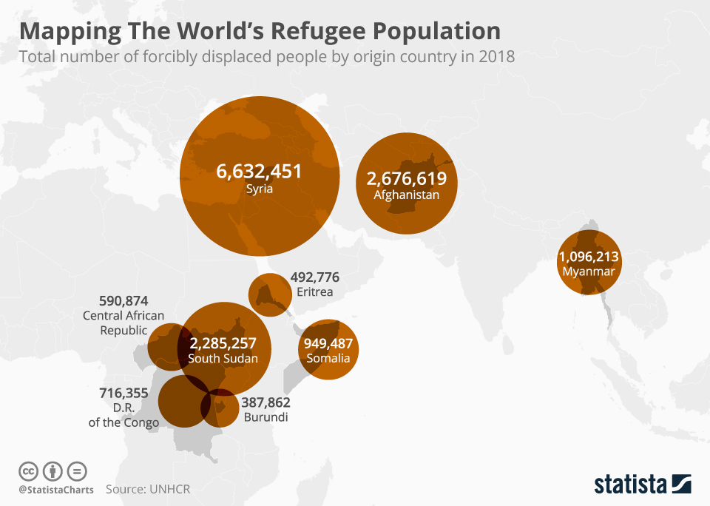

Slide 26
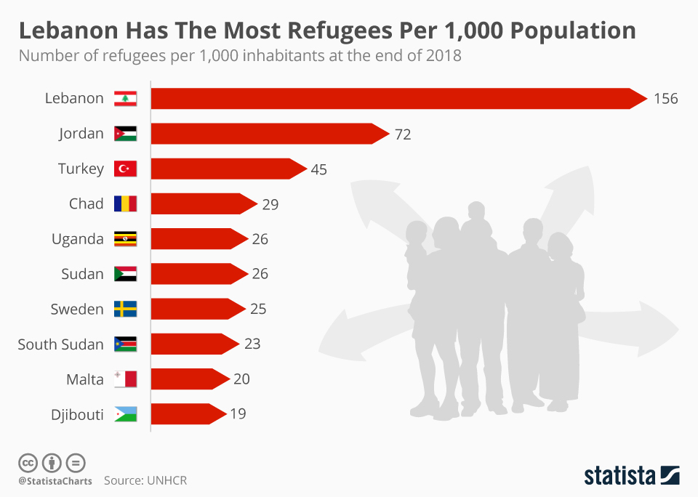
https://www.statista.com/chart/8800/lebanon-has-by-far-the-most-refugees-per-capita/
Most Refugees
per 1000 population
3.7 Million
1.2 Million

Slide 27
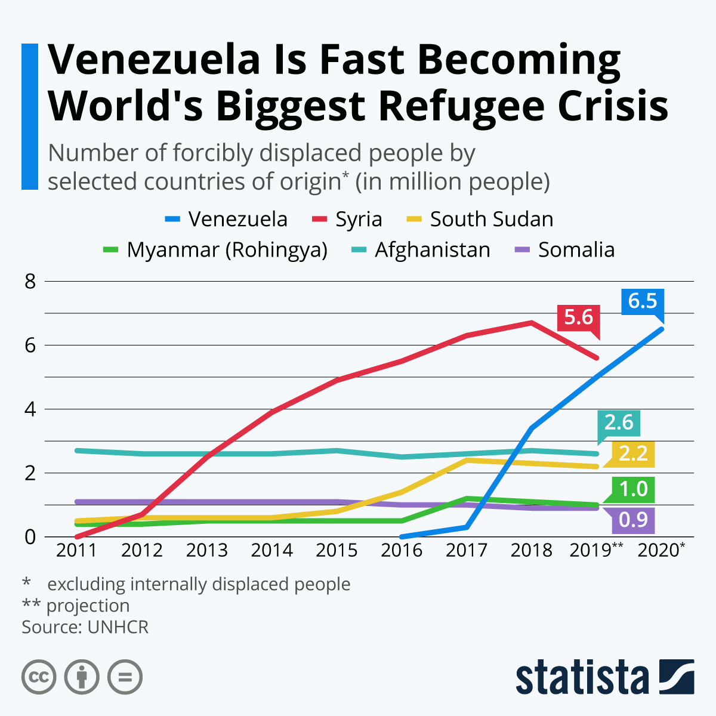
https://www.statista.com/chart/20337/populations-of-forcibly-displaced-people-by-country-of-origin/

Slide 28
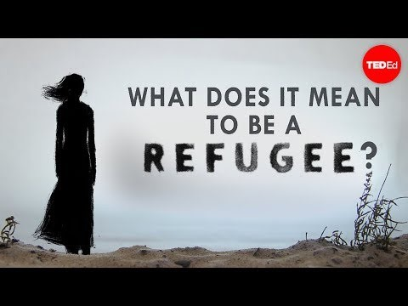
What does it mean to be a refugee? - Benedetta Berti and Evelien Borgman
https://youtu.be/25bwiSikRsI

Slide 29
Refugees Vs. Migrants – What's The Difference? A+J September 8, 2015
https://youtu.be/NethRULYorA

Slide 30
Refugees – What’s the World’s Responsibility?
https://youtu.be/KX0Db8L6Jso

Slide 31
The 'vital' role of mobile phones for refugees & migrants - BBC News 9/7/2015
https://youtu.be/DWTFG-x1dnk
2 mins

Slide 32
Take Home Quiz #4 – Sent via Email & posted in Week #5 folder
Step 1: Please choose one of the following positions and then maintain that position in your responses.
Step 2: Assume you are the USA as the host country / destination for immigrants / refugees that YOU represent in your responses.
Step 3: Please provide complete answers these 5 questions. One sentence responses are not considered a complete response.

Slide 33
Step 1: Please choose one of the following
Position 1: Immigration / Migration must be controlled, no matter what the circumstances, in order to maintain society.
Position 2: Refugee Migration must be allowed through open borders by all more developed or stable countries than the country from which the refugees are fleeing.
Position 3: Immigration must be allowed /capitalized on by host countries through creation of jobs and economic impacts for skilled migrants into all nations providing an improved standard of living for those fleeing their homeland.
Position 4: ALL mankind (immigrant or refugee) must be allowed free movement and provided adequate support in transit and by final destination country, including healthcare, education, skills training and employment.
Position 5: ALL borders should be closed to those who do not provide an immediate, direct positive socio-economic impact to citizens of the hosting country.

Slide 34
Step 3: Answer the following questions
What criteria would YOU want to see utilized to decide whether or not immigrants are allowed into your country? Why?
Do YOU perceive your criteria detailed in your answer to question 1 to be controlling, monitoring, or enabling for those seeking opportunities? Do these criteria protect your country’s citizens?
Does the same criteria in Answer 1 apply to refugees seeking asylum from war, terrorism, and poverty? Please explain.
How will you explain / describe the recent migration events to your children?
What existing technologies could be utilized to assist YOU in applying your criteria to immigration? What existing technology can be utilized to monitor / control and identify / find persons in migration status? Would you use different technologies for refugees?

Slide 35
What do you take with you…??
http://qz.com/496220/photos-what-syrian-refugees-carry-in-their-bags-as-they-leave-their-lives-behind/

Slide 36
Learning WHAT to give up
As you are fleeing…
How do you decide what to carry-on with you when you reach an obstacle that requires you to choose among your most valued possessions?

Slide 37
Immigration Wave: Will Europe Still Be Europe? CBN News September 2, 2015
https://youtu.be/tXMkcZBvq7U
5 mins

Slide 38
How to solve the refugee crisis? – The Economist
https://youtu.be/EFBBQ4GocfI

Slide 39
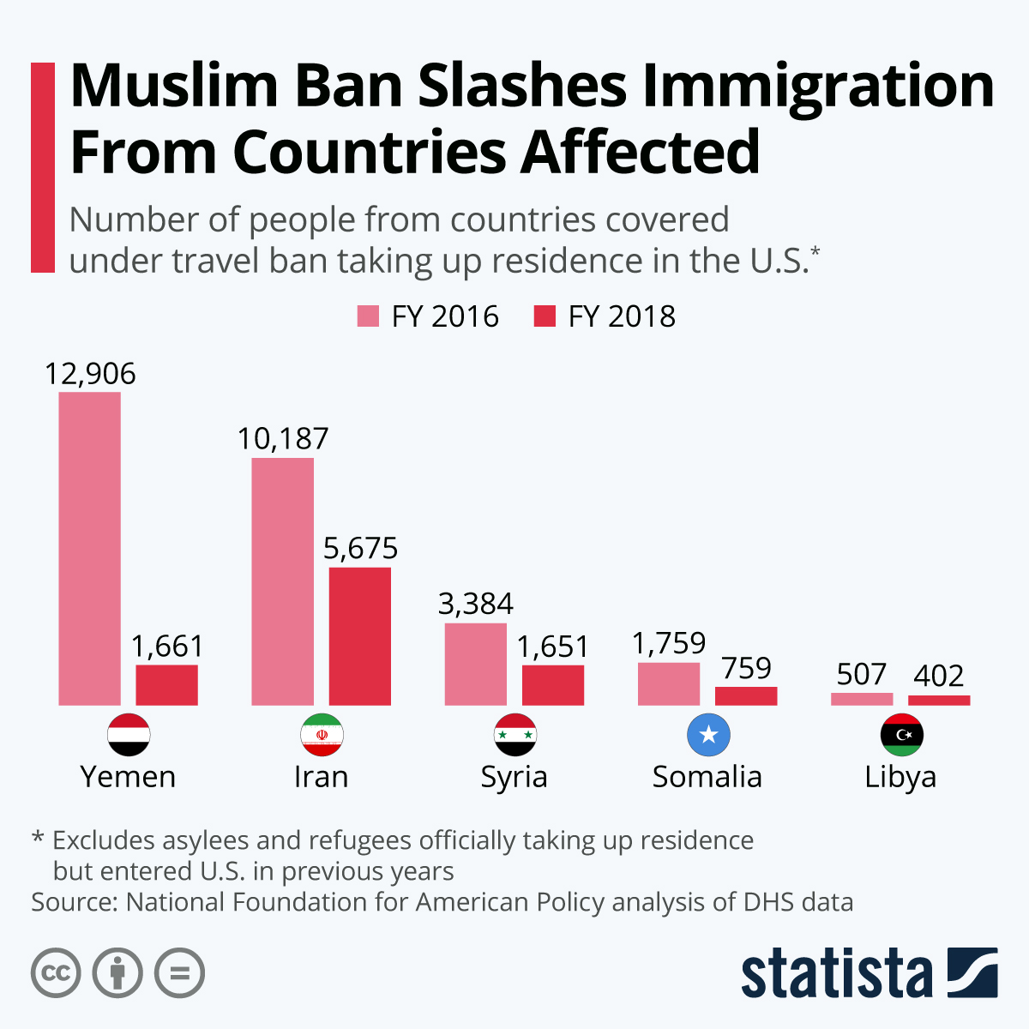
https://www.statista.com/chart/20557/number-of-new-us-residents-from-travel-ban-countries/

Slide 40
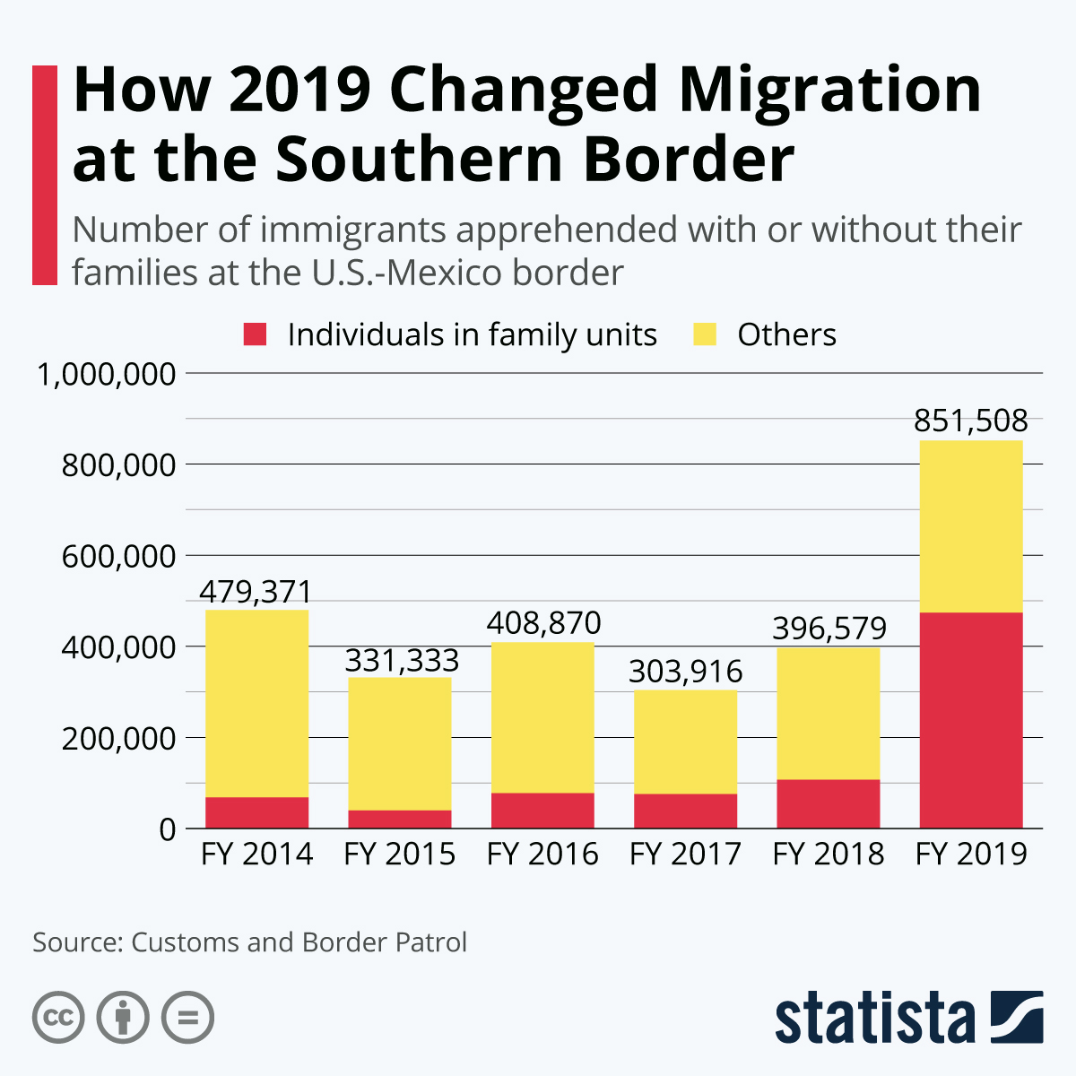
https://www.statista.com/chart/20397/number-of-immigrants-apprehended-at-us-mexico-border-with-without-families/

Slide 41
Reminders
Turn in Home-Work – Play activity
Turn in Take Home Quiz #4
Have a great weekend!
Tuesday – Defining American Culture

Slide 42
Refugee crisis in Hungary: how thousands spend the night at Keleti station
https://youtu.be/0FiMmkIaWig
4 mins

Slide 43
The great European immigration disaster - the third world pouring into Europe.
https://youtu.be/kUPbu1RKNcA
25 mins
view Mins 2-8
ADDITIONAL MATERIALS FOR YOUR CONSIDERATION

Slide 44
Refugees cheered into Germany and Austria
https://youtu.be/txdKyT2tscU
5 mins

Slide 45
Dreaming of the UK: Europe’s Migrant Crisis Changing World August 6, 2015
https://youtu.be/JSO7cOiQkIg
35 mins
ADDITIONAL MATERIALS FOR YOUR CONSIDERATION

Slide 46
Inside Story: Migrants or refugees?
Al Jazeera August 21, 2015
https://youtu.be/IAPY0MZFmM0
25 mins
ADDITIONAL MATERIALS FOR YOUR CONSIDERATION

Slide 47
Immigration in Germany - The statistics | Made in Germany - July 2, 2014
https://youtu.be/5kHredDs-IY
2 mins
ADDITIONAL MATERIALS FOR YOUR CONSIDERATION

Slide 48
Stirring Images of Syrian Boy’s Body Now Symbol of Europe’s Crisis NBC Nightly News 9/2/2015
https://youtu.be/286cPY8BiwI
3 mins

Slide 49
