Slide 1
Today – February 21, 2019
Test #1 Results
Follow –up on Defining American Culture Activity
Social Media and Global Perspectives
In-Class Activity
Current Events Topics
Turn in Materials

Slide 2
TEST #1 Feedback

Slide 3

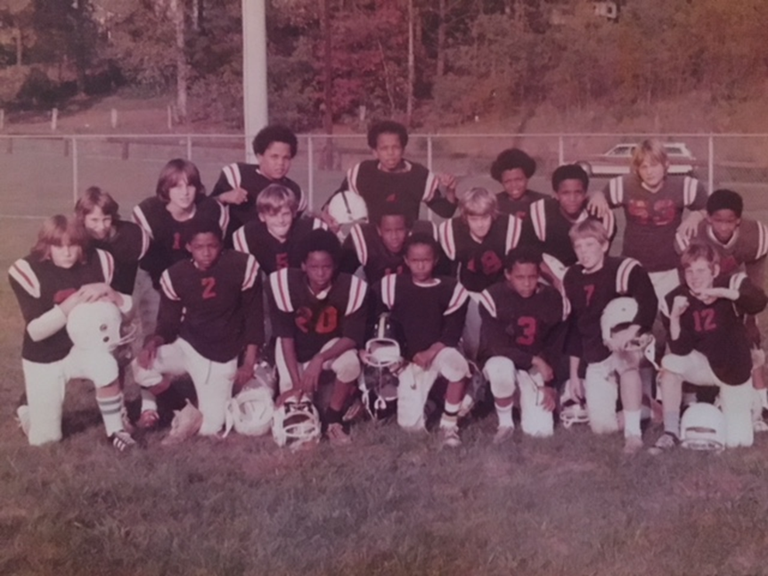
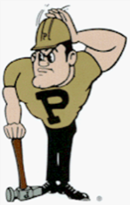
Global IT and Social Media
TECH 330 – February 21, 2019

Slide 4
Defining American Culture
In your original 7 groups:
Each person reads their response to:
“American culture can be defined as….”
Choose the “BEST” from among your group
Each group’s choice shares with the class.

Slide 5
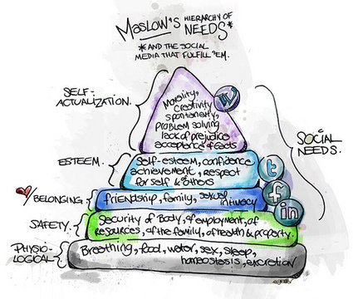
Infographic: Maslow’s Hierarchy of Needs & the Social Media that Fulfill ‘Em – http://www.dontwasteyourtime.co.uk/social-network/infographic-maslows-hierarchy-of-needs-the-social-media-that-fulfill-em-infographic/#sthash.u3KMaP1k.dpuf
David Hopkins - August 16, 2010

Slide 6
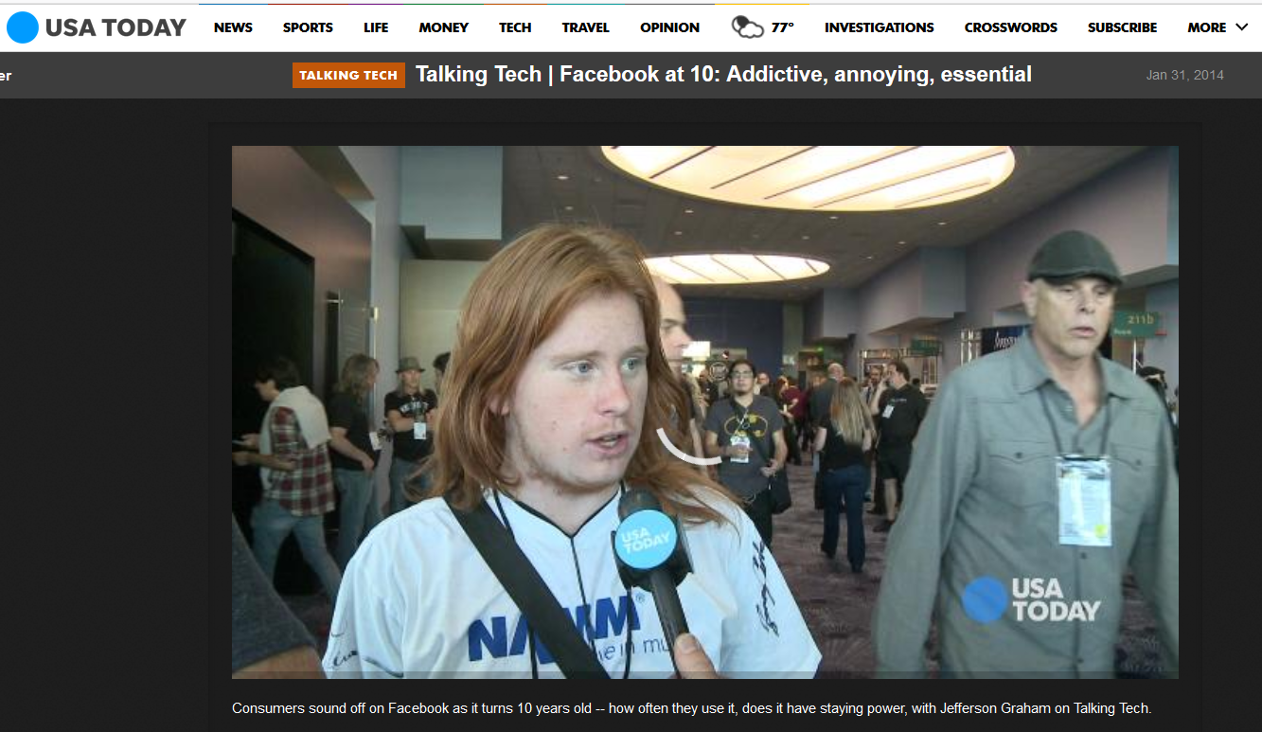
Talking Tech | Facebook at 10: Addictive, annoying, essential (3.50 minutes)
Notes:
http://www.usatoday.com/media/cinematic/video/5087329/talking-tech-facebook-at-10-addictive-annoying-essential/

Slide 7
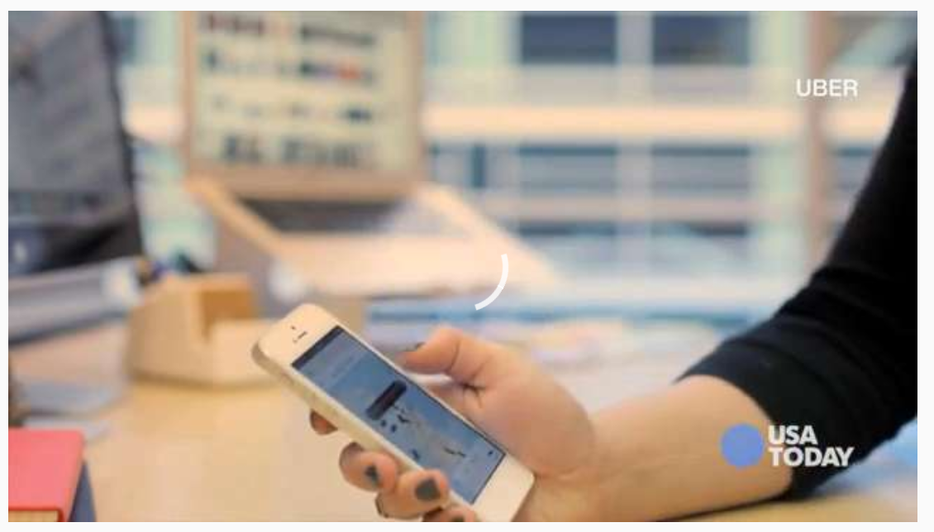
Could you live without these apps? (2.75 minutes)
Notes:
http://usat.ly/1nzlUCs

Slide 8
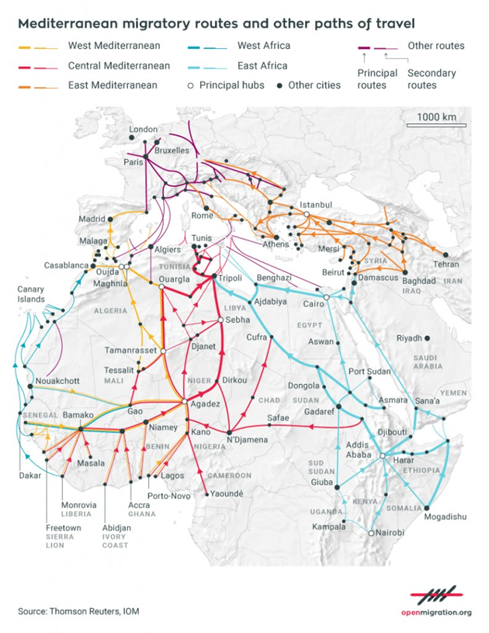

Slide 9

Refugees and social media: Smartphones become a critical tool for refugees
Notes:
https://youtu.be/Px6zkpFk77Y

Slide 10
The 'vital' role of mobile phones for refugees & migrants - BBC News
Notes:
https://youtu.be/DWTFG-x1dnk

Slide 11
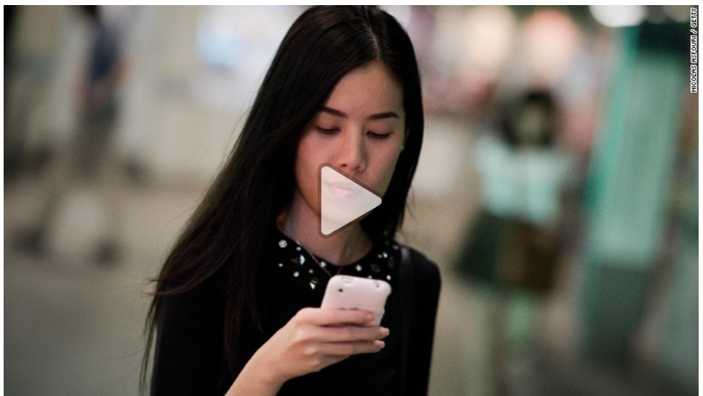
CNN – Social Media & Teens
Notes:
http://www.cnn.com/2015/11/03/health/teens-tweens-media-screen-use-report/index.html

Slide 12
Forbes – Social Media & Mental Health
https://www.forbes.com/sites/alicegwalton/2017/06/30/a-run-down-of-social-medias-effects-on-our-mental-health/#6aab50532e5a
It’s addictive
It triggers more sadness, less well-being
Comparing our lives with others is mentally unhealthy
It can lead to jealousy—and a vicious cycle
We get caught in the delusion of thinking it will help
More friends on social doesn’t mean you’re more social

Slide 13
How does IT and Social Media IMPACT Global Perceptions?
Maturation Process
Exposure
Cultural understanding
Multi-national teams
Multi-cultural projects
Trust through experience
Better sense of history
WOW! Factor
Technology Transfer
Learning Opportunity

Slide 14
Group Discussion: Social Media
What headline did you Choose? (February 14 to February 20th)
Did you utilize social media to follow the commentary on this headline? Is the story portrayed the same on News Media as it is on Social Media?
Which forms of social media were utilized to get the news headline broadly communicated? Shared, liked, comments, tweets, etc…
Which form of media are you more inclined to trust; your chosen social media platform or the news agencies? Why?
What social media APPs are on your mobile phone device?

Slide 15
Consider this…
IT and Social Media
Information is POWER….
Control of Information
  those who control information have power
Control of Expectations
  Unaware of what we are missing
  We remain content

Slide 16
Consider this…
IT and Social Media
Information is POWER….
Use of media for good things
  Better understanding, etc…
  Aligning principles
    e.g., Arab Spring Activities
Use of media for bad things
  Control by fear = terrorism
  Mass exposure of actions to drive fear

Slide 17
Consider this…
IT and Social Media
Mass exposure of actions ….
Why have TV networks refused to show the antics of sports fans running on the field?

Slide 18
Consider this…
IT and Social Media
How has technologies like Skype changed “OUR” perception of the world?

Slide 19
Consider this…
IT and Social Media
How has social media such as Facebook changed “YOUR” perception of the world?

Slide 20
Consider this…
IT and Social Media
How has technologies like Skype changed “OUR” perception of the world?

Slide 21
Consider this…
IT and Social Media
How has social media such as Facebook changed “YOUR” perception of the world?

Slide 22
Social Media / News Reports
How does access to information affect TRUST?

Slide 23
Social Media / News Reports
How does access to other people’s OPINIONS affect TRUST?

Slide 24
Reminders for Week #7
Turn in your Defining American Culture Assignments
Turn in your Social Media In-class Assignments
NEXT WEEK:
  Global Cyber Security – Professor Ngambeki

Slide 25
Social Media and Self-Image
http://www.cnn.com/2017/01/12/health/girls-social-media-self-image-partner/index.html

Slide 26
Facebook Profiles (2 minutes)
Scammers copying Facebook profiles for ransom

