Slide 1
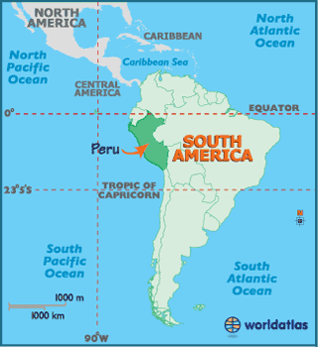
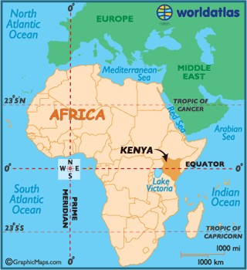
Design Thinking and Culture: an inter-social program of Immersion – (PERU/ Kenyan Perspective)

Slide 2
Tech 330
Key things you have been discussing in TECH 330 so far:
Education access
https://www.facebook.com/watch/?v=1886706451430579
Global business positioning i.e. cultures and business

Slide 3
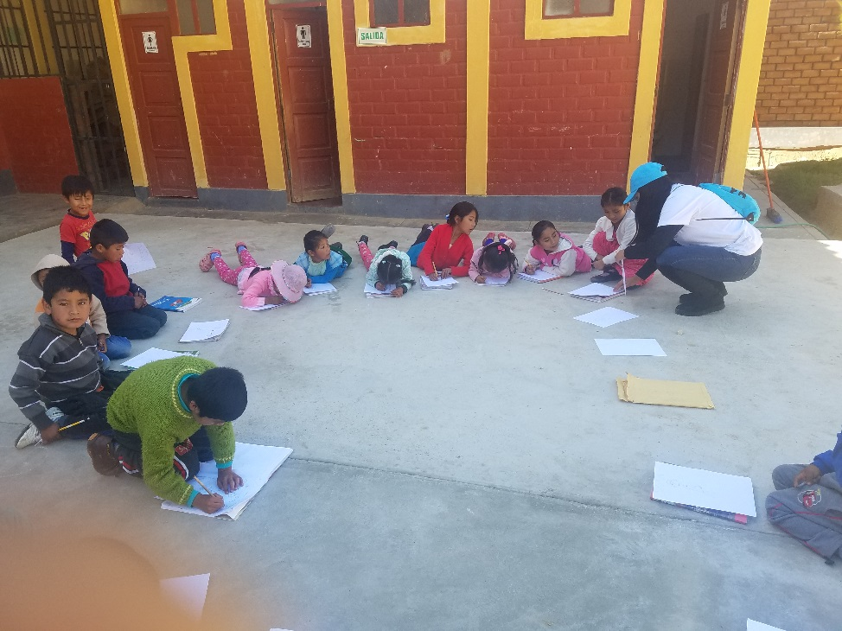
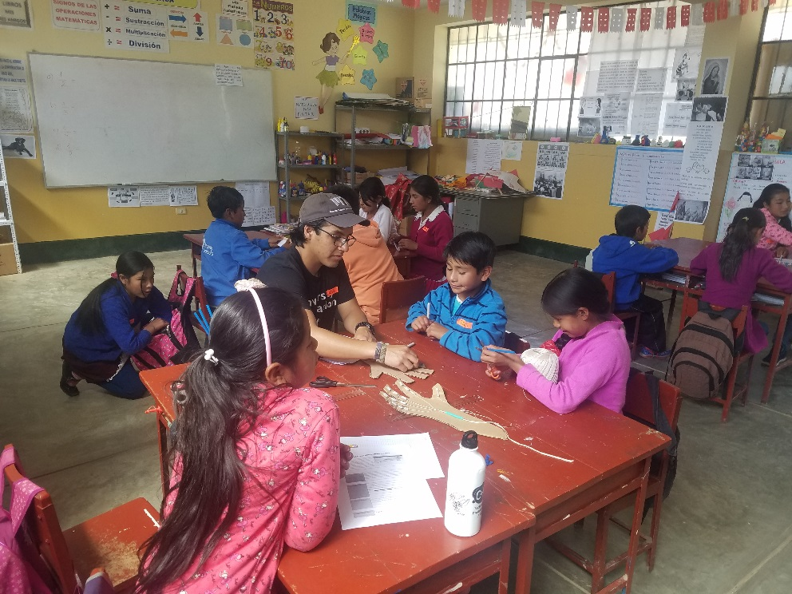
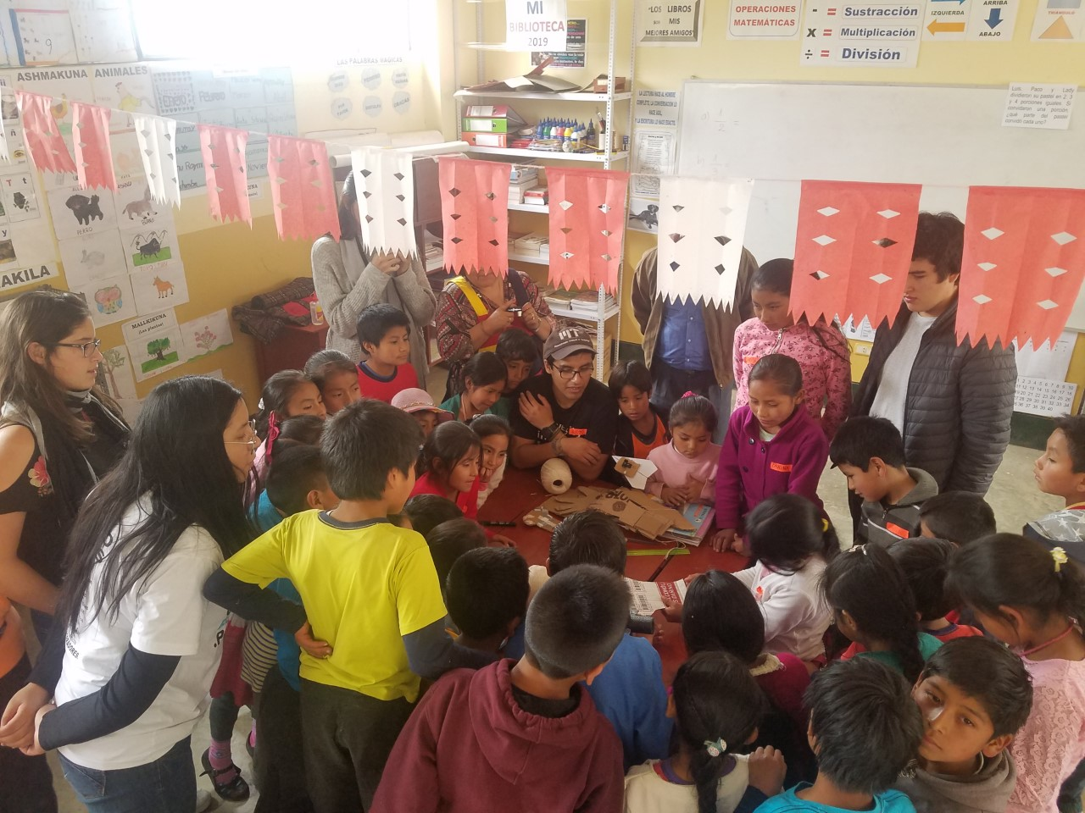

Slide 4
Kenya
Kenya is an East African country almost the size of state of Texas
Total population of about 49 Million people as of 2017
About 2.5% of population lives in Urban cities and towns such as Nairobi (Capital) and Mombasa
Kenya is a blend of several different cultures, and ethnic groups living together. Although various indigenous languages are spoken in Kenya today, English and Kiswahili are two official languages spoken
Despite the abundance of natural and human resources, Kenya is like most other developing countries in Africa today and is crippled with so many issues (both natural and man made)

Slide 5
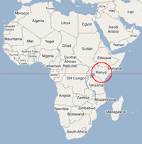
Location of Kenya

Slide 6
Kenya
75% of Kenya’s population is into subsistence farming (agriculture and cattle rearing)
In times of crop failure most of the these families go starving
Due to tropical regions and coastline, natural havoc’s (such as droughts and flooding) often push many of the families into absolute poverty
Although Kenya holds best literacy rate, the quality of education is something very hard to be at par with different countries. Where after graduation most of the graduates end up on streets jobless.
Around 50% of Kenyan population live below poverty line according to the recent report published by UNDP

Slide 7
Challenges?
Based on this brief intro what are some the “grand challenges” you foresee that affect Kenyans?
3 minutes in groups… share
https://www.youtube.com/watch?v=7sQlPj6QzUo

Slide 8
The issues are:
Corruption
High Cost of Living/Inflation
Lack of Employment
Poor Leadership
Poverty/Rich‐Poor Gap
Hunger/Drought
Tribalism/Ethnic Tensions
Poor Infrastructure
Terrorism
Crime

Slide 9
Poverty
The amount of unemployment is high
Graduates ends up doing odd jobs
People still live in unhygienic places like slums
Rural Kenya lacks infrastructure, electricity etc.

Slide 10
Alleviating Poverty ?
Share Some key things from a problem solving aspect how you can alleviate poverty in Kenya?
3 minutes in groups… share

Slide 11
An American Perspective
https://www.americanprogress.org/issues/poverty/news/2014/09/17/97287/the-top-10-solutions-to-cut-poverty-and-grow-the-middle-class/

Slide 12
Alleviating Poverty ?
Can the American Perspective work?
Yes/NO
Why?
3 minutes in groups… share

Slide 13
Job Creation through SMEs
The JUA KALI sector
Some studies show that four out of five working Kenyans are in the informal sector
The sector produces mainly for the local market and helps the country save foreign exchange
It requires less expensive machinery and technology that can be locally produced and help establish the country’s technological capabilities
Jua Kali operators do imitate the products that are already in the market thus spreading technological skills

Slide 14
Job Creation through SMEs
The Jua Kali businesses can roughly be divided into four main categories: suppliers, producers, sellers, and service providers
The supplying businesses consist of hardware stores, paint stores and scrap metal suppliers
Producing businesses use these materials to produce the products available in the Jua Kali
The selling businesses buy the products from the producers and sell them to the customers
Most businesses combine production and selling in one business. In this case the shopkeeper is responsible for the sales, while the artisans do most of the production.

Slide 15
Some Products
Jua Kali businesses produces a large variety of products, including wheelbarrows, gutters, boxes, chicken feeders, popcorn machines, food heaters and gas cookers
There are hundreds of workshops that consist of only a few employees, and often produce similar products
Although innovation is present, it comes at a slow pace

Slide 16
https://sites.google.com/site/kamukunjijuakali/about-kamukunji/businesses
https://www.youtube.com/watch?v=g95iN8UDIVE

Slide 17
Design Thinking and Culture
What role do you see design thinking in job creation vis a vis problem solving in the case of Kenya
What about Peru?
Does Culture play a role?
https://engineering.purdue.edu/ME/News/firepup-firefighting-vehicle-for-africa

Slide 18
Hofstede’s Cultural Dimensions
Which aspects of the jua kali sector can you relate to Hofstede’s Cultural dimensions?
3 minutes in groups… share

