Slide 1
Sys-Tech Approaches to Combating Human Trafficking
Dr. Chad Laux
Dr. Kate Seigfried-Spellar

Slide 2
Outline
Overview of Human Trafficking
Sys-Tech Approaches
Failure Mode Effects Analysis (FMEA)
Chat Analysis Triage Tool (CATT)
Q&A

Slide 3
What is human trafficking? (10 min)
Discuss w/ a partner what is a description of human trafficking
What are the different types?

Slide 4
Human Trafficking - Definition
Human trafficking is “the acquisition of people by improper means such as force, fraud or deception, with the aim of exploiting them” (UNODC, 2018).
The Global Report on Trafficking in Persons (UNODC, 2016) states that human trafficking includes sexual exploitation, informal labor, child soldiers, forced begging, forced marriage, selling children, removal of organs, forced labor, and sexual exploitation.

Slide 5
Human Trafficking - The crisis
Human Trafficking is a worldwide crime referred to as the modern-day slavery.
Approximately 24.9 million trafficked worldwide.
$150 billion-dollar industry worldwide
For the Americas, 56% of detected victims were trafficked for sexual exploitation, and 28% were trafficked for forced labor.
In Central America, the majority of detected victims are children.
(UNODC, 2016; ILO, 2016)

Slide 6
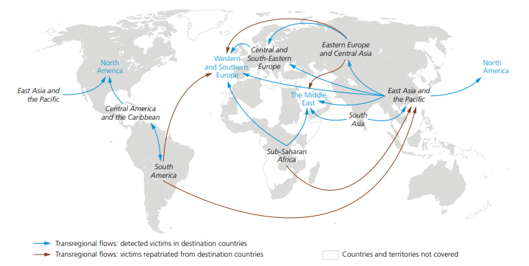
(UNODC Research, 2016)

Slide 7
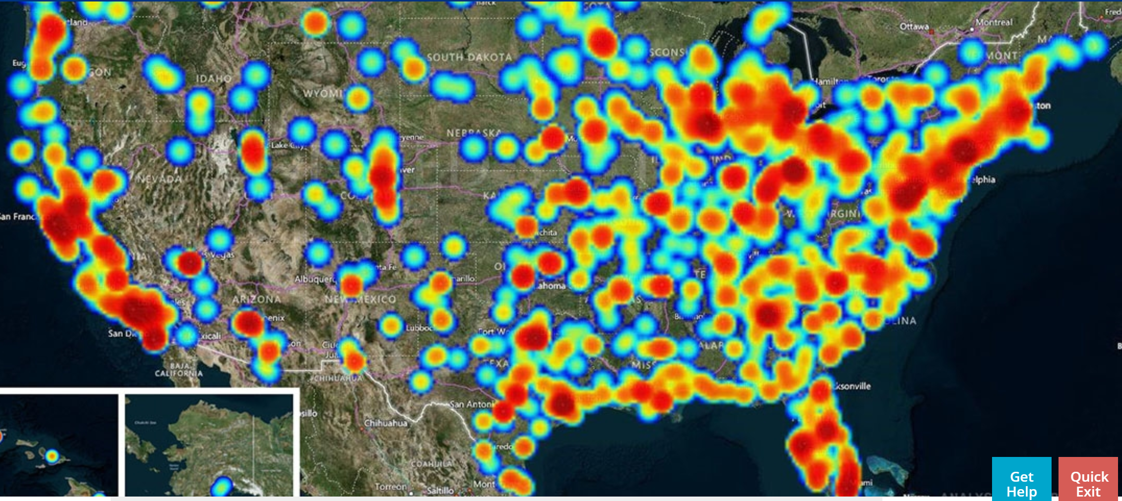
(United States)

Slide 8
 | PUSH FACTORS | PULL FACTORS
Definition | Local conditions that force individuals to move to find better conditions in another place. | Incentives in foreign countries (destination) that make individuals want to leave their country as a promise of a better future.
Examples | Poverty Oppression Lack of human rights Lack of social or economic opportunity Danger from conflict/ instability Political instability Militarism Natural Disasters | Lack of workers Good social measures Higher wages Demand for low-wage jobs (migrants) Political stability Social Stability Positive economic situation
(Stanojoska & Biagojce, 2012)

Slide 9
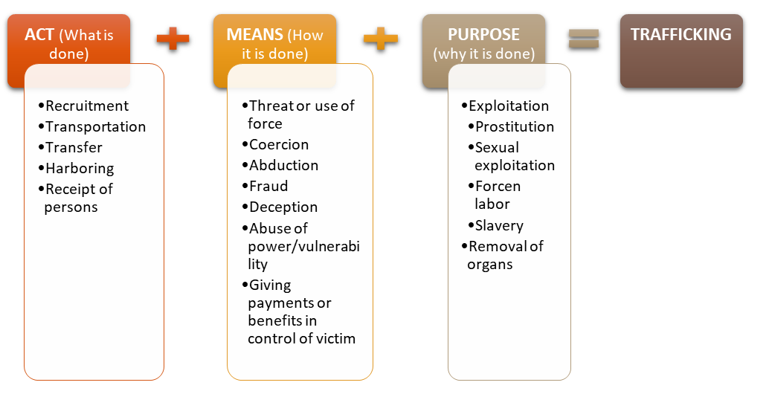
(UNODC: United Nations Office on Drugs and Crime, 2018)

Slide 10
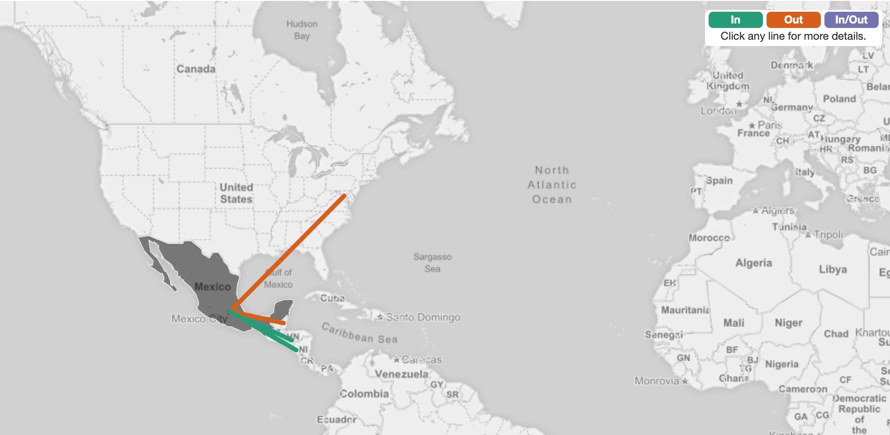
Flow Map for Mexico

Slide 11
Mitigation Strategies
Creation of national database for FBI and local law enforcement to enter, access, and share pertinent information of Human Trafficking cases
Enhancing existing social media platform (s) to include space for survivor leaders, recent survivors and service providers to communicate and share information
Expansion of existing mobile-based apps for survivors, service providers, and law enforcement to provide information on local services available for survivors
Including an emergency function to existing mobile-based apps commonly used by youth that instantly notifies specifies contacts and/or local law enforcement

Slide 12
Mitigation Strategies
Creating a digital platform for service providers that facilitates secure and prompt cross-sectional information-sharing for stakeholders involved with human trafficked survivors receiving rehabilitative services
Internship and employment opportunities for human trafficking survivors
Facilitating an app-based challenge for survivors to develop ways to prevent sex-trafficking of youth, intervene with victims, enhance after-care services and reduce recidivism rates.
Further research on the interplay of technology with the following populations: at risk-youth in schools and the child welfare system; mental and physical health of human trafficked victims and survivors; child labor practices; labor and sex trafficking in adults.

Slide 13
Sys-Tech approach When does the human trafficking process fail?

Slide 14
FMEA Sys-Tech Approach
Research Objective:
Apply a systems engineering approach to understand the human sex trafficking process in order to identify efficient ways to mitigate
Specific aim:
Construct a Failure Mode and Effects Analysis (FMEA) to identify the most critical points where criminal elements are likely to fail

Slide 15
How to be a Systems thinker

Slide 16
FMEA
First developed by US military to study how systems fail for reliability purposes
Inductive Reasoning – SMEs and data
Based upon occurrence, severity, and ability to detect failures
Risk based
Used in this study on how we can intercede and disrupt these systems

Slide 17
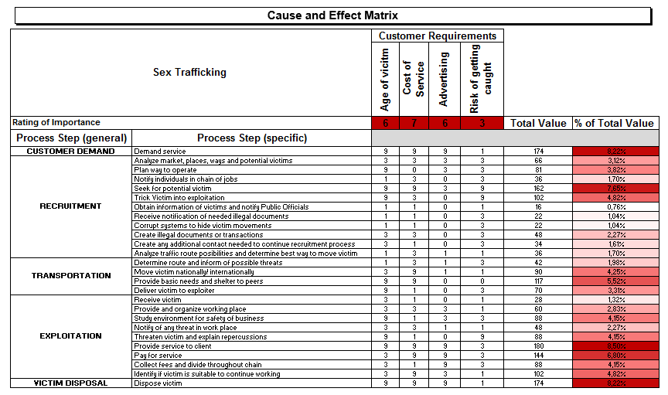
Cause & Effect Diagram for FMEA - results

Slide 18
Cause & Effect Diagram Activity

Slide 19
Chat analysis triage Tool
Can we identify the motivation of an internet offender based on their chats with a minor?

Slide 20
Solicitation of minors
Online enticement is a broad category of online exploitation:
being groomed to take sexually explicit images
meet face-to-face for sexual purposes
engage in a sexual conversation (NCMEC, 2018).
It is estimated that 750,000 adults seek sex with minors daily (FBI, 2015).
1 out of 25 children will experience a sexual solicitation online, where the offender asks to meet-up for sex.

Slide 21
Solicitation of minors
NCMEC (2017) analyzed the tips made in 2015 regarding the online enticement of minors.
60% wanted to obtain sexually explicit images from the minors.
32% of the offenders wanted to meet and have sexual contact with the minors.
8% were interested in sexual conversation and/or role-play

Slide 22
Solicitation of minors
Identifying offenders is difficult because they have different motivations:
Contact-driven vs. Fantasy-driven
Law enforcement are presented with thousands of cases involving online enticement.
Can law enforcement identify contact vs. fantasy-driven offenders in order to prioritize cases?

Slide 23
Solicitation of minors – hypothesis
How is trust built so that a child will meet a stranger?
Through grooming
What about the language used when they “groom?”
Adults build trust with each other through self-disclosure, which show vulnerability, by talking about negative emotions & experiences
Do contact-driven offenders use more self-disclosures compared to fantasy-driven offenders?

Slide 24
Solicitation of minors – DATA
We found statistically significant differences in the chats between minors and contact-driven vs. fantasy-driven offenders.
Self-disclosure as a grooming tactic
Chats varied across time
First person pronoun + negative emotion
Based on these findings, we are developing a digital forensics tool: Chat Analysis Triage Tool (CATT)

Slide 25
Thank you
Questions and Answers
Chad Laux, CSSBB, PhD
Associate Professor
Computer and Information Technology
Purdue University
West Lafayette, IN 47907
claux@purdue.edu
+1765-494-0742
Kathryn Seigfried-Spellar, PhD
Associate Professor
Purdue University
Department of Computer & Information Technology
Purdue University
West Lafayette, IN 47907
+1765-494-2439

