Slide 1
Global Challenges
SDG and ICT Guidebook
TECH 330 – Technology and the Global Society
Week 11 – Class #1
March 26, 2019

Slide 2
reminders
IDI Debriefs?
Reflection Assignment…Due on Blackboard before class on April 25th
Current Events Due in class on Thursday April 4th

Slide 3
today
Part 1: In Class Global Challenges Activity
  Individual and Group
  Discussion
Assignment Part 2 of Global Challenges and SDG via Blackboard… due Thursday, March 28th

Slide 4
Group activity
Define a “Global Challenge”?
Rank the TOP 5 “global challenges” facing society?
  Which one is the most threatening to society?
Which global challenges that we can resolve / overcome in our lifetime?
Which global challenges will continue to worsen over time
NEW global challenges will we encounter 50 years from now?

Slide 5
TOP 5 Global Challenges - march 26, 2019
Tech 330 in-class activity
CLIMATE CHANGE
POVERTY
SECURED FOOD AND WATER
EDUCATION
VIOLENCE (WAR, TERRORISM)

Slide 6
Sustainable Development Goals

Slide 7
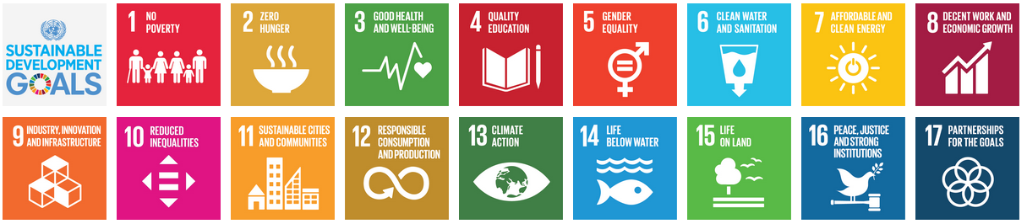
Sustainable Development goals
17 Goals around peace and prosperity for people and the planet, now and into the future
Adopted by all 193 in 2015
It´s an urgent call for action for all - developed and developing – countries in a global partnership

Slide 8
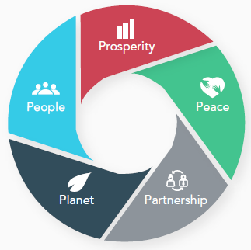
SDG ICT Guidebook
Sustainable development goals (SDG´s) and information and communications technology (ict)
Shared commitment:
ensuring healthy lives, achieving dignity, prosperity and justice for all people and protecting our planet for all future generations
Relies on partnerships to catalyze global solidarity for sustainable development in all its dimensions (economic, social and environmental)

Slide 9
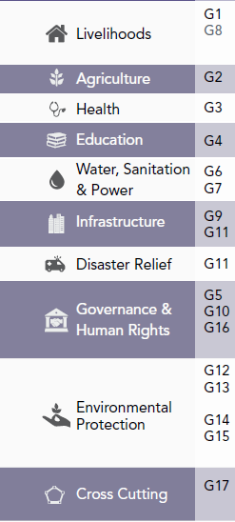
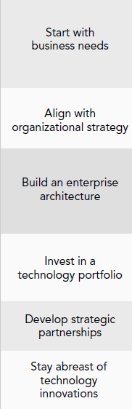
SDG ICT Guidebook
Development Sectors and ICT Strategy
Defining goals in different development sectors
Using ICT Strategy to achieve the goals through the use of technology

Slide 10
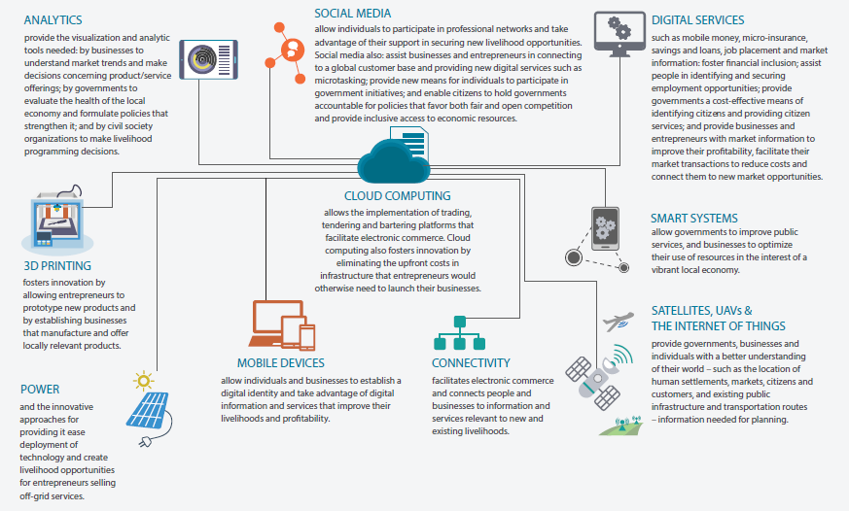
SDG ICT Guidebook
Technology Building Blocks and technology used by sectors
Benefits, Trends, Challenges and Recommendation of Technology Building Blocks
Technology use in development sectors

Slide 11
Thursday’s class
Complete Global Challenges Part 2 Assignment and bring to class on Thursday.
Thursday’s Lecture:
  Stephen Hellen, Catholic Relief Services,
  Utilizing the Sustainability Guidebook
Next Tuesday… Fake News

