Slide 1
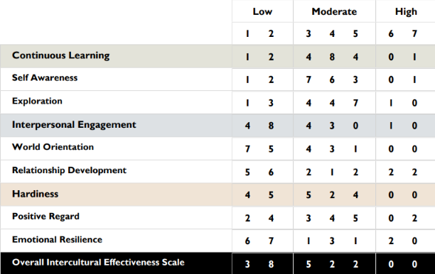
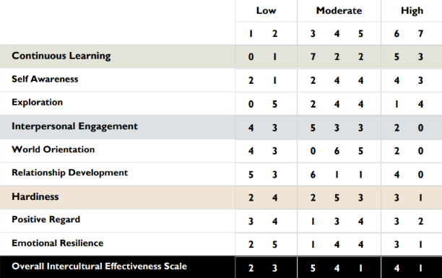
Jim Tanoos
Clinical Associate Professor- IET dept.
Gauging Undergraduate Intercultural Competencies by Utilizing the Intercultural Effectiveness Scale (IES) as an Assessment Tool
Table 1.
IES Pre-survey output (Week 1)
Table 2.
IES Post-survey output (Final Week)
Takeaways:
Strong linkages exist between changes in IE and H as they relate to changes in overall IES, as a positive change in pre- and post-survey scores will lead to a positive change in IES score as well
Changes in IE scores predicted similar changes in overall IES scores
Since the IE reflects world orientation and relationship development, further analysis on these two sub-areas may shed some light on the factors within these that are inherent in the final IES score
Jim Tanoos
jtanoos@purdue.edu

