Slide 1
Interactive (even fun!) resources for reviewing the Intercultural Development Continuum
Annette Benson
Senior Public Relations Consultant
West Lafayette Campus
Notes:
Hi, I’m Annette Benson, and I serve as the senior public relations consultant at the Center for Intercultural Learning, Mentorship, Assessment and Research (CILMAR). Many of you have heard of the International Students and Scholars office which is on any campus with any sort of international student population, and you probably also have a concept of what a study abroad office is all about. Well, on the Purdue-West Lafayette campus, the Office of the Dean of International Programs has an ISS office and a study abroad office, but International Programs also includes our Center—CILMAR, for short. Our Center was created by the IP Dean in order to embed intercultural learning into the curriculum of each college—something unique that is not done as much in other institutions of higher education.
So that answers one mystery on this slide—what is CILMAR? But there is another group of words that you may also be wondering about—intercultural learning.
For just a second, pretend that “intercultural” is not part of the title of this presentation—”Enlarging Students’ Sense of Belonging in the World Through Learning.” So through education. Through the increase of understanding, etc.
Now, keep that concept of ‘learning’ as a noun and add ‘intercultural’ as the adjective which describes learning.
Intercultural learning is a particular kind of learning. It is lifelong learning. It is a process by which each of us become increasingly more interculturally competent. We are gaining learning throughout life, and the learning that we are talking about is intercultural—the process by which each of us become increasingly more interculturally competent. Intercultural learning refers to the acquisition of attitudes and knowledge and skills that support the ability of learners to both understand culture and interact with people from cultures different from their own. And in this phrase, ‘intercultural’ refers to any difference that two humans may encounter upon meeting—any difference, not just national difference.

Slide 2
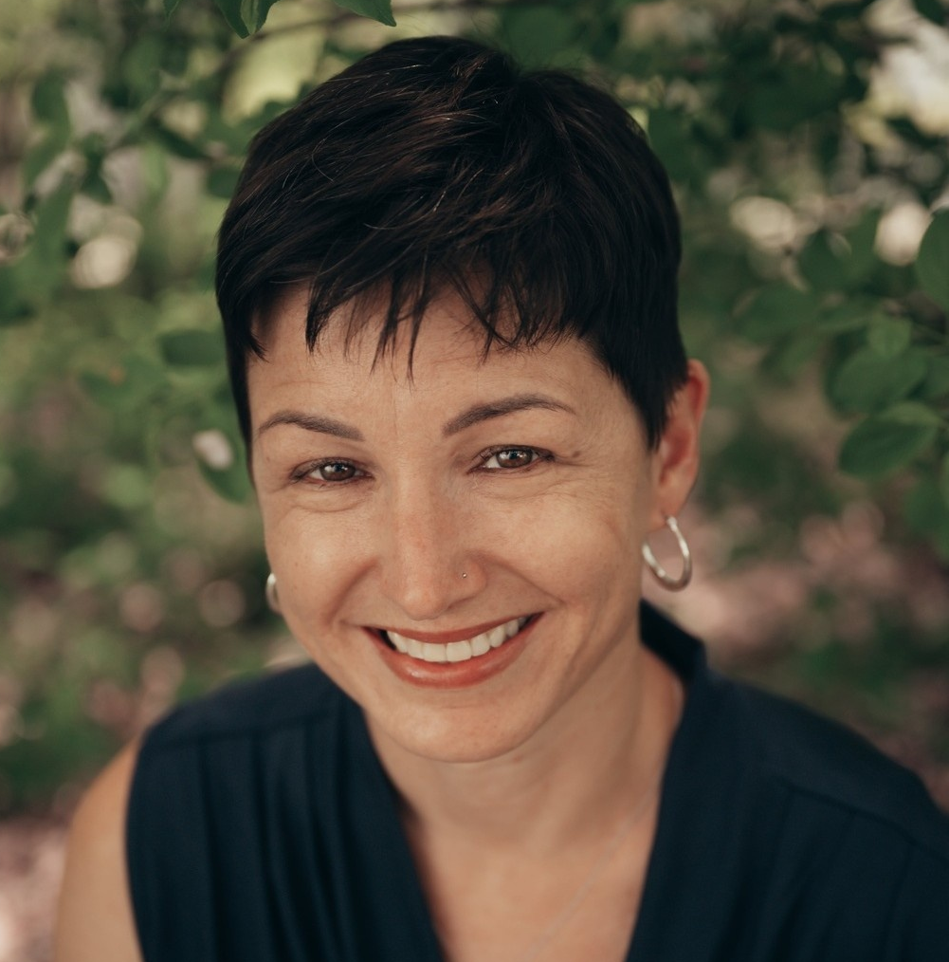
Facilitating intercultural learning in a constructivist way is not about knowledge transfer, but about guiding students as they engage in their own unique intercultural learning journey.
- Tara Harvey, PhD
Notes:
Back to Tara Harvey’s statement, she intimates that we as educators can facilitate intercultural learning for our students. So that is the question for this workshop as reflected in the title: How do we use intercultural learning to help to increase our students’ sense of belonging as their world enlarges from home to college to career.

Slide 3
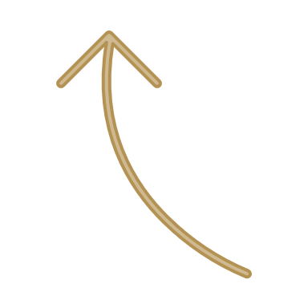
The process by which each of us become increasingly more interculturally competent
What is intercultural learning?
Have children
Marry
Go to a conference
Get a job
Debrief with a mentor
Study abroad
Take a class
Reflect
Experience difference
Notes:
Going back to the Chat, we can agree that we learn about others different from ourselves in a variety of ways. For example, we might take a class, study abroad, get a job, go to a conference, date or marry…All of these events teach us that, even when people look and sound just like us, they may still have different beliefs, different values, different politics, different religions, etc. that need to be negotiated. And hopefully, we can help students to learn to negotiate difference before a paycheck and a career are hanging in the balance. Research by interculturalists such as R. Michael Paige and Michael Vande Berg tells us that for intercultural learning to happen, help of a mentor and reflection are invaluable, so I have also added these to the timeline.

Slide 4
The process by which each of us become increasingly more interculturally competent
What is intercultural learning?
Have children
Bridging difference
Marry
Deeply comprehending difference
Go to a conference
Get a job
De-emphasizing difference
Debrief with a mentor
Study abroad
Judging difference
Take a class
Reflect
Missing difference
Experience difference
Notes:
Research by Milton and Janet Bennett and later Mitchell Hammer informs us that, as intercultural learning happens, the attitude toward difference changes in predictable ways. As people initially miss differences between themselves and others, then dwell on judging difference as good or bad, then gloss over difference, then struggle with the deep ethical issues that divide people, and finally learn to bridge difference.

Slide 5
Intercultural Development Continuum (IDC)
Adaptation
Bridging difference
Acceptance
Deeply comprehending difference
Minimization
De-emphasizing difference
Polarization
Judging difference
Denial
Missing difference
Notes:
So going deeper into this model. The intercultural learning terms given by Bennett and Hammer to the stages are:

Slide 6
Denial
Missing Difference
I’ve traveled a lot. I can deal with any culture without much thought.
As long as we speak the same language, there’s no issue.
Culture shock just doesn’t happen to me.

Slide 7
Polarization
Judging Difference
Traveling abroad made me realize all I appreciate at home.
Forget my home culture, from now on, I want to be like them.
These people are sexist/racist/etc.

Slide 8
Minimization
Deemphasizing Difference
I’ve found things in common with local students here. When it comes down
to it, our values are universal.
Our basic needs are the same world-wide.
I don’t see color.

Slide 9
Acceptance
Deeply Comprehending Difference
Knowing that people’s values differ, and that my culture gives me privilege, it
can be confusing how to behave around those different than me.
I know my host family & I have had very different life experiences, but we are learning how to live together.
Being around sameness all the time would be stale, boring.

Slide 10
Adaptation
Bridging Difference
Whatever the situation, I can usually see it from various cultural points of
view, and respond effectively.
“I greet people from my culture and people from others cultures in different
ways, taking those differences into account to show respect.”

Slide 11
Kahoot Questions

Slide 12
Intercultural Development Continuum (IDC)
Adaptation
Bridging difference
Acceptance
Deeply comprehending difference
Minimization
De-emphasizing difference
Polarization
Judging difference
Denial
Missing difference
Notes:
So going deeper into this model. The intercultural learning terms given by Bennett and Hammer to the stages are:

Slide 13
Mindsets

Slide 14
Gay-Rights Movement Ventures Beyond Urban America

Slide 15
Intercultural Development Orientations Classification Card Game

Slide 16
Other resources in the IDC collection
Pendulum research, worksheet, and independent learning module
Jojo Rabbit lesson plan
Ethics Across the IDC PowerPoint and lesson plan

Slide 17
Annette Benson
Senior Public Relations Consultant
purdue.edu/ippu/cilmar/
THANK YOU
annetteb@purdue.edu cilmar@purdue.edu
facebook.com/purduecilmar
hubicl.org

Slide 18
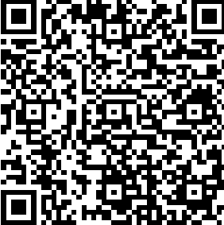
Annette Benson
Senior Public Relations Consultant
annetteb@purdue.edu

Slide 19
Thank you!
Resources for reviewing the Intercultural Development Continuum
annetteb@purdue.edu cilmar@purdue.edu
facebook.com/purduecilmar https://www.purdue.edu/IPPU/CILMAR/
hubicl.org/members/1005/collections/supplements-for-teaching-the-intercultural-development-continuum-idc
hubicl.org

