Slide 1
Beyond the Global Clichés: Intercultural Learning for Equity & Inclusion
East Carolina University
May 8, 2023
Aletha Stahl

Slide 2
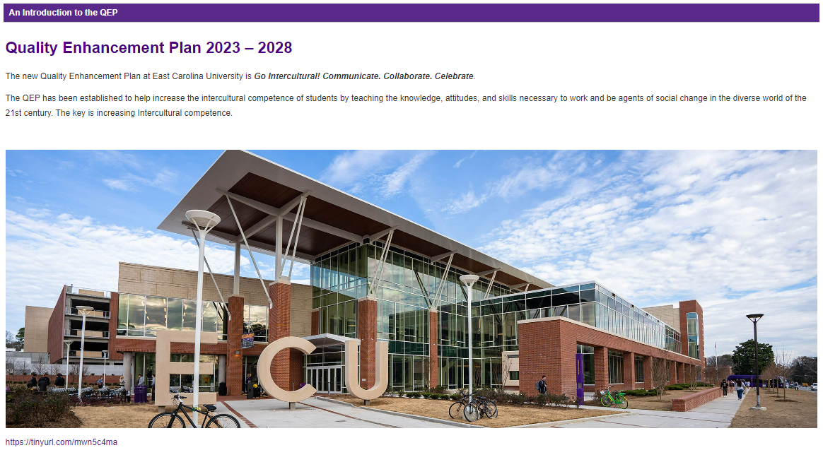
Kudos!
Notes:
I have to start with Kudos to all of you involved with the QEP. Your statement that the QEP was established to help increase the intercultural competence of students is spot on.
I hope you will document and assess your efforts all along the way and share what you learn with other institutions. This work is exciting, and I feel privileged to be a small part of it.

Slide 3
Framing Our Time Together
1. What is intercultural learning? Definitions, Models, Frameworks
2. Student Voices
3. Why intercultural learning?
4. Resources
Notes:
Today I’ll walk you through some definitions, models, and frameworks related to intercultural learning, ask you to engage with student voices, offer some key reasons for why intercultural learning is important, and share a few resources.

Slide 4
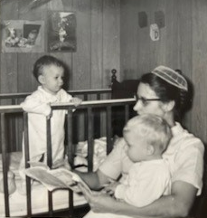
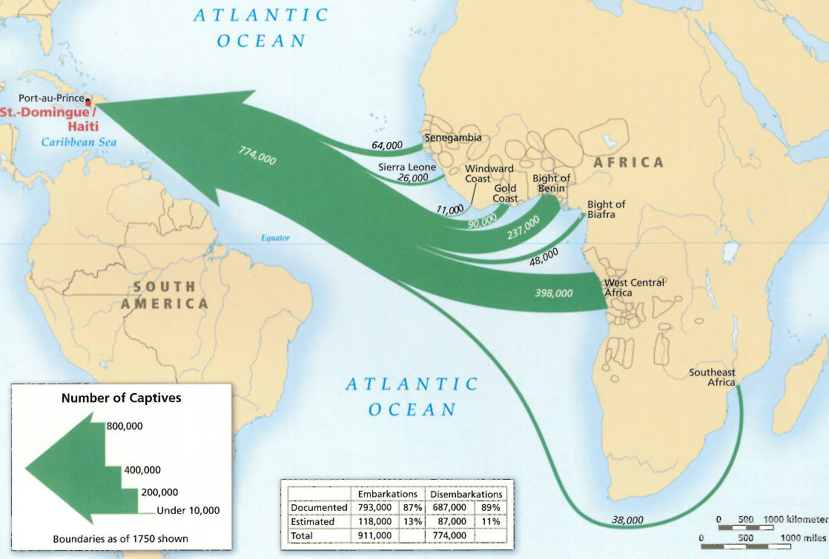
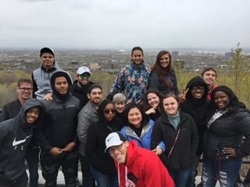
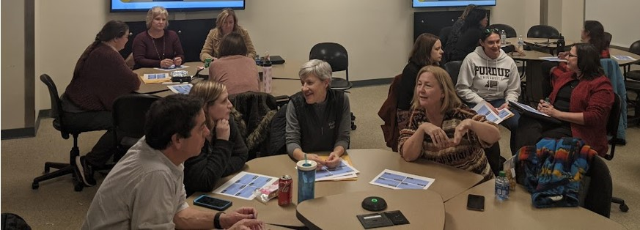
Lenses
Distillation
Eltis et al (2015). Atlas of the Transatlantic Slave Trade.
Purdue University, 2018-present
Senior Intercultural Learning Specialist, CILMAR (Center for Intercultural Learning, Mentorship, Assessment and Research)
Conduct curricular needs assessment and design interventions, manage and facilitate faculty and staff PD programs, mentor, develop and edit curricula and assessments, consult.
Earlham College, 1996-2018
French and Francophone Studies: Professor, 2010-18; Associate, 2003-10; Assistant, 1997-2003; Visiting Assistant, 1996-97
Co-Director, Center for Social Justice, 2017-18
Teaching and Learning Consultant, 2012-14
Notes:
Before I delve deeper into intercultural learning, I want to give you a glimpse into what has shaped me and why I’m here today.
I’ll start with the photo on the top left of me in the crib with my mother, who wears a head covering and is reading. I was raised in a culture of reading and with a faith perspective that instilled both curiosity about people who were different from me and a deeply-held belief in their intrinsic value.
To the right of that photo, the seal from my undergraduate institution, Goshen College, bears the motto “Culture for service.” You may catch the resonance with ECU’s mission statement.
The map speaks to my academic work on French Caribbean literature and language and the privilege I’ve had to study and lead student programs in places like Martinique, Haiti, and Benin. As a white person, I was a minority in those spaces, but always a privileged one, and I feel much gratitude to the people who extended grace and friendship to me as I bumbled my way in their worlds.
I also spent more than 2 decades as a faculty member learning with and from students at Earlham College – some of whom are in the photo on the bottom right. Earlham had the informal motto was “Awaken the teacher within,” and I still hold to that.
Lastly, I often joke that I was hired in my current position at Purdue because I had street cred with the faculty, who are my primary partners now. When I landed at Purdue, I was very much a practitioner of all things intercultural but lacked disciplinary and interdisciplinary theories and frameworks. The definitions, models, and frameworks I bring to you next are a distillation of the past 4 ½ years of my own learning curve.

Slide 5
What shapes your reasons for being here today?
Notes:
Before we move on to those frameworks, I’d like to invite you to do what I just did: reflect on the people, communities, and institutions that have shaped your reasons for wanting to engage with intercultural learning. Take a minute to reflect, then share with someone near you.
We’ll take about 3 minutes for this.
Thank you. That’s just one small exercise in cultural self-awareness, but I wanted to start with it as a way of acknowledging that just like the students we work with, our motivations and understandings are shaped by many forces. My hope is that by identifying some of these, you may better connect and make meaning for yourself of the information I share.

Slide 6
What Is Intercultural Learning?
Definitions, Models, Frameworks
Notes:
I’d like to turn now to definitions, models, and frameworks for intercultural learning.

Slide 7
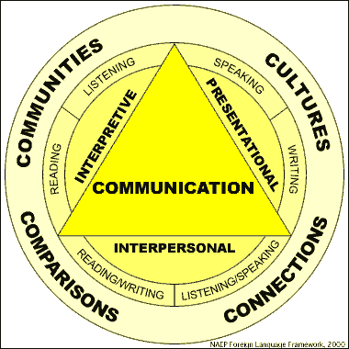
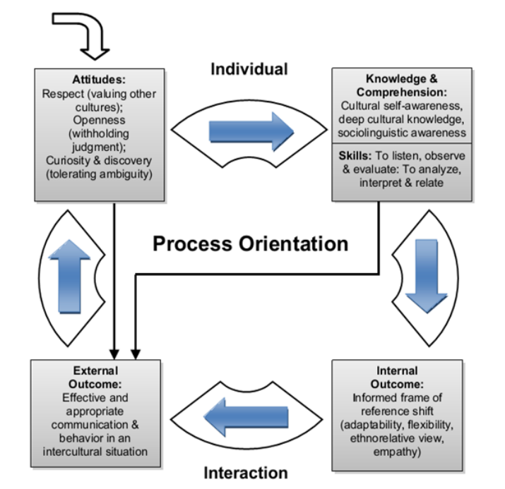
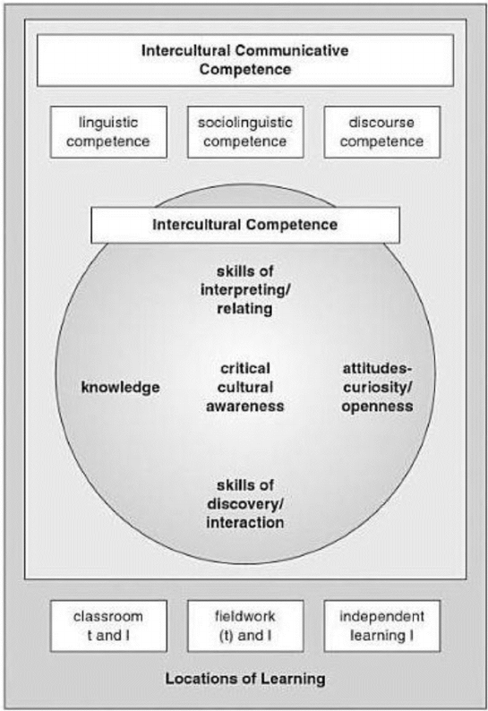
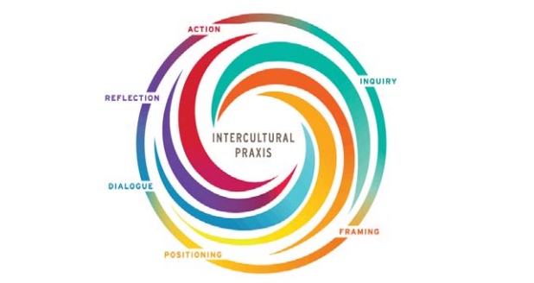
Frameworks and Models
ACTFL,
5Cs
Five “Savoirs”
(Byram, 1997)
Process Model of Intercultural Competence,
(Deardorff, 2006)
Intercultural Praxis Model,
(Sorrells, 2021)
Intercultural Knowledge and Competence VALUE Rubric
Notes:
I tend to use intercultural learning as an umbrella term, but there are many models and frameworks out there as this slide filled with shapes and colors suggests. I’ll return to several of these soon.

Slide 8
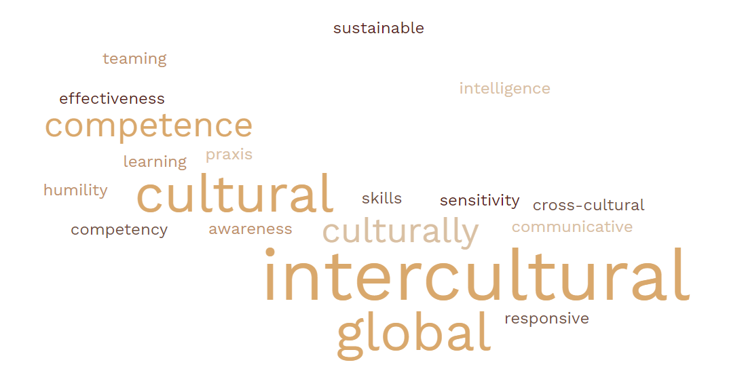
Intercultural Competence or ???
Intercultural praxis
Intercultural communicative competence
Cultural intelligence
Cultural humility
Cultural competence
Global awareness
Global teaming
Global learning
Cross-cultural skills/competency
Culturally responsive X
Culturally sustainable X
Notes:
When I enter a list of related frameworks or models related to intercultural competence in a word cloud generator, the result highlights the term INTERCULTURAL, but GLOBAL and CULTURAL are also highly present.
Although I focus on intercultural competence, I have found it helpful to adapt to what resonates in specific settings and disciplines. For example, Engineering gets on board quickly when I talk about Global Awareness and Global Teaming, Languages are more familiar with Intercultural Communicative Competence through the national organization ACTFL, Education tends toward models that evoke Cultural Sustainability or Cultural Responsiveness, and Cultural Intelligence is the framework of choice for some faculty in Health and Human Sciences.
I don’t mean to reduce these models and frameworks or subsume them under intercultural competence. Rather, I share them because I encourage you to look beyond one framework or model if you find one to be too limiting or if you want to conduct research on intercultural learning. For example, CQ or cultural intelligence models emphasize the importance of measuring behaviors whereas global awareness seems to suggest knowledge and attitudes.

Slide 9
Intercultural Competence
All Models
ABCs (affective, behavioral, cognitive skills), ASKs (attitudes, skills, knowledge), Mindset + Heart set + Skillset
Culture general, not culture specific: transferable
Learnable, therefore teachable
A life-long process
Intercultural competence: the attitudes, skills, and knowledge that support effective, appropriate, and authentic interaction in a variety of cultural contexts.
Definition adapted from AAC&U Intercultural Knowledge and VALUE Rubric, 2009, which cites Bennett, 2008
Notes:
Intercultural competence is the concept with which I’m most familiar and it gets the most purchase in higher education.
First, whatever the multiple models out there, there is general agreement about several aspects.
(Bullet points)
I define intercultural competence, then, as. . .

Slide 10
Notes:
To get more granular about intercultural competence, it helps to look at specific models.
This is the developmental model, which focuses on particular stages or orientations in which individuals are located along a continuum between a monocultural mindset and an intercultural mindset. You might think of these stages as degrees of intercultural competence. I’m aware that here at ECU you plan to use the IDI, which measures where an individual is on this Intercultural Development Continuum.
If you work with the IDI, I encourage you to read about the Pendulum Model, which is based on research that suggests there are magnets that pull us to focus more on commonalities or more on differences depending on our context and events in our lives. We know from research in Study Abroad, for example, that students who encounter too much challenge in adapting tend to regress on the continuum.

Slide 11
AAC&U Intercultural Knowledge and Competence VALUE Rubric
 | Capstone
Knowledge Cultural self-awareness | Articulates insights into own cultural rules and biases (e.g., seeking complexity; aware of how own experiences have shaped these rules, and how to recognize and respond to cultural biases. . .)
Knowledge Knowledge of cultural worldview frameworks | Demonstrates sophisticated understanding of the complexity of elements important to members of another culture in relation to its history, values, politics, communication styles, economy, or beliefs and practices.
Skills Empathy | Interprets intercultural experience from the perspectives of own and more than one worldview and demonstrates ability to act in a supportive manner that recognizes the feelings of another cultural group.
Skills Verbal and nonverbal communication | Articulates a complex understanding of cultural differences in verbal and nonverbal communication (. . .) and is able to skillfully negotiate a shared understanding based on those differences.
Attitudes Curiosity | Asks complex questions about other cultures, seeks out and articulates answers to these questions that reflect multiple cultural perspectives.
Attitudes Openness | Initiates and develops interactions with culturally different others. Suspends judgment in valuing their interactions with culturally different others.
Notes:
The AAC&U IKC VALUE rubic is a key place to go for breaking down intercultural competence into specific domains or components. This rubric is one of about 16 that were developed as tools for establishing learning outcomes and assessing learning in undergraduate education.
I only show you the Capstone level on this slide, but on the lefthand side, the rubric’s organization by knowledge, skills, and attitudes is clear.
Both the Intercultural Development Continuum and this rubric are grounded in the Developmental Model of Intercultural Sensitivity, which supports the argument that the two can be reasonably integrated – that is, that you can think of the increasing levels of the rubric as indicative of movement toward an intercultural mindset. (Bennett,1993, Wickenhauser, 2021)
I will admit that I find this rubric to lack some components of intercultural competence. For example, there is no explicit reference to positionality in the sense of an individual’s access to power. Nor is there reference to managing emotions or emotional resilience.
[Bennett, M. J. (1993). Towards ethnorelativism: A developmental model of intercultural sensitivity. In R. M. Paige (Ed.), Education for the intercultural experience (pp. 22-71). Yarmouth, ME: Intercultural Press.
Wickenhauser, J. L. (2021). Development of intercultural competence through embedded course curriculum. Purdue University Graduate School. Thesis. https://doi.org/10.25394/PGS.14515134.v1]

Slide 12
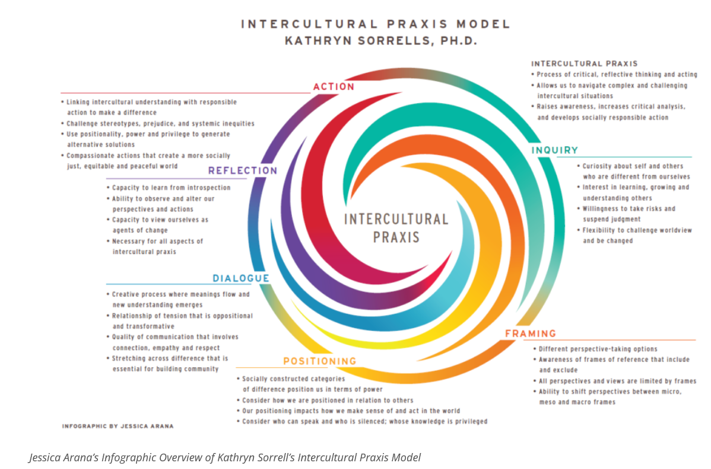
https://globalsolidaritylocalaction.sites.haverford.edu/identity-diversity-equity-and-inclusion-in-a-global-context/
Notes:
For this reasons, I also turn to Sorrells’ Intercultural Praxis Model. This model is designed to demonstrate that intercultural interactions entail a cyclical process with no single entry point. Rather there six points of entry – inquiry, framing, positioning, dialogue, reflection, and action – which also serve as guides for navigating across differences.
There are intersections with the domains on the Intercultural Knowledge and Competence Rubric, e.g., inquiry involves curiosity and reflection points to cultural self-awareness.
This model bridges knowledge, skills, and attitudes focused on the individual with the systems and institutions in which individuals participate.
Under Positioning, for example, is the idea of that socially constructed categories of difference position us in terms of power. Reflection includes the capacity to view ourselves as agents of change, and Action entails challenging stereotypes, prejudice and systemic inequities.
I find this model less user-friendly than a rubric for assessing learning, but it can be used to help students understand the complex process of intercultural engagement and it can also leveraged for descriptions of goals and learning outcomes.
https://www.cbglcollab.org/identity-diversity-equity-and-inclusion-in-a-global-context

Slide 13
Additional Resources for Concepts, Outcomes, Assessment
Champlain College Diversity, Equity, and Inclusion Rubric
Social Justice Standards
Rubric for Cultural Diversity (Hawaii)
Intercultural Effectiveness Scale
Other Relevant AAC&U VALUE Rubrics
Global Learning
Civic Engagement
Teamwork
Notes:
I don’t want to overwhelm you with models, but I’d like to point out a few others – all hotlinked if you’d like my slides.
The Champlain College Diversity, Equity, and Inclusion Rubric is the sole rubric of which I’m aware that explicitly targets student learning in the areas of its title. I have drawn on it for its category of “Systems, Institutions, Resources” which again gets at understanding power structures as part of intercultural competence.
The Social Justice Standards spell out exactly what students will be able to do under various categories and although designed for K-12 learning, are be readily applicable at the college level.
The Rubric for Cultural Diversity from Hawaii draws on Native Hawaiian language and concepts and is applied in the Hawaiian public education system.
The Intercultural Effectiveness Scale is actually a proprietary instrument like the IDI, but it includes a measure for the category of hardiness, defined as a combination of regarding others positively and being emotionally resilient.
And speaking of rubrics, the AAC&U has other rubrics whose outcomes intersect with those of intercultural learning, in particular Global Learning, Civic Engagement, and Teamwork.

Slide 14
From Frameworks to Student Learning
Next steps
“Backward design” what is relevant for your course/program/discipline/profession:
Establish explicit intercultural learning outcomes
Determine what evidence will tell you students have learned (assessment)
Choose, develop, facilitate learning activities that target your outcomes in ways that. . .
Explore and validate multiple perspectives (not one right answer or affective response)
Allow for co-construction of meaning and knowledge with you and with other students
Encourage articulation of affective responses
Guide reflection
Recognize that not all learners need to leave with the same learning.
Work on your own intercultural development
Notes:
Models and frameworks can help us design student learning.
This includes choosing include outcomes that are relevant for your learning context and planning not just content but also how content will be processed.
For example, it’s important to set up a learning environment in which multiple perspectives are validated, where co-construction of meaning takes place, where affective responses are supported, where you guide learners in their reflection and recognize that not everyone needs to leave with the same learning.
Research conducted by a PhD student at Purdue suggests that an instructor’s orientation on the IDC may affect students’ intercultural development as well. (Horane Diatta Holgate) It’s helpful to reflect on your own intercultural development.

Slide 15
A Word on Assessment
Priority questions
For whom are you assessing the learning? (e.g., yourself, students, department, institution, etc.)
What are you assessing? (e.g., developmental orientation of intercultural competence, a skill/attitude/knowledge)
What measure – direct/indirect – will give you adequate information while meeting time/cost constraints? (e.g., quantitative/qualitative, IDI or other proprietary instrument, rubric, survey, observation, etc.)
How can you leverage assessment to enhance learning? (e.g., formative/summative, how will you use the information?)
Notes:
I skipped assessment in talking about learning design but will say a word about it here.
One challenge with assessing intercultural competence is that there aren’t many quick, direct quantitative measures. But there are still myriad ways to assess it, and I’m happy to go down that path with you in conversation later.
The first question to answer in assessing intercultural learning is for whom you are doing the assessment. That will shift your answer to subsequent questions.

Slide 16
The Easy Lift?
Where you might already foster intercultural development
STEM: teaming, curiosity
Humanities: perspective taking, communication
Social sciences: awareness of how systems and individuals are shaped and interact
Management & business: worldview frameworks
Co-curriculum: emotional resilience, self-awareness, self-efficacy
Notes:
The lift for embedding intercultural learning in programs does not always have to be heavy. There are areas where I suspect attitudes, skills, and knowledge relevant to intercultural competence can be intentionally leveraged in new ways. This list is not meant to be exhaustive but to give you some ideas of where to begin.

Slide 17
Why is Intercultural Learning Important?
Student Voices
Notes:
I’d like to shift the focus to what is at the heart of this talk: what students gain from intercultural learning, and what this can mean for an institution and for the future.
To do that, I’ll first share a number of quotes from students. Most are excerpts from written reflections that followed specific intercultural learning activities. One is from a study abroad journal, and one from an email.
After every 2-3 quotes, I’m going to ask you: What are students taking away, and why is this important? Feel free to just call out your ideas.

Slide 18
Doing the social identity wheel helped me realize a lot about my own self that I never really thought could have much of an effect on my identity. I think most people just think of a few things like race and gender because that might be easier to identify from meeting someone new. The best part about doing this is that some of the other identity categories can really impact how people mentor. . . I would need to strategize my style of mentorship depending on the mentee. I think I would have to look deeper into some privileges I have from others like being middle class and being a man.
Technology Leadership & Innovation 200
Social Identity Wheel

Slide 19
I’m in a design major and [this activity] made me realize if you’re making a web site or product to do with a person’s name and you want it to be globally used you have to take in consideration of how people like their names to be displayed so that they feel like its made for them. User experience is key In design and I’m glad this helped my awareness to cultural differences.
Italian 101, My Name Is. . .

Slide 20
I am a monochronic person, I do not like wasted time on things that I do not particularly care about I am just trying to graduate, and above all else, I despise uptightness in simple group projects I am efficient, I prefer to complete my portion of the work on my own time I am a collectivist, if you can’t contribute to the project much because of legitimate reasons I couldn’t care less, you’ll still get 5 stars from me. . . I am introverted, let’s keep the small talk to a minimum I am anti-authority, none of us are gods and no one should act like it I am a direct communicator, a spade is a spade and I will call it as such I am still a hard-worker. . .
Earth, Atmospheric & Planetary Sciences 360
“I Am” Poem

Slide 21
Morocco Maymester, Human Development & Family Studies, Journal/social media – 3 photos of same thing from 3 different angles

Slide 22
It’s eye-opening to think about my own listening styles because I realized that I tend to pay more attention to my reply than the other person’s actual words. . . Whenever my roommates gather in the kitchen (our informal living room), we tend to discuss big topics like our childhoods, religion, culture, and our plans for the future. I would like to spend more time actively listening in these conversations, not focusing on my own replies, because I really want to build my relationships with my roommate.
Communications 303/Engineering 397
Effective Listening and Meaningful Conversations

Slide 23
The technique I chose to go over was positive intent. This covers how we automatically read what people are saying to us - and to always assume that they intended it positively.
I applied this technique when talking to my boss last week. She sent me a rather short email, and usually I would kind of panic and think she hates me or something silly. Rather then do that though, I just took a breath and remembered what we had learned. I then saw her in the office and she was perfectly pleasant, so she obviously meant it in a positive way.
Technology Leadership & Innovation 200, Applying a Technique

Slide 24
I truthfully tell my friends this course is a way to give students a therapy class while studying abroad, and as someone who has been visiting a mental health professional all year, I think it's so important that students have access to things like mindfulness and analyzing their cultural views.
Unsolicited email, 1-credit virtual intercultural course during semester SA program

Slide 25
Why Intercultural Learning?
Notes:
Now I’d like to tie the outcomes of intercultural learning explicitly to the title of my talk.

Slide 26
Global Workforce Preparation
96% of employers agree that “[a]ll college students should have educational experiences that teach them how to solve problems with people whose views are different from their own”; 78% agree that they should “gain intercultural skills.” Only 37% say students are well prepared for teamwork, only 21% say they’re well prepared in terms of “awareness/experience of diverse cultures in US,” and only 18% say they’re well prepared for working with people from different backgrounds and staying current on global developments. (Hart Research Associates, 2015).
National Academies of Sciences, Engineering, and Medicine (2017) lists “intercultural/diversity competence” as a valued outcome of college education. Researchers agree that STEM professionals need intercultural competence to do their jobs effectively (e.g., Babitsch et al, 2020, Minshew et al, 2021). Among ABET’s 7 student outcomes criteria (2021) are communication with a range of audiences (3), making informed judgments that consider the impact of engineering solutions in global, economic, environmental, and societal contexts (4); and teamwork (5).
2020 AACSB Business Accreditation Standards includes “Global Mindset and Diversity and Inclusion” as Guiding Principles and Expectations: “All business degree programs include an understanding of, and appreciation for, cultural norms across various regions and countries and how such differences impact managerial decision-making.” (42)
MLA 2024 Convention Language and Literature Program Innovation Room, a space for sharing successful and promising new initiatives, invites submissions under the category “Global citizenship, intercultural competence, and study abroad.”
Notes:
I titled this talk “Beyond the Global Cliches: Intercultural Learning for Equity and Inclusion” because for about 25 years now I’ve heard the refrain, “In our increasingly globalized world.” We’re already there, and we’ve been there! It’s more important to look at how constant global restructuring creates specific inequities and work to address those. I’d like to see that cliché put to bed.
More intercultural research articles than I care to count appeal to global workforce preparation as the raison d’etre for including intercultural competence in a college education. Employers confirm that idea: 96% agree that “all college students should have educational experiences that teach them how to solve problems with people whose views are different from their own,” yet only 18% say that college graduates are well prepared for working with people from different backgrounds.
National and international professional and accrediting bodies such as the National Academies, ABET (engineering), and the AACSB (business) also call for versions of intercultural competence, and the next Modern Language Association includes intercultural competence as a topic in its innovation room.
I don’t argue with the importance of intercultural competence for workforce preparation, but I would like to make the case that there are other outcomes that deserve attention too.
Hart Research Associates. (2015). Falling short? College learning and career success (White paper). Retrieved from https://www.aacu.org/sites/default/files/files/LEAP/2015employerstudentsurvey.pdf
National Academies of Sciences, Engineering, and Medicine. 2017. Supporting Students’ College Success: The Role of Assessment of Intrapersonal and Interpersonal Competencies. Washington, DC: The National Academies Press. https://doi.org/10.17226/24697. P. 186
Babitsch, B., Bretz, L., Mansholt, H., & Götz, N.-A. (2020). The relevance of cultural diversity on safety culture: a CIRS data analysis to identify problem areas and competency requirements of professionals in healthcare institutions. GMS Journal for Medical Education, 37(2), Doc14–Doc14. https://doi.org/10.3205/zma001307
Minshew, L. M., Lee, D., White, C. Y., McClurg, M., & McLaughlin, J. E. (2021). Development of a Cultural Intelligence Framework in Pharmacy Education. American Journal of Pharmaceutical Education, 85(9), 8580–8949. https://doi.org/10.5688/ajpe8580
ABET Engineering Accreditation Commission (2021). 2022-2023 Creiteria for Accrediting Engineering Programs. https://www.abet.org/wp-content/uploads/2022/01/2022-23-EAC-Criteria.pdf. Pp. 8-9.
AACSB. (2020). 2020 Guiding Principles and Standards for Business Accreditation. https://www.aacsb.edu/-/media/documents/accreditation/2020-aacsb-business-accreditation-standards-jul-1-2022.pdf?rev=b40ee40b26a14d4185c504d00bade58f&hash=9B649E9B8413DFD660C6C2AFAAD10429. Pp. 18-19.
MLA. MLA 2024 Language and Literature Program Innovation Room. https://www.maps.mla.org/Resources/Webinars-and-Conversations/MLA-2024-Language-and-Literature-Program-Innovation-Room

Slide 27
Equity
Equity: The creation of opportunities for historically underrepresented populations to have equal access to and participate in educational programs that are capable of closing the achievement gaps in student success and completion. (AAC&U)
Intercultural competence can be viewed as cultural capital (Beneroso & Alosaimi, 2020). Fostering it in all students supports their access to opportunities now and in the future.
Intercultural learning on campus -- as opposed to study abroad/away -- is as accessible as other on-campus learning opportunities. This suggests equality of access, which is one component of equity.
However, barriers to learning on campus may not be significantly different from barriers to study abroad/away. These barriers include norms around how learning takes place, instructor practices, and peer relationships. Greater intercultural competence within a classroom or within any campus community may help lower these barriers.
Notes:
The first is equity.
I use the AAC&U definition of equity given our context: Namely, equity entails creating opportunities for historically underrepresented populations to have equal access to and participate in our classrooms and programs in ways that can close achievement gaps.
As I understand it, [Read 3 bullet points]
D. Beneroso, N. Alosaimi. 2020. Cultural intelligence of chemical engineering students: A demographics study, Education for Chemical Engineers, 32: 32-39, https://doi.org/10.1016/j.ece.2020.05.003

Slide 28
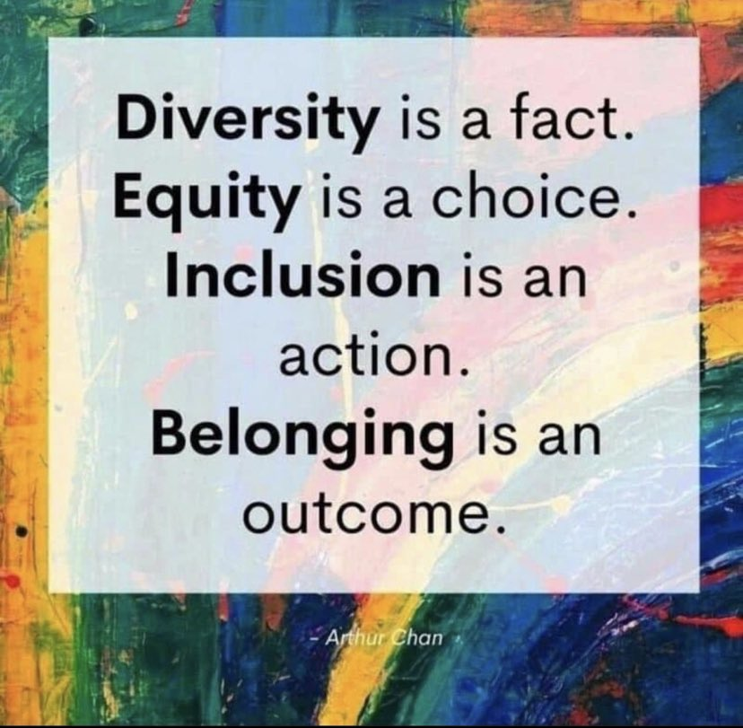
Inclusion
The active, intentional, and ongoing engagement with diversity — in people, in the curriculum, in the co-curriculum, and in communities (intellectual, social, cultural, geographical) with which individuals might connect — in ways that increase one’s awareness, content knowledge, cognitive sophistication, and empathic understanding of the complex ways individuals interact within [and change] systems and institutions. (AAC&U)
Fostering intercultural competence is fostering inclusion. It’s about engaging explicitly with the diversity of thought, experience, values, emotions, etc., that our students bring.
Notes:
Where inclusion is concerned, I’ll again cite AAC&U’s definition.
Inclusion is the active, intentional, and ongoing engagement with diversity in ways that increase one’s awareness, content knowledge, cognitive sophistication, and empathic understanding of the complex ways individuals interact within [and change] systems and institutions.
As I see it, fostering intercultural competence is precisely the kind of engagement with diversity described in that definition.
As this simple poster shows, the ultimate outcome is belonging.
D. Beneroso, N. Alosaimi. 2020. Cultural intelligence of chemical engineering students: A demographics study, Education for Chemical Engineers, 32: 32-39, https://doi.org/10.1016/j.ece.2020.05.003

Slide 29
Sense of Belonging: The Research
Sense of Belonging: The extent to which students agree that they are part of, valued and supported by your campus community, and that they are respected and can be themselves in that community.
Intercultural competence can reduce negative intergroup contact. (Meleady et al, 2021)
Teaching emotional management, which is part of intercultural competence, as part of teamwork and DEI training can help produce optimal belonging. (Davis et al, 2021)
A supportive campus environment moderates the relationship between cultural diversity and students’ sense of belonging and can be created through a curriculum that builds students’ cultural competences. (Owusu-Agyeman, 2021)
Cultural intelligence has been shown or is hypothesized to relate to wellbeing and multinational team integration (Ang & Dyne, 2008) and predicts student sense of belonging. (Wu et al, 2022)
Notes:
Sense of belonging, then, is the extent to which students agree that they are part of, valued and supported by your campus community, and that they are respected and can be themselves in that community.
The research demonstrates that intercultural competence has a direct impact on sense of belonging.
[Read quotes.]
In a nutshell – and I don’t think this is new to those of you who articulated the vision for developing intercultural competence at ECU in the first place – I suspect and certainly hope that you will experience some other shifts on campus as you build and track intercultural learning. This may be the moment to baseline sense of belonging so that you can follow some of those other shifts over time as well.
Meleady, Rose, Charles R. Seger, and Marieke Vermue. “Evidence of a Dynamic Association Between Intergroup Contact and Intercultural Competence.” Group processes & intergroup relations 24.8 (2021): 1427–1447.
Team Belonging: Integrating Teamwork and Diversity Training Through Emotions. Alicia S. Davis, Adrienne M. Kafka, M. Gloria González-Morales, and Jennifer FeitosaSmall Group Research 2021 53:1, 88-127
Owusu-Agyeman, Yaw. “The Relationship Between Supportive Campus Environment and Cultural Diversity in Enhancing Students’ Sense of Belonging in Higher Education.” Journal for multicultural education 15.4 (2021): 429–444.
Ang, S.; Dyne, L.V. (Eds.) Handbook of Cultural Intelligence Theory, Measurement, and Applications; M.E. Sharpe, Inc.: Armonk, NY, USA, 2008; pp. 1–433.
Wu, Shiyong et al. “Effects of Cultural Intelligence and Imposter Syndrome on School Belonging through Academic Resilience Among University Students with Vocational Backgrounds.” International journal of environmental research and public health 19.13 (2022): 7944–.

Slide 30
Resources

Slide 31
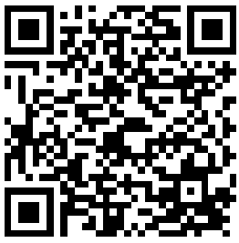
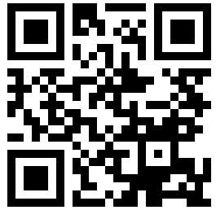
Key Resources for Intercultural Learning
Intercultural Learning Hub
(hubicl.org)
Digital Toolbox​
800+ activities & assessments
searchable by outcomes on the AAC&U IKC rubric​
includes tags for emotional resilience, teamwork, diversity, etc.
Professional Development Zone​
Crowd sourced: register to review, build, etc.
Curated collections
ECU Intercultural Resources
Notes:
I am going to point you to one resource that is a collection of many resources, the Intercultural Learning Hub.

Slide 32
THANK YOU!
Let's connect!
Aletha Stahl stahl23@purdue.edu

