Slide 1
TEACHING THE SKILL OF INTERCULTURAL EMPATHY ACROSS THE GENERATIONS Annette Benson Communication Strategist & Intercultural Learning Specialist Center for Intercultural Learning, Mentorship, Assessment and Research Purdue University

Slide 2
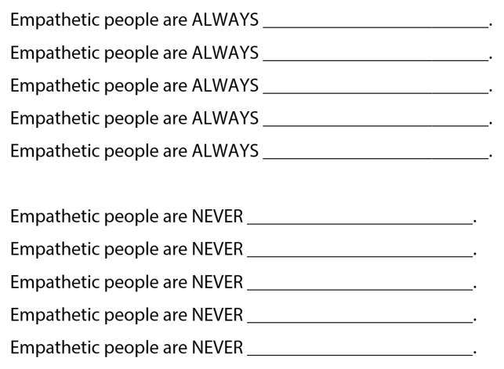
ALWAYS & NEVER
Thiagarajan, S. & van den Bergh, S. (2017). Always and Never. Interactive templates for intercultural training. Bloomington, IN: Workshops by Thiagi, Inc., pp. 82-86. Retrieved from https://hubicl.org/toolbox/tools/128/objectives

Slide 3
What is empathy?
“Dispositional empathy can be seen as the tendency to react to other people’s observed experiences.”
Davis, M. H. (1983). Measuring individual differences in empathy: Evidence for a multidimensional approach. Journal of Personality and Social Psychology, 44, 113-126.

Slide 4
Quiz: Talking ‘bout my generation?
“We all know the stereotypes. Millennials are lazy and self-absorbed. Gen Xers are cynical loners. Baby boomers are liberal revolutionaries, while their parents are deferential to authority. But how distinctive are these generations, really? Can you match each generalization with the generation it refers to?” (Bellack, 2015)
THE SILENT GENERATION
BABY BOOMERS
GENERATION X
MILLENNIALS
GENERATION Z
(1928-1945)
(1946-1964)
(1965-1980)
(1981-1997)
(1996ISH-2010)
Bellack, M. (2015, December 3). Quiz: Talking ‘bout my generation? The Washington Post. Retrieved from https://www.washingtonpost.com/quiz-talking-bout-my-generation/f2eb1164-5fa3-4d77-ad53-53546e02edae_quiz.html?utm_term=.a57ba31b87ce

Slide 5
1. “Never had American youth been so withdrawn, cautious, unimaginative, indifferent, unadventurous.”
Manchester, W. (1973). In W. Strauss & N. Howe. Generations: The history of America’s future, 1584 to 2069. New York, NY: William Morrow and Company, Inc.
SILENT GENERATION
MILLENNIALS
BABY BOOMERS
GENERATION X
GENERATION Z
(1928-1945)
(1946-1964)
(1965-1980)
(1981-1997)
(1996ish-2010)
Bellack, M. (2015, December 3). Quiz: Talking ‘bout my generation? The Washington Post. Retrieved from https://www.washingtonpost.com/quiz-talking-bout-my-generation/f2eb1164-5fa3-4d77-ad53-53546e02edae_quiz.html?utm_term=.a57ba31b87ce

Slide 6
2. “Some depict a group of irrational, self-absorbed ‘brats,’ while others describe them as well-educated, self-reliant entrepreneurs with technical savvy.”
Martin, N. M., & Prince, D. Factoring for X: An empirical study of Generation X’s materialistic attributes. Journal of management and Marketing Research. Retrieved from https://docplayer.net/10451025-Factoring-for-x-an-empirical-study-of-generation-x-s-materialistic-attributes.html
SILENT GENERATION
MILLENNIALS
BABY BOOMERS
GENERATION X
GENERATION Z
(1928-1945)
(1946-1964)
(1965-1980)
(1981-1997)
(1996ish-2010)
Bellack, M. (2015, December 3). Quiz: Talking ‘bout my generation? The Washington Post. Retrieved from https://www.washingtonpost.com/quiz-talking-bout-my-generation/f2eb1164-5fa3-4d77-ad53-53546e02edae_quiz.html?utm_term=.a57ba31b87ce

Slide 7
3. “They want jobs that affect societal change, and they give what they can. [One] study found that three-quarters of young people gave to a charity…and 63 percent volunteered for a cause.”
Glassman, M. (2013, August 30). Five myths about millennials. The Washington Post. Retrieved from https://www.washingtonpost.com/opinions/five-myths-about-millennials/2013/08/30/a6d9a854-ff6c-11e2-9711-3708310f6f4d_story.html?utm_term=.47266fed4b90
SILENT GENERATION
BABY BOOMERS
GENERATION X
MILLENNIALS
GENERATION Z
(1928-1945)
(1946-1964)
(1965-1980)
(1981-1997)
(1996ish-2010)
Bellack, M. (2015, December 3). Quiz: Talking ‘bout my generation? The Washington Post. Retrieved from https://www.washingtonpost.com/quiz-talking-bout-my-generation/f2eb1164-5fa3-4d77-ad53-53546e02edae_quiz.html?utm_term=.a57ba31b87ce

Slide 8
4. “They are the most self-centered, self-seeking, self-interested, self-absorbed, self-indulgent, self-aggrandizing generation in American history.”
Begala, P. (2007, March 3). The worst generation. Esquire. Retrieved from https://www.esquire.com/news-politics/a1451/worst-generation-0400/
SILENT GENERATION
BABY BOOMERS
GENERATION X
MILLENNIALS
GENERATION Z
(1928-1945)
(1946-1964)
(1965-1980)
(1981-1997)
(1996ish2010)
Bellack, M. (2015, December 3). Quiz: Talking ‘bout my generation? The Washington Post. Retrieved from https://www.washingtonpost.com/quiz-talking-bout-my-generation/f2eb1164-5fa3-4d77-ad53-53546e02edae_quiz.html?utm_term=.a57ba31b87ce

Slide 9
5. “This generation was supposed to graduate from college, land jobs and move out of the house just as their parents did, but, unlike their parents, their job prospects aren’t as rich, and they seem to get poorer the longer they’re away from home.”
Davis, J. (1995, June 23). Boomerang gang: For many 20somethings, returning home is a necessity—and a pleasure. Los Angeles Times. Retrieved from http://articles.latimes.com/1995-06-23/news/ls-16176_1_group-home
SILENT GENERATION
BABY BOOMERS
GENERATION X
MILLENNIALS
GENERATION Z
(1928-1945)
(1946-1964)
(1965-1980)
(1981-1997)
(1996ish-2010)
Bellack, M. (2015, December 3). Quiz: Talking ‘bout my generation? The Washington Post. Retrieved from https://www.washingtonpost.com/quiz-talking-bout-my-generation/f2eb1164-5fa3-4d77-ad53-53546e02edae_quiz.html?utm_term=.a57ba31b87ce

Slide 10
6. “The traditional cycle seems to have gone off course, as young people remain untethered to romantic partners or to permanent homes…forestalling the beginning of adult life.”
Marantz Henig, R. (2010, August 18). What is it about 20-somethings? The New York Times Magazine. Retrieved from https://www.nytimes.com/2010/08/22/magazine/22Adulthood-t.html
SILENT GENERATION
MILLENNIALS
BABY BOOMERS
GENERATION X
GENERATION Z
(1928-1945)
(1946-1964)
(1965-1980)
(1981-1997)
(1996ish-2010)
Bellack, M. (2015, December 3). Quiz: Talking ‘bout my generation? The Washington Post. Retrieved from https://www.washingtonpost.com/quiz-talking-bout-my-generation/f2eb1164-5fa3-4d77-ad53-53546e02edae_quiz.html?utm_term=.a57ba31b87ce

Slide 11
7. “Couples with one or no children worry that time is running out. Job or family?”
Jones, L. Y. (1980, December 29). The generation that gave us Spock and rock now faces a brave new cause: Midlife. People. Retrieved from https://people.com/archive/the-generation-that-gave-us-spock-and-rock-now-faces-a-brave-new-cause-midlife-vol-14-no-26/
SILENT GENERATION
BABY BOOMERS
MILLENNIALS
GENERATION X
GENERATION Z
(1928-1945)
(1946-1964)
(1965-1980)
(1981-1997)
(1996ish-2010)
Bellack, M. (2015, December 3). Quiz: Talking ‘bout my generation? The Washington Post. Retrieved from https://www.washingtonpost.com/quiz-talking-bout-my-generation/f2eb1164-5fa3-4d77-ad53-53546e02edae_quiz.html?utm_term=.a57ba31b87ce

Slide 12
8. They are “more willing to be caregivers than previous generations.”
Bahrampour, T. (2015, October 24). Self-absorbed millennials? Not the ones who are caregivers for their elders. Retrieved from https://www.washingtonpost.com/local/social-issues/self-absorbed-millennials-not-the-ones-who-are-caregivers-for-their-elders/2015/10/24/32e474c0-7903-11e5-b9c1-f03c48c96ac2_story.html?utm_term=.78c4946c5994
SILENT GENERATION
BABY BOOMERS
GENERATION X
MILLENNIALS
GENERATION Z
(1928-1945)
(1946-1964)
(1965-1980)
(1981-1997)
(1996ish-2010)
Bellack, M. (2015, December 3). Quiz: Talking ‘bout my generation? The Washington Post. Retrieved from https://www.washingtonpost.com/quiz-talking-bout-my-generation/f2eb1164-5fa3-4d77-ad53-53546e02edae_quiz.html?utm_term=.a57ba31b87ce

Slide 13
9. “Most of these busy mothers, fathers, and workers are able to balance those responsibilities and still find time to engage in numerous professional and community activities.”
Miller, J. D. (2011, Fall). Active, balanced, and happy: These young Americans are not bowling alone. The Generation X Report, 1(1). Retrieved from http://lsay.org/GenX_Rept_Iss1.pdf.
SILENT GENERATION
BABY BOOMERS
GENERATION X
MILLENNIALS
GENERATION Z
(1928-1945)
(1946-1964)
(1965-1980)
(1981-1997)
(1996ish-2010)
Bellack, M. (2015, December 3). Quiz: Talking ‘bout my generation? The Washington Post. Retrieved from https://www.washingtonpost.com/quiz-talking-bout-my-generation/f2eb1164-5fa3-4d77-ad53-53546e02edae_quiz.html?utm_term=.a57ba31b87ce

Slide 14
10. “As they came of age, and as idealism might have required some real sacrifice, idealism suddenly became unfashionable.”
Begala, P. (2007, March 3). The worst generation. Esquire. Retrieved from https://www.esquire.com/news-politics/a1451/worst-generation-0400/
SILENT GENERATION
BABY BOOMERS
GENERATION X
MILLENNIALS
GENERATION Z
(1928-1945)
(1946-1964)
(1965-1980)
(1981-1997)
(1996ish-2010)
Bellack, M. (2015, December 3). Quiz: Talking ‘bout my generation? The Washington Post. Retrieved from https://www.washingtonpost.com/quiz-talking-bout-my-generation/f2eb1164-5fa3-4d77-ad53-53546e02edae_quiz.html?utm_term=.a57ba31b87ce

Slide 15
11. “Growing up in an uncertain world, and being raised by…parents whose own prospects seemed stunted by less exuberant times, [this generation] is drawn to safety. Like the silent generation who grew up amidst war and the Depression, [this generation] is a more cautious class that steers away from risky behaviors and towards more sensible careers and choices. Stats on lower underage drinking and higher seatbelt wearing for this group are just a couple of data points for this characteristic, as well as anecdotal evidence of job paths that are forged less by passion and more by practical realities.”
Scott, R. (2016, November 28). Get ready for Generation Z. Forbes. Retrieved from https://www.forbes.com/sites/causeintegration/2016/11/28/get-ready-for-generation-z/#28debe822204
SILENT GENERATION
BABY BOOMERS
MILLENNIALS
GENERATION Z
GENERATION X
(1928-1945)
(1946-1964)
(1965-1980)
(1981-1997)
(1996ish-2010)

Slide 16
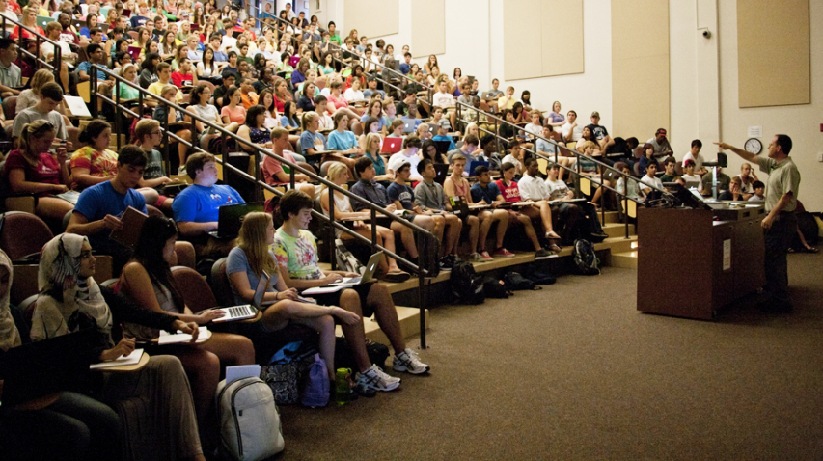

Slide 17
AKA:
iGen
Homelanders
Plurals
Posts
ReGen
Founders
Known for:
their diversity
reliance on social media
desire to fix a society disrupted
GENERATION Z
(1996ish-2010)
Sanburn, J. (2015, December 2). How every generation of the last century got its nickname. Time. Retrieved from http://time.com/4131982/generations-names-millennials-founders/

Slide 20
“Whether it is a true lack of empathy or simply that they are misunderstood depends on your point of view. It has even been said that those who accuse them of being less empathetic are in fact showing a lack of empathy themselves.”
Understanding the Common Lack of Empathy in Millennials. (2016, October 7). Open forest. [web log]. Retrieved from https://openforest.net/understanding-common-lack-empathy-millennials/

Slide 21
“According to a 2009 study, American college students believe themselves to be less empathetic than previous generations. Taken over a period of time spanning three decades (1979-2009), the study surveyed a total of 13,737 college students about their perceived tendencies toward empathy and social concern.
“Dr. Sara Konrath, Assistant Professor at the Lilly Family School of Philanthropy at Indiana University and one of the authors of the 2009 study, spoke with BTR to discuss its findings.
“’What’s interesting is that [our study] didn’t look at the attitudes of previous generations toward college students, but actually surveyed the beliefs of college students themselves,’ Konrath explains. ‘When asked about some core empathy traits, we tended to see responses such as, “I don’t think about others when they’re in need, when someone is suffering it doesn’t move me,” and so on.’
Gentzel, T. (2015, October 27). Lifestyle: Do Millennials Lack Empathy? BTRtoday. Retrieved from http://www.btrtoday.com/read/lifeandtimes/misc-lifeandtimes/tuesday-life-times-70/

Slide 22
Is it OK to use the M word?
“But here's what's amazing, if you talk to young people today in college, they will talk about how they want to someday be good neighbors, good citizens. Record shares say they someday want to get married and have kids. And if you ask them their favorite way to spend their time they say with their parents or their family. You know, I hear people talk about them - they're too fragile. They're accustomed to too much cosseting and protection. You know, here's an interesting question I would have for you. Was there ever a time when older people said, hmm, I think it's just right?"
http://www.npr.org/2013/09/06/218904691/is-it-ok-to-use-the-m-word
http://www.npr.org/templates/transcript/transcript.php?storyId=218904691

Slide 23
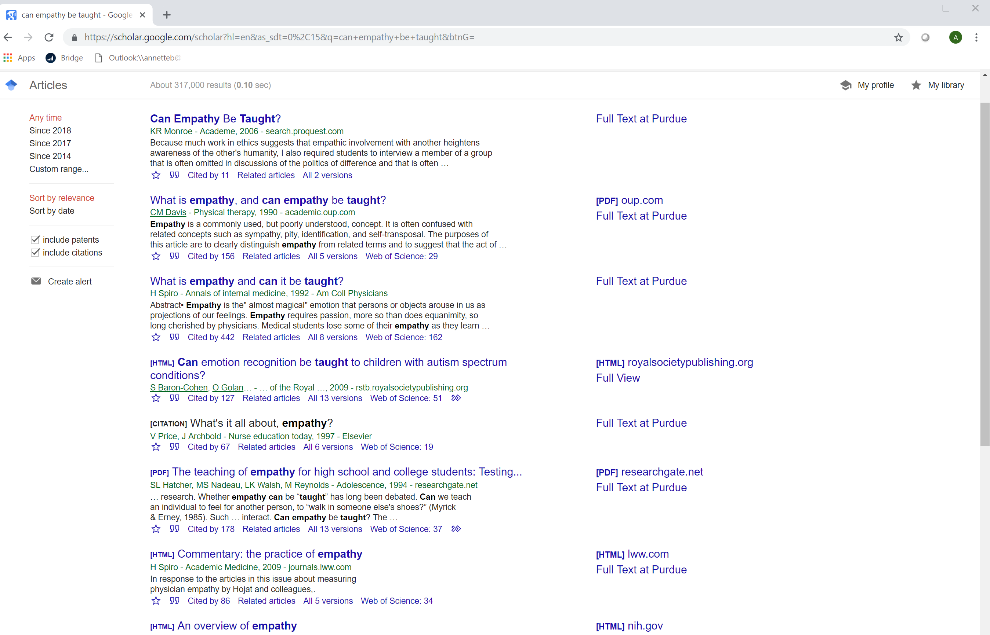

Slide 24
AAC&U* VALUE**
RUBRIC FOR INTERCULTURAL KNOWLEDGE & COMPETENCE
Adapted by Purdue University.
*American Association of Colleges & Universities **Valid Assessment of Learning in Undergraduate Education

Slide 25
 | Developing | Emerging | Proficient
Knowledge Cultural self- awareness | Identifies own cultural rules and biases (e.g. with a strong preference for those rules shared with own cultural group and seeks the same in others.) | Recognizes new perspectives about own cultural rules and biases (e.g. not looking for sameness; comfortable with the complexities that new perspectives offer.) | Articulates insights into own cultural rules and biases (e.g. seeking complexity; aware of how her/his experiences have shaped these rules, and how to recognize and respond to cultural biases, resulting in a shift in self-description.)
Knowledge Knowledge of cultural worldview frameworks | Demonstrates partial understanding of the complexity of elements important to members of another culture in relation to its history, values, politics, communication styles, economy, or beliefs and practices. | Demonstrates adequate understanding of the complexity of elements important to members of another culture in relation to its history, values, politics, communication styles, economy, or beliefs and practices. | Demonstrates sophisticated understanding of the complexity of elements important to members of another culture in relation to its history, values, politics, communication styles, economy, or beliefs and practices.
Skill Empathy | Identifies components of other cultural perspectives but responds in all situations with own worldview. | Recognizes intellectual and emotional dimensions of more than one worldview and sometimes uses more than one worldview in interactions. | Interprets intercultural experience from the perspectives of own and more than one worldview and demonstrates ability to act in a supportive manner that recognizes the feelings of another cultural group.
Skill Verbal & Nonverbal Communication | Identifies some cultural differences in verbal and nonverbal communication and is aware that misunderstandings can occur based on those differences but is still unable to negotiate a shared understanding. | Recognizes and participates in cultural differences in verbal and nonverbal communication and begins to negotiate a shared understanding based on those differences. | Articulates a complex understanding of cultural differences in verbal and nonverbal communication (e.g., demonstrates understanding of the degree to which people use physical contact while communicating in different cultures or use direct/indirect and explicit/implicit meanings) and is able to skillfully negotiate a shared understanding based on those differences.
Attitude Curiosity | Asks simple or surface questions about other cultures. | Asks deeper questions about other cultures and seeks out answers to these questions. | Asks complex questions about other cultures, seeks out and articulates answers to these questions that reflect multiple cultural perspectives.
Attitude Openness | Expresses openness to most, if not all, interactions with culturally different others. Has difficulty suspending any judgment in her/his interactions with culturally different others, and is aware of own judgment and expresses a willingness to change. | Begins to initiate and develop interactions with culturally different others. Begins to suspend judgment in valuing her/his interactions with culturally different others. | Initiates and develops interactions with culturally different others. Suspends judgment in valuing her/his interactions with culturally different others.

Slide 26
AAC&U* VALUE** RUBRIC FOR INTERCULTURAL KNOWLEDGE & COMPETENCE
SKILL OF EMPATHY
 | Developing | Emerging | Proficient
Skill of Empathy | Identifies components of other cultural perspectives but responds in all situations with own worldview. | Recognizes intellectual and emotional dimensions of more than one worldview and sometimes uses more than one worldview in interactions. | Interprets intercultural experience from the perspectives of own and more than one worldview and demonstrates ability to act in a supportive manner that recognizes the feelings of another cultural group.

Slide 27
Jones, J. (2017, February 1). Scenery, machinery, people—Rethinking our view of humans. The Culture Blend.
Retrieved from http://www.thecultureblend.com/scenery-machinery-people-rethinking-our-view-of-humans/
Notes:
Kris

Slide 28
SCENERY encompassed everything off in the distance worth looking at and talking about. Mountains. Clouds. Trees. Fascinating things. Confusing things. Strange things. It might be fun to explore and makes for great conversation but doesn’t take priority in the day to day.
MACHINERY then, was everything that helped the farmer accomplish his goals and get his work done. Tractors. Horses. Pitchforks. Manure spreaders. It existed for the sole purpose of accommodating the farmer. Machine maintenance is hard work but worth it because the farmer’s life is better when the machines work well. When machinery is no longer helpful it get chucked onto the scrap pile.
PEOPLE were people. Family. Friends. Neighbors. Other farmers. Complex relationships that involve a give and take. Emotions are invested in all directions and the benefits along with the challenges are mutual (although not necessarily balanced). People are also high maintenance but less likely to be chucked onto the scrap pile because they hold intrinsic Value beyond what they offer to the farmer…and they keep off of the scrap pile.

Slide 29
The Native Americans off in the distance with their strange clothes and confusing rituals were definitely worth talking about and absolutely fascinating to watch…but not so significant day to day.
They were scenery.
The hired help—the farm hands—the transient laborers were good to have around, especially if you got a strong one at a low wage. They were incredibly helpful…until they weren’t.
They were machinery.
The prime spot was reserved exclusively for those worth a relationship. Family, friends, neighbors and other farmers. Despite the fact that they were not the only humans in the picture they had a category all their own.
They were the only people.

Slide 30
FOR WHOM ARE YOU…
?
?
FOR YOU, WHO ARE…
?
Acheson, K. (2017). Scenery, Machinery, People. Retrieved from https://hubicl.org/toolbox/tools/109/objectives

Slide 32
Jolt 7: Different Similarities
Please take a seat with your partner. This will be your seat for the duration, so please gather your things if you need to.
Please take 2 minutes and discuss how many ways you are
similar.

Slide 33
Similarities and Differences
Find as many similarities as you have in 2 minutes.
age
military service
automobile ownership
birth order
educational background
family
favorite author
favorite magazine
food preferences
health status
hobbies
home ownership
home town
language
learning style
leisure time activities
marriage status
membership in groups
musical preferences
personality type
political affiliation
professional reading preference
religion
schooling
sports
thinking style
TV preferences
Thiagarajan, S., & van den Bergh, S. (2017). Jolts! Brief activities to explore diversity and inclusion. Bloomington, IN: Workshops by Thiagi.

Slide 34
Jolt 7: Different Similarities
Please take a seat with your partner. This will be your seat for the duration, so please gather your things if you need to.
Please take 2 minutes and discuss how many ways you are
different.

Slide 35
Similarities and Differences
Find as many differences as you have in 2 minutes.
age
military service
automobile ownership
birth order
educational background
family
favorite author
favorite magazine
food preferences
health status
hobbies
home ownership
home town
language
learning style
leisure time activities
marriage status
membership in groups
musical preferences
personality type
political affiliation
professional reading preference
religion
schooling
sports
thinking style
TV preferences
Thiagarajan, S., & van den Bergh, S. (2017). Jolts! Brief activities to explore diversity and inclusion. Bloomington, IN: Workshops by Thiagi.

Slide 36
Debrief in a group.
Did you anticipate that you would find that many similarities/ differences between the two of you?
How do you feel about the similarities/differences you discovered?
How do you feel about the other person?
Ori Brafman and Ron Brafman claim that similarities between people help them click with each other and help them become members of the in-group. Do you agree with this statement?
How would you encourage members of a team to discover their similarities?
Thiagarajan, S., & van den Bergh, S. (2017). Jolts! Brief activities to explore diversity and inclusion. Bloomington, IN: Workshops by Thiagi.

Slide 37
New From CILMAR in 2018…
For questions, contact: cilmar@purdue.edu

Slide 38
What is ?
An online space in which to collaborate on ICL projects
A repository of intercultural research
An interactive toolbox of experiential & reflection exercises, media, assessments, and curricula

Slide 39
Are you looking for a teaching tool that
Can be assessed with the AAC&U VALUE Rubric for Intercultural Knowledge and Competence?
Is matched with students’ intercultural development as assessed by the Intercultural Development Inventory (IDI)?
Strengthens skills in leadership, mentorship, diversity, and/or teamwork?
Try out the HubICL’s searchable toolbox!
www.hubicl.org/toolbox

Slide 40
Who would be on your spaceship? A school exercise backfires in Ohio
Caron, C. (2018, August 30). Who would be on your spaceship? A school exercise backfires in Ohio. The New York Times. Retrieved from https://www.nytimes.com/2018/08/30/us/ohio-school-spaceship-diversity-quiz.html.

Slide 41
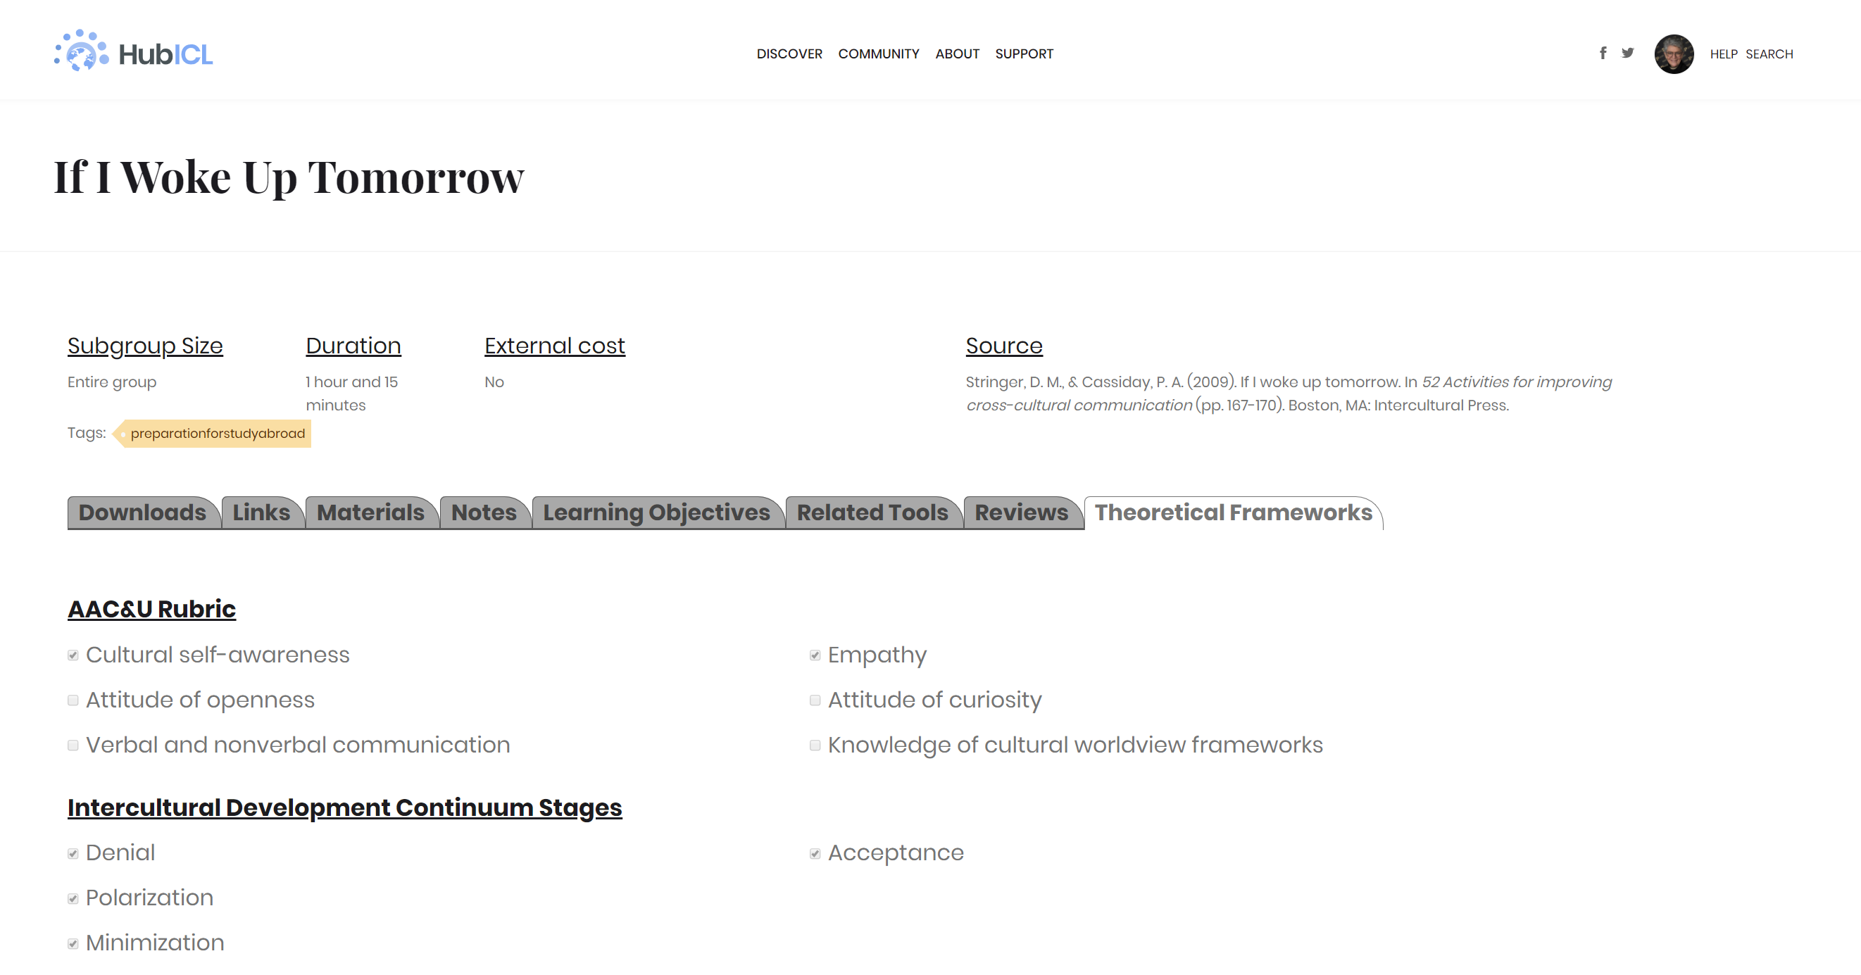

Slide 42
The Parable
1. Of whom do you most approve:
Rosemary
Her fiancé
“Spend the night”
“Can’t help”
“I don’t love you, but I’ll marry you.”
2. Of whom do you least approve?
3. Can you order them from most approve to least approve?
4. Negotiate who your group most approves of down to least approves of.
Notes:
Kris

Slide 44
We’d love to hear from you!
Email Annette Benson at cilmar@purdue.edu
Like and follow us at https://www.facebook.com/PurdueCILMAR/
For more information, please go to www.purdue.edu/ippu/cilmar
Engage with the Intercultural Learning Hub at www.hubicl.org

