Slide 1
Emotion labor
To smile or not to smile
Kris Acheson-Clair and Annette Benson
Purdue University’s Center for Intercultural Learning, Mentorship, Assessment and Research

Slide 2
Invitations & Permissions
What would help you feel like you belong in this space?
Invitation to hear and to be heard (not “safe” but “brave” space)
Invitation to speak to each other, not just me
Invitation not to freeze yourself or others in time – we are all in process!
Invitation to be curious
Permission to take care of yourself
What is said in this session stays in this session.
Notes:
Kris

Slide 3
Introductory Exercise Activity created by Dr. Kris Acheson-Clair https://hubicl.org/toolbox/tools/703/
Please turn your camera on.
Please turn your microphone off.
Please type Finished in your Chat box, but do not press Send.
Notes:
Annette

Slide 4
Say It in Sequence
While looking pleasant, please look directly into the camera and count from one to ten out loud (with your microphone off).
Activity adapted from Dr. Sivasailam “Thiagi” Thiagarajan, https://thiagi.net/archive/www/pfp/IE4H/december2008.html#Jolt
Notes:
Annette

Slide 5
Say It in Sequence
While continuing to look pleasant and looking directly into the camera, say the numbers one to ten in alphabetical order.
When you are finished counting from one to ten in alphabetical order, please send your “Finished” message in the Chat.
Activity adapted from Dr. Sivasailam “Thiagi” Thiagarajan, https://thiagi.net/archive/www/pfp/IE4H/december2008.html#Jolt
Notes:
Annette

Slide 6
Emotion labor
Debriefing Questions
What did you notice about others’ faces during the activity?
Notes:
Kris and Annette

Slide 7
Emotion labor
Debriefing Questions
How did you feel during the activity?
Notes:
Kris and Annette

Slide 8
Emotion labor
Debriefing Questions
What situations in your professional life does this call to mind?
Notes:
Kris and Annette

Slide 9
Just Smile! Activity created by Dr. Aletha Stahl https://hubicl.org/toolbox/tools/632/
Place yourself in each of the situations listed on the handout provided to you and imagine the various feelings you would have.
Then, rate the strength of those feelings from “no feelings” to “very strong” feelings.
The emotion wheel may help you to think about what your feelings are, if you have any.
Notes:
Kris will lead the discussion, and Annette will supply the handout for the audience to download.

Slide 10
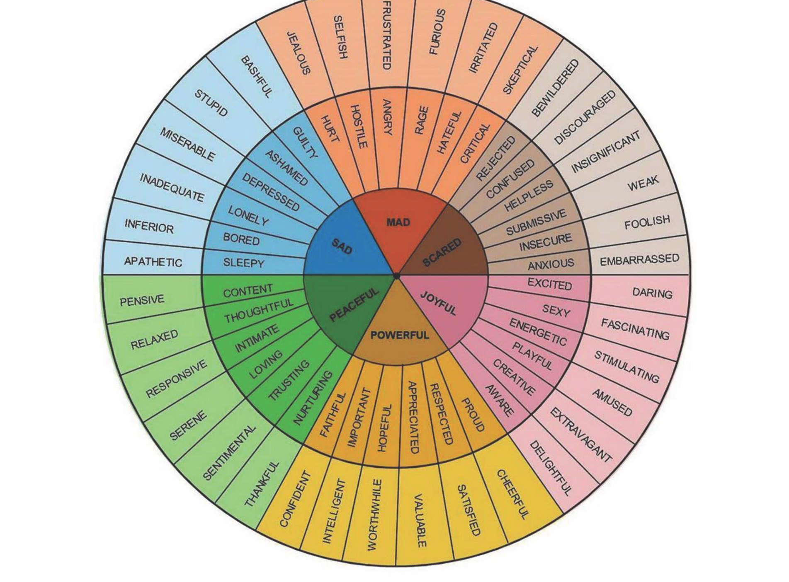
Notes:
Kris will continue the discussion, and Annette will also put the wheel in the Chat for them to download. Kris will instruct people to fill out the sheet with camera off and return when finished.

Slide 11
Group Debrief 1
Group Debrief 1
How was it to consider the strength of your feelings in these situations?
What were some of the feelings that came up?
Where would you like to know more about a situation?
Notes:
Annette and Kris will debrief

Slide 12
Small group discussion
Small Group Discussion
In small groups (3-4 people), discuss several of the situations where at least one of you marked “strong” or “very strong.” What do you think you would do in each situation?
Suppress your emotions
Try to produce certain emotions in someone else
Pretend that you share someone else’s emotions
Genuinely share someone else’s emotions
Notes:
Kris will send to breakout rooms.

Slide 13
Group Debrief 2
Group Debrief 2
What were some of the situations you discussed?
What surprised you in the discussion?
Based on this activity and the counting activity, how would you define emotion labor?
What are other situations—work, home, social—where emotion labor is required?
Notes:
Annette and Kris will debrief.

Slide 14
Emotion labor
What is emotion labor?
According to Hochschild (1983), emotion labor is the work that professionals are expected to perform to manage their feelings and ”to create a publicly observable facial and bodily display” (p. 7).
Emotion labor involves the following:
Surface acting: Verbal and nonverbal displays of emotions that are not genuinely felt by the person performing them. Could also be hiding the things that you do feel.
Deep acting: Consciously generating emotions towards other people in order to experience the appropriate, authentic emotion needed for the interaction.
Emotional consonance: Feeling the appropriate emotion required without effort (Acheson et al., 2016, Hochschild, 1983)
Hochschild, A.R. (1983). The managed heart: Commercialization of human feeling. University of California Press.
Notes:
Kris will provide the research.

Slide 15
What do you think?
Are some careers more demanding in terms of emotion labor?
Which identities are more expected to perform emotion labor?
What are the positive and negative results of often engaging in emotion labor?
Notes:
Kris

Slide 16
Emotion labor
Emotion labor scholarship
Professions studied:
Medical professionals, particularly nurses & physicians
Mental health professionals
Childcare professionals
Criminal justice professionals, such as 911 operators, correctional facility officers, firefighters, and law enforcement officials
Social workers
Clergy members
Hospitality & tourism professionals
Educators
Notes:
Kris

Slide 17
Emotion labor
Emotion labor scholarship (continued)
Most often applied to women-dominated professions , and women often encounter a different set of rules about expected emotions (Gray, 2010, Payne, 2009)
Emotion labor often expected in particular professions, especially the service and hospitality/tourism industries (Brotheridge & Grandey, 2002).
There are both positive and negative effects of emotion labor:
Many professionals find work with high emotion labor rewarding (Boyer et al., 2013)
Can lead to burnout and emotional exhaustion in some, but not all, professions with high levels of emotion labor (Näring et al., 2006).
Burnout/emotional exhaustion associated with imbalance between emotional effort and job satisfaction (Martínez-Iñigo, et al., 2007)
Notes:
Kris

Slide 18
Do you notice any gaps in this body of scholarship?
What are the factors at play that create more pressure for some to perform?
What consequences do people face when they don’t perform emotion labor as expected?
What impact does this dynamic have on diversity, equity, and inclusion in a professional space?
Notes:
Kris

Slide 19
Emotion labor
What is emotion labor?
According to Hochschild (1983), emotion labor is the work that professionals are expected to perform to manage their feelings and ”to create a publicly observable facial and bodily display” (p. 7).
Emotion labor involves the following:
Surface acting: Verbal and nonverbal displays of emotions that are not genuinely felt by the person performing them. Could also be hiding the things that you do feel.
Deep acting: Consciously generating emotions towards other people in order to experience the appropriate, authentic emotion needed for the interaction.
Emotional consonance: Feeling the appropriate emotion required without effort (Acheson et al., 2016; Hochschild, 1983)

Slide 20
Emotion Labor in Careers
How can professions with great amounts of emotion labor be rewarding?
How can professions with great amounts of emotion labor lead to burn out?
In you own career, has emotion labor been more rewarding or more draining?
Notes:
Annette

Slide 21
Emotion Labor—2020-2022
Have you seen emotion labor played out during the pandemic? In the greater public? In your work environment?
How do you think that emotion labor might or might not be connected to introversion and extraversion?
How have you supported your co-workers or employees as they have experienced emotion labor?
Notes:
Annette

Slide 22
Self-Care Assessment
Notes:
Kris will introduce, and Annette will put the document in the Chat for download.

Slide 23
Self-Care Assessment
How did it feel to fill out the Self-Care Assessment?
Select an item that you rated "?" or "0." Why do you think you don't do this?
Select an item that you rated "3." Why do you think you do this? What patterns, if any, do you notice in your responses to the questionnaire?
Do you think the responses of your close family members or friends would have similar patterns? Why or why not?
Where in the past have you gotten messages about self-care and what it looks like?
Notes:
Kris and Annette

Slide 24
What will you do to recover when emotion labor is negative?
Authenticity: Make time to connect with people or things that you love in a genuine way.
Ask for help: If you find that you're doing the brunt of the emotional labor at home, at work or in a relationship, ask for help.
Mindfulness: Becoming more aware of your own emotions and motivations and how to connect them to the behavior you need to show at work is the heart of deep acting.
Regain your sense of control: In her research on emotional labor, Hochschild found that low perceived control combined with high pressure to conform to an emotional standard increased stress and burnout for employees.
Self-care
Cooks-Campbell, A. (2021, November 9). Emotional labor: How to relate—and recover—in your role. BetterUp. https://www.betterup.com/blog/emotional-labor
Notes:
Annette

Slide 25
So why is the Center for Intercultural Learning, Mentorship, Assessment and Research interested in emotion labor?
Intercultural learning was born out of study abroad.
We are interested in the overlap of ICL with diversity, equity, inclusion, and belongingness.
We are interested in how emotion labor appears differently across cultures.
Notes:
Kris

Slide 26
Emotion labor
Works Cited
Acheson, K., Luna, K. & Taylor, J. (2016). The burnout spiral: The emotion labor of five rural U.S. foreign language teachers. The Modern Language Journal, 100(2), 522-537.
Brotheridge, C.M. & Lee, R.T. (2002). Development and validation of the Emotional Labour Scale. Journal of Occupational and Organizational Psychology, 76, 365-379.
Gray, B. (2010). Emotional labour and befriending in family support and child protection in Tower Hamlets. Child & Family Social Work, 7, 13-22.
Hochschild, A.R. (1983). The managed heart: Commercialization of human feeling. University of California Press.
Martínez-Iñigo, D., Totterdell, P., Alocver, C.M., & Holman, D. (2007). Emotional labour and emotional exhaustion: Interpersonal and intrapersonal mechanisms. Work & Stress, 21, 30-47.
Näring, G., Briȅt, M., & Brouwers, A. (2006). Beyond demand-control: Emotiona labour and symptoms of burnout in teachers. Work & Stress, 20, 303-315.
Payne, J. (2009). Emotional labour and skill: A repraisal. Gender, Work & Organization, 16, 348-367.

Slide 27
For more…
purdue.edu/ippu/cilmar
cilmar@purdue.edu
facebook.com/purduecilmar
https://www.linkedin.com/company/cilmar
hubicl.org
All of the materials demonstrated today are at : https://hubicl.org/members/1005/collections/emotion-labor
Notes:
Annette

