Slide 1


Emotion labor
To smile or not to smile
Created by Dr. Kris Acheson-Clair, Annette Benson, & Aletha Stahl
Facilitated on 11/04/2022 for SIETAR-USA by Annette Benson, Senior Public Relations Consultant

Slide 2
Invitations & Permissions
What would help you feel like you belong in this space?
Invitation to hear and to be heard (not “safe” but “brave” space)
Invitation to speak to each other, not just me
Invitation not to freeze yourself or others in time – we are all in process!
Invitation to be curious
Permission to take care of yourself
What is said in this session stays in this session.

Slide 3
Introductory Exercise
Activity created by Dr. Kris Acheson-Clair https://hubicl.org/toolbox/tools/703/
Choose a persona
You must smile and nod the entire time that we are engaged in the activity.
Try to genuinely care about how other people are responding emotionally to the activity. Watch their body language, ask people if they’re doing okay, and try to express genuine concern and empathy for them.
You must hide any frustration or anxiety (or really any other emotion) that you may be feeling, always presenting a neutral facial expression and tone of voice.

Slide 4
Say It in Sequence
While maintaining your role, please count from one to ten.
When you are finished counting from one to ten, please stand and remain standing.
Roles
Smiling and nodding
Checking in to see if others are OK
Neutral face
Activity adapted from Dr. Sivasailam “Thiagi” Thiagarajan, https://thiagi.net/archive/www/pfp/IE4H/december2008.html#Jolt

Slide 5
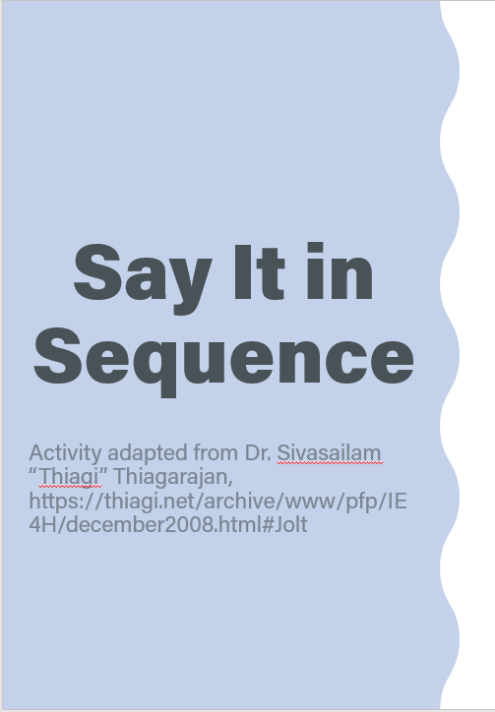
Say It in Sequence
While maintaining your role, say the numbers one to ten in alphabetical order.
When you are finished counting from one to ten in alphabetical order, please sit down.
Roles
Smiling and nodding
Checking in to see if others are OK
Neutral face
Activity adapted from Dr. Sivasailam “Thiagi” Thiagarajan, https://thiagi.net/archive/www/pfp/IE4H/december2008.html#Jolt

Slide 6

Emotion labor
Debriefing Question
How did you feel during the activity as you were performing your role?

Slide 7
Just Smile!
Activity created by Dr. Aletha Stahl https://hubicl.org/toolbox/tools/632/
Place yourself in each of the situations listed on the handout provided to you and imagine the various feelings you would have.
Then, rate the strength of those feelings from “no feelings” to “very strong” feelings.
The emotion wheel may help you to think about what your feelings are, if you have any.

Slide 8
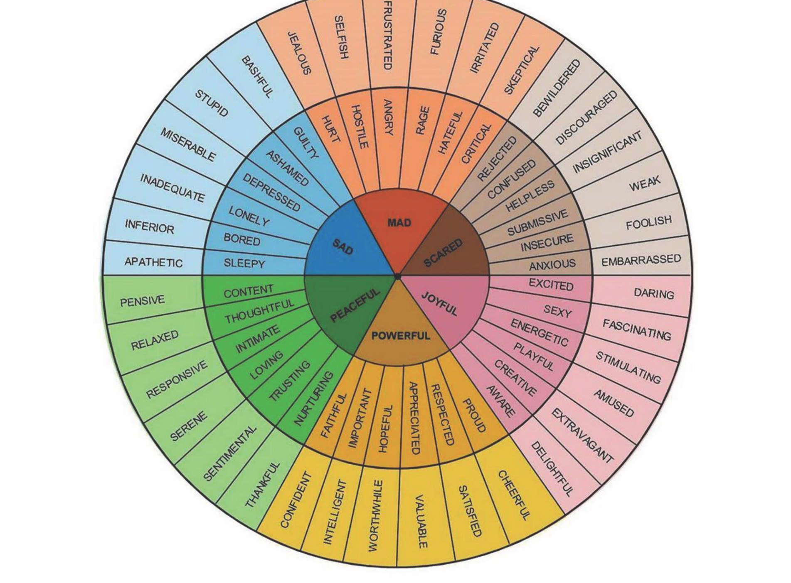

Slide 9
Group Debrief 1
Group Debrief 1
How was it to consider the strength of your feelings in these situations?
What were some of the feelings that came up?
Where would you like to know more about a situation?

Slide 10
Small group discussion
Small Group Discussion
In small groups (3-4 people), discuss several of the situations where at least one of you marked “strong” or “very strong.” What do you think you would do in each situation?
Suppress your emotions
Try to produce certain emotions in someone else
Pretend that you share someone else’s emotions
Genuinely share someone else’s emotions

Slide 11
Group Debrief 2
Group Debrief 2
What were some of the situations you discussed?
What surprised you in the discussion?
Based on this activity and the counting activity, how would you define emotion labor?
What are other situations—work, home, social—where emotion labor is required?

Slide 12
Emotion labor
What is emotion labor?
According to Hochschild (1983), emotion labor is the work that professionals are expected to perform to manage their feelings and ”to create a publicly observable facial and bodily display” (p. 7).
Emotion labor involves the following:
Surface acting: Verbal and nonverbal displays of emotions that are not genuinely felt by the person performing them. Could also be hiding the things that you do feel.
Deep acting: Consciously generating emotions towards other people in order to experience the appropriate, authentic emotion needed for the interaction.
Emotional consonance: Feeling the appropriate emotion required without effort (Acheson et al., 2016, Hochschild, 1983)
Hochschild, A.R. (1983). The managed heart: Commercialization of human feeling. University of California Press.

Slide 13
Emotion Labor—2020-2022
Please scan “The Staff Are Not OK.”
Have you seen emotion labor played out during the pandemic? In the greater public? In your office?
How have you supported your co-workers or employees as they have experienced emotion labor?

Slide 14
Emotion labor
What is emotion labor?
According to Hochschild (1983), emotion labor is the work that professionals are expected to perform to manage their feelings and ”to create a publicly observable facial and bodily display” (p. 7).
Emotion labor involves the following:
Surface acting: Verbal and nonverbal displays of emotions that are not genuinely felt by the person performing them. Could also be hiding the things that you do feel.
Deep acting: Consciously generating emotions towards other people in order to experience the appropriate, authentic emotion needed for the interaction.
Emotional consonance: Feeling the appropriate emotion required without effort (Acheson et al., 2016; Hochschild, 1983)

Slide 15
Emotion labor
Emotion labor scholarship (continued)
Most often applied to women-dominated professions , and women often encounter a different set of rules about expected emotions (Gray, 2010, Payne, 2009)
Emotion labor often expected in particular professions, especially the service and hospitality/tourism industries (Brotheridge & Grandey, 2002).
There are both positive and negative effects of emotion labor:
Many professionals find work with high emotion labor rewarding (Boyer et al., 2013)
Can lead to burnout and emotional exhaustion in some, but not all, professions with high levels of emotion labor (Näring et al., 2006).
Burnout/emotional exhaustion associated with imbalance between emotional effort and job satisfaction (Martínez-Iñigo, et al., 2007)

Slide 16
Emotion labor
Emotion labor scholarship
Professions studied:
Medical professionals, particularly nurses & physicians
Mental health professionals
Childcare professionals
Criminal justice professionals, such as 911 operators, correctional facility officers, firefighters, and law enforcement officials
Social workers
Clergy members
Hospitality & tourism professionals
Educators
Can you think of any other professions where one might have to perform emotion labor?

Slide 17
Emotion Labor in Careers
How can professions with great amounts of emotion labor be rewarding?
How can professions with great amounts of emotion labor lead to burn out?

Slide 18
Emotion labor
Debriefing Questions
How does what you experienced in these activities connect to past experiences you’ve had at work?
Do you have co-workers or employees who are called upon to perform emotion labor? How might you support them?
How do you think that emotion labor might or might not be connected to introversion and extraversion?
Do you have ideas for how people might move from surface-acting to deep-acting to emotional consonance?

Slide 19
Emotion Labor in Careers Case Study Analysis
Activity created by Dr. Kris Acheson-Clair https://hubicl.org/toolbox/tools/729
We will now transition into a group activity. You will be divided into five groups, and each will be assigned a different “Emotion Labor in Careers case study. You will first read through your assigned case individually and then discuss the case together using the following questions as guides:
What challenges do workers in the profession detailed in this case study tend to face?
How do they perform emotion labor in response to that challenge?
What are the differences in terms of gender, race, ethnicity, or other social identity markers that were identified within the case?
What strategies for coping or managing emotion labor were suggested by the case study authors?

Slide 20
Emotion labor
Time to Debrief
I need one representative from each of the breakout groups to report back with:
  A brief summary of the case
  One or two insights that surfaced in your group discussion
Be ready to answer questions from others and to comment on connections you see with other groups’ cases.

Slide 21
Emotion labor
Works Cited
Acheson, K., Luna, K. & Taylor, J. (2016). The burnout spiral: The emotion labor of five rural U.S. foreign language teachers. The Modern Language Journal, 100(2), 522-537.
Brotheridge, C.M. & Lee, R.T. (2002). Development and validation of the Emotional Labour Scale. Journal of Occupational and Organizational Psychology, 76, 365-379.
Gray, B. (2010). Emotional labour and befriending in family support and child protection in Tower Hamlets. Child & Family Social Work, 7, 13-22.
Hochschild, A.R. (1983). The managed heart: Commercialization of human feeling. University of California Press.
Martínez-Iñigo, D., Totterdell, P., Alocver, C.M., & Holman, D. (2007). Emotional labour and emotional exhaustion: Interpersonal and intrapersonal mechanisms. Work & Stress, 21, 30-47.
Näring, G., Briȅt, M., & Brouwers, A. (2006). Beyond demand-control: Emotiona labour and symptoms of burnout in teachers. Work & Stress, 20, 303-315.
Payne, J. (2009). Emotional labour and skill: A repraisal. Gender, Work & Organization, 16, 348-367.

Slide 22
Self-Care Assessment

Slide 23
Self-Care Assessment
How did it feel to fill out the Self-Care Assessment?
Select an item that you rated "?" or "0." Why do you think you don't do this?
Select an item that you rated "3." Why do you think you do this? What patterns, if any, do you notice in your responses to the questionnaire?
Do you think the responses of your close family members or friends would have similar patterns? Why or why not?
Where in the past have you gotten messages about self-care and what it looks like?

Slide 24

Emotion Labor & DEIB
Please read “What I’ve Learned Grieving on the Job”
How do the author’s thoughts interplay with our conversation around emotion labor?

Slide 25

What will you do to recover when emotion labor is negative?
Authenticity: Make time to connect with people or things that you love in a genuine way.
Ask for help: If you find that you're doing the brunt of the emotional labor at home, at work or in a relationship, ask for help.
Mindfulness: Becoming more aware of your own emotions and motivations and how to connect them to the behavior you need to show at work is the heart of deep acting.
Regain your sense of control: In her research on emotional labor, Hochschild found that low perceived control combined with high pressure to conform to an emotional standard increased stress and burnout for employees.
Self-care
Cooks-Campbell, A. (2021, November 9). Emotional labor: How to relate—and recover—in your role. BetterUp. https://www.betterup.com/blog/emotional-labor

Slide 26
So why is the Center for Intercultural Learning, Mentorship, Assessment and Research interested in emotion labor?
Intercultural learning was born out of study abroad.
We are interested in the overlap of ICL with diversity, equity, inclusion, and belongingness.
We are interested in how emotion labor appears differently across cultures.

Slide 27







For more…
purdue.edu/ippu/cilmar
cilmar@purdue.edu
facebook.com/purduecilmar
https://www.linkedin.com/company/77824370/
https://www.instagram.com/cilmar.purdue/
hubicl.org
All of the materials demonstrated today are at : https://hubicl.org/members/1005/collections/emotion-labor

