Slide 1
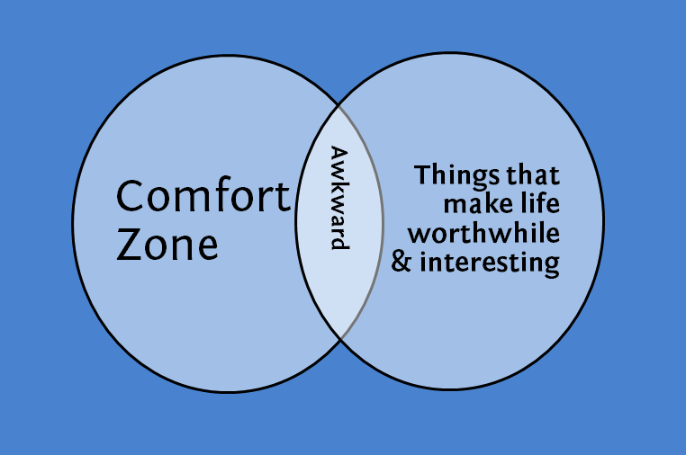
Prepare for awkward moments
Notes:
Developing cultural competencies is not easy but it is necessary
We advocate that you take time to step outside of your comfort zone

Slide 2
Defining Culture “shock”
Shock or fatigue or adjustment?
A story of culture shock
Plant metaphor

Slide 3
The W-curve Model

Slide 4
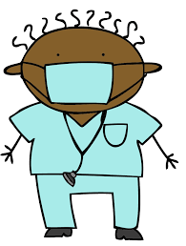
The Medical Model
Symptoms
Causes
Cures

Slide 5
Cures/Strategies
Short-term Approach: Deal with symptoms
Pros/Cons
Long-term Approach: Remove causes
Pros/Cons
When might you want to choose short vs. long term approaches?

