Slide 1
Strategies for Enhancing Intercultural Learning,
Empathy and Facilitation
Barbara J. Kappler & Yuliya Kartoshkina, University of Minnesota
Annette K. Benson, Purdue University
Notes:
4 min total for the intro and the outline
(Barbara will welcome the audience.)
(Each presenter will briefly introduce themselves.)

Slide 2
During this session, together we will...
Identify key findings from educational and cultural neuroscience that can provide insights into how the functions of our brains impact intercultural learning.
Discover the complexity of intercultural facilitation and explore how effective facilitation techniques can benefit students’ intercultural learning.
Review several examples and scenarios involving intercultural facilitation techniques and analyze how you might apply these in your own practice.
Become familiar with several models and teaching tools to enhance intercultural empathy.

Slide 3
Neuroscience
Behind Intercultural Learning

Slide 4
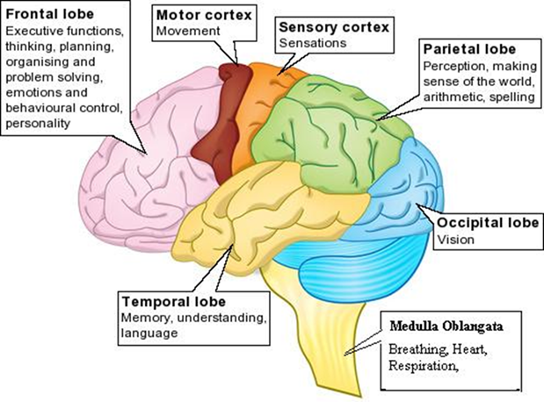
Educational Neuroscience
Interdisciplinary field that combines findings from cognitive neuroscience, educational psychology, and education.
Explores the brain mechanisms in learning and develops principles to enhance teaching and learning practices.
(Tokuhama- Espinosa, 2010)
Notes:
Common tendencies in ho our brains function. Neurosciencsts revealed that different areas of the brain are responsible for different function and biochemistry but unique wiring due to genetics and life experiences.

Slide 5
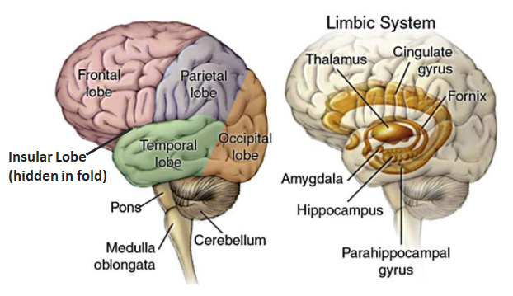
Learning and Emotions
Notes:
The limbic system is the part of the brain that deals with three key functions: emotions, memories and arousal (or stimulation). Evolutionary, it evolved the earliest and thus, it turns on the fastest to help us react to the dangers in our environment. But those dangers do not have to real- they can also be perceived.

Slide 6
Emotions and Learning: Perspective from Neuroscience
The “emotional brain” (the limbic system) has the power to open or close access to learning, memory, and the ability to make novel connections (Jensen, 2008).
We tend to lose access to our frontal lobe when we are “in danger”- feeling fear, worry, or anxiety.
Importance of awareness and realization that you can calm down your emotions and regain access to the frontal lobe.

Slide 7
Cultural Neuroscience
Integrates theories and methods from various fields, with cultural psychology, neuroscience, and neurogenetics being most prominent (Chiao, 2009).
Seeks to understand how the human brain is capable of learning cultural elements (e.g., values, practices, and beliefs), and how these cultural elements in turn shape the human brain and its functions.

Slide 8
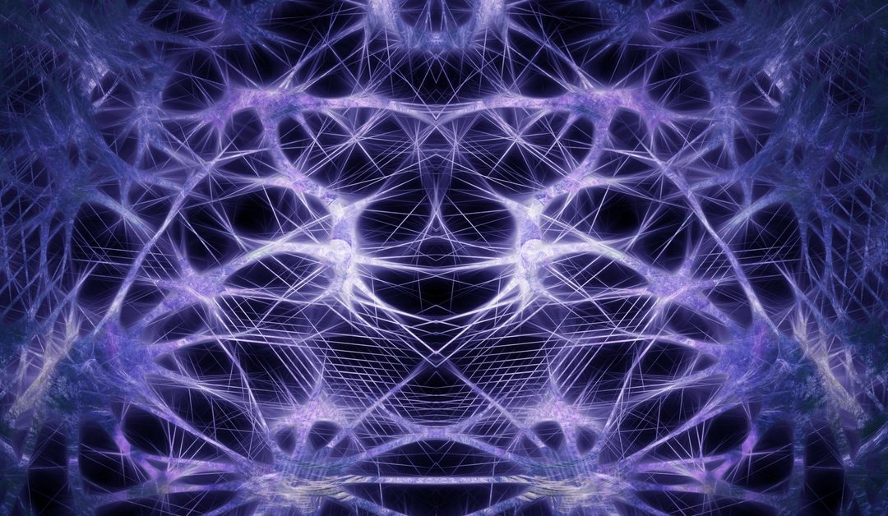
Cultural patterning of the brain
People from a shared cultural background not only acquire similar patterns of thinking and behavior, but also develop similar neural patterns in their brains.
No “right” or “wrong” wiring- just wiring that helped adjust to a specific cultural environment.
Differences in perceiving self, emotions, performing different tasks (Casey & Robinson, 2017; Chiao, 2008).

Slide 9
The process of Facilitation: Perspective from Neuroscience
Create psychological safety for yourself and especially for your participants so people have access to the frontal lobe (icebreakers are cruitual).
Connect to a person’s unique neural wiring (help them expand the existing neural networks).
Keep in mind that it takes time, repetition, and personal motivation for the brain to “re-wire.”
Notes:
s

Slide 10
The Art of
Intercultural Facilitation

Slide 11
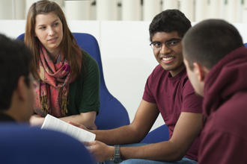
Facilitation
“Facilitate” is derived from the Latin word facilis which means “to ease”
Learning Across Cultures, page 139
Notes:
Does not mean the process is easy, but it means the facilitator is assisting and supporting others in this process.

Slide 12
Keep in mind ...
Learner-centered
Listening intently so that you can hear the dimensions, concepts, struggles, insights
Artfulness comes from being present
Significant stimuli in the room
Notes:
You can not really pre-determine the direction of the learner

Slide 13
Intercultural Facilitation
Image deleted to honor copyright of the artist
Notes:
Assist learners in shifting perspectives
Help learners realize that they may not fully understand the experience as they are using the lens of their own culture to make sense of it.
Learning Across Cultures, page 141

Slide 14
Vestibulum congue
Validate emotions
Vestibulum congue
Vestibulum congue
Raise awareness of perspective
Toward Intercultural Development
Notes:
Intercutural Facilitation is balancing these -- simulataneously!

Slide 15
Intercultural Facilitator
Simultaneously validates the emotional aspect of the experience, while prompting the participants to realize the conclusions they have drawn need to be examined to the extent that they reflect more than one cultural perspective.
Guides learners through this paradigm shift toward intercultural learning and development.
Notes:
(This text explains previos model)

Slide 16
Three options when facilitating
Ask the participant who just spoke a probing question
Provide a comment or mini lecture
Turn the conversation back to the group to gather more information
Ask the same question
Generate a new question
Notes:
Seems simple -- and it is! We jus thave three choices. It’s the stimulus that makes it seem so much more complex!!
What might the advantages of each be
Environment, experience- we provide a student with
Emphasize one or another, but not everything

Slide 17
What would you do?
Options:
Groups of 4-5. You all just arrived to the conference. One of you be the facilitator. You ask: How has your experience been at the conference? Facilitate the conversation and be aware of the option you choose. Participants be active!
Probe
Comment or mini lecture
Gather more information from the group
Ask same question
Ask a new question
Notes:
Quick practice:

Slide 18
Theories & Frameworks
Developmental Model of Intercultural Sensitivity (DIMS)
Describe Interpret Evaluate (DIE)
Student Development Theories
Cultural values
And more...
Notes:
What do you draw upon fto facilitate? If time, we’ll do this as “Think pair, share”

Slide 19
Facilitation in Practice
Notes:
About 7 min total

Slide 20
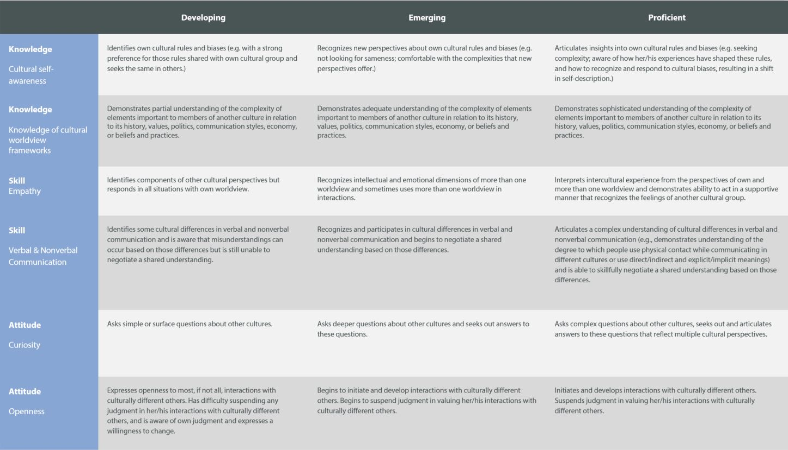

Slide 22
Things to consider
Group subdivisions
Cost
Time
Experiential, media, reflection, assessment, curriculum
Kinesthetic
AAC&U Rubric for Intercultural Knowledge and Competence
Downloads
Links
Materials
Learning Objectives
Other theoretical frameworks

Slide 24
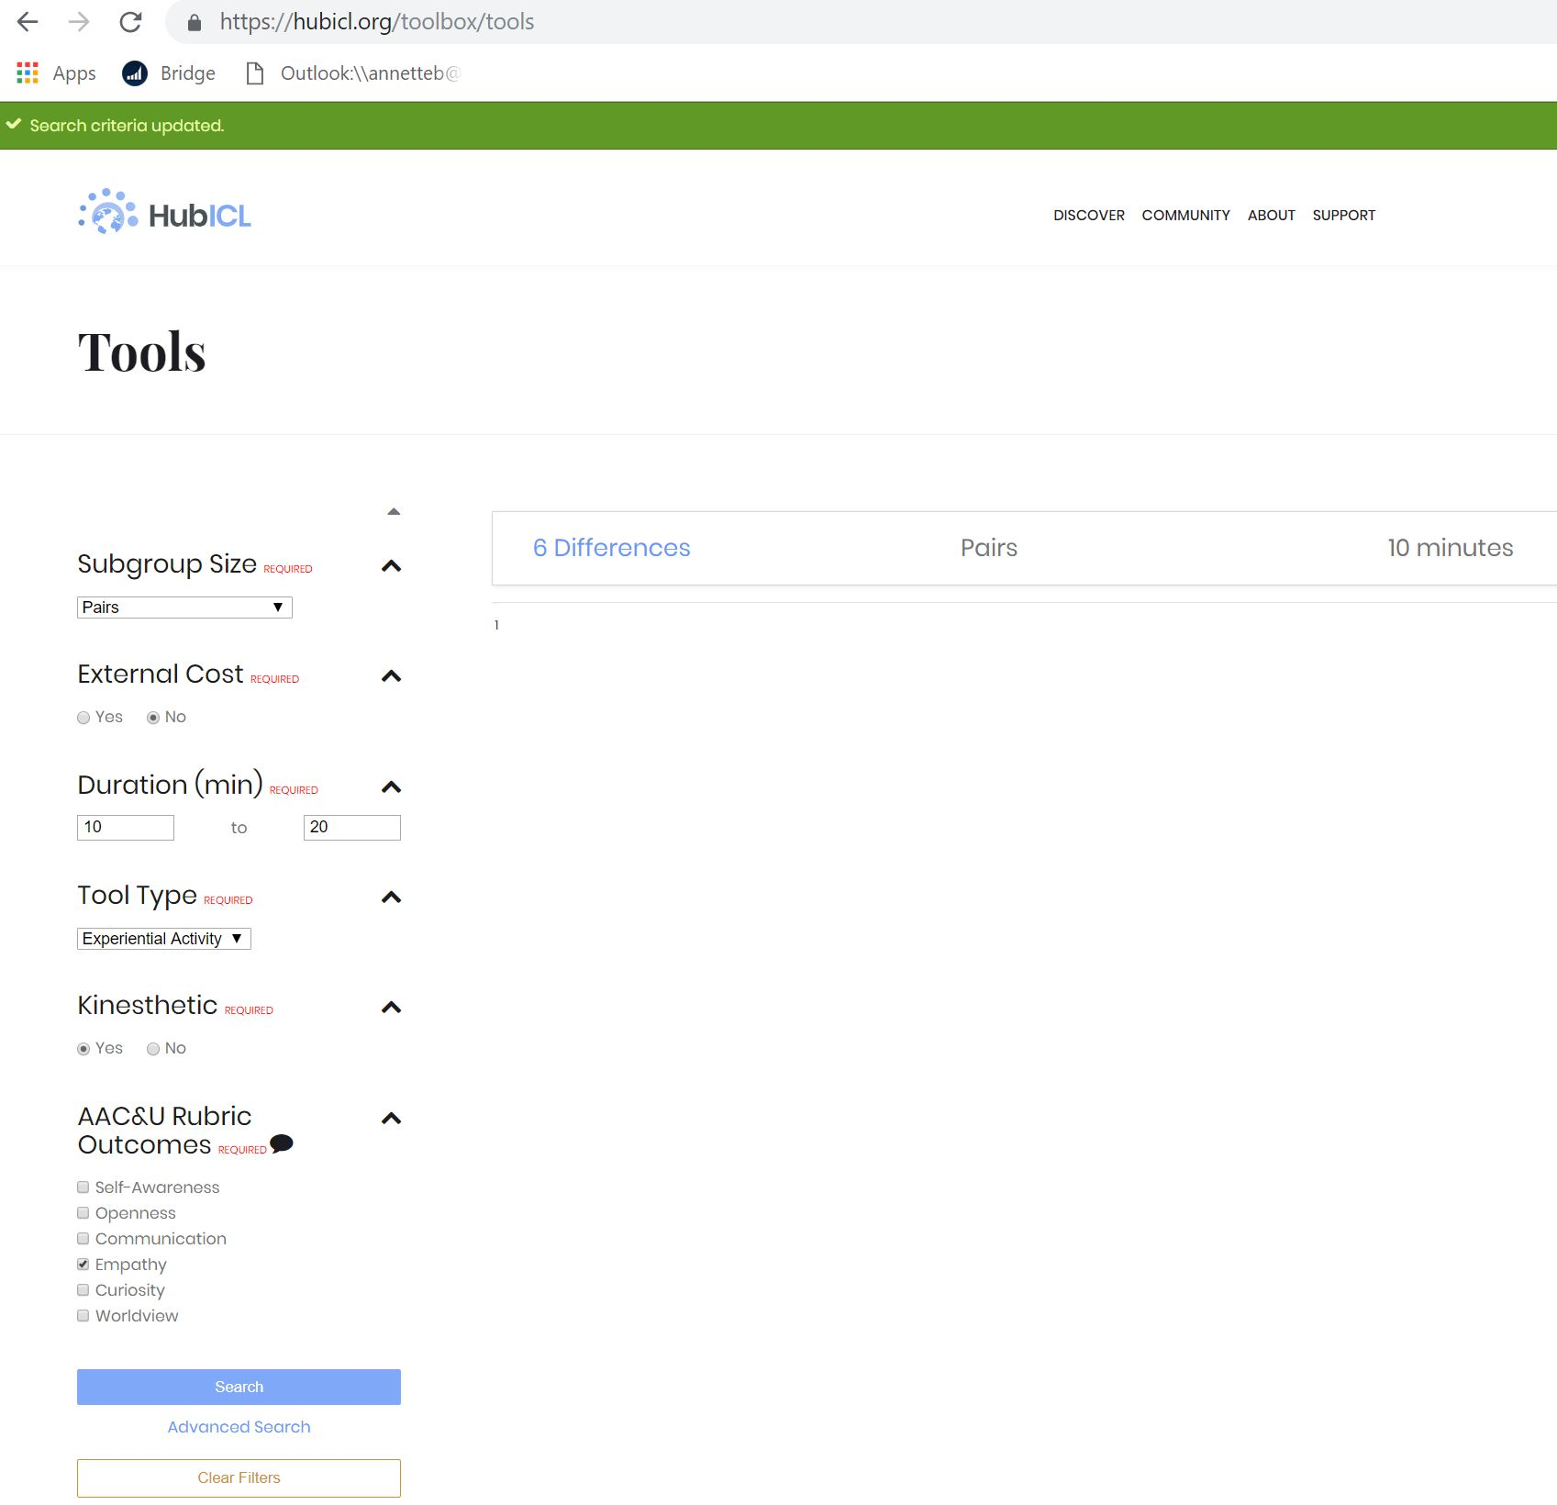
www.hubicl.org/toolbox/tools/

Slide 25
Choosing tools that flow
6 Differences
Different Similarities
Scenery, Machinery, People

Slide 27
Jolt 7: Different Similarities
Please take a seat with your partner. This will be your seat for the duration, so please gather your things if you need to.
Please take 2 minutes and discuss how many ways you are
similar.

Slide 28
Similarities and Differences
Find as many similarities as you have in 2 minutes.
age
military service
automobile ownership
birth order
educational background
family
favorite author
favorite magazine
food preferences
health status
Hobbies
Home ownership
Home town
Language
Learning style
Leisure time activities
Marriage status
Membership in groups
Musical preferences
Personality type
Political affiliation
Professional reading preferences
Religion
Schooling
Sports
Thinking style
TV preferences
Thiagarajan, S., & van den Bergh, S. (2017). Jolts! Brief activities to explore
diversity and inclusion. Bloomington, IN: Workshops by Thiagi.

Slide 29
Jolt 7: Different Similarities
Please take a seat with your partner. This will be your seat for the duration, so please gather your things if you need to.
Please take 2 minutes and discuss how many ways you are
different.

Slide 30
Similarities and Differences
Find as many differences as you have in 2 minutes.
age
military service
automobile ownership
birth order
educational background
family
favorite author
favorite magazine
food preferences
health status
Hobbies
Home ownership
Home town
Language
Learning style
Leisure time activities
Marriage status
Membership in groups
Musical preferences
Personality type
Political affiliation
Professional reading preferences
Religion
Schooling
Sports
Thinking style
TV preferences
Thiagarajan, S., & van den Bergh, S. (2017). Jolts! Brief activities to explore
diversity and inclusion. Bloomington, IN: Workshops by Thiagi.

Slide 31
Preparing to Facilitate
Debriefing Question: So...did you find it more interesting to learn about similarities or differences?

Slide 32
Three options when facilitating
Ask the participant who just spoke a probing question
Provide a comment or mini lecture
Turn the conversation back to the group to gather more information
Ask the same question
Generate a new question
Notes:
Seems simple -- and it is! We just thave three choices. It’s the stimulus that makes it seem so much more complex!!
What might the advantages of each be
Environment, experience- we provide a student with
Emphasize one or another, but not everything

Slide 33
Questions:
What did you find most interesting to talk about - similarities or differences?
How is your answer to #1 affected by your own intercultural development?
How does your answer to #1 play into the stages of the intercultural development continuum?
Options:
Probe
Mini-lecture
Ask the group same or new question

Slide 34
Advanced Tools
Personal Leadership
http://www.plseminars.com/
Cultural Detective
https://www.culturaldetective.com/

Slide 35
Selected References (Intercultural Facilitation)
Kappler Mikk, B. & Steglitz, I. (2017) (Eds.) Learning across cultures: Locally and globally (3rd edition). NAFSA, Washington D.C.
Kappler Mikk, B. & Bjarnadottir, T. (2017) Intercultural facilitation. In B. Kappler Mikk & I. Steglitz (eds.) Learning across cultures: Locally and globally (3rd edition). NAFSA, Washington D.C.
Yefanova, D., Montgomery, M. L., Woodruff, G., Johnstone, C., Kappler B. (2017). Instructional Practices facilitating cross-national interactions in the classroom. Journal of International Students. 7 (3) (pp. 786-805).
Thiagarajan, S. (2015). Six questions to ask during debriefing. In Interactive techniques for Instructor-Led Training (p. 252). Bloomington, IN: The Thiagi Group.

Slide 36
Arkoudis, S., Yu, X., Baik, C., Borland, H., Chang, S., Lang, I., Lang, J., Pearce, A., & Watty, K. (2010). Finding common ground: Enhancing interaction between domestic and international students. Mebourne, Australia: Australian Learning & Teaching Council.
Mestenhauser, J. (1976). Learning with Foreign Students. A Handbook for Student on How to Enrich Their Learning in International Studies, in International Education and Other Social and Behavioral Sciences Through Foreign Students. International Student Adviser's Office, University of Minnesota.
Xi, Y., Isensee, B., Kappler Mikk, B (2016). Using Data Wisely to Improve International Student Satisfaction: Insights Gained from International Student Barometer. In Bista, K. and Foster, C. (Eds.) Exploring the Social and Academic Experiences of International Students in Higher Education Institutions, (pp.212-232). Hershey, PA: IGI Global.
University of Minnesota’s Conceptual Framework for Internationalizing the Campus: http://global.umn.edu/icc/documents/icc_conceptual_framework.pdf

Slide 37
Selected References (Intercultural Learning)
American Association of Colleges & Universities. (2009). Intercultural Knowledge and Competence VALUE Rubric. Retrieved from https://www.aacu.org/value/rubrics/intercultural-knowledge.
Thiagarajan, S., & van den Bergh, S. (2017). Jolts! Brief activities to explore
diversity and inclusion. Bloomington, IN: Workshops by Thiagi.
Vande Berg, M. (2016, February).Workshop 1: Intercultural learning & teaching program. Workshop presented at Purdue University, West Lafayette, IN.

Slide 38
Selected References (Neuroscience)
AAC&U Panel. (2009). AAC&U VALUE Rubric for Intercultural Knowledge & Competence. American Association of Colleges and Universities.
Casey, M. E. & Robinson, S. M. (2017). Neuroscience of inclusion: New skills for new times, Outskirts Press.
Chiao, J. Y. (2009). Cultural neuroscience: a once and future discipline. Progress in Brain Research, (178), 287-304.
Duhigg, C. (2016). What Google learned from its quest to build the perfect team. The New York Times Magazine, Retrieved from https://www.nytimes.com/2016/02/28/magazine/what-google-learned-from-its-quest-to-build-the-perfect-team.html
Jensen, E. (2008). Teaching with the brain in mind. Alexandria, VA: Association for Supervision and Curriculum Development.

Slide 39
Kartoshkina, Y. (2017). Neuroscience behind intercultural learning. In B. Kappler Mikk & I.E. Steglitz (Eds.), Learning across cultures: Locally and globally (3rd ed), (87-108). Washington, D.C.: NAFSA: Association of International Educators.
Tokuhama-Espinosa, T. (2010). The New Science of Teaching and Learning: Using the Best of Mind, Brain, and Education Science in the Classroom. New York, NY: Columbia University Teachers College Press.
Sousa, D. A. (2011). Mind, Brain, and Education: The Impact of Educational Neuroscience on the Science of Teaching. In Learning Landscapes: Mind, Brain, and Education: Implications for Teachers (5), 37–43.

