Slide 1
ASSESSING & DEVELOPING TEAMWORK SKILLS
Presented by
The Individual & Team Performance Lab
Notes:
Hi Everyone, my name is Genevieve and I am a 2nd year master’s student from the individual and team performance lab.
Today I am going to be delivering one of two workshops on assessing and developing your teamwork skills.

Slide 2
TEAM DEVELOPMENT: PEER FEEDBACK

Slide 3
“There are three things in life that are extremely hard: Steel, Diamond, and to know one’s self”
- Benjamin Franklin
Notes:
We just put these slides in to let participants know it is a constant challenge to develop and fully understand how your own behavior is perceived by others.

Slide 4
CREATING A SAFE SPACE
The spirit is growth, development, and improvement. Look for ways that the team can help you do better, and how you can support others’ development of teamwork skills.
DON’T interrupt, don’t blame, don’t accuse, don’t point fingers.
DO smile, nod, and appreciate each contribution.
DON’T ask others to defend their position or viewpoint.
DO ask what you can do better, or how you can help someone else.
DON’T assume you are perfect.
DO look for ways to improve.
Notes:
Everyone should contribute a perceived team-related strength they bring to the team and also a perceived area where you could do better.

Slide 5
Team Competencies
Commitment to the Team’s Work
Communicating with Teammates
Encouraging High Performance
Keeping the Team on Track & Focused
Strong Foundation of Knowledge, Skills & Abilities
Notes:
This individual level competency model was developed over 10 years of research but engineers and industrial psychologists in the US (Ohland et al., 2012). It is used in the itpmetrics.com platform to define effective team players.
1) Contributing to the team’s work: This is about your contribution to the team’s success and workload. It is about accountability and responsibility.
2) Communicating with teammates: This is in regards to your interactions and your ability to listen actively so that there is no confusion or hard feelings.
3) Strong foundation of knowledge, skills, and abilities: This can be developed with effort and it’s important to seek out learning opportunities.
4) Encouraging high performance: Express stronger expectations that the team will succeed. Express more of a belief that the team can produce high-quality work. Believe that the team will achieve high standards. Care even more that the team produced high-quality work.
5) Keeping the team on track: Maintain a better awareness of fellow team members’ progress. Assess more whether the team is making progress as expected. Provide more constructive feedback to others on the team. Continue to help the team plan and organize its work.

Slide 6
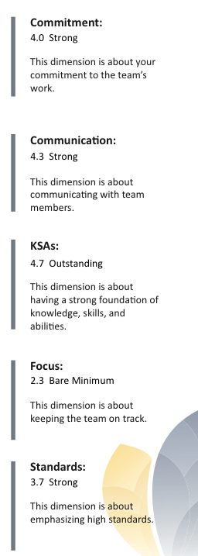
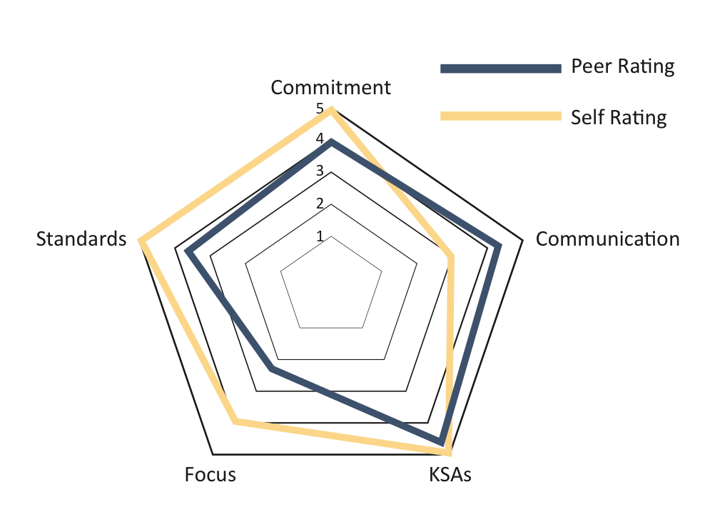
Example Overview
Notes:
There are three things to note here:
How do you perceive yourself? This is the yellow bar.
How do your peers perceive you? This is the navy bar and is likely a close approximation of your true performance
What is the gap? Are there areas your team members rated higher or lower than you? Blindspots!!!
There are 5 possible ratings you can get on each dimension from unsatisfactory, bare minimum, moderate, strong, and outstanding.

Slide 7
How to Give Effective Feedback
Future Oriented
Specific
Behavioral

Slide 8
Peer Feedback Debrief
Tell your teammates:
What’s one strength you perceive you can contribute to your team going forward?
What’s one area of improvement where you can contribute to your team going forward?
Share a goal for your area of improvement.
Specific, Measurable, Achievable, Relevant, Time-bound (SMART!)
Notes:
Optional slide

Slide 9
THANK YOU
Contact Tom O’Neill with any comments or suggestions
toneill@ucalgary.ca
@ITPMetrics

