Slide 1
iLEAD WORKSHOP SERIES FOR VISITING SCHOLARS #2 Provided by: Purdue Polytechnic Institute The Office of International Students and Scholars The Center for Intercultural Learning, Mentorship, Assessment and Research Presenter: Dr. Daniel Jones

Slide 2
Workshop #2: Cultural Differences & Stresses
Agenda:
Share Amazing Race location
Selecting a community event
Senninger’s Learning Zone Model
What is emotional resilience?
Critical incidences
Stressors and triggers
Coping strategies
Writing Prompt
Notes:
To create a new slide: right click and select “Duplicate Slide.”

Slide 3
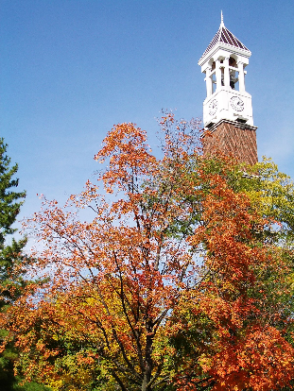
Share your Amazing Race location
Which location did you choose to research and why?
Where is it located?
What did you learn that surprised you?
What insights if any did it give you into U.S., Indiana, Greater Lafayette area, Purdue culture?
Does this cultural artifact remind you of anything back home?
Will you explore this further?
Notes:
Participants can address as many or as few of these as they wish.

Slide 4
Helpful Organizations
International Friendship Program (IFP) friendship@purdue.edu
Culture Catalysts
Primary Advisor: Hailey Dady hdady@purdue.edu
Club President: Michaela Hagler haglerm@purdue.edu
Notes:
Participants can address as many or as few of these as they wish.

Slide 5
Emotional Resilience

Slide 6
Emotional Resilience
What is emotional resilience?
Why is emotional resilience important for you as a visiting scholar?
https://youtu.be/tLzHPM9muwQ
This video has been removed for proprietary reasons.
How to Deal With Loneliness When Living Abroad
Balancing Challenge and Support

Slide 7
Emotional Resilience
Let’s Debrief!
What do the zones look like?
Comfort zone
Learning zone
Panic zone
Critical Incidences?
What have you experienced?
Panic Zone
Learning Zone
Comfort Zone
Senninger‘s Learning Zone Model
Senninger, T. (2000). Abenteuer leiten-in Abenteuern lernen: Methodenset zur Planung und Leitung kooperativer Lerngemeinschaften für Training und Teamentwicklung in Schule, Jugendarbeit und Betrieb. Ökotopia Verlag.

Slide 8
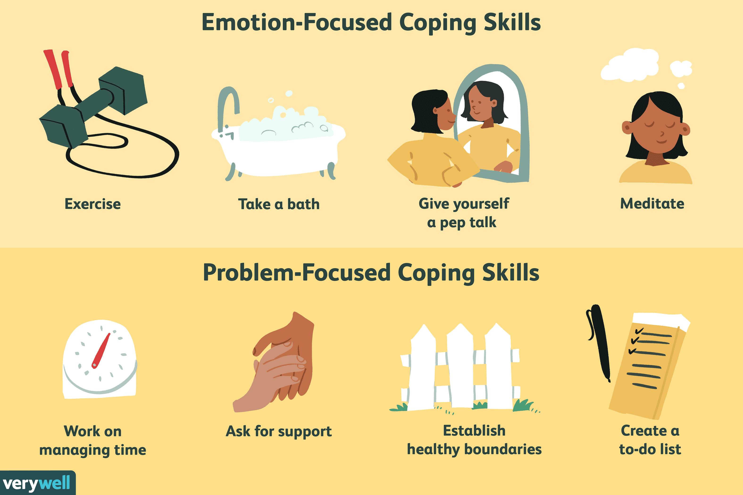
Emotional Resilience
Work with a partner to fill out the Emotional Resilience Handout
Stress Points and Triggers
Coping Strategies
Helping Others
What resources do you have available to help you cope?
Resources Handout

Slide 9
COPING STRATEGIES
What helps you manage how you feel?
Come up with 3-5 strategies for managing emotions.
Discuss in groups of 3-4 for 5-7 minutes
Share your list of coping strategies
Let’s discuss.

Slide 10
Emotional Resilience
Panic Zone
How do we stay in the Learning Zone as long as possible?
Resources for help
Talking out problems
Prayer, meditation and reflection
What are your goals while in the U.S.?
Learning Zone
Comfort Zone
Senninger‘s Learning Zone Model
Senninger, T. (2000). Abenteuer leiten-in Abenteuern lernen: Methodenset zur Planung und Leitung kooperativer Lerngemeinschaften für Training und Teamentwicklung in Schule, Jugendarbeit und Betrieb. Ökotopia Verlag.

Slide 11
Homework

Slide 12
Writing Prompt
Who is your support network at home?
Who is your support network at Purdue/in the Greater Lafayette area?
How will you expand your local support network?

Slide 13
Thank You
Contact info:
dcjones@purdue.edu
shouston@purdue.edu
sparks36@purdue.edu
mclugh@purdue.edu
barajase@purdue.ed

