Slide 1
MOVING INTERCULTURAL
LEARNING FROM THE
EXTRA TO THE ESSENTIAL
Presenter: Dr. Daniel Jones, Intercultural Learning Specialist
Chair: Annette Benson, Communication Strategist
October 18, 2018

Slide 2
SESSION OBJECTIVES
Upon completion, participant will be able to...
Discuss the advantages and disadvantages of various types of on-line mentoring for study abroad students.
Communicate the importance of and connection between intercultural learning efforts and the AAC&U Intercultural Knowledge and Competence VALUE rubric, as well as other rubrics, for assessment purposes.
Conduct a needs analysis for faculty or staff interested in embedding intercultural learning into their on-campus or study abroad curricula
Notes:
http://lizhem.weebly.com/the-idi.html

Slide 3
Semester Abroad in Intercultural Learning (SAIL)

Slide 4
ADVANTAGES OF
INTERCULTURAL INTERVENTIONS
Supported by research:
Left on their own, students do not learn intercultural competencies through immersion alone. There needs to be guided intentional intervention.
Vande Berg, M., Connor-Linton, J. & Paige, R.M. (2009). The Georgetown Consortium Project: Interventions for Student Learning Abroad, Frontiers: The Interdisciplinary Journal of Study Abroad, v18, 1-75.
Vande Berg, M., Paige, R. M., & Lou, K. H. (2012). Student Learning Abroad: What Our Students Are Learning, What They’re Not, and What We Can Do About It. Stylus Publishing, LLC.
Notes:
http://lizhem.weebly.com/the-idi.html
Paradigm shift—Mick’s 3 stories
Reflection before, during, and after
Most effective guided by mentor

Slide 5
SAIL COURSE OFFERINGS
During Semester Abroad
1 credit hour courses:
1-1 mentored courses (entirely online in VLE- BlackBoard Learn)
College of Science (SCI 39500)
College of Engineering (ENGR 397)
Group mentored course (hybrid course – online modules & webinars)
Lamb School of Communication (COM 30301)
Participation incentivized with a scholarship

Slide 6
SAIL COURSE OFFERINGS
Pre- and Post-IDI average gains
One-to-one mentored course:
Spring 2017 = +11.29
Fall 2017 = +7.91
Spring 2018 = +13.46
Group mentored course:
Spring 2018 = +7.74
Control Group (no formal mentoring)
Spring 2017 = +3.30
Spring 2018 = +5.60
*Increases of >7 points are considered statistically significant.
Total N = 137
Total N = 137
Total N = 52
Notes:
Less than 7 is not considered statistically significant, so 5.60 is not considered a change.

Slide 7
CHALLENGES OF
INTERCULTURAL INTERVENTIONS
varying levels of expertise and commitment among mentors
managing large numbers of mentors and students
technical issues
Notes:
http://lizhem.weebly.com/the-idi.html
Give examples if there are questions.
Some have a lot of education and skill in this area.
The larger it gets, the more you need a strict management system.
People are all around the world, so problems…

Slide 8
What are you doing at your institution to make intercultural learning essential to study abroad?

Slide 9
NEEDS ANALYSIS

Slide 10
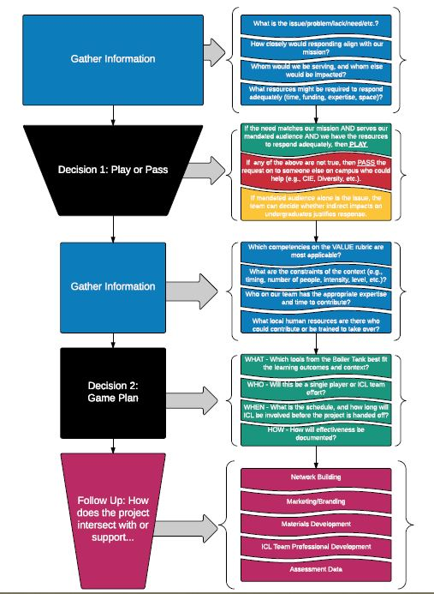
INTERCULTURAL COMPETENCE AS EMBEDDED LEARNER OUTCOMES
Needs Analysis
Learner Outcomes
Backward Design
Embedding
Train-the-Trainer

Slide 11
How do you see yourself in the needs analysis process?
An expert advising others?
A curriculum/program designer seeking mentoring?
Other?

Slide 12
New From CILMAR in 2018…
HubICL.org & The Digital Toolbox

Slide 13
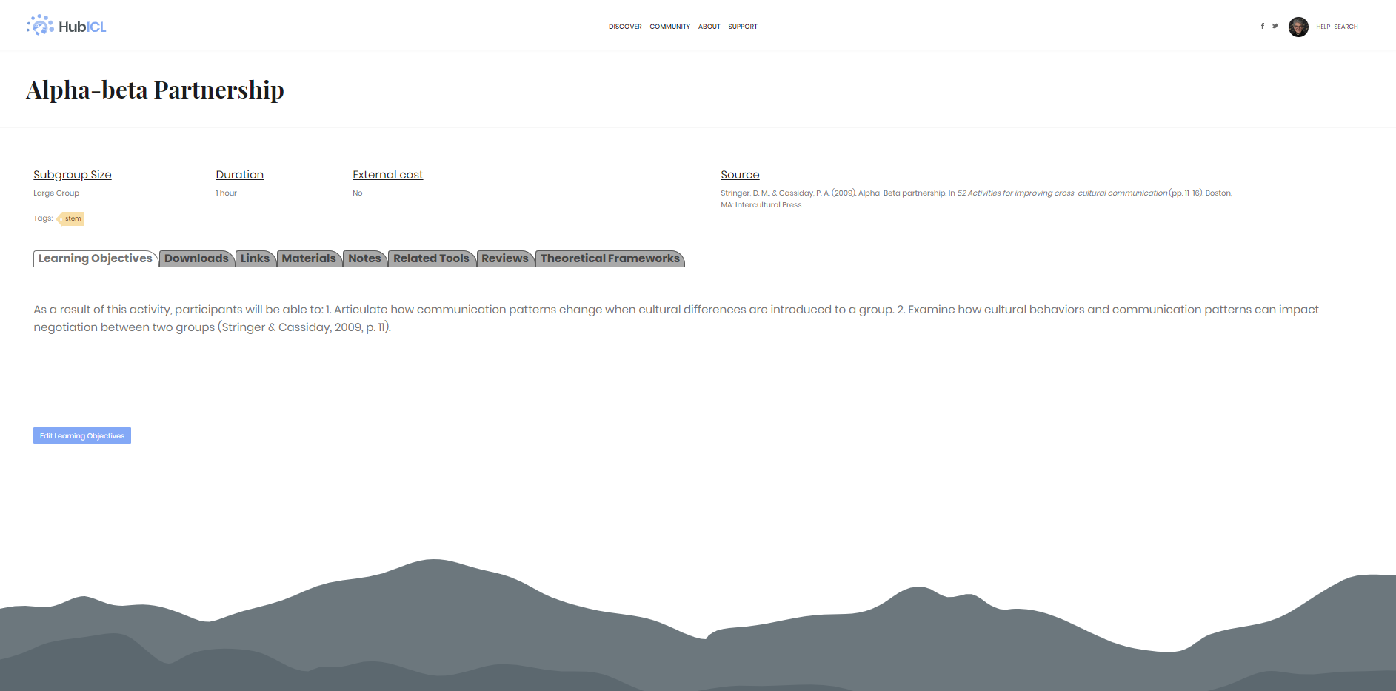

Slide 14
Intercultural Teamwork Certificate
&
The FrankenRubric

Slide 15
CO-CORRICULAR PROGRAMS
The Intercultural Teamwork Certificate piloted across multiple courses in Mechanical Engineering + ad hoc sessions outside of class time:
ME 263
ME 290
ME 315
ME 365
ME 375
ME 463
ICT Certificate is comprised of 7 Badges
Badges are based on the ICT Rubric

Slide 16
ADVANTAGES & DISADVANTAGES OF
CO-CURRICULAR PROGRAMS
Advantages
A quick and easy way to add ICL to courses
Access to large populations of students
Disadvantages
Varying levels commitment among partners
Managing large numbers of student artifacts and data
Technical issues
Notes:
http://lizhem.weebly.com/the-idi.html

Slide 17
INTERCULTURAL TEAMWORK RUBRIC:
The “FrankenRubric”
Composite of multiple AAC&U V.A.L.U.E Rubrics
Modified from the AAC&U VALUE Rubrics: Association of American Colleges and Universities. (2009). Global Learning VALUE Rubric; Foundations and Skills for Lifelong Learning VALUE Rubric; Integrative Learning VALUE Rubric; Intercultural Knowledge and Competence VALUE Rubric; Teamwork VALUE Rubric. Retrieved from https://www.aacu.org/value/rubrics/inquiry-analysis
Rubrics serve as theoretical framework of instruction as well as the assessment tool for student work.

Slide 18
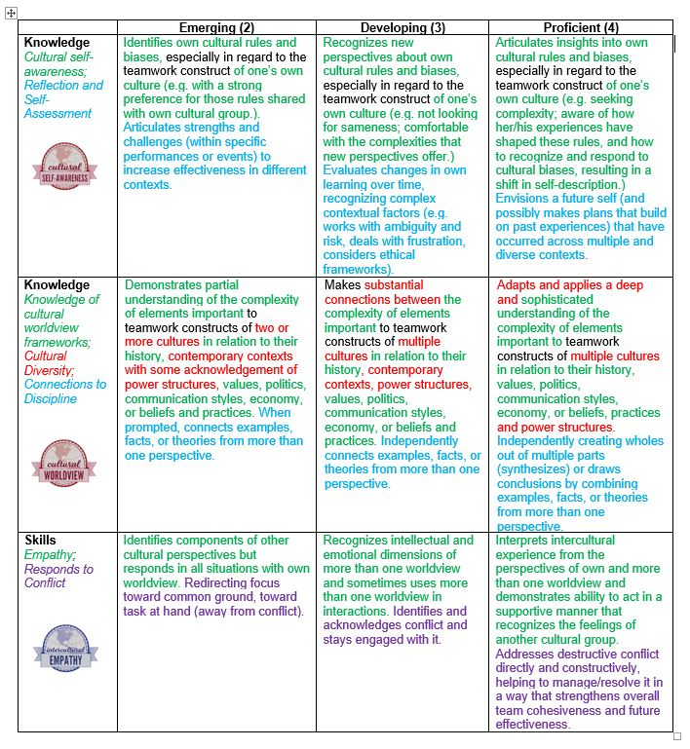
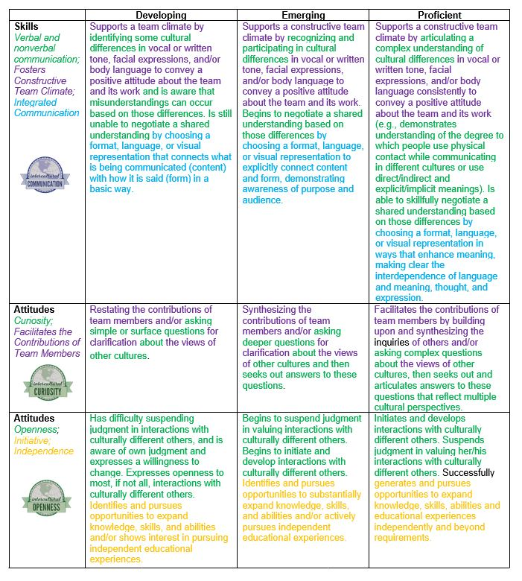
INTERCULTURAL TEAMWORK RUBRIC:
The “FrankenRubric”
Notes:
Use Worldview Frameworks

Slide 19
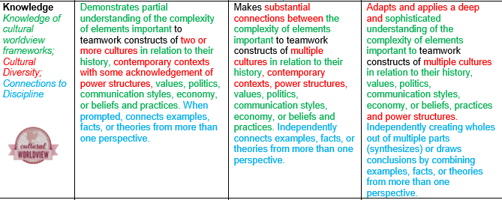
INTERCULTURAL TEAMWORK RUBRIC:
The “FrankenRubric”
Notes:
Use Worldview Frameworks

Slide 20
Resources
The Intercultural Teamwork Certificate Toolbox
Available on the CILMAR website
https://www.purdue.edu/IPPU/CILMAR/
https://hubicl.org/login
We’d love to hear from you!
cilmar@purdue.edu
https://www.purdue.edu/IPPU/CILMAR/
https://www.facebook.com/PurdueCILMAR/

Slide 21
PLEASE EVALUATE THIS PRESENTATION.
Open the NAFSA Regional Conference App.
Find this presentation’s record.
Click the “Evaluation” icon at the bottom of the screen.
Answer the questions that appear on the screen.
Your response is complete!

