Slide 1
Strategic Assessment of Undergraduate Technical Education for Competencies and Belongingness
Dr. Kris Acheson-Clair, CILMAR
Katherine N. Yngve, IDA+A
June 2021

Slide 2
Executive Summary
Large-scale longitudinal assessment
Intercultural Development Inventory (IDI) – measures intercultural perspective
Beliefs, Events, and Values Inventory (BEVI) – measures intercultural competence, critical thinking, resilience/wellbeing, and more
Institutional data (retention and graduation)
Main findings:
Institutional signature
Increases in belongingness for minority students
Achievement of learning outcomes

Slide 3
pOLL
Who is in the room with us?
What is your background knowledge and comfort level with:
Assessment design
Intercultural assessment instruments

Slide 4
BACKGROUND INFORMATION

Slide 5
The Big Picture Purdue Polytechnic’s Global Transformation
Students must have the experience of being immersed in an environment that is culturally, economically, or socially different from their own and has a different way of thinking about challenges and solutions.
The Polytechnic has many innovative and non-traditional programs to provide students with a global experience.
Reality: Not ALL Polytechnic Students will go abroad

Slide 6
Assessment's Role in Transforming the Polytechnic
Evidence-based innovations
Knowing our students
Demonstrating effectiveness of changes
Requires:
Operationalization of learning and other outcomes
Strong local leadership
Buy in from stakeholders (faculty, admin, students)
Institutional-level collaboration (CILMAR, IDA+A, other colleges)

Slide 7
The Black Box Input, Varied Experiences, Output
Polytechnic
GLOBAL / CULTURAL
EXPERIENCES
College-wide Environment of Global / Cultural Awareness
Study Abroad Activities
Input
Global / Cultural Related Courses
Output
Local or on Campus Global / Cultural Activities
Virtual Exchanges, Global Research Projects

Slide 8
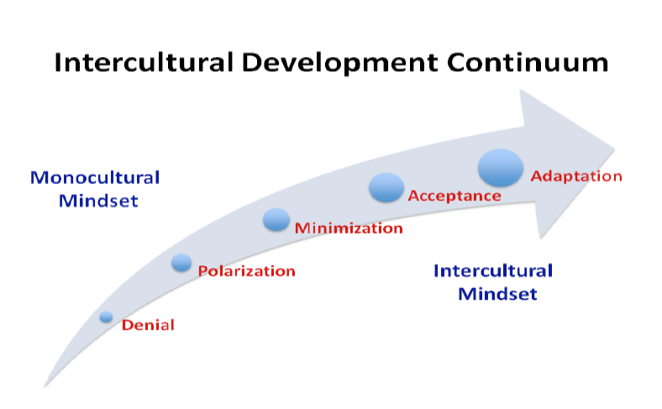
Theoretical Frameworks
Idiinventory.com

Slide 9
Assessment Design
1st Year Baseline Analysis
4th Year
Longitudinal
Analysis

Slide 10
BASELINE ANALYSIS

Slide 11
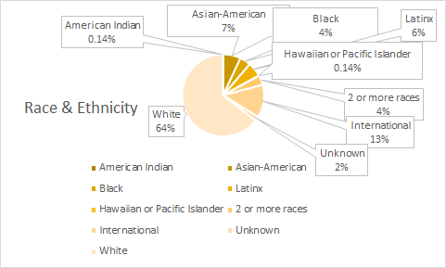
Polytechnic demographics
For the entering class of 2017
1448 Traditional Age First-Year Students
80% Male

Slide 12
Intercultural Development inventory
idiinventory.com
Built upon the framework of the Developmental Model of Intercultural Sensitivity (Bennett, 1986; 1993; 2004; 2013), which grew out of grounded theory research.
50-item psychometric survey, validated across cultures, with strong construct, content & predictive validity
https://idiinventory.com/idi-validation/
Little to no social desirabilty bias
Available in 17 languages
Determines a person's dominant interaction posture across a 5-stage continuum of comfort with difference (see next slide for visual).

Slide 13
Stages of the IDI Continuum

Slide 14
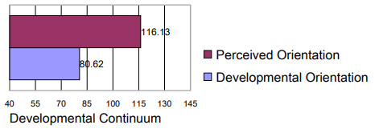
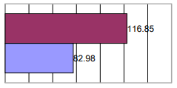
IDI aggregate means
2017
Typical means for STEM 1st year students all three years
Large gap between subjective and objective measurement (over-estimation of capacity), also typical
2018
2019

Slide 15
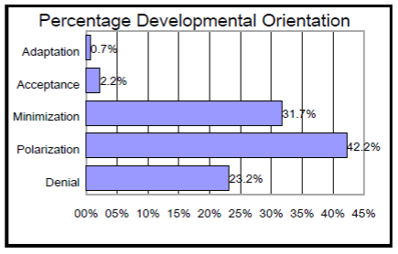
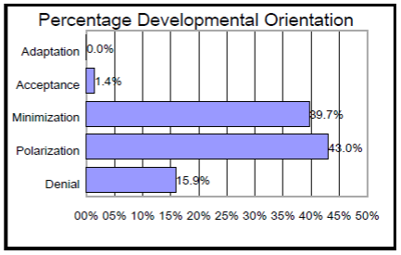
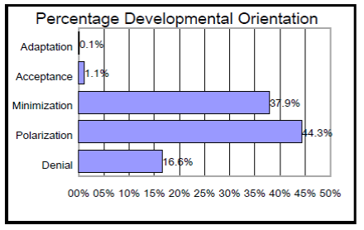
IDI Distributions
Nearly identical distributions each year
Compared to ENG (study abroad, not 1st year) students, more students in polarization and denial
Sample goal – move mean to minimization with less downwards skew (more students in acceptance and adaptation)
2017
2018
2019

Slide 16
Beliefs, events, and values inventory
thebevi.com
Built on the principles of Equilingration Theory & over 25 years of research (Shealy, 2016)
Normed on an international sample of over 20,000 respondents with strong psychometrics (e.g., excellent reliability / validity)
Measures core aspects of identity and self (e.g., development, needs, emotions, value
Assesses how and why humans change (e.g., on self / other awareness, critical thinking)
Extremely supportive outcome report to survey-takers for formative assessment
Used to facilitate "engaged," "high impact" & "transformative" learning

Slide 17
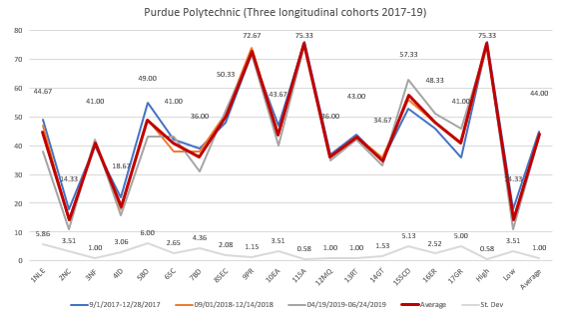
BEVI Institutional signature
College profile very consistent over time (each line = cohort)

Slide 18
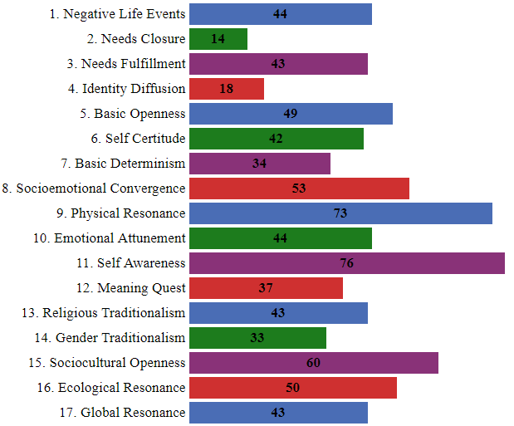
BEVI aggregate means
Resilience/wellbeing
Critical thinking
Intercultural competence

Slide 19
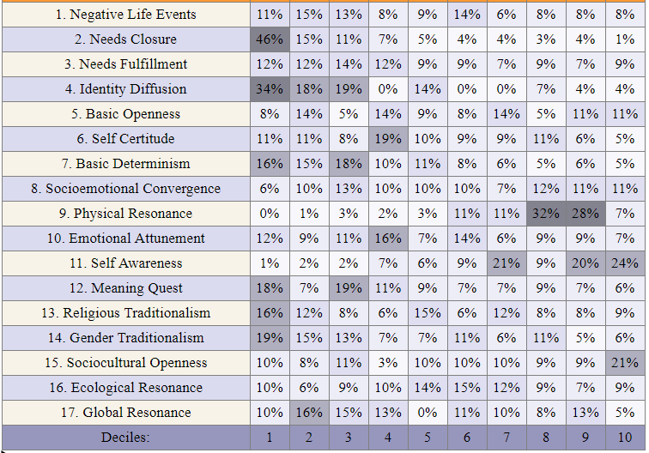
BEVI decile scores

Slide 20
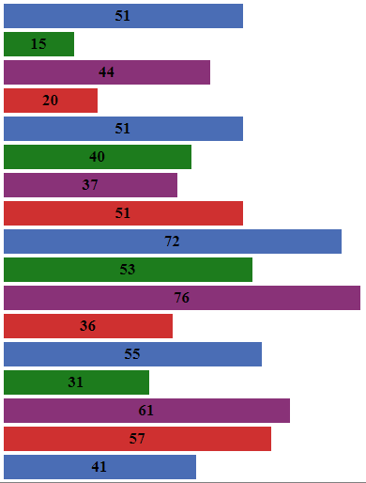
BEVI internal comparison
Polytechnic (N = ~1300)
Agriculture (N = ~1100)

Slide 21
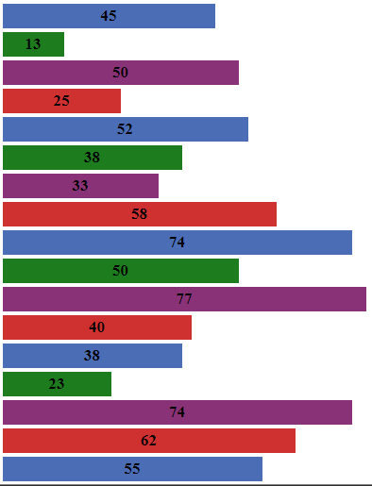
BEVI external comparison
Purdue Polytechnic (N = ~1300)
Georgia Tech (N = ~2100)

Slide 22
Implications
Modeling college-wide assessment at Purdue and beyond
Nearly half of students minimize cultural differences, and the other half are polarized – both perspectives present challenges to learning and belongingness
PPI data are comparable to other Purdue STEM colleges as well as other STEM institutions except Ag students are more empathetic and environmentally aware, and GA Tech students come in more interculturally competent
These data constitute an excellent baseline for longitudinal change analysis – achieving learning outcome targets requires commitment to rigorous post-testing of graduating seniors

Slide 23
Strategic Assessment of Undergraduate Technical Education​ for Competencies and Belongingness
Discussion of Implications and applications

Slide 24
PRELIMINARY LONGITUDINAL ANALYSIS

Slide 25
IDI Group means comparison
Goals were to increase DO mean to minimization and reduce the large (though typical) gap between subjective and objective measurement (over-estimation of capacity)
DO increase 4.52
Gap decrease 2.58
2017
2021

Slide 26
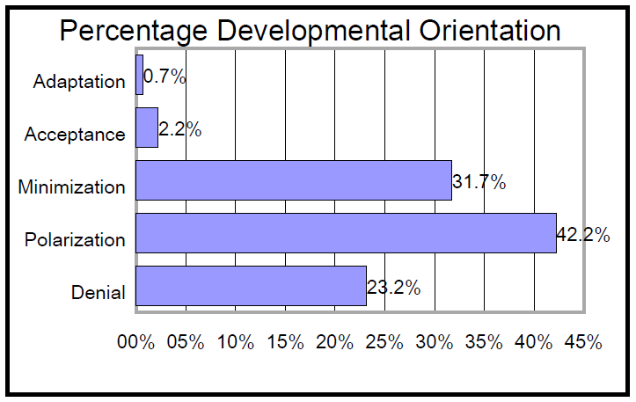
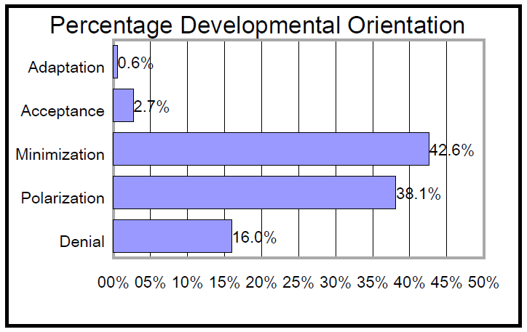
IDI Distribution comparison
Goal was to shift the skew upwards towards minimization (increase percentage of students at and above and decrease percentage of students below minimization)
Minimization and above increased 11.3% to 45.9%
Polarization decreased by 4.1%
Denial decreased by 7.2%
2017
2021

Slide 27
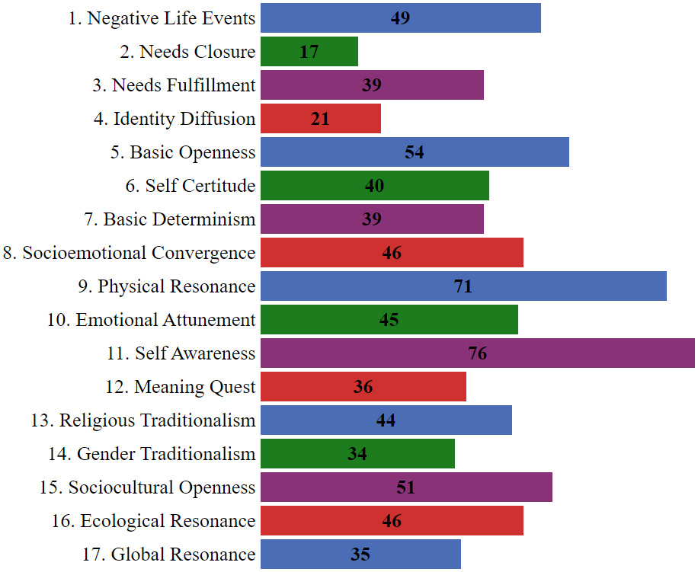
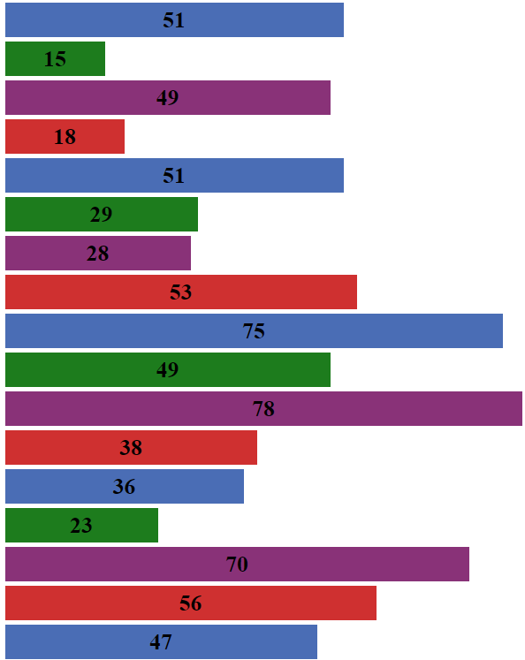
BEVI group means comparison
1st Year Students, 2017 (N = 335)
4th Year Students, 2021 (N = 375)
ER/W
CT
IC

Slide 28
FINER ANALYSIS
2017
2021
2017
2021
2017
2021

Slide 29
Belongingness of urm* students
Belongingness is "a sense of connectedness with one's university, a strong support network, and an appropriate balance of challenge and support. [Further, it seems to] buffer the effects of racism" (Glass & Westmont, 2012)
Research Question: What is the effect on retention for under-represented students, in cases where:
a psychometric intercultural assessment instrument has been used
formatively by the instructor as part of a core or required course that is offered every semester, and
professional identity is intentionally tied to improving one’s intercultural or multicultural competence as a part of in-class discussion?
Or in plain(er) English: Does requiring large numbers of students to talk about their cultural identity and stage of intercultural competence in class help build connectedness for minority students?
*Under-Represented Minority

Slide 30
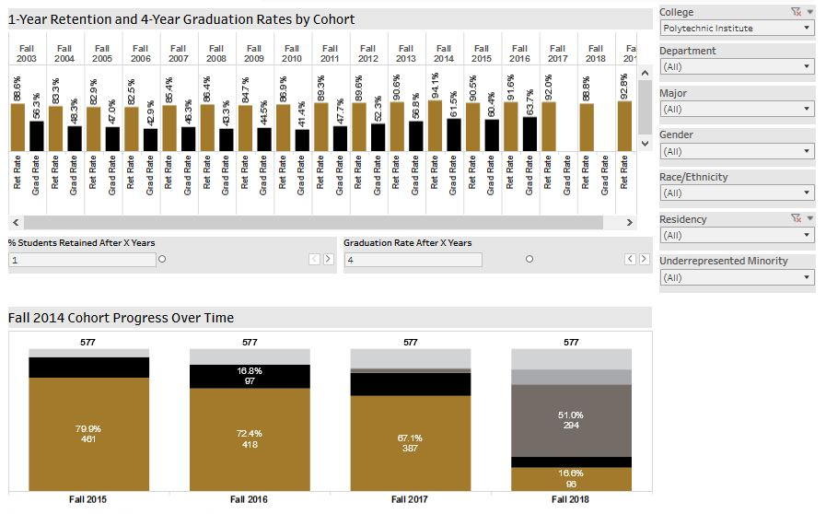
Belongingness of urm students
Source of Data: Purdue Data Digest
https://www.purdue.edu/datadigest/

Slide 31
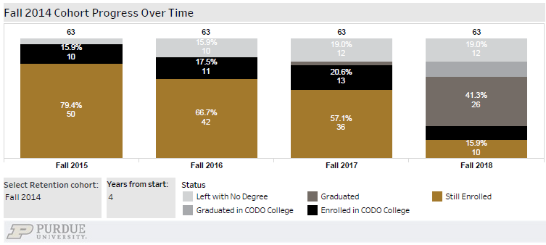
Belongingness of urm students
Method of Inquiry
Source of Data: Purdue Data Digest
https://www.purdue.edu/datadigest/

Slide 32
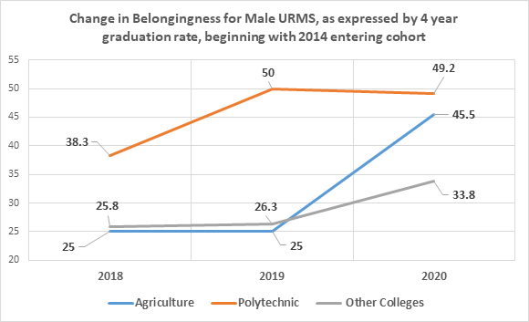
Belongingness of urm students

Slide 33
Belongingness of urm students
Additional Findings
2020 was a difficult year, in terms of graduation rates, for some student identity groups:
Asian-American Tech students
International Tech Students
Latinx Tech Students
But NOT African-American Tech students!
Using formative intercultural assessment tools in the classroom appears to make the most difference when the minoritized group is small
Possibly greater numerical representation contributes to minoritized group members' resilience

Slide 34
Belongingness of urm students
Additional Findings
Preliminary pre-post BEVI data on the matched pairs of entering 2017 Tech students who are about to graduate suggests that those students who identify as an ethnic minority made greater gains than White students in:
Emotional Resilience & Well-Being (e.g. belongingness)
As well as in:
Critical Thinking
& Intercultural Competence

Slide 35
Implications
IDI reveals small gains in intercultural competence
BEVI provides evidence of significant achievement of emotional resilience/well-being, critical thinking, and intercultural competence learning outcomes
Retention, learning, and graduation of minoritized students has been positively impacted
What comes next:
Deeper dive into data (matched pair analysis, demographic comparisons)
Merge proprietary and institutional data for regression analysis (Black Box – what fosters transformation?)
Continue curricular innovations and new globalized program offerings (e/g/ virtual exchanges, local opportunities for engagement, etc.)

Slide 36
Strategic Assessment of Undergraduate Technical Education​ for Competencies and Belongingness
Discussion of Implications and applications

Slide 37
SMALL GROUP ACTIVITY

Slide 38
Strategic Assessment of Undergraduate Technical Education for Competencies and Belongingness
Questions?
Kris Acheson- Clair, krisac@purdue.edu
Katherine Yngve, kyngve@purdue.edu

